Slide 1
GROWTH
AND
DEVELOPMENT

Slide 2
Growth: is increase in size of the body or quantitative growth leading to physical maturation.
Development: is maturation of function or qualitative growth leading to mental maturation.

Slide 3
GROWTH

Slide 4
The factors affecting growth and development are the following:
1. Host or genetic factors like genetic make up (genotype).
2. Physical expression (phenotype).
3. Demographic factors like race and sex or gender.
4. Nutritional factors like maternal nutritional status,
breastfeeding and weaning, complementary feeding
practices, diet during illness, supplementary feeding.

Slide 5
5. Environmental factors like socio-economic status.
6. Physical factors like climate, pollution.
7. Biological factors like infections, exercise, drugs and
chemicals.
8. Emotional factors like mother infant bonding, parent child
interaction, family harmony, stimulation and tender loving
care.
9. Antenatal, natal and postnatal factors like infections, irradiation,
drugs and placental insufficiency affect the potential for growth and development to a great extent.

Slide 6
Stages of Growth
The different stages of growth are:
1. Ovum (0-14 days).
2. Embryo (2-9 weeks).
3. Fetus (9 weeks-birth).
4. Newborn (first 7 days of life).
5. Neonate (from birth to 28 days).
6. Infant (first year of life).
7. Toddler (1-3 years).
8. Preschool child (3-5 years).
9. School child (5-9 years).
10. Adolescence is divided into prepubertal, pubertal and post
pubertal stages (10-19 years)

Slide 7
Growth of Different Tissues:
Different tissues grow at different rates. Somatic growth of the body is very fast in the first 2 years of life and then it slows down.
The second spurt is seen in adolescence and then it practically stops.
Brain growth is maximum in the first two years of life and then it slows down. It becomes almost 80% of the adult size by two years of age and body growth is up to 20%.
Lymphoid growth especially of the tonsils and lymph node picks up slowly and peaks before puberty and then it slows down.
Gonadal growth is noted around puberty only.

Slide 8
Newborn Growth
-The newborn has around 3 Kg weight (2.5-4 Kg) and 50 cm length (45-55cm).
-The head circumference is 35 cm (33-37 cm).
-The midpoint of the body is umbilicus unlike pubic symphysis in the adult.
-The upper segment to the lower segment ratio from the vertex to
pubic symphysis and the pubic symphysis to the heels respectively is 1.7:1.
-Most newborns lose up to 10% weight initially and regain birth
weight by 10 days.

Slide 9
-The weight gain is around 200 g/week in the first 3 months, 150 g/week in the next 3 months and 100 g/week in the next 6
months.
The birth weight doubles by 5 months, triples by one year, quadruples by two years. Thereafter 2 kg is added on every year till six years and thereafter 3 kg is added on every year till puberty.
The birth length is 50 cm; it becomes 66 cm by 6 months, 75 cm by 1 year and 87 cm by 2 years. It doubles by 4 years and thereafter 6 cm is added on every year till puberty. Birth length triples by 12 years.

Slide 10
The head circumference at birth is 35 cm, it increases to 40 cm by 3 months,43 cm by 6 months, 45 cm by 9 months, 47 cm by one year, 49 cm by two years and 50 cm by 3 years. The approximate increase is 2.0 cm/month is the first 3 months, 1 cm/month in the next 3 months and 0.5 cm/month in the next 6 months.

Slide 11
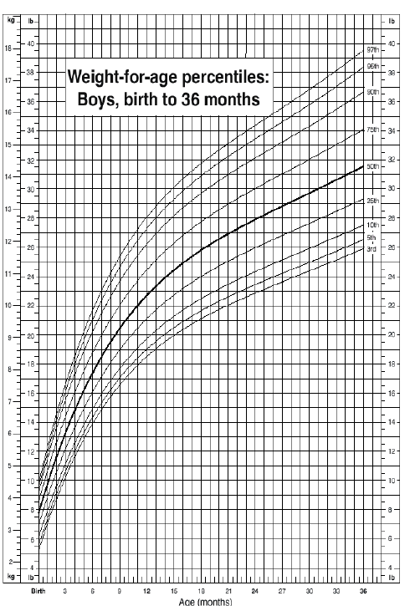
Growth
Chart

Slide 12
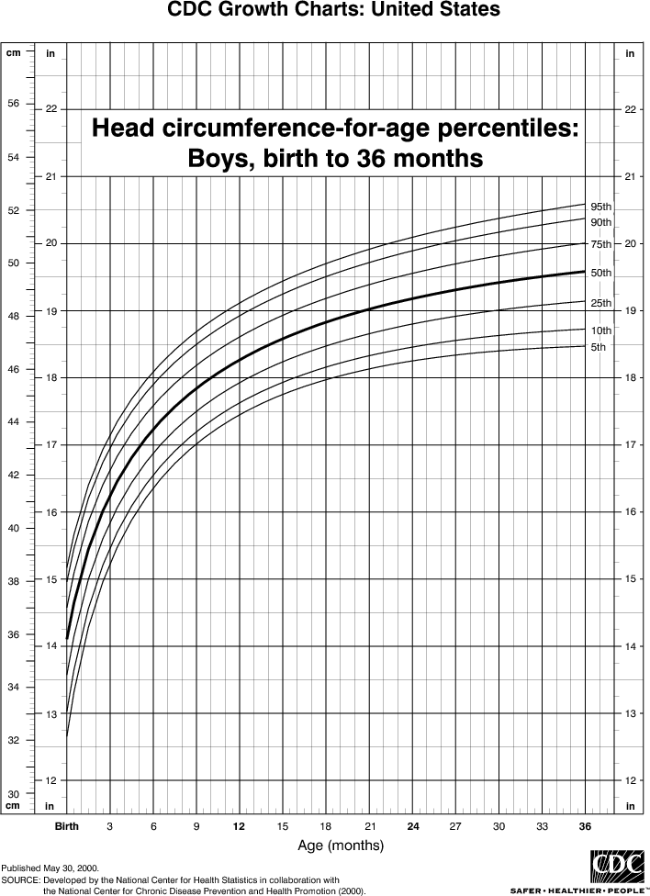

Slide 13
Teeth Development:
The temporary, deciduous or milk set has 20 teeth (8 incisors, 4 canine and 8 molars). These appear by two and a half years of age. The first tooth appears by 5-9 months. By 1 year of age, 6-8 teeth are present. In the permanent set, there are 32 teeth including 8 incisors 4 canines, 8 premolars and 12 molars and the first molars appear by 6 years.
Eruption of the second molar marks puberty.
The eruption of the third molar (Wisdom tooth) is variable and occurs after 18 years of age.

Slide 14
DEVELOPMENT

Slide 15
Development occurs in four areas namely:
-Gross motor.
-Fine motor.
-Language.
-Social.
Gross Motor:
A newborn has head lag on pulling to sitting position. In ventral suspension, the head and the limbs are flexed.

Slide 16
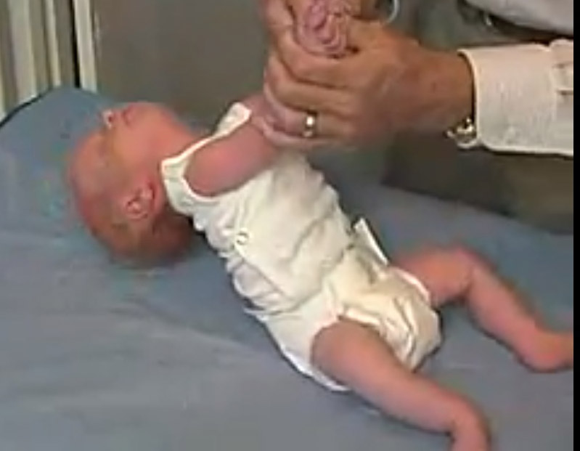
Head Lag

Slide 17
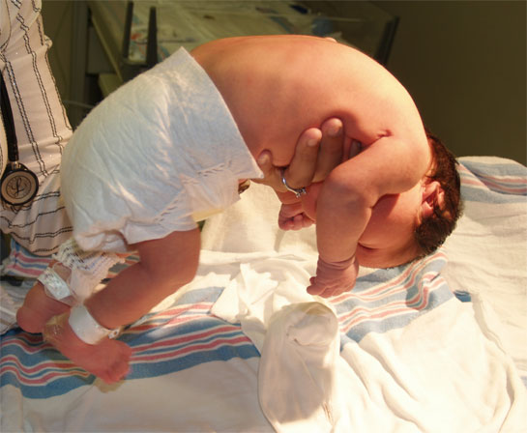
Ventral Suspension

Slide 18
By 3 months, the head lag is minimal when pulled to sitting position. The baby can raise the chin in prone position. On ventral
suspension, the head is in line with the body.

Slide 19
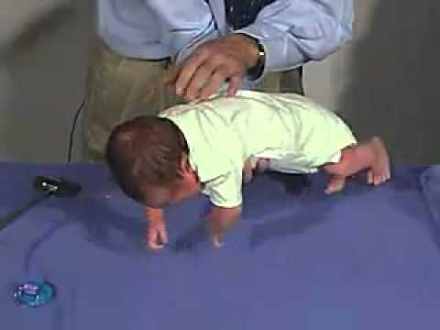
Ventral Suspension

Slide 20
By 4 months, the baby has head control when held up. In prone position, the baby can raise the head and shoulder.
By 5 months, the baby bears weight on the forearm in prone position and can bear weight on standing, also rolling over can be seen at this age.
By 6 months, the baby bears weight on hands in prone position.
By 7 months, the baby can sit with support and lean forward and also bounce on standing.

Slide 21
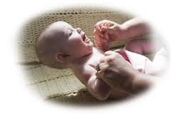
Head Control

Slide 22
Sitting with Support

Slide 23
By 8 months, the baby crawls on the abdomen, and can sits without
support.
By 10 months, most of the babies pull to standing posture and walk holding on to a piece of furniture. This is called “cruising”, they can
crawl.
By 1 year, the baby can make a few steps with support.
By 15 months, the baby can walks alone.
By 18 months, the baby can runs.
By 24 months, the baby can climb stairs two feet per step and
the baby can also kick a ball.

Slide 24
By 3 years, the baby can climb stairs 1 foot per step and can ride
a tricycle.
By 4 years the baby can climb down stairs one foot per step.
By 5 years, the child can skip.
Fine Motor:
The newborn can focus on objects.
By 1 month, the baby can follow objects for up to 90º and for 180
degrees by 2 months.
By 4 months the baby can hold objects with both hands and take them to the mouth.

Slide 25
By 5 months, the baby can take the feet to the mouth.
By 7 months, the baby can transfer objects from hand to hand and
having a palmar grasp.
By 9 months, the baby can hit two cubes together, can drink by a cup
By 10 months, the baby has a “pincer grasp” by approximating the thumb and the index finger and can uncover hidden things.
By 1 year, the baby can release objects on request and can make a tower of two cubes.
By 13 months, the baby can turn pages of a book, two to three
pages at a time.

Slide 26
By 15 months, the baby can feed self with a spoon without much spilling.
By 18 months the baby can build a tower of 3 cubes.
By 2 years, the baby can turn page by page, and can build a tower of
6 cubes also he can scribble lines.
The baby can draw a circle by 3 years, a square by 4 years and a
triangle by 6 years.
Baby can dress and undress alone by 4 years.

Slide 27
Language Development:
Baby makes cooing sounds by 3 months.
By 4 months, the baby can babble.
By 7 months the baby responds to his/her name.
By 7-8 months, baby vocalizes monosyllables.
By 10 months understands spoken speech.

Slide 28
By 1 year, the baby speaks 2-3 words with meaning.
By 18 months, one can speak 20 words.
By 2 years baby can speaks about 200 words and can make a 2 words
sentence.
Personal Social Development:
The baby regards faces by 1 month, has social smile by 6 weeks and recognizes the mother and caretakers by 3 months, can laugh loudly by 4 months.
The baby enjoys looking at the mirror by 6 months and imitates other by 1 year.

Slide 29
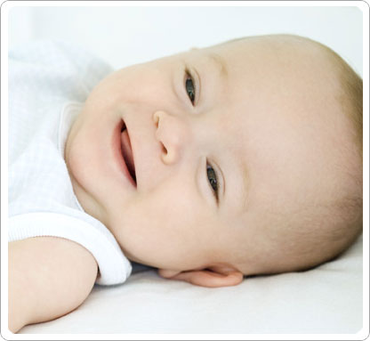
Social Smile

Slide 30
Laughing baby

Slide 31
By 6 months, the baby shows sadness when mother leaves and has stranger anxiety by 8 months.
By 9 months, the baby can drink from a cup and by 15 months
the baby can self feed with a cup and a spoon with little spilling.
By 10 months baby can wave bye bye.
The baby starts toilet training by around 2 years, being dry during day by around 3 years. Bowel control is before urine control, and
girls can control before boys.
By 2 years of age, baby refers to self as “ I “
By 3 years, the baby also has gender identity.

