Slide 1
Thalassemias

Slide 2
Definition. Thalassemias are hereditary hemolytic anemias characterized by decreased or absent synthesis of one or more globin subunits of the Hb molecule.
α-Thalassemia results from reduced synthesis of α-globin chains.
β-thalassemia results from reduced synthesis of β-globin chains.

Slide 3
An imbalance in globin chain production is a hazard to the RBC because excess unpaired globin chains produce insoluble tetramers that precipitate, causing membrane damage.
This makes RBCs susceptible to destruction within the reticuloendothelial system of the BM (resulting in ineffective erythropoiesis) as well as the RES of the liver and spleen (resulting in hemolytic anemia).

Slide 4
The types and quantities of different Hb in infancy & adulthood
HbA₂ | HbF | HbA | Type of Hb
α2δ2 | α2γ2 | α2β2 | Notation
1 | 80 | 20 | Normal % at birth
2 | 1 | 98 | Normal % in older children

Slide 5
α-Thalassemias
α-Thalassemias are usually the result of gene deletion.
α-Thalassemia variants are found most often in populations of African or East Asian ancestry.
Normally there are four α-globin genes; clinical manifestations of α-thalassemia variants reflect the number of genes affected

Slide 6
1-α-thalassemia major: 4 genes deleted (Hb Bart ) , Hydrops fetalis/death in utero .
2-Hemoglobin H disease:3 genes deleted, (Hb H ), baby born with severe anemia, mild jaundice & splenomegaly
3-α-Thalassemia minor : 2 genes deleted, Mild anemia .
4-Silent carrier :one gene deleted, No anemia

Slide 8
β-Thalassemias
The clinical phenotype of β-thalassemia is related to the degree of globin chain imbalance.
1-Heterozygous β-thalassemia
(β-thalassemia minor).
2-Homozygous β-thalassemia
(β-thalassemia major, Cooley anemia, and intermedia).

Slide 9
Heterozygous β-thalassemia (β-thalassemia minor)
Clinical features.
1- Mild anemia (Hb about 10 gm/dl)
2- Normal growth and development.
3- Blood film: Hypochromia, microcytosis, and anisocytosis.
4- Hb electrophoresis shows elevation of the Hb A2 level and, sometimes, elevation of the Hb F level.

Slide 10
Therapy: No treatment is necessary.
It is important, however, that thalassemia minor is distinguished from ID to prevent inappropriate therapy with medicinal iron.
Folic acid may be given.
Genetic counseling is also important.

Slide 11
Homozygous β-thalassemia
Homozygous β-thalassemia (β-thalassemia major, Cooley anemia, and intermedia). Patients who have this form of anemia are usually of Mediterranean background.
Defect. Molecular defects range from complete absence of β-globin synthesis (genotype β0/β0) to partial reduction in the gene product from the affected locus (genotype β+/β+).

Slide 12
Clinical features: beginning in the middle of the first year of life
1- the infant manifests a progressively severe HA & jaundice .
2- marked HSM.
3- FTT
4- BM hyperplasia produces characteristic features such as tower skull, frontal bossing, maxillary hypertrophy with prominent cheekbones, and overbite.

Slide 13
5- Hemochromatosis: Even in the untransfused state, iron overload develops in thalassemic pt because of hyperabsorption of dietary iron.
The iron load becomes even greater with chronic transfusion therapy. When the BM storage capacity for iron is exceeded, iron accumulates in parenchymal organs such as the liver, heart, pancreas, gonads, and skin, producing the complications of hemochromatosis (“bronzed diabetes”).
Many patients succumb to congestive HF , hypoparathyroidism, hypogonadism , DM , liver cirrhosis and short stature.

Slide 14
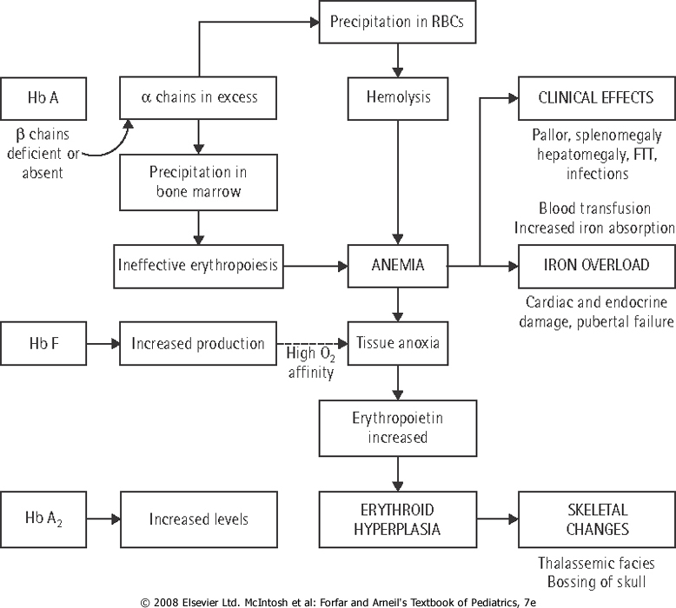

Slide 15
Investigations:
1-CBC : hypochromic microcytic anemia, with nucleated RBC and retics count commonly less than 8% which is inappropraitely low to the degree of anemia due to ineffective rythropoiesis).
2-Elevated unconjucated bilirubin.
3-On Hb electrophoresis, Hb A is either markedly decreased or totally absent. Of the total Hb concentration, 30% to 90% is Hb F.
4-BM hyperplasia is seen in bone XR.
5-Elevated S.ferretin & transferrin saturation.

Slide 16
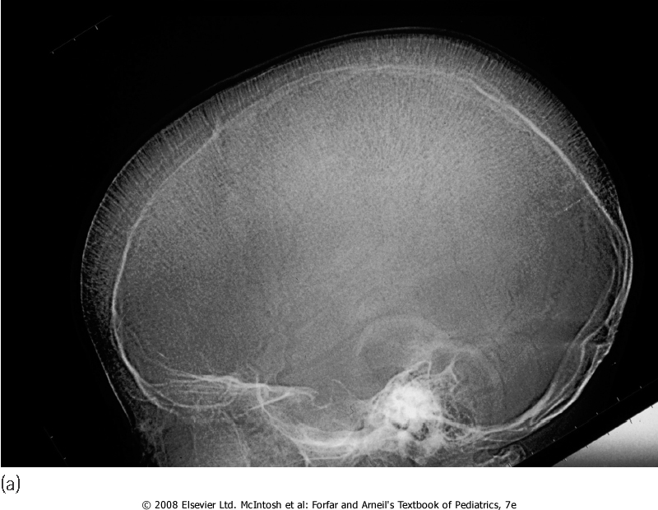
Skull X-ray showing ‘hair on end’ appearance caused by marrow hyperplasia and expansion

Slide 17
Treatment:
1- The mainstay of treatment is transfusion with packed RBCs using irradiated CMV –ve blood, a post transfusion Hb level of 9.5-10 gm/dl is the goal.
2- In an effort to prevent hemochromatosis, pts who receive chronic transfusion regimens are treated with chelating agents (e.g., deferoxamine, deferiprone) that promote iron removal from the body through excretion in the urine & stool.
Deferoxamine is given subcutaneously over 10-12 hrs,5-6 days a week.

Slide 18
Side effects of deferoxamine includes:
a-ototoxisity.
b-retinal changes.
c-bone dysplasia with truncal shortening.
d-Yersinia bacteria over growth.

Slide 19
3- Splenectomy is usually considered when transfusion requirements exceed 250 mL/kg/year.
4- bone marrow transplantation can cure the patients .
5- Genetic counseling .

