Slide 1
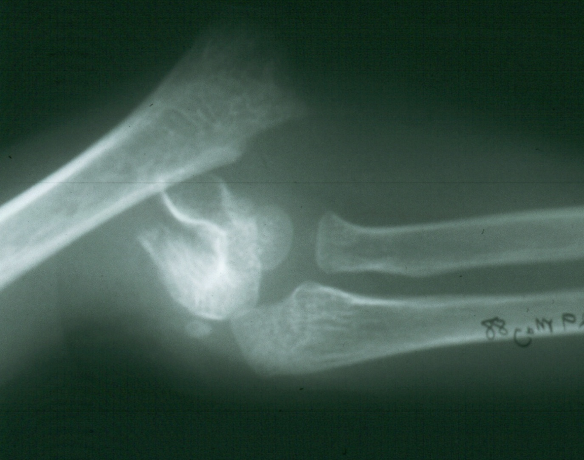
Supracondylar Fractures
of the Humerus
Part I
Inter-active

Slide 2
In this first part we are going to cover:
Basic concepts
Management of the fractures
The prevention and management of the Complications will be covered in Part II.

Slide 3
I. Incidence
At what age do supracondylar fractures
most commonly occur ?
The incidence peaks at
7 years.
3 years
10 years
That is the age when children reach
their maximum ligamentous laxity.
Why?

Slide 4
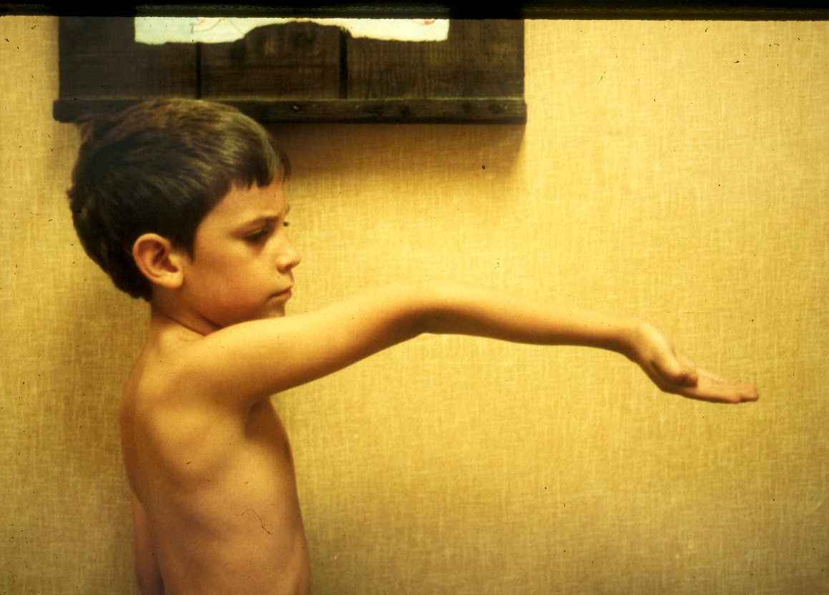
When a child falls on their extended upper extremity,
which ones are most likely to sustain
supracondylar fractures?
Those who have cubitus recurvatum.

Slide 5
which ones are most likely to sustain
distal radius fractures?
When a child falls on their extended upper extremity,

Slide 6
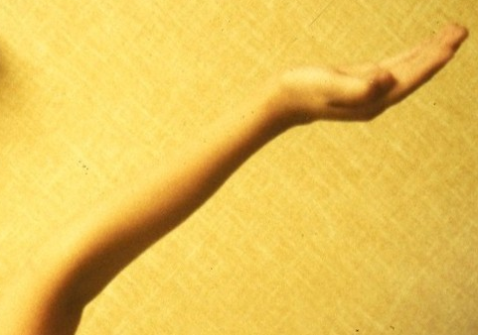
distal radius fractures?
Those who lack full elbow extension.

Slide 7
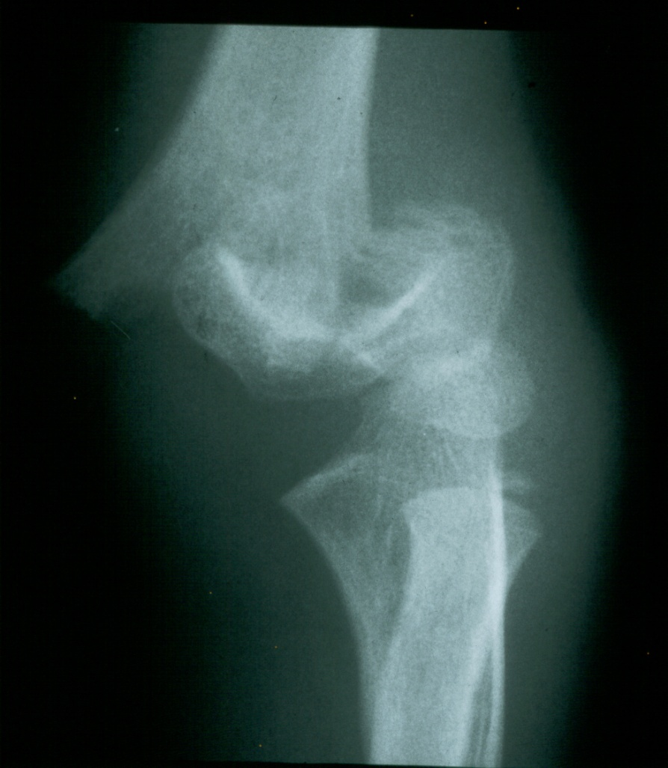
What other factor contributes
to the development of
fractures in the supracondylar area?
Mechanism of Injury
The supracondylar area consists
of weak metaphyseal bone.
Very thin
cortical
structure

Slide 8
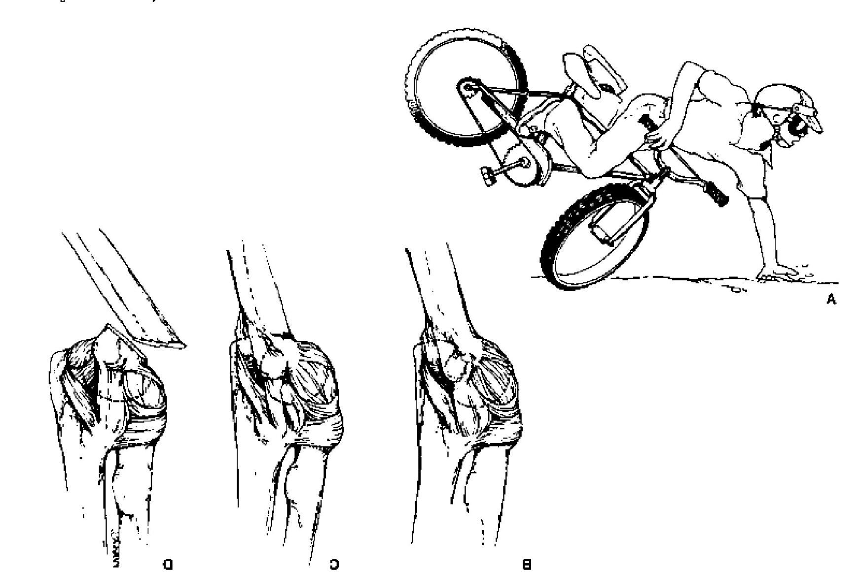

II. Mechanism of Injury
What is the mechanism of injury
for extension type supracondylar fractures ?
As the
extended extremity
attempts to break
the fall,
the olecranon
is forced
deep into its fossa.
This causes
the humerus to fail
in the weak metaphyseal
supracondylar area.

Slide 9
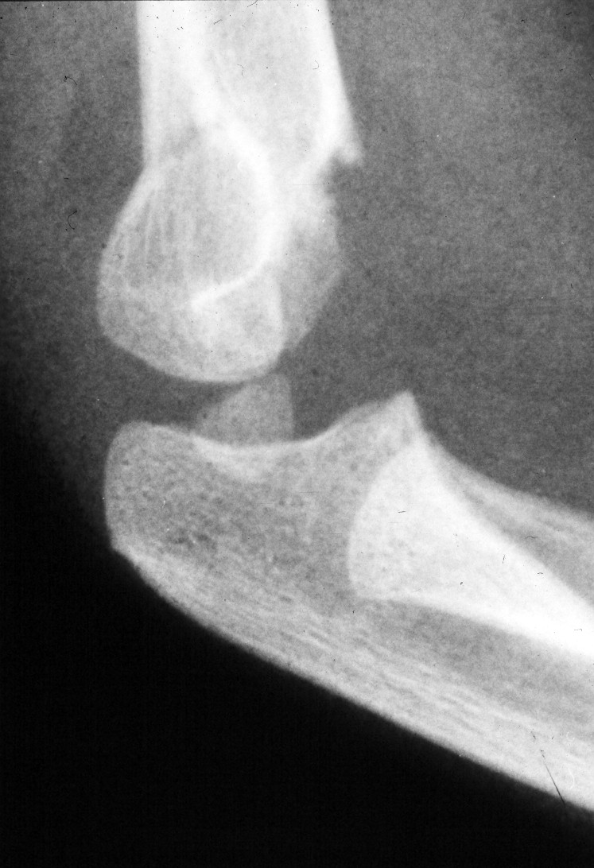
III. Classification
Into what two major types are supracondylar
fractures commonly sub-classified?
What
type ?
Exten
sion
The extension type is
the
most common type.

Slide 10
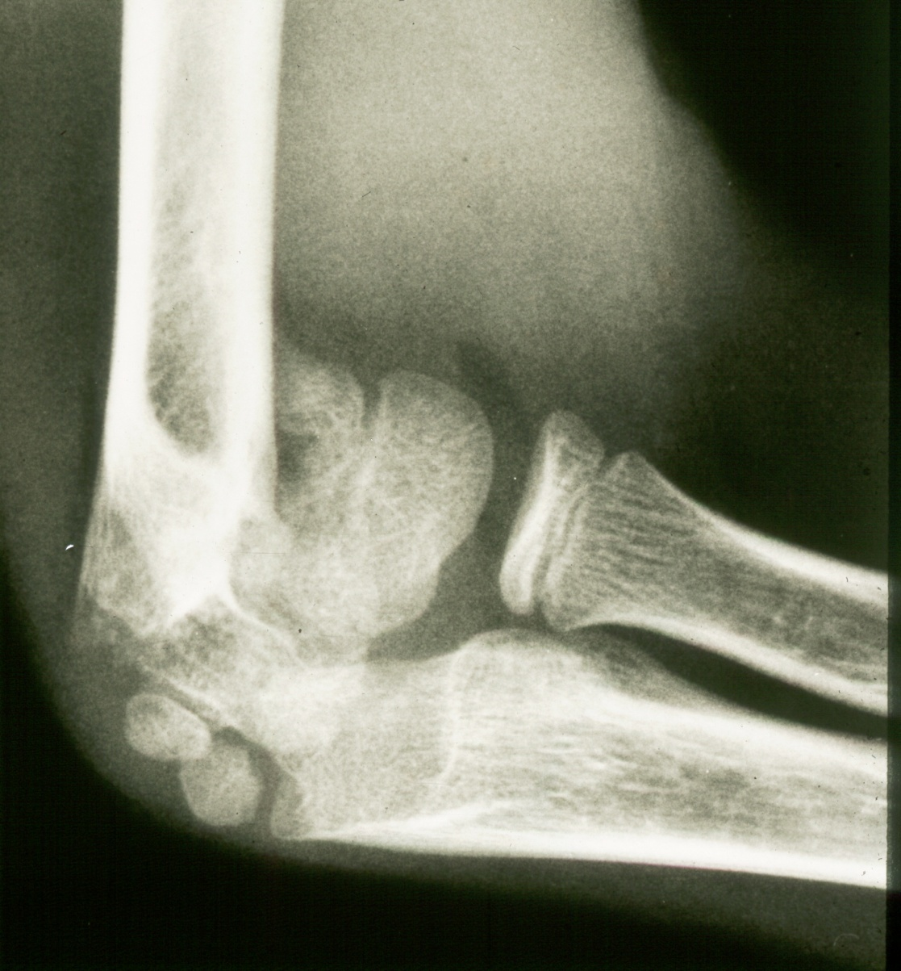
What is this less common type?
Flex
ion

Slide 11
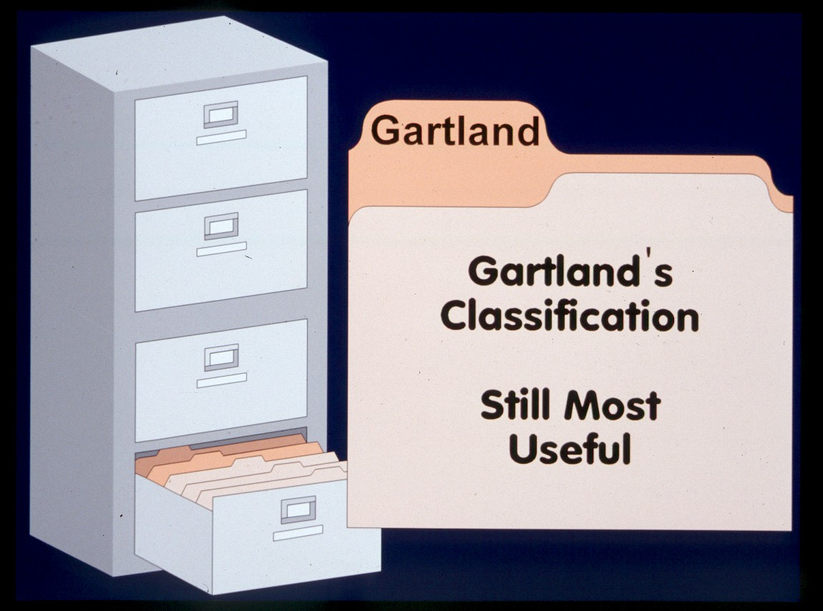
How are the extension type supracondylar
humeral fractures further classified?
*
What does his classification represent ?
*Gartland,JJ:.
Surg Gynecol Obstet 109:145,1959.

Slide 12
How are the extension type supracondylar
humeral fractures further classified?
His types represent
no more than the
three stages
of displacement.
What are the
three stages
of displacement?

Slide 13
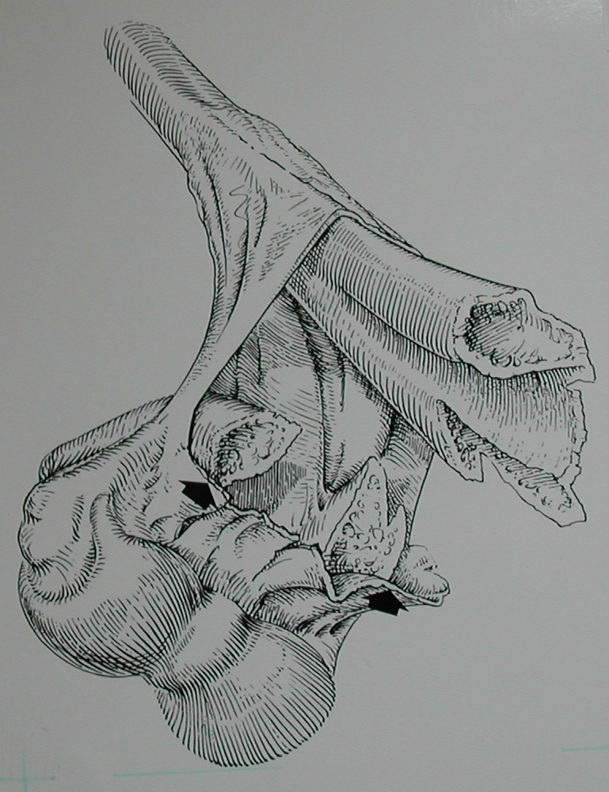
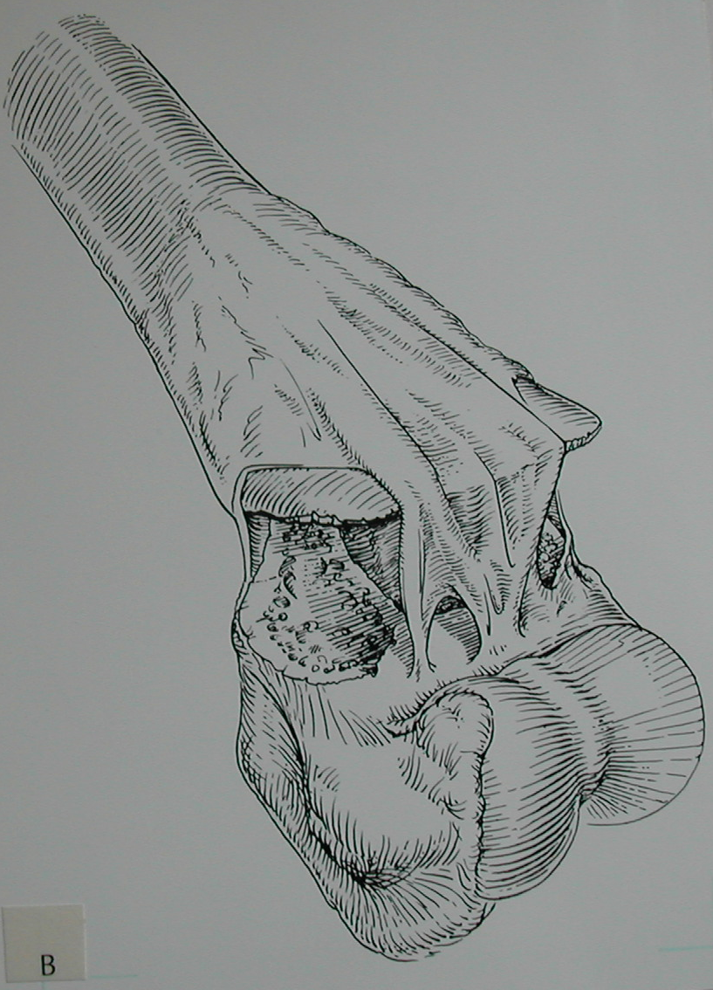
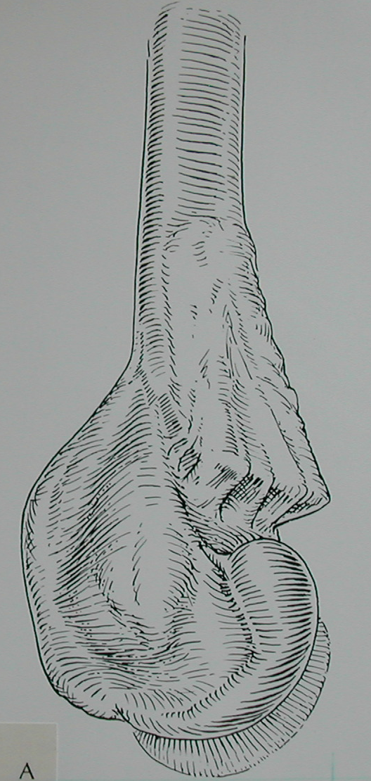
*
It dictates
the
method of
treatment.
Why all this
emphasis
on the classification?
Type II
Incomplete
displacement
Type III
Complete
displacement
Type I
No displacement
*Abraham E, Powers T, Witt P, Ray RD
Clin Orthop 171:309, 1982.

Slide 14
IV. Extension type supracondylar fractures
Let us examine the treatment
based upon the
Gartland Types.

Slide 15
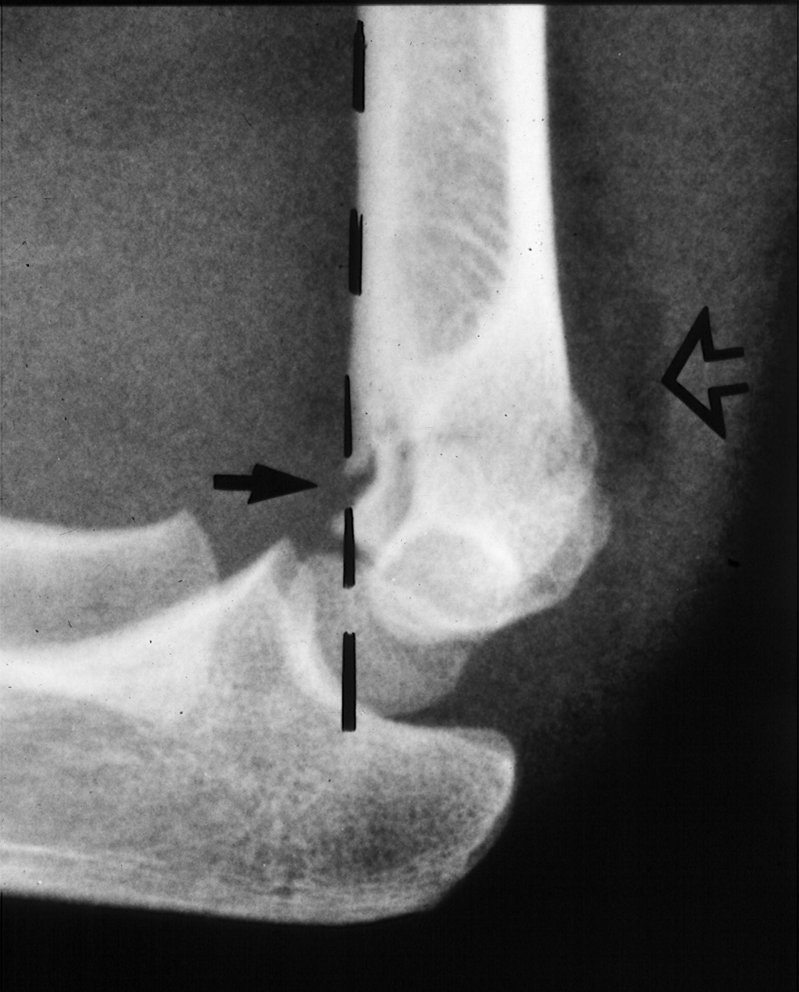
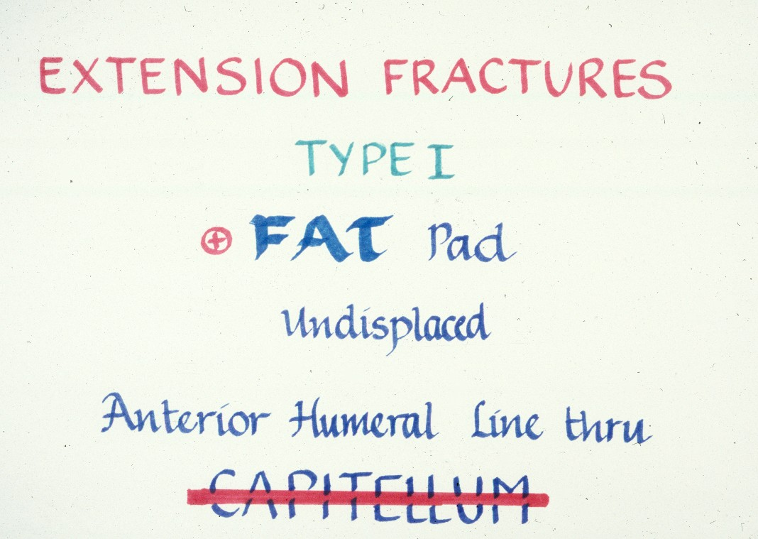
What are the criteria for Type I Fractures ?

Slide 16
What are the criteria for Type I Fractures ?
+

Slide 17
What are the criteria for Type I Fractures ?

Slide 18
What are the criteria for Type I Fractures ?
Absence of
a crescent sign

Slide 19
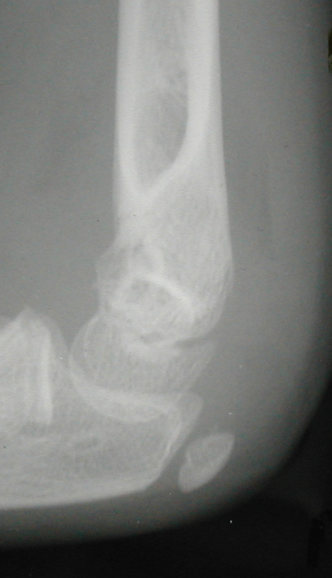
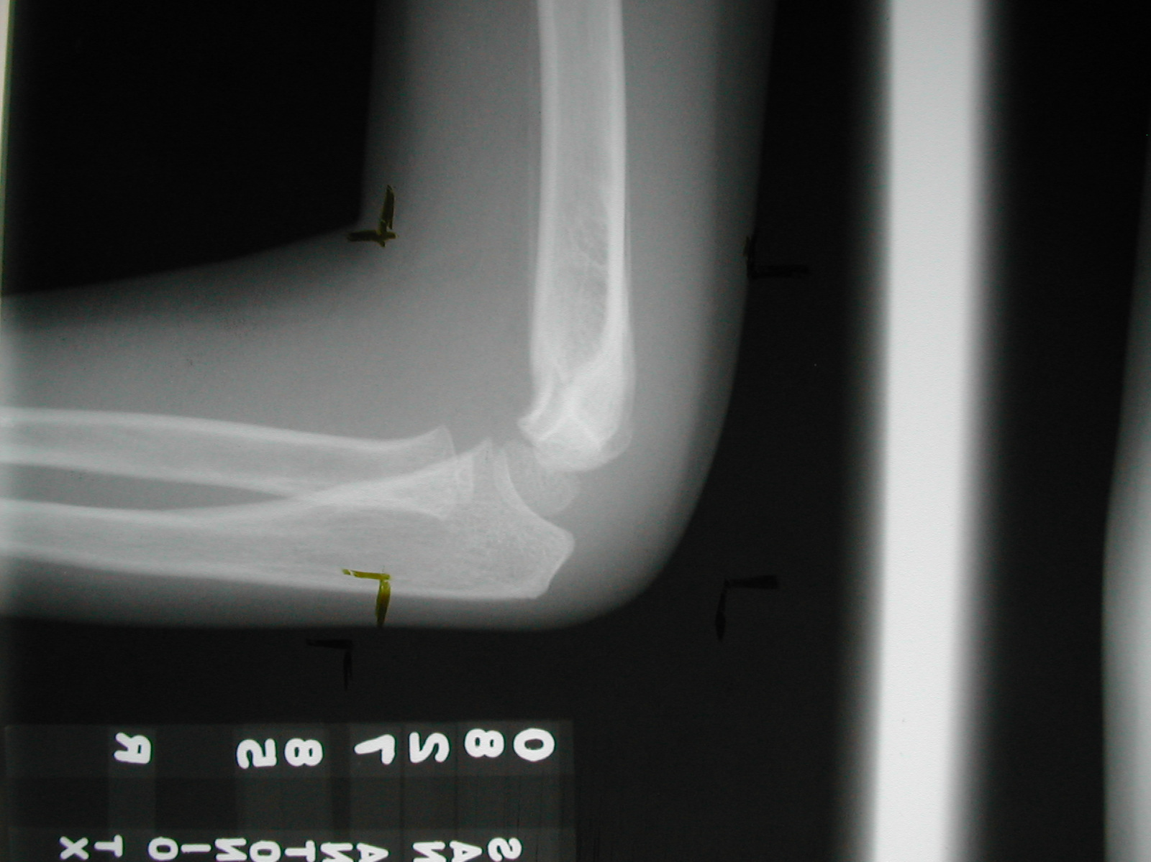
If there was no definite fracture
seen on the injury films,
what confirms the presence
of a suspected Type I fracture?
Periosteal new bone
fat pads displaced
Injury film
The original suspicions of
a fracture are now confirmed.
Type I suspected
3 wks post fracture

Slide 20
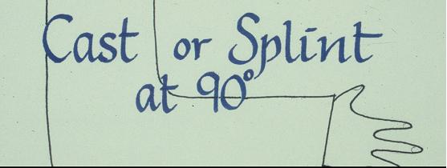
How are the Type I
fractures usually treated?

Slide 21
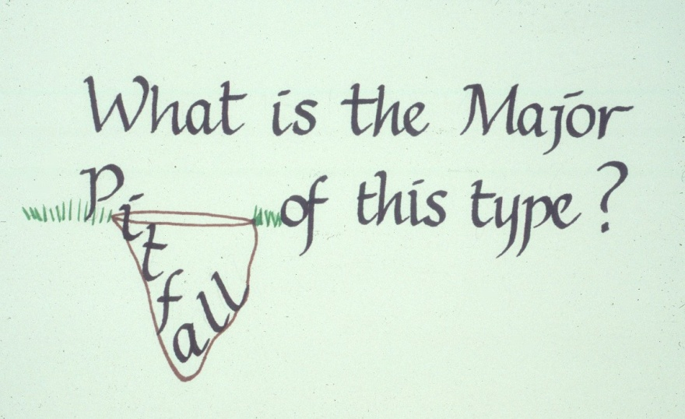
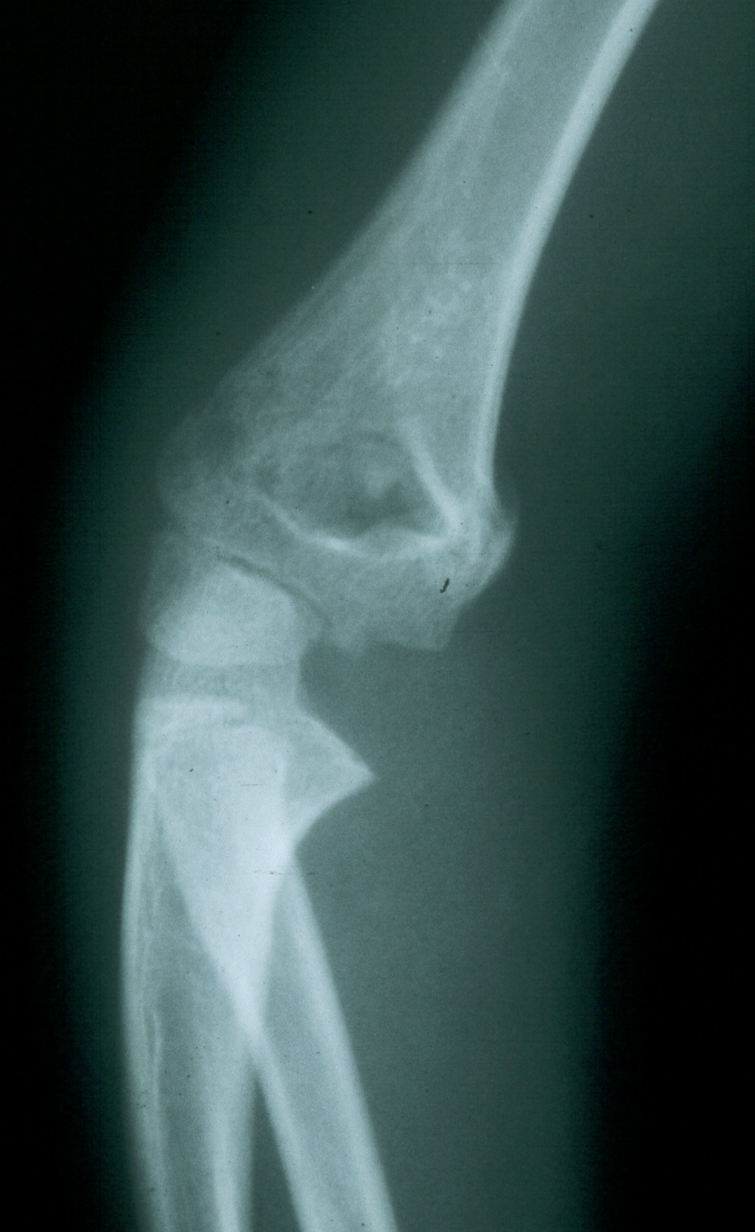
The major pitfall is
a failure to recognize
the true nature
of the fracture pattern.
Originally felt
to be undisplaced

Slide 22
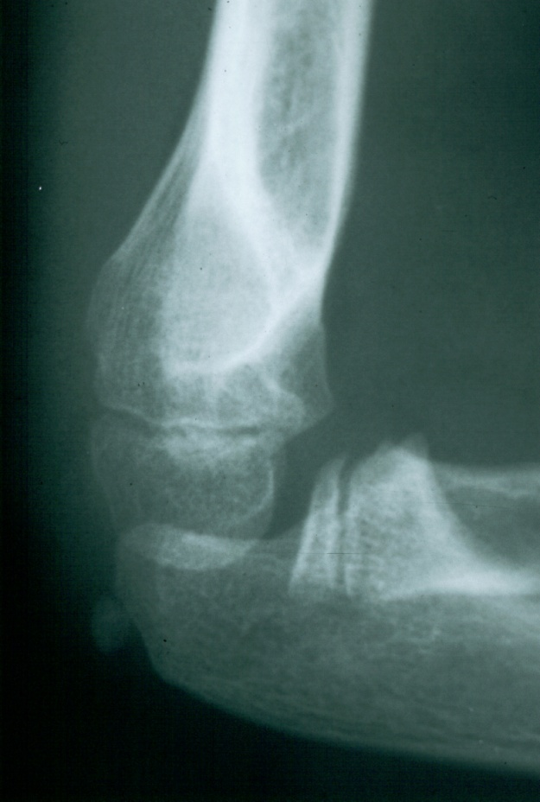
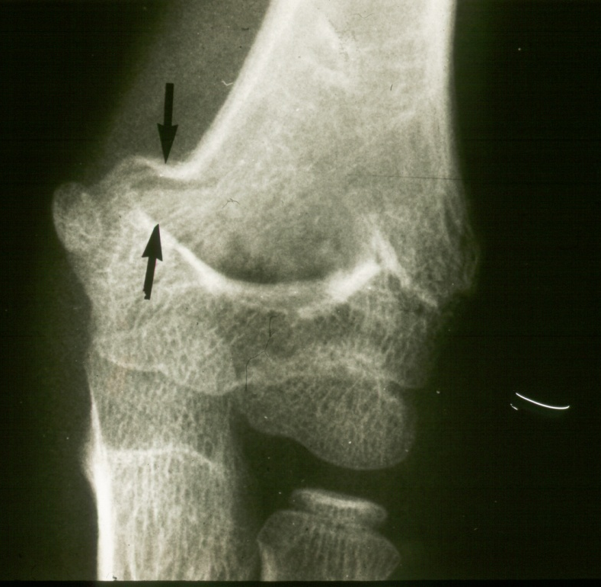
What are the two major displacement deformities occurring in Type I injuries ?
1. Medial greenstick collapse
2. Hyperextension of the condyles
This can accentuate the varus.

Slide 23

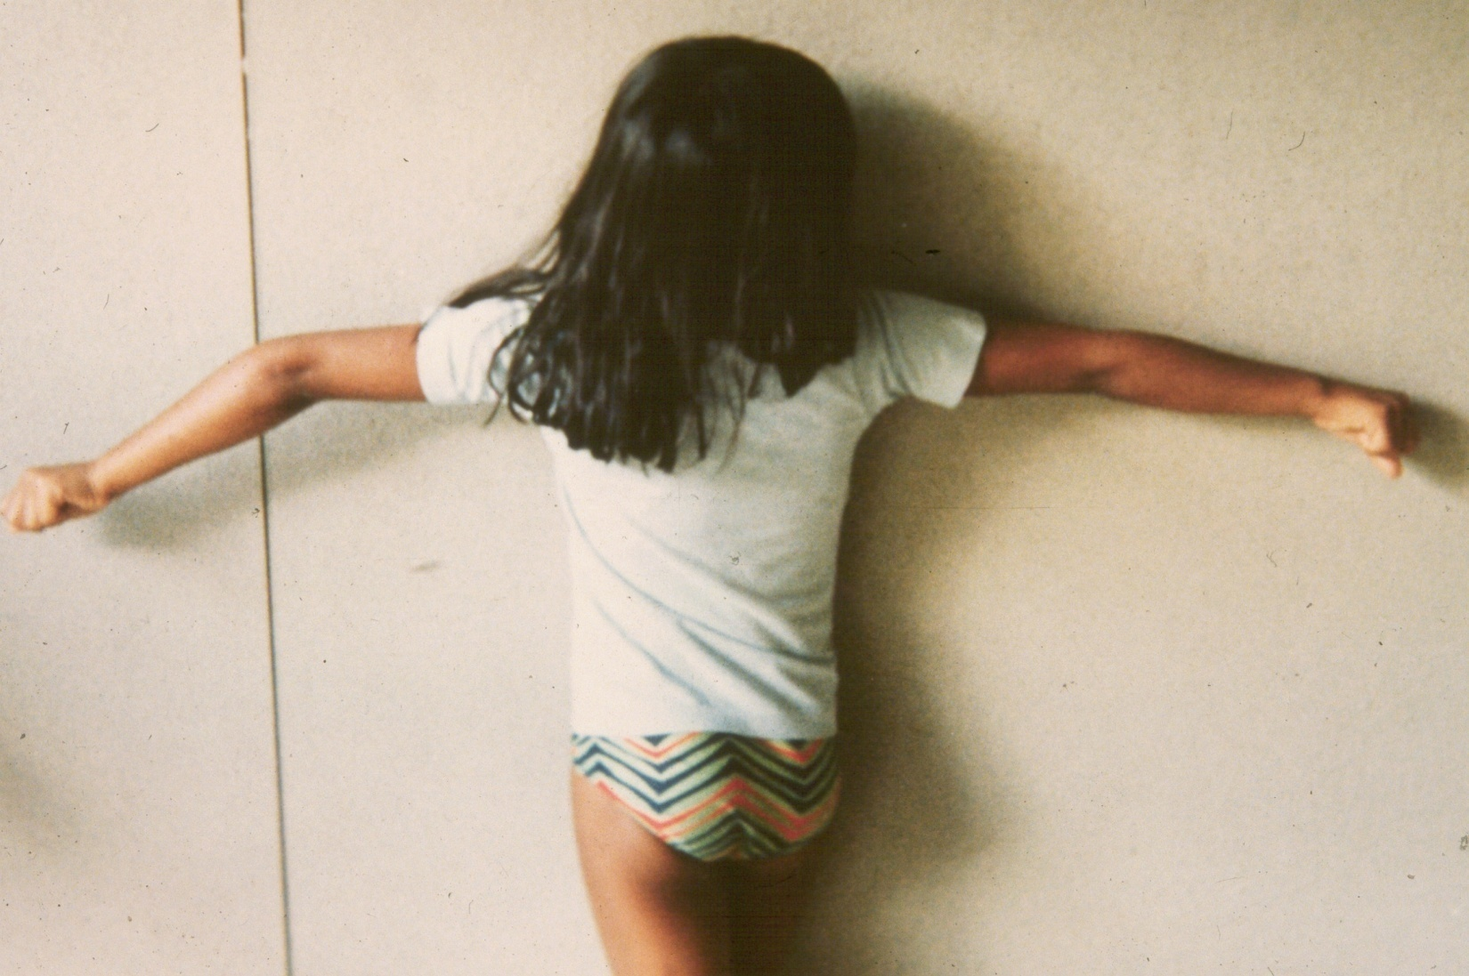

reveals both deformities were present
on the original x-rays.
A more careful evaluation
of our original “undisplaced” fracture
All of this combines to form a
very
unappealing
clinical appearance
+
The crescent sign
indicates a varus alignment.
Medial greenstick collapse
Distal hyperextension

Slide 24
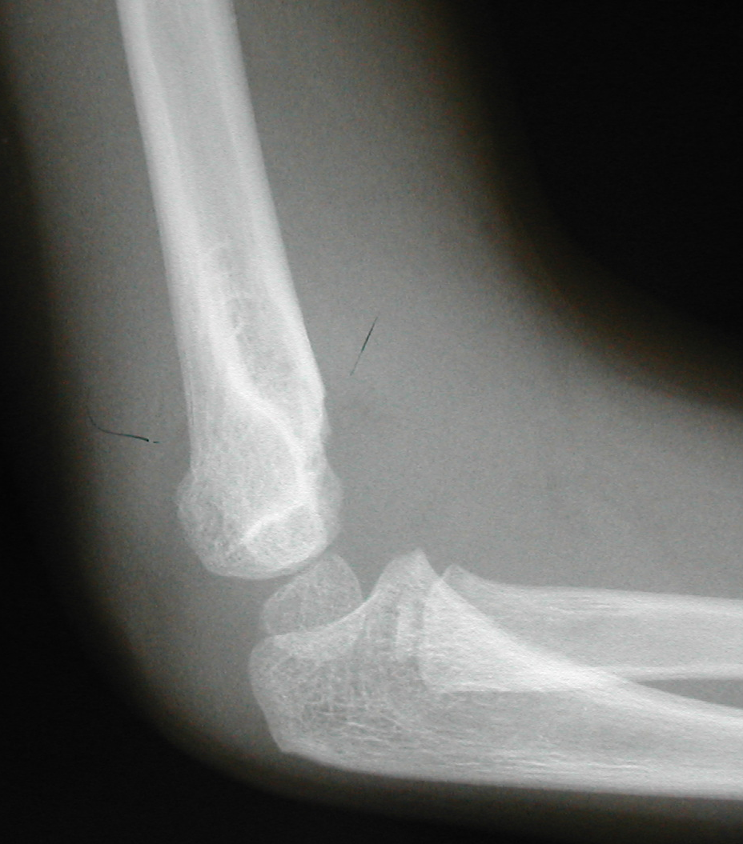
How can one avoid this complication?
The surgeon needs to perform both
careful x-ray and clinical assessments.
Is this
acceptable?
Is there varus?
The anterior
humeral line
barely passes
through the
capitellum.
Is the
crescent sign real?
Or is it the result of
a poorly
taken x-ray?

Slide 25
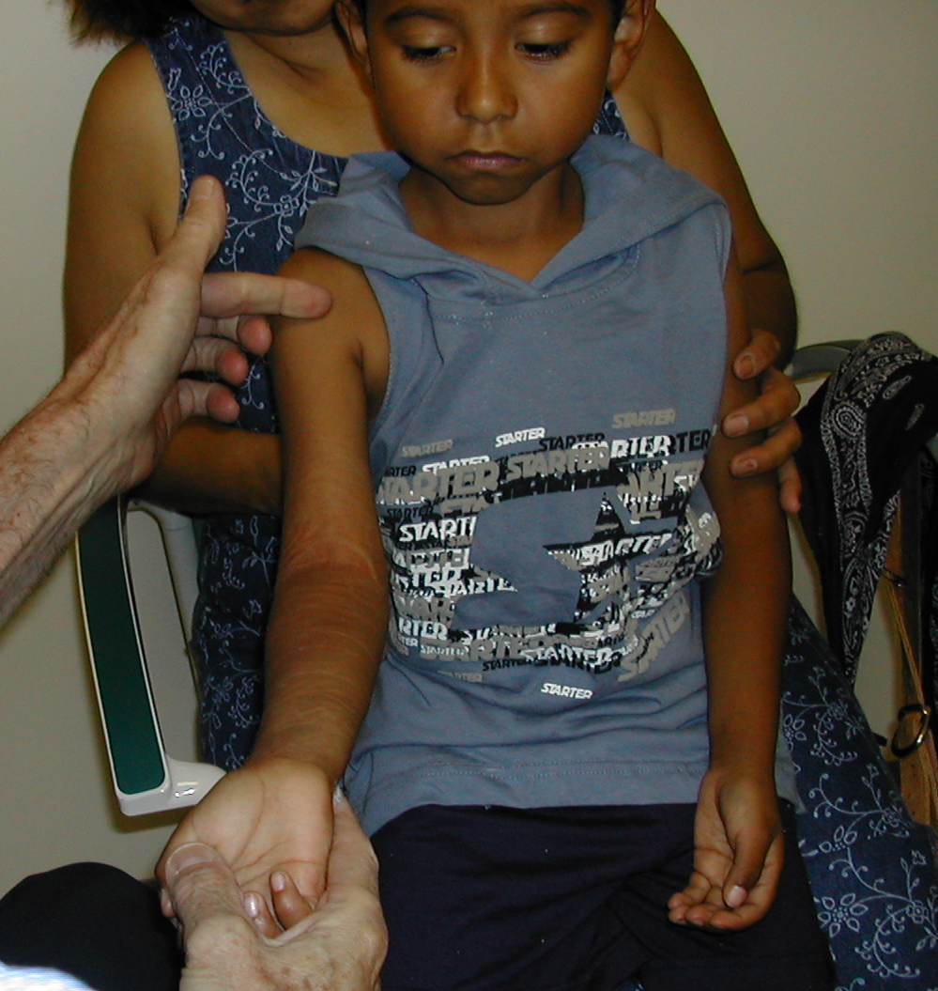
The clinical examination involves
carefully coaxing the elbow into extension.
However, displacement in the
saggital plane may be difficult
to determine clinically.
This allows the surgeon to determine that
the carrying angle has been maintained.

Slide 26
What are the
criteria for
Type II fractures ?
This integrity must
be sufficient
to prevent rotation
of the distal
fragment.
Usually some
cortical
integrity
remains.

Slide 27
Treatment
How must Type II fractures
be managed?
1. Manipulate to obtain a reduction
then
2. Stabilize the reduction

Slide 28
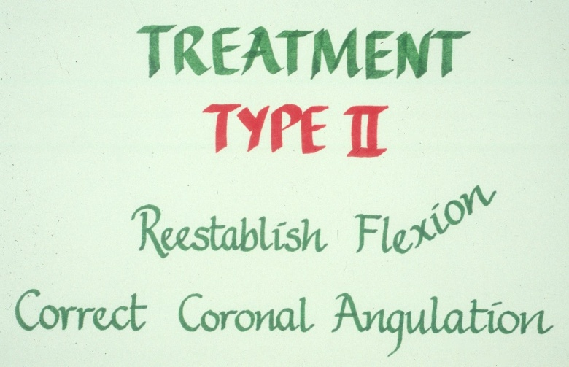
Treatment
What must be accomplished with
the manipulative process?
The deformities in both planes
need to be corrected.
First
This is usually accomplished
by first forcing the forearm
into pronation.
Some manipulative correction
may need to be accomplished
in the coronal plane as well.
15⁰

Slide 29
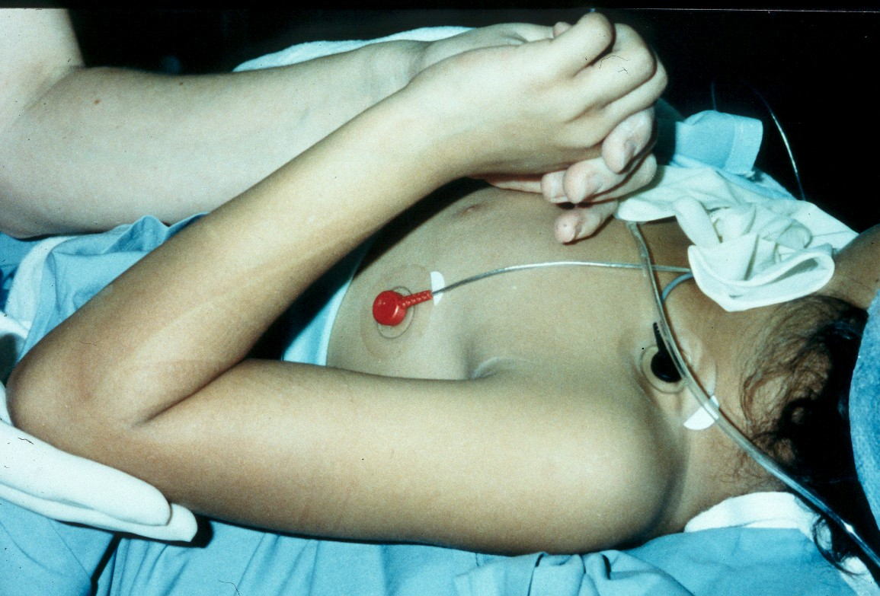
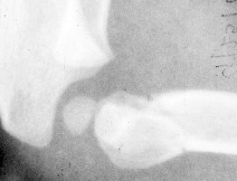
The deformities in both planes
need to be corrected.
First
Then
15⁰
One usually meets resistance,
at the point where the shaft condylar malalignment limits flexion.

Slide 30
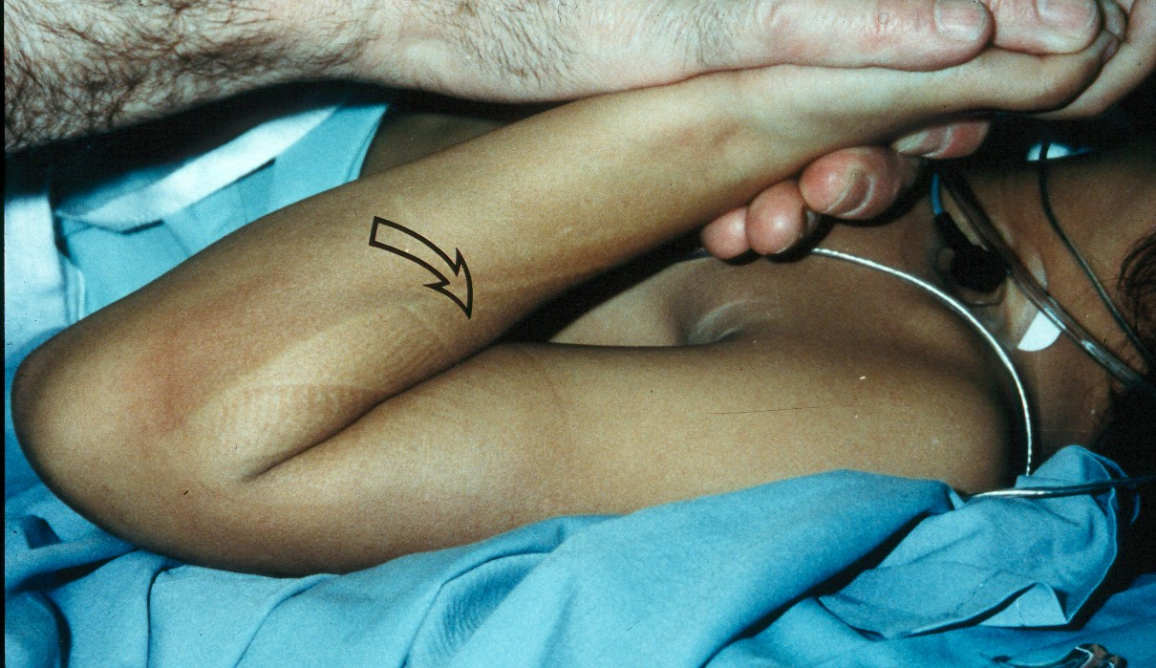
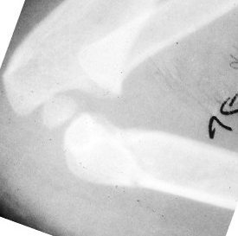
To obtain a complete reduction in the
saggital plane, one must
.
To obtain a complete reductionin the
saggital plane one must
Full
How does one determine
if this fracture can be
immobilized with a cast
alone?
40⁰
and examined to be sure the carrying angle
has been corrected as well.
Following this hyper flexion, the elbow is then extended
This usually re-establishes the saggital
alignment (shaft-condylar angle) of the distal fragment.

Slide 31
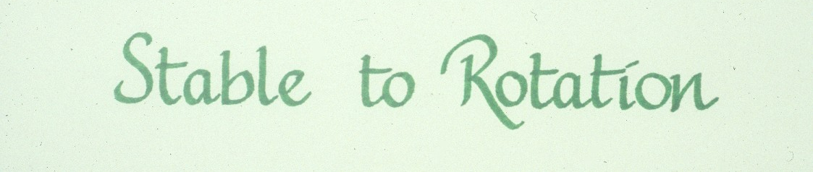
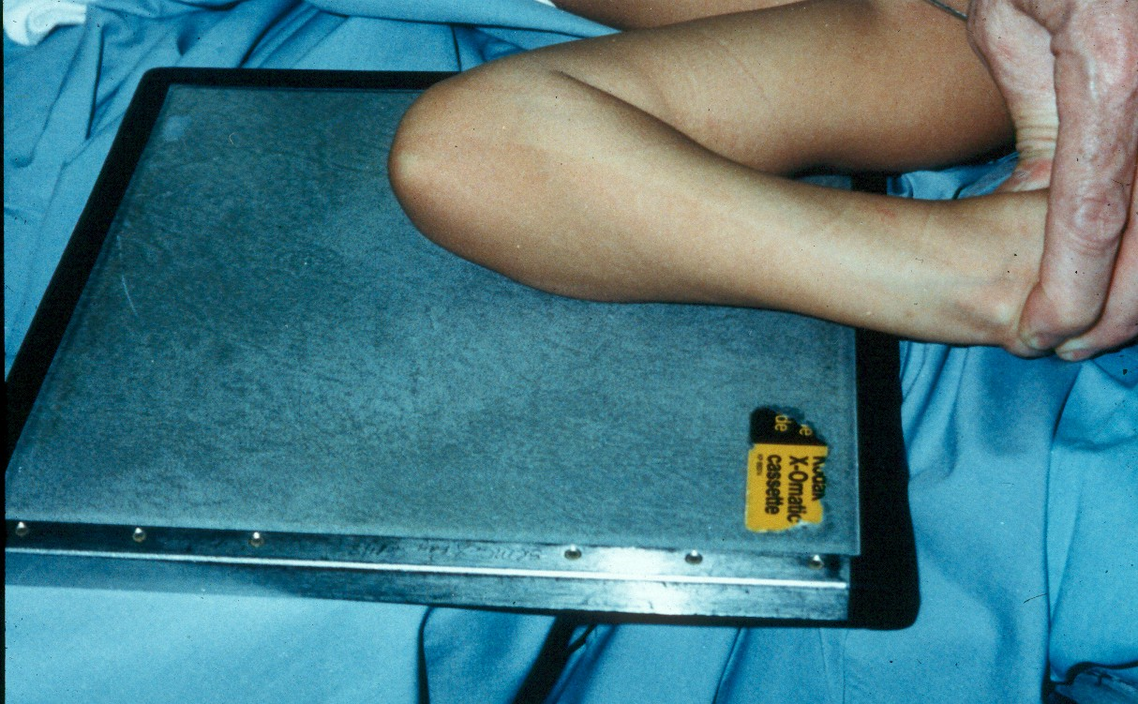
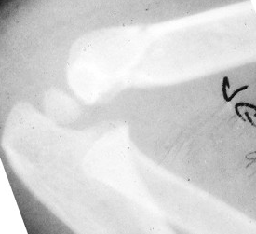
.
Determine if it is
40⁰
The reduction has been maintained
at 120⁰ of flexion
and 90⁰ of external rotation.

Slide 32
If the reduction is stable
at 120⁰ of flexion,
and there is no evidence
of
vascular compromise,
how can these fractures
be best immobilized
post reduction?

Slide 33
Stabilization with a
may not be adequate !!

Slide 34
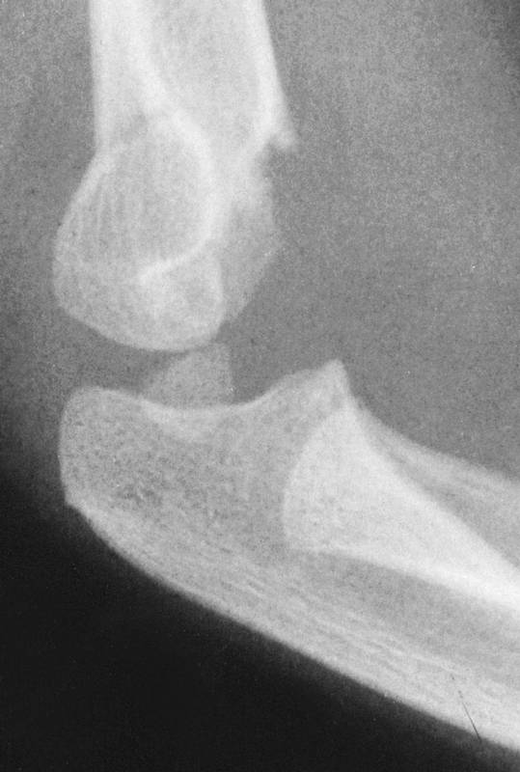
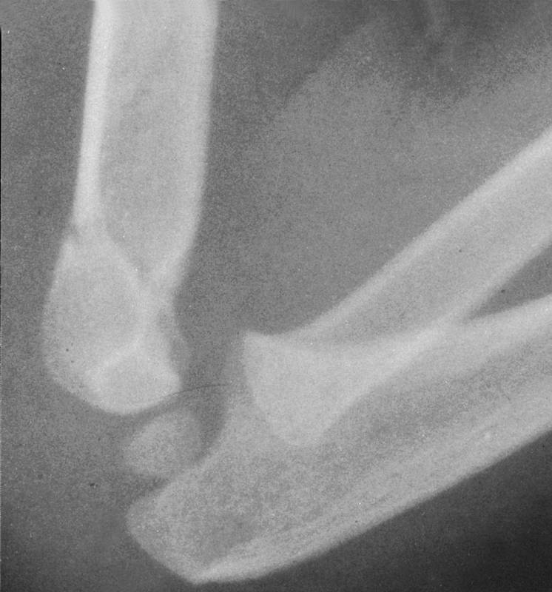
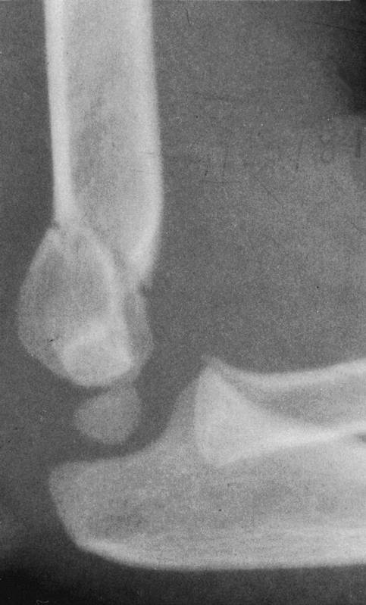
to maintain the reduction .
The elbow must be flexed to 120 ⁰
Injury film
Reduced at 120⁰
Reduction lost
at 90⁰
WARNING
Flexing to > 120⁰ may increase the risk
of vascular problems.
*
*Millis MB, Singer IJ, Hall JE.
Clin Orthop 188:90–97,1984.

Slide 35
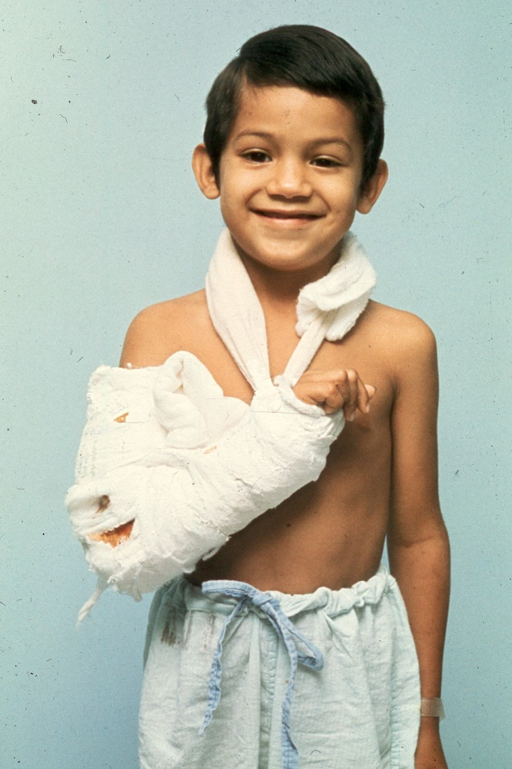
8
Thus these fractures need to be immobilized
with a figure
cast.

Slide 36
Always incorporate
the sling into
the cast.

Slide 37
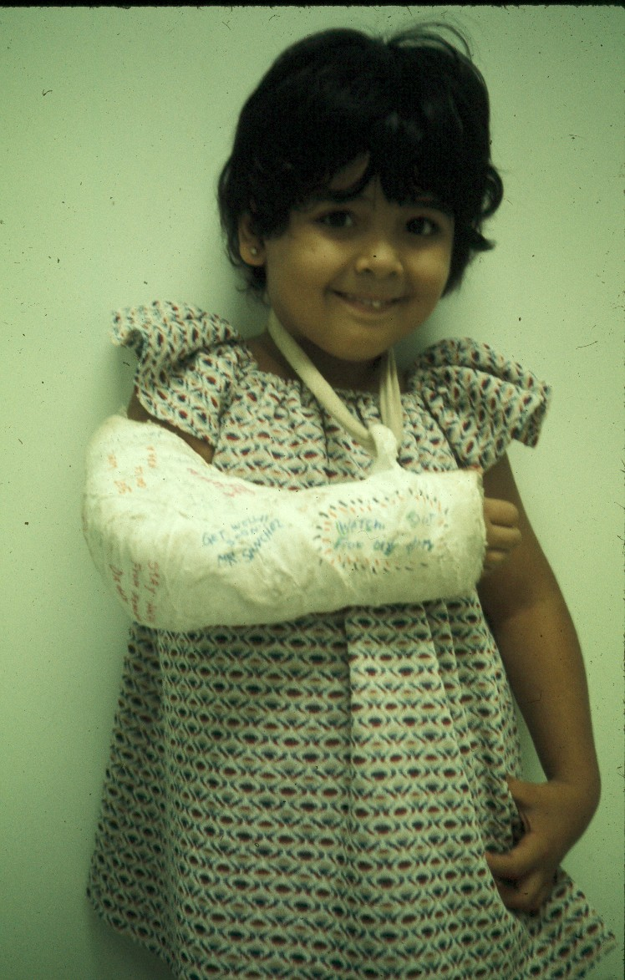
Mommy,
this sling
is
bothering me!

Slide 38
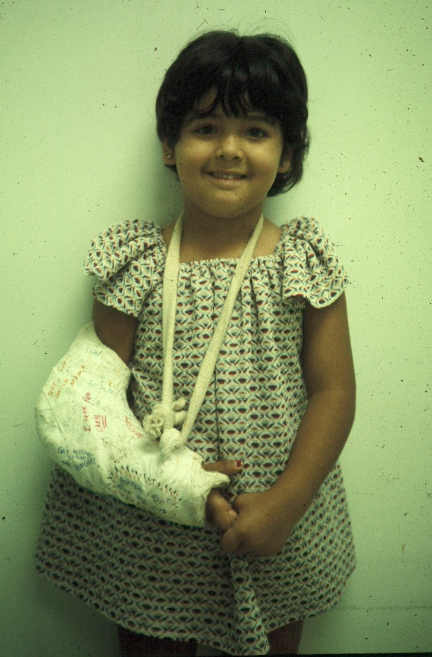
But,
loss of
elbow
flexion
may
That’s
much
better !
result in
a loss of
reduction.

Slide 39
With Type II fractures, if
there is any concern about
vascular compromise
or fracture stability
due to the severe swelling,
then secure the fragments
with percutaneous pins,
so that the extremity can be
immobilized at 90 degrees.

Slide 40
*
In fact, a recent study has demonstrated
that asymptomatic pressures of > 30mm Hg. may
occur in the deep volar forearm compartment,
even when
the elbow is flexed to just above 90 degrees.
For this reason, some surgeons advocate
stabilizing all Type II fractures with pins.
*Battaglia TC, Armstrong DG, Schwend RM.
Journal of Pediatric Orthopedics 22:431,2002.

Slide 41
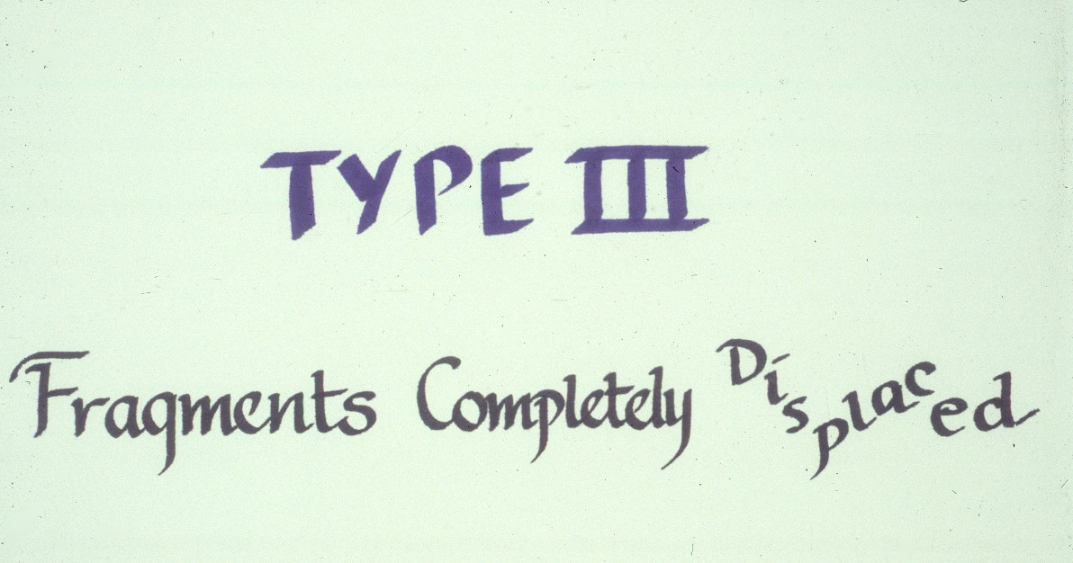
What are the criteria for
fractures?

Slide 42
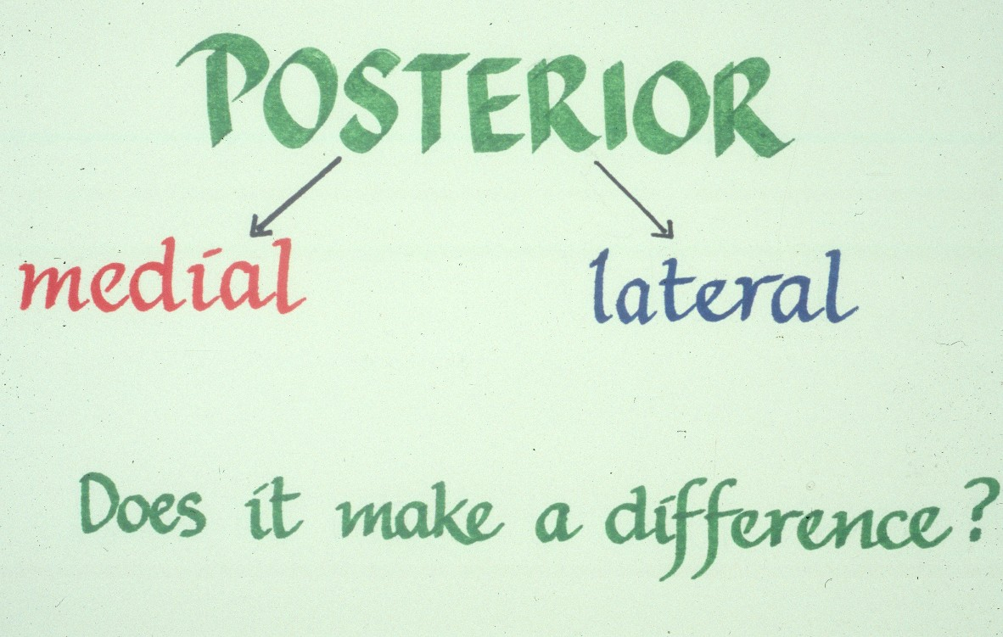
How are Type III extension supracondylar
fractures sub-classified?
Yes

Slide 43
Posteromedial vs. Posterolateral
In what aspects is there a difference?
Nerve, Vessel Injured
Surgical Approach
Rate of Complications
What type has a greater
potential for complications?

Slide 44
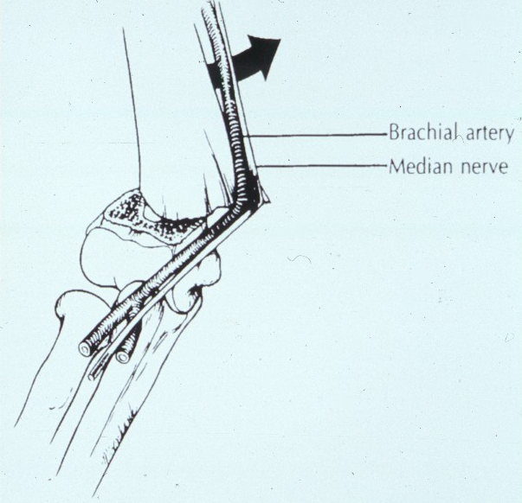
The rate of complications is greater with the posterolateral fractures.

Slide 45
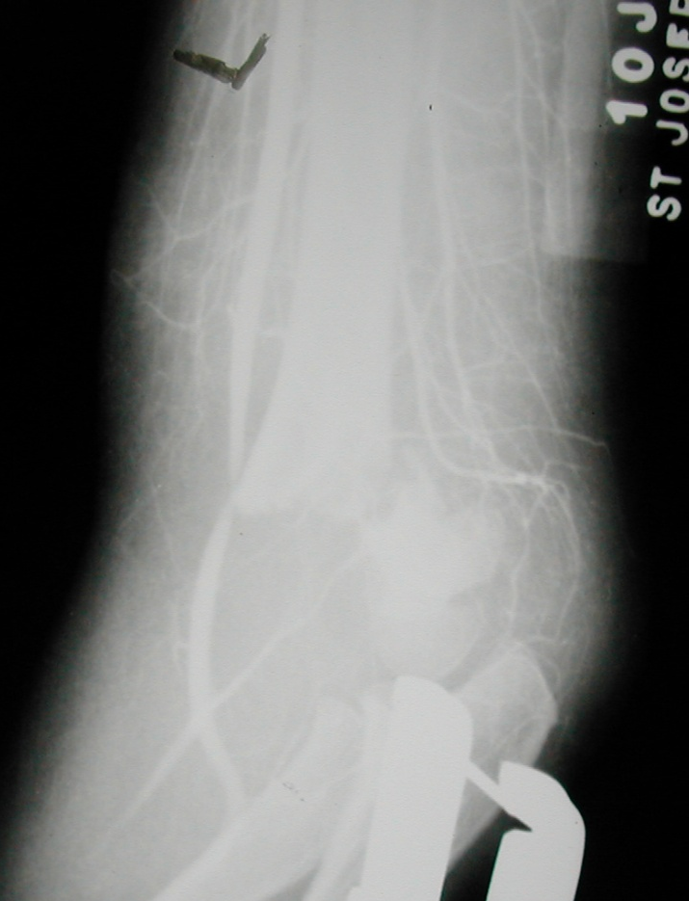
What’s the major concern with the posterolateral pattern ??
Higher Risk of:
1.Vascular injuries
Posterolateral Pattern

Slide 46
What’s the major concern with posterolateral pattern ??
Higher Risk of:
2.Irreducibility
Posterolateral Pattern

Slide 47
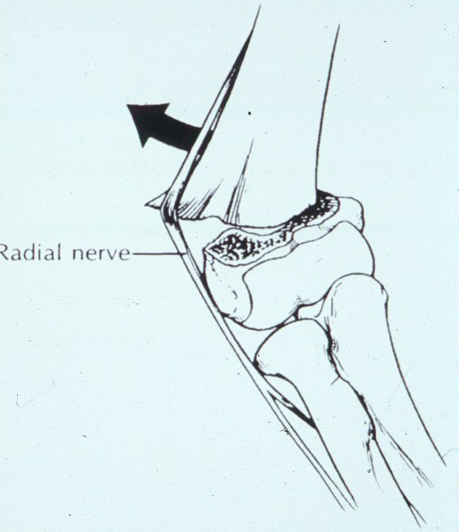
What is the major concern
with the posteromedial fractures ?
The radial nerve
is more vulnerable
to injury.

Slide 48
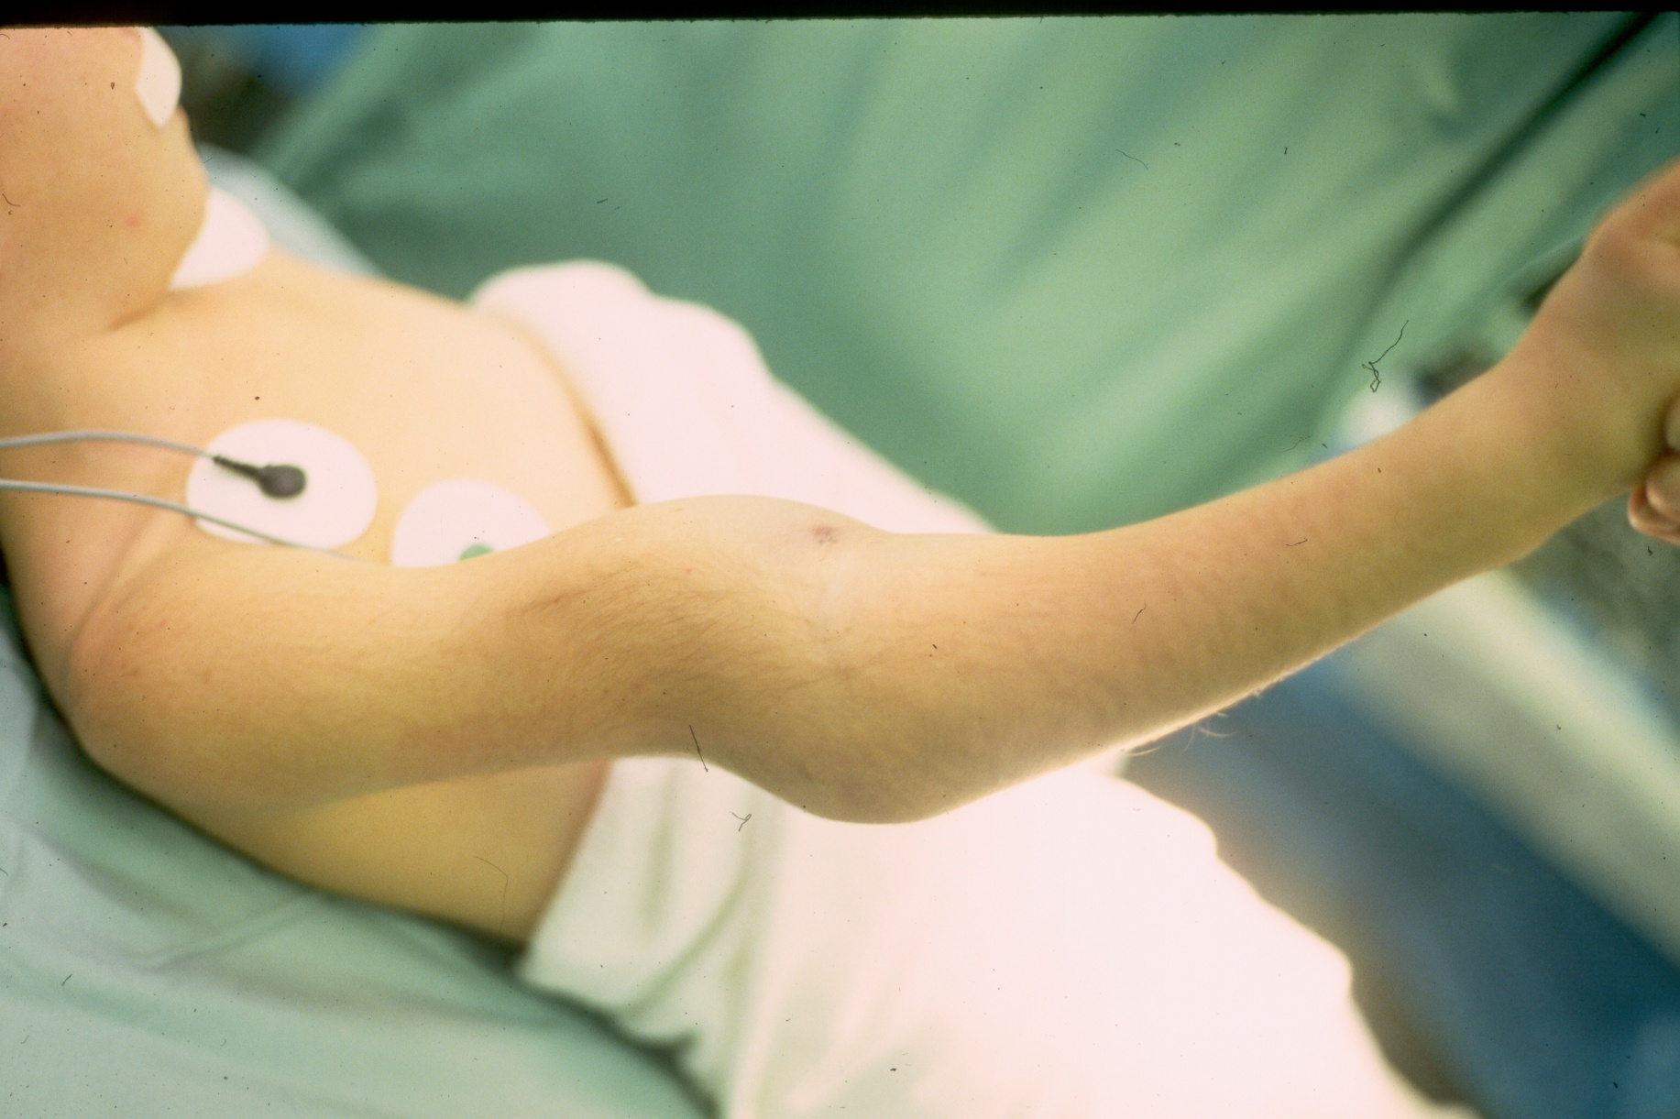
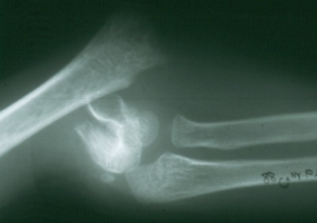
How are Type III fractures
best treated?
Treatment

Slide 49
Simple
1. Obtain the reduction
then
2. Maintain the reduction

Slide 50
Do these fractures have to be reduced
in the middle of the night?
No, as long as there is no evidence of
any vascular compromise.
*
Several studies have demonstrated that
a delay of 6-8 hours in reducing these fractures,
does not increase the incidence of
complications or unsatisfactory results.
* Leet AI, Frisancho J, Ebramzadeh E.
Journal of Pediatric Orthopedics. 22:203,2002.
Mehlman CT, Strub WM, Roy DR, Wall EJ, Crawford AH..
Journal of Bone & Joint Surgery.83A:323,2001.

Slide 51
What does the manipulative
process entail ?
Reduction of the fracture
It consists of four steps:

Slide 52
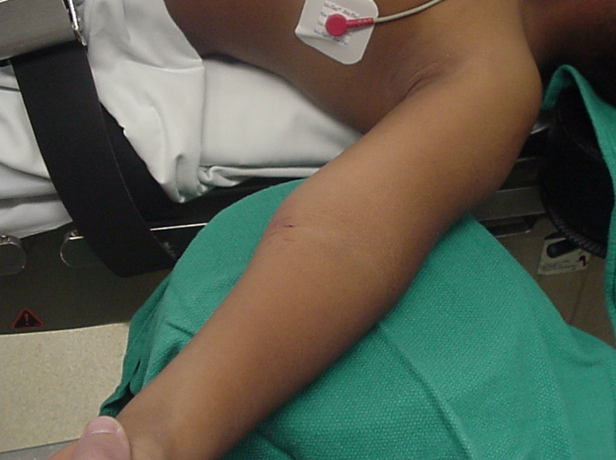
1. Correct coronal plane alignment
With the elbow in extension, align the distal fragment
to the proximal fragment in the coronal plane.

Slide 53
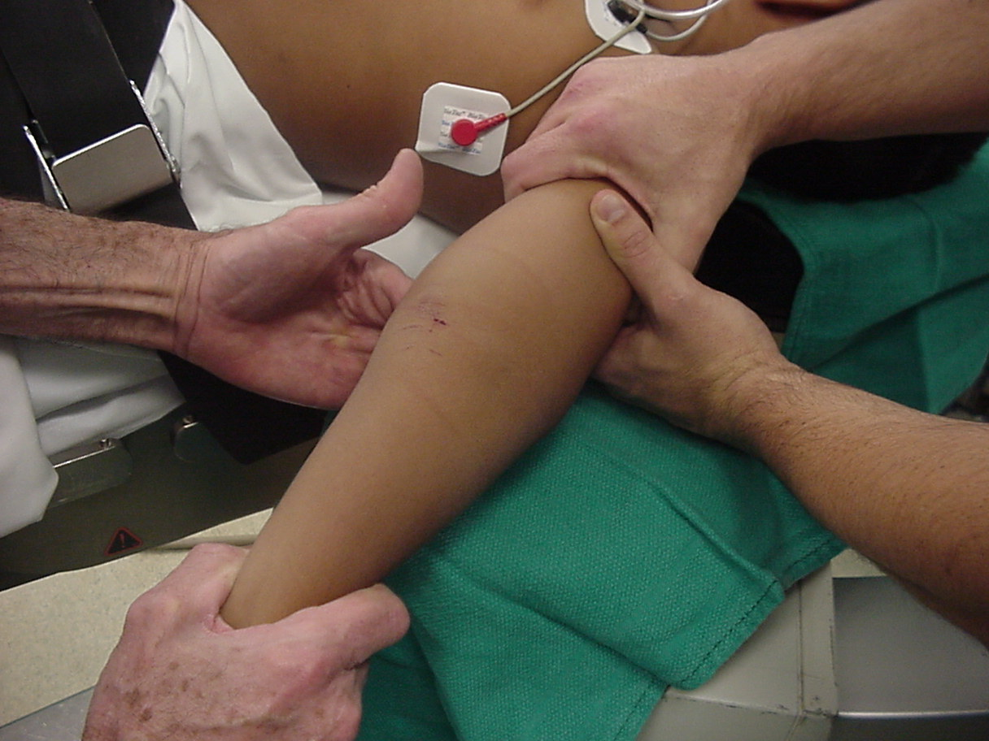
2. Re-establish Length
This usually requires
an assistant.
Counter-Traction
Traction

Slide 54
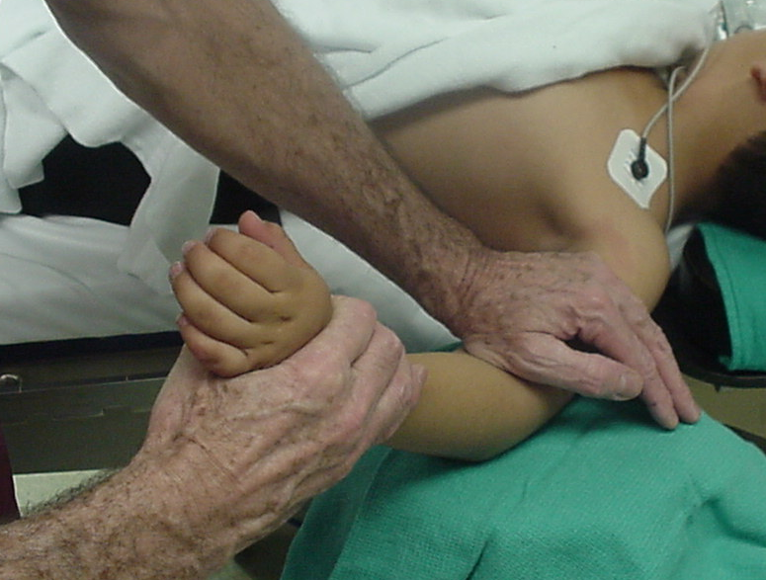
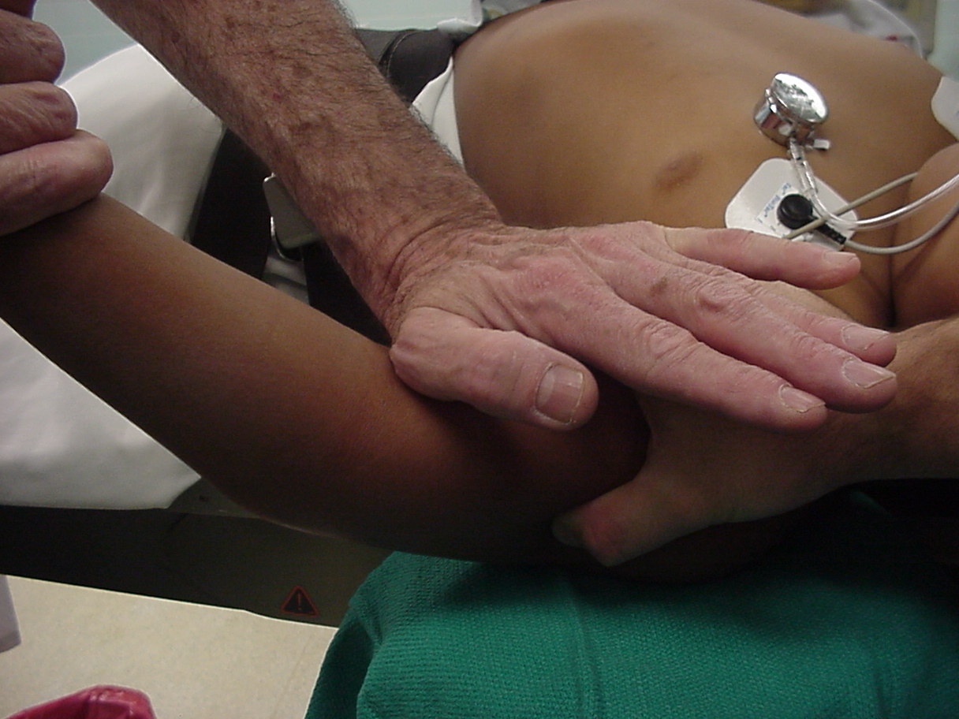
3.Correct Angulation
and
Posterior Displacement
Apply longitudinal traction
with the elbow semi- flexed,
Then, slowly flex the elbow to bring
the distal fragment into alignment.
while applying posterior
pressure on the proximal fragment.

Slide 55
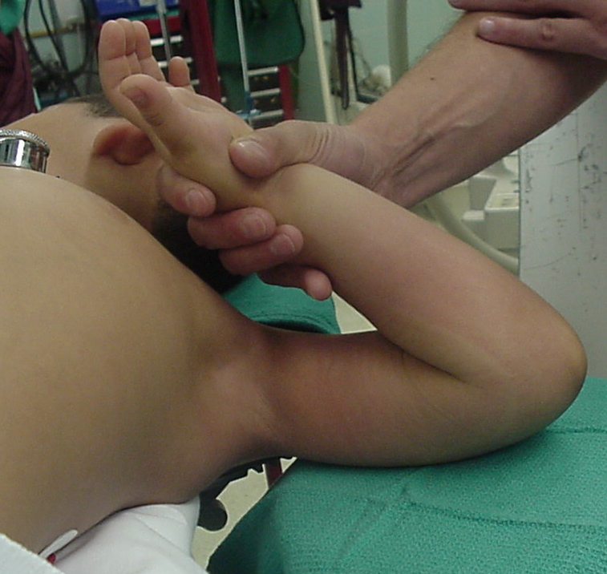
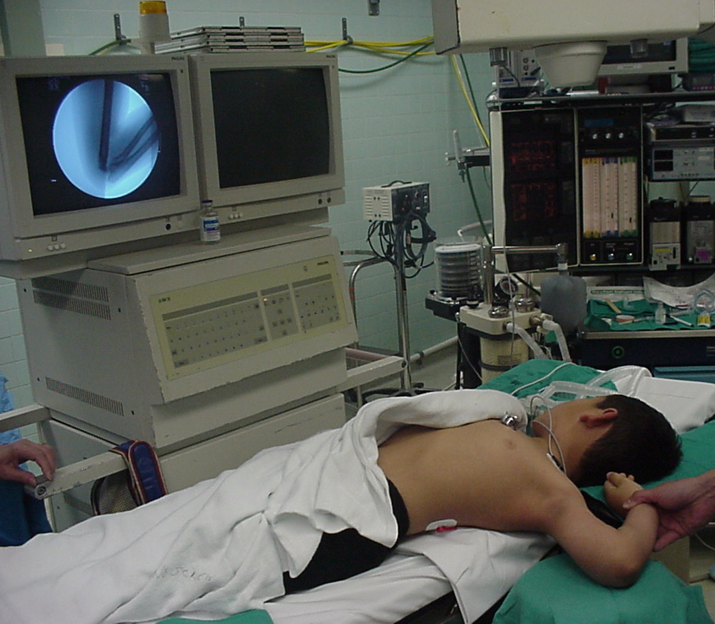

4. Temporary stabilization and assessment
Once the fragments are reduced,
Warning!!
If unable to obtain
full flexion
STOP!!
There may be
interposed tissue
between the fragments!!
hyper-flex the elbow
Then, confirm the reduction
in full external rotation
on the monitor.
to lock the distal
fragment to the
proximal fragment.
with
hyper-pronation

Slide 56

Using a cast alone for post-reduction,
*
produces the poorest results
when compared with other methods.
Now-- how do we
maintain the
reduction?
*Pirone AM, Graham HK, Krajbich JI. J Bone Joint Surg 70A:641,1988.
Kurer MH, Regan MW. Clinical Orthopaedics & Related Research. 256:205,1990.

Slide 57


This immobilization
device is no
longer commercially
available.
Full flexion
is required
to prevent
rotation of
the distal
fragment.
How much
flexion is needed
to prevent rotation
of the distal fragment?

Slide 58

If a cast is inadequate,
then what is
the standard for maintaining the reduction?
Percutaneous
pin
fixation

Slide 59

In what manner may the pins be used?
Advantages ?
Most stable construct
Post-operative, one is able to fully extend elbow to visualize coronal alignment
Disadvantages ?
Ulnar nerve injury
Medial-lateral
pins

Slide 60
How can the danger of ulnar nerve
injury be minimized?
By
making an incision
directly over the
medial epicondyle,

Slide 61

to locate the
medial epicondyle
by direct vision.

Slide 62

Then, insert the medial pin by direct vision
into the center of the medial epicondyle.
The pin is inserted,
while the ulnar nerve
is
retracted posteriorly.

Slide 63


What are the principles of lateral pin fixation?
Advantages ?
Easy to apply
Almost no risk of nerve injury
Disadvantages
Poor rotational stability
Pins must be parallel
or divergent
*
Two lateral
pins
Pins crossing at the
fracture lack stability
*Cheng J, Lam T, Shen W.
J Orthop Trauma 9:511,1995.

Slide 64


Loss of rotation of distal fragment
this rotational malalignment
is usually of
no clinical significance.
These three pins with
But, since the coronal alignment has been maintained,
in addition to the shaft condylar angle,
no separation allowed rotation.

Slide 65

and adding a third pin.
*
By separating the pins
How can the rotational stability with lateral pin be enhanced?
Advantages ?
Almost as strong as medial-lateral pins
Disadvantages?
The larger patients may still have rotational instability,
requiring supplementation with a medial pin.
*Zionts LE, McKellop HA, Hathaway R.
J Bone Joint Surg [Am];76:253,1994.

Slide 66

Is there a way to put X pins
without producing this scar?

Slide 67



Lateral Antegrade pin

Slide 68


Slide 69
Following pin fixation,
how are these fractures managed ?
For three weeks

Slide 70


What is this physical finding ??
The “Pucker Sign” which may indicate irreducibility.

Slide 71
How may the proximal spike be
dis-impaled
By performing the “milking ” maneuver.

Slide 72

The “milking ” maneuver
The distal humeral spike
is impaled through
the brachialis muscle.

Slide 73
*
With the milking maneuver
The brachialis is milked distally
past the impaled fragment.
*Archibeck,MJ et. al.:
Jour Pedi Orthop 17:298,1997.

Slide 74


In those irreducible fractures, what dictates the preferred surgical approach?
Post-Lat Fracture:
Post-Medial Fracture
The ability to visualize
the interposed vital structures is essential.
Medial humeral
spike
Lateral humeral
spike
Anteromedial incision
Anterolateral Incision

Slide 75




What about the posterior approach?
Advantages:
*
Easy approach
This fracture
was irreducible
by closed
manipulation.
The posterior
triceps
splitting
approach
Direct
visualization
of fracture site
Disadvantages:
Injures virgin
tissue
Unable to
visualize
anterior A. & N.
Injury film
*Compliments of Jamie Maclean(Pearth ,Scotland)

Slide 76
What is the primary purpose of an open reduction?
The goals are to
remove the interposed structures which
facilitates a closed reduction and
a percutaneous pinning.

Slide 77

What is one of the main tissues
preventing an anatomical reduction?
The periosteum
tears proximally,
and remains as
big wad
attached distally.

Slide 78



X-ray evidence of this periosteal interposition
often is demonstrated as a gap in many fractures
Gap with interposed
periosteum
Gap persists
Gap has remodeled
Mind the Gap!
Post-reduction
6 weeks
3 months

Slide 79

it remains attached distally as a large flap.
While the periosteum tears proximally,
This flap of periosteum
can serve as a guide to
locating and reducing
the distal fragment.

Slide 80



What about late-appearing fractures ?
Wait. Remodeling can change things.
Periosteal
new bone
2 wks. post
closed reduction
Repeat
closed reduction?
Open reduction?
He had only slight valgus alignment with full elbow motion
What now?

Slide 81

What are the risks
of doing a late open reduction ?
*
The dilemma when one of these
fractures presents late is:
2.Wait and do a corrective osteotomy
when the patient has recovered
full motion.
1.Do a delayed open reduction
and risk loss of motion from myositis.
or
*Lal, G.M. Bhan,S.:
Int.Ortho.15:89,1991.
Myositis Ossificans

Slide 82


Always check for ipsilateral fractures.
In addition to evaluating the neurovascular
function, what else needs to be done ?

Slide 83
Do the patients with ipsilateral
fractures have more of a risk
for compartment syndromes?
The answer is not clear!
*
In three series, there was
no increase in vascular complications.
*Harrington P, Sharif I, Fogarty EE, Dowling FE, Moore DP.:
Archives of Orthopaedic & Trauma Surgery. 120:205, 2000.
Roposch,A et.al.: Jour Pediatr Orthop 21:307,2001.
Siemers,F et.al.: Zentralblatt fur Chirugie 127:212,2002.

Slide 84
Do the patients with ipsilateral
fractures have more of a risk
for compartment syndromes?
Both fractures need
to be stabilized surgically
to eliminate the need for
constrictive cast.
The answer is not clear!
Because ipsilateral fractures
are usually the result of trauma
of greater magnitude,
they need to be followed closely.
*
In two other series
compartment syndromes developed.
*Blakemore,LC et.al.: Clin. Orthop and RR 376:32,2000.
Ring,D et.al.: Jour Pediatr Orthop 21:456,2001.

Slide 85


In what order do they need
to be stabilized?
Ipsilateral shaft fractures
Distal radius
Are they treated differently ?
2
1
1
2
Yes. One has to establish a lever arm first.

Slide 86

What type of supracondylar fracture
does this patient have?
Flex
ion

Slide 87
They present
in the same manner as the extension types.
How do the flexion patterns present?
Type I:
Criteria?
They are undisplaced. Therefore no reduction is needed.
Type II:
Criteria?
There is enough intrinsic stability to be treated with a cast alone.
Type III:
Criteria
They have no intrinsic stability, thus they need surgical stabilization.

Slide 88


Type I Flexion Injury
Increase in the shaft
condylar angle
Tendency toward
valgus alignment
55⁰
What are the limits of acceptability ?
Greater than 20 ⁰ of an increase of the shaft-condylar angle
probably should be corrected.
Because, if the flexion of the condyle is not aggressively
corrected, the elbow may lose extension.
No good data

Slide 89

Type II Flexion Injury
The treatment entails a closed reduction
What is the
management?
+
a long arm extension cast.

Slide 90

This classical Type III pattern
is obviously a flexion injury.
With these one needs to be
prepared to do an open reduction !!

Slide 91


But, if not recognized as such, it may be a problem.
This also is a Type III Flexion Pattern.
The distal fragment is
not flexed,
8 y.o.
It also has
anterolatateral
displacement !!
but also it is not extended to any degree.
This fracture was irreducible,
and required an open reduction !!!
What is different
about this fracture?
Is this a simple extension
type supracondylar fracture ??

Slide 92
There are some clues to these occult flexion injuries.

Slide 93

1. The distal fragment is not extended,
It may be
rotated!!
however,it may not be flexed to any degree.

Slide 94
2. The distal fragment is in valgus.

Slide 95

3. The medial spike of the proximal fragment is usually posterior.

Slide 96

4. There may be clinical signs of ulnar nerve dysfunction.

Slide 97

Why are these fractures irreducible ?
The location of the proximal medial spike is critical.

Slide 98

It is also posterior to the
intermuscular septum.
The medial spike
is pressing against
the ulnar nerve.

Slide 99

What is the operative approach ?
Anterior N.V. Bundle
Medial
spike
Ulnar Nerve
It involves an anteromedial incision.
One needs to be able to see the:

Slide 100
So what’s the message here?
If critically evaluated
flexion SC fractures
may be more common.
Be prepared to
perform open reduction
on Type III flexion injuries.

Slide 101

Exotic methods of stabilization
of
Supracondylar Fractures
This is how we treated these fractures
when I was a resident !!

Slide 102
6 y.o. sustained this FX. NV intact.
Following obtaining a satisfactory closed reduction how do you propose to stabilize it?
Medial-lateral pins

Slide 103
6 y.o. sustained this FX. NV intact.
Following obtaining a satisfactory closed reduction how do you propose to stabilize it?
Multiple lateral pins
Outside fracture line ?

Slide 104
6 y.o. sustained this FX. NV intact.
Following obtaining a satisfactory closed reduction how do you propose to stabilize it?
Cross pins
antegrade lateral

Slide 105

Five y.o. male with this fracture pattern
Following obtaining a satisfactory closed reduction how do you propose to stabilize it?
Multiple lateral pins
Stable ??

Slide 106
Five y.o. male with this fracture pattern
Following obtaining a satisfactory closed reduction how do you propose to stabilize it?
Medial-lateral
retrograde cross pins
Difficult and unstable

Slide 107


How about retrograde IM Fixation??
Must visualize the medial epicondyle

Slide 108


8 y.o. rolled over on an ATV
with mild closed head injury
Radial A.
Clinical appearance
Only N-V deficit:
Anterior interosseous n. function weak
FCR Musc.

Slide 109




Imaging Studies

Slide 110

How are we going to stabilize this boy’s fracture?

Slide 111

This is probably one of the few indication to use
Antegrade Flexible I M Nails

Slide 112


Slide 113


Our Patient P.O.
Probably acts more
as an internal splint

Slide 114


Six months post-operative

Slide 115


How is he doing clinically?

Slide 116

What is the place for an external fixator
if any?
Screws in proximal
and distal fragments
Single pin to control
rotation

Slide 117



Slide 118
The place for an external fixator
Reported useful
to manipulate
the fragments
May be effective
with
comminution of
distal humerus

Slide 119


6 y.o. comminuted Supra/T condylar
Treated in skeletal traction

Slide 120


Good results achieved
In this time this may have been a candidate for ex-fix

Slide 121
Now you should
be prepared to treat
all the unusual cases
Thank you

Slide 122

What are
the two most common complications?
The details of these complications
will be discussed in Part II of this module.
Complications
Cubitus varus
Volkmann's

Slide 123

Thank you for participation!

