Slide 1
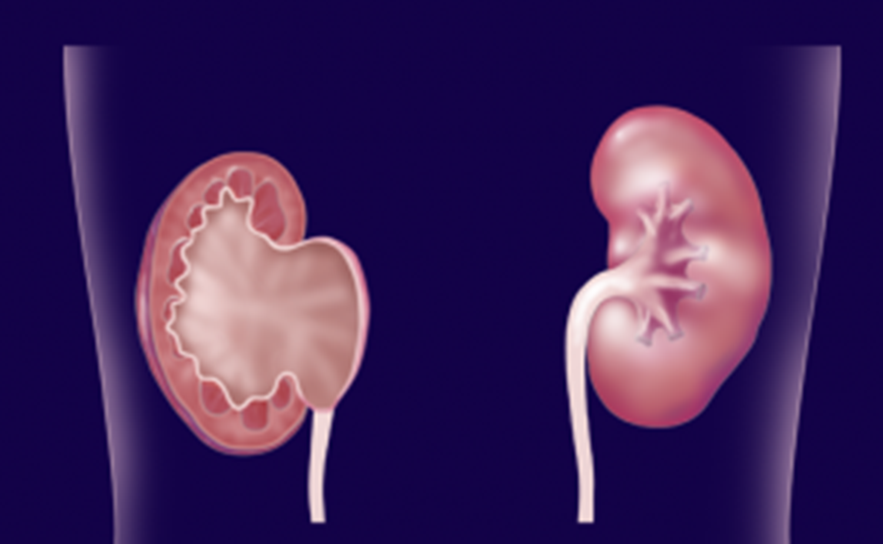
Ureteropelvic Junction Obstruction (UPJO)
مرحلة رابعة\107 د.محمد فوزي
23\10\2017 العدد8

Slide 2
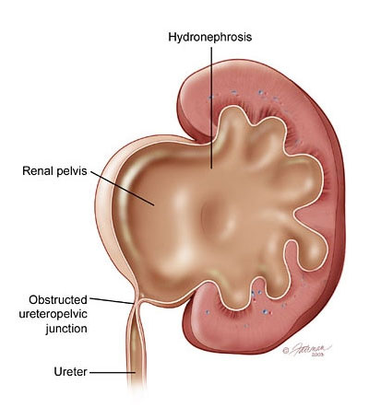
Overview
Most common cause of fetal hydronephrosis.
Obstruction at the junction between renal pelvis and ureter.
Incidence: 1:1000
Boys:Girls = 2:1
Left:Right = 2:1
Bilateral in 10%.

Slide 3
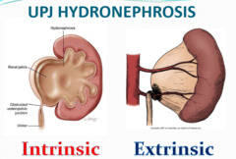
Aetiology
Congenital:
Intrinsic
Aperistaltic segment
Fibrous stricture
Extrinsic:Crossing vessels (Aberrant vessel).
Acquired:
Stone disease
Iatrogenic post-operative stricture.
Chronic inflammatory process
Malignancy
VUR (Vesico-ureteral Reflux disease)
Idiopathic.

Slide 4
Clinical Presentation
Antenatal US Detection.
Abdominal mass
Recurrent UTI
Hematuria
In older children:
flank or abdominal pain,
UTI,
hematuria following minor trauma
Dietl’s crisis.

Slide 5
Investigations
US: pre- and post-natal.
IV Urography
Isotope renal scan.
CT & MRI
Pressure-Flow Study (Whitaker Test)

Slide 6
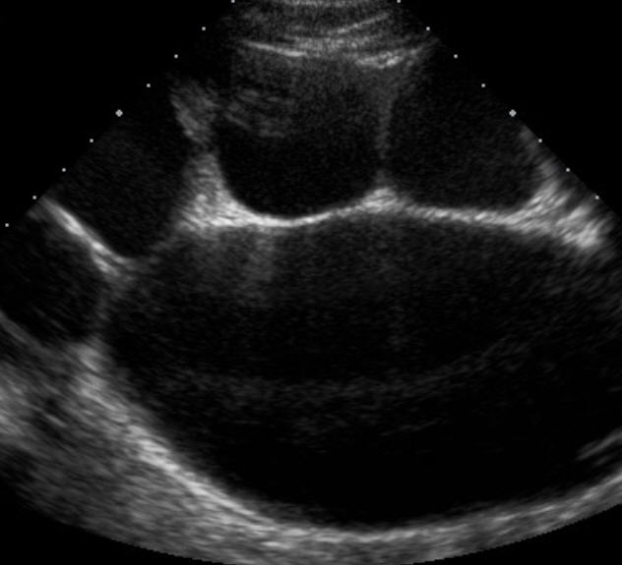

Slide 7
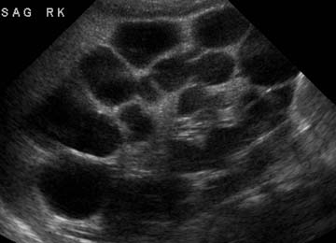

Slide 8
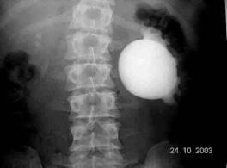
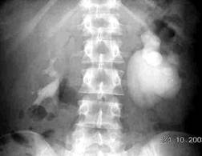

Slide 9
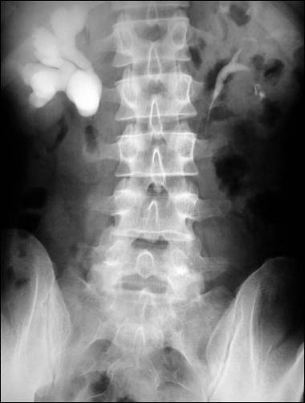

Slide 10
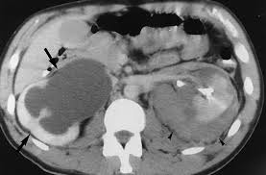
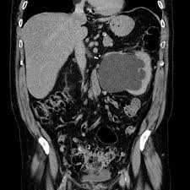

Slide 11
Management
Conservative:
Prophylactic antibiotics.
Serial follow-up and observation for complications.

Slide 12
Indications of Surgery
Symptomatic UPJO
Complications
Progressing hydronephrosis
Impaired function of the affected kidney
Options include open or laparoscopic pyeloplasty. (Anderson-Hynes)

Slide 13
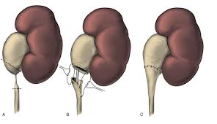

Slide 14
Renal impairment eg. bilateral disease may necessate nephrostomy.
A sac-like non-functioning kidney needs removal.

Slide 15
Vesico-ureteric Reflux Disease (VUR)

Slide 16
An abnormal retrograde flow of urine from the bladder into the upper urinary tract.
Incidence: 1%
Male:Female = 1:5
Family history.

Slide 17
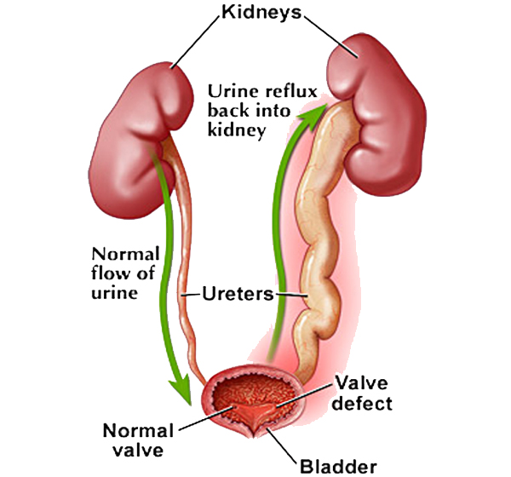

Slide 18
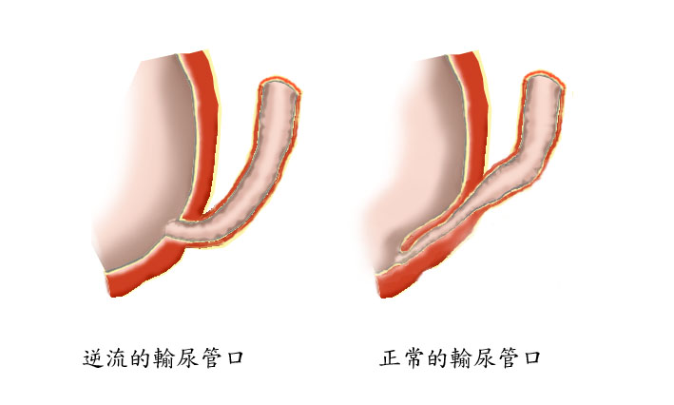
Pathophysiology
The distal ureter passes through the bladder wall creating anti-reflux valve.
Reflux may cause renal scarring.
Remote changes may include hypertension and ESRD.

Slide 19
Classification
Primary
Secondary
BOO
Neurogenic bladder dysfunction.

Slide 20
Presentation
VUR by itself is asymptomatic
Symptoms and signs are due to associated UTI.
Febrile UTI in infants:
Irritability
Persistent high fever
Respiratory distress
FTT
Renal impairment

Slide 21
Older children may more clearly reveal symptoms and signs of UTI
Urgency,
Frequency,
Dysuria,
Incontinence.

Slide 22
Investigations
Baseline measurements
Urine analysis
Urine culture
Ultrasound scan.
Micturating Cystourethrography (MCUG)
Isotope renal
Video-urodynamics.

Slide 23
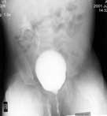

Slide 24
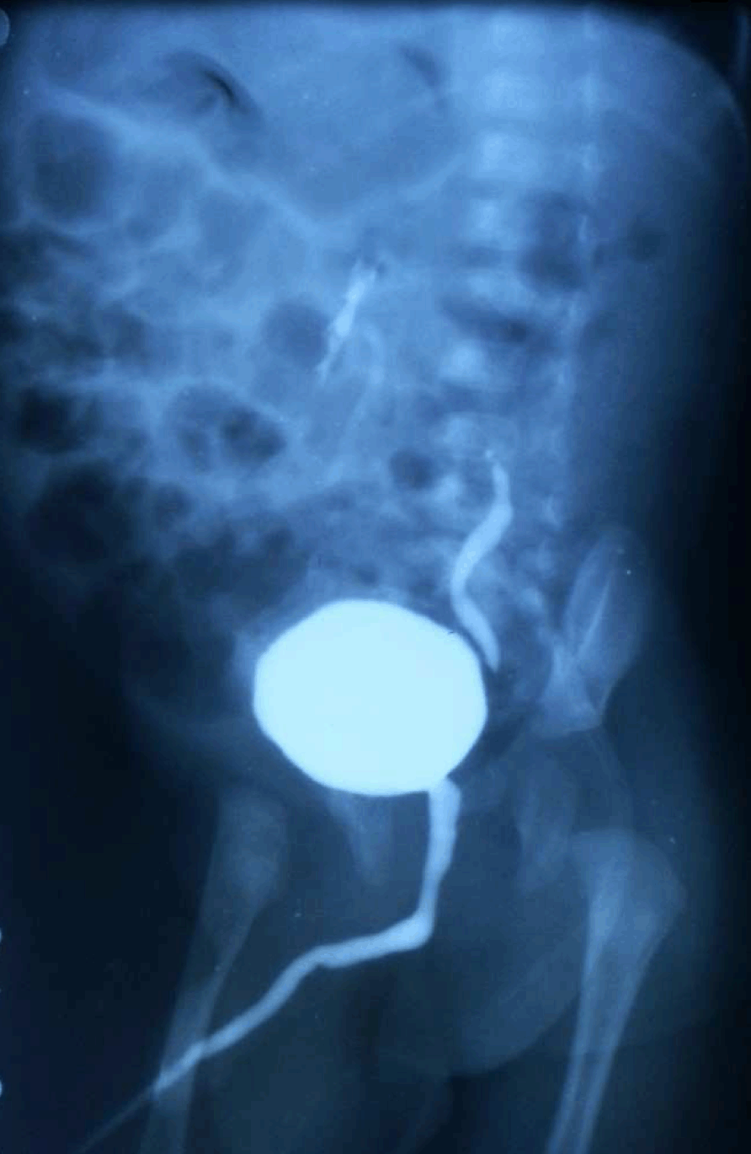

Slide 25
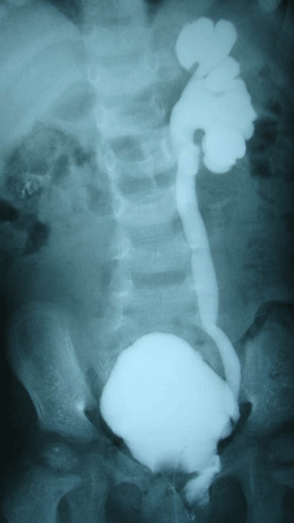

Slide 26
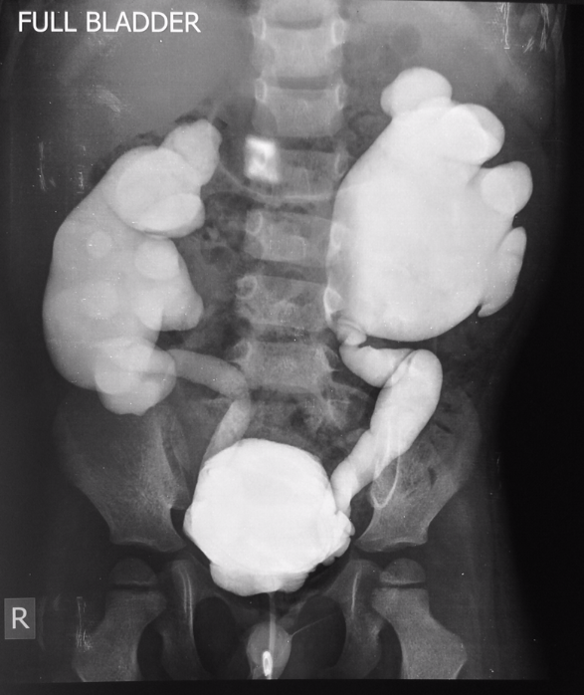

Slide 27
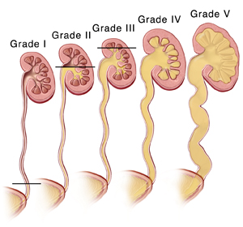
VUR is classified into 5 grades depending on the severity of reflux and the associated dilatation of the renal system.

Slide 28
Treatment
Depends on the severity
Grades 1 & 2 resolve spontaneously.
Reflux improves by age.
General Advices:
Adequate fluid intake.
Regular voiding.
Good genital hygiene
Medical attention required in cases of:
Unexplained fever
Features of UTI

Slide 29
Medical Treatment
Low-dose antibiotics.
Regular monitoring of growth and blood pressure.
Serial follow-up US

Slide 30
Indications of Surgery
High grade reflux.
Febrile UTI in spite of prophylactic antibiotics
Surgical options include:
Endoscopic minimally invasive techniques
Reimplantation of the ureter into the bladder

Slide 31
Thank You

