Slide 1
Bacterial motility

Slide 2
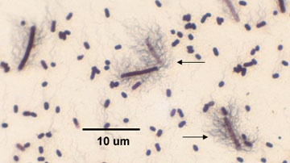
Motility:
means that microorganism change its position or move from place to place by using the major organelles of motility( flagella).
flagellum consist of protein called flagellin
Flagellum
is a rigid helical structure that can extend as much as 10 microns out from the cell .but they are very thin structures ,less than 0.2 microns, and therefore ,they are below the resolution of light microscope

Slide 3
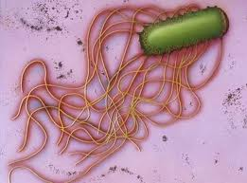
- Flagella rotate in away similar to a screw on a boat engine that rotate to propel a boat through the water.

Slide 4
Function of motility :
Increase the uptake of nutrient materials by continuous movement .
Assist the pathogenic B. by penetration and invasion.
Assist the bacteria to move away from harmful substance such as acid in a complicated process called(chemotaxis).
Motility and arrangement of flagella are useful in characterizing bacteria.

Slide 5
Classes of motile bacteria
Monotrichous (single polar flagella) e.g. Pseudomonas aeroginosa & viborio cholera
Amphitrichous (either single flagella or tuft of flagella at 2 poles e.g. Pseudomonas spp .
Peritrichous (many flagella surrounded body cell) e.g. Salmonella typhi & Proteus spp .
Lophotrichous (tuft of flagella at one pole of the cell) e.g. Spirillum spp .
tuft

Slide 6
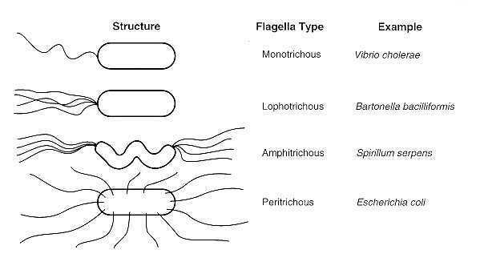
The pattern of flagellation is an important feature in identification of motile bacteria.

Slide 7
bacteria possess two kinds of movement
True movement .
Brownian movement : Its an oscillatory movement which possessed by all small bodies suspended in fluid whether living or not.

Slide 8
Motility testing
Motility could be detected by:
Flagellar stain.
Hanging Drop technique.
Semi-Solid media Inoculation.

Slide 9
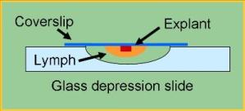
Hanging drop method Procedure :
By using concave slide if available, other wise ordinary slide will do .
By means of stick dipped in vaseline, a ring or a square (according to the shape of the cove slip) is out lined .
With a wire loop, place a drop of broth containing bacteria on a cover slip, take care to avoid contamination of culture by open the mouth of the tube near the flame .

Slide 10
Invert the slide over the cover slip
Place the slide on the microscope stage with the condenser slightly down .
With the lower power, focus the edge of the drop so that it appears across the center of the field .
Turn the high power objective lens in to position and the edge of the drop, obtain the best illumination by lowering or raising the condenser .

Slide 12
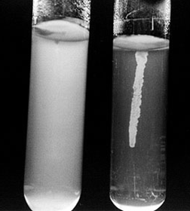
Semi solid media
Materials :
Semi solid nutrient agar .
Young culture of motile bacteria & non motile bacteria .
Inoculating wire

Slide 14
Thank you

