Slide 1
Management of SLE

Slide 2
Investigations
Antibody | Antigen/epitope | Prevalence (%) | Clinical and other associations
Intracellular
DNA | dsDNA (ssDNA) | 40–90 | present in renal eluates. Pathogenic cross-reactions: LAMP/glomerular heparin sulfate
Histone | H1, 2A, 2B, 3, 4 | 30–80 | Drug induced lupus
Sm | A, B/B′ | Overall ~35 | SLE specific Afro-Caribbean
U1RNP | ribonucleoprotein | 20–35 | Mild disease
Ro/SS-A | protein bound to cytoplasmic RNA ) | 25–40 | Renal involvement

Slide 3
Antibody | Antigen epitope | Prevalence (%) | Clinical and other associations
Intracellular (Cont.)
La/SS-B |  | 10–15 | Secondary Sjogren’s (2° SS)
Heatshock proteins |  | 40 | IgM > IgG
Cell membrane
Cardiolipin | Phospholipids DNA |  | Recurrent abortion Thrombosis
Red cell Platelet | Non-Rh related |  | Haemolytic anaemia ITP

Slide 4
Non-pharmacological management
General measures which may be useful for patients with SLE include the avoidance of excessive sunlight.
This is particularly important in fair-skinned people since solar radiation may not only cause photosensitive rash, but also a more general flare of symptoms.
Rest as appropriate, a low-fat diet with added fish oil, and avoidance of oestrogen-containing contraceptive pills are also advised.
Vaccinations apart from 'live' vaccines in patients on greater than 10 mg prednisolone and/or immunosuppressives are safe but the use of hormone replacement in patients past the menopause is still controversial

Slide 5
Pharmacological management
Patients with SLE are treated with four main groups of drugs, often in combination. These are:
  Non-steroidal anti-inflammatory drugs (NSAIDs),
  Antimalarials
  Corticosteroids
  Cytotoxic drugs.

Slide 6
Drug therapy in systemic lupus
 | NSAID | Antimalarial | Corticosteroids | Cytotoxic agents
Malaise | + | + | + | −
Fever | + | − | + | −
Serositis | + | − | + | −
Arthralgia | + | + | + | −
Arthritis | + | + | + | +
Myalgia | + | + | + | −
Myositis | − | − | + | +
Malar/discoid rash | − | + | + | −
Pneumonitis | − | − | + | +
Carditis | − | − | + | +
Vasculitis | − | − | + | +

Slide 7
Drug therapy in systemic lupus
 | NSAID | Antimalarial | Corticosteroids | Cytotoxic agents
CNS disease | − | − | ? ª | ?
Renal | − | − | + | +
Haemolytic anaemia | − | − | + | +
Thrombocytopaenia | − | − | + | +
Raynaud's | − | − | ? | ?
Alopecia | − | − | ? | ?
ª Widely prescribed but doubts remain that steroids are beneficial in many cases.
Note: + = usually beneficial; − = not beneficial; ? = dubious/controversial.

Slide 8
Recommendations for drug usage in lupus
Arthralgia
Non-steroidal anti-inflammatory drugs
No special recommendations
Myalgia& Lethargy
Hydroxychloroquine
Start 400 mg/day for 3–4 months then reduce to 200 mg/day for 3–4 months, then to 200 mg five times week for 3–4 months;repeat courses may be necessary and retinal checks every 6–9 months are generally recommended

Slide 9
Recommendations for drug usage in lupus
Arthritis, Pleuritis, Pericarditis
Prednisolone 20–40 mg per day initially for 2–4 weeks, reducing in 5–10 mg increments per week, if patient is responding; treatment is likely to be required for several months
Autoimmune haemolytic anaemia/thrombocytopaenia
Prednisolone often accompanied by azathioprine. 60–80 mg prednisolone for 1–2 weeks reducing in 10 mg increments in response to the blood test results; aim for 2.5–3 mg/kg azathioprine; treatment will last for several months

Slide 10
Recommendations for drug usage in lupus
Renal
Prednisolone plus azathioprine or cyclophosphamide
Central nervous system
Prednisolone plus an appropriate drug, e.g. an antidepressant, anticonvulsant, etc.
Depending upon the severity of the renal lesion, anything from 30–80 mg/day is required; cyclophosphamide can be given by intravenous boluses (750 mg–1 g) monthly for 6 months, then every 3 months for 2 years; some groups prefer prednisolone and azathioprine at 2–3 mg/kg in the first instance; treatment is likely to be required for several years
Controversial—but 20–100 mg prednisolone have been prescribed (sometimes accompanied by azathioprine or intravenous cyclophosphamide pulses); treatment is likely to be required for months

Slide 11
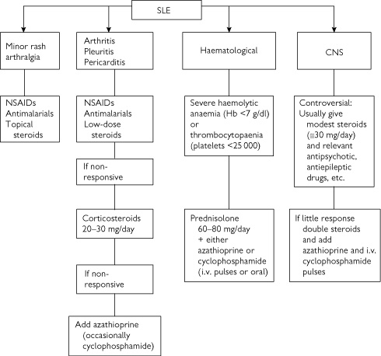

Slide 12
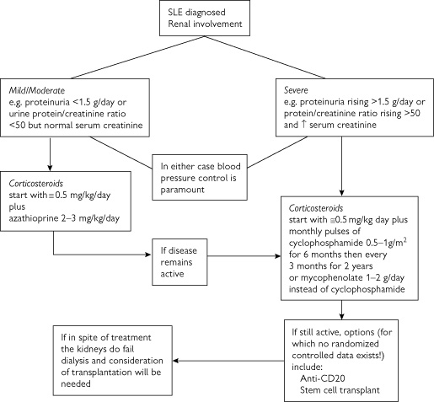

Slide 13
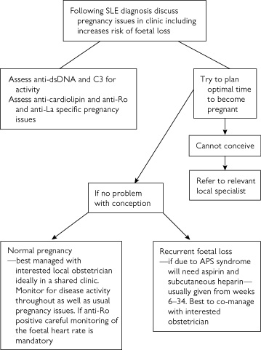
Management in special situations-Pregnancy

Slide 14
Prognosis and survival
Studies on duration of disease and overall survival rates have frequently been confounded by the numbers of patients lost to follow-up and inadequate attention paid to the ethnic group, age of onset, and socio-economic status of individual patients.
With these possible confounding factors in mind, and the division of lupus patients into those with overt nephritis and those without, it is reasonable to state that the five year survival in lupus is presently 90 per cent or greater,

Slide 15
but at 15 years only 60 per cent of those with nephritis will still be alive compared to around 85 per cent of those without nephritis.
In the United States, it has been claimed that black lupus patients, males, those from poorer socio-economic groups and possibly children, have poorer survival, especially if nephritis is present.

Slide 16
Prognosis and survival
It has also been suggested that there exists a bimodal mortality curve.
Patients who die within 5 years usually have very active disease, with a requirement for substantial doses of steroids and other immunosuppressives.
Those patients dying much later tend to do so from cardiovascular disease and possibly infection. Overall, most lupus patients die from active generalized disease, malignancy, sepsis, nephritis, and cardiovascular disease.

