Slide 1
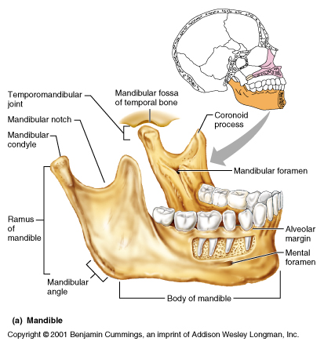
Anatomical landmarks of the Mandible and mandibular arch

Slide 2
Mandibular anatomical land marks
Supporting structures
Residual alveolar ridge
Buccal shelf area
Mental foramen
Mylohyoid ridge
Genial tubercles
Torus mandibularis
Limiting or peripheral structures
Labial frenum
Labial vestibule
Buccal frenum
Buccal vestibule
Lingual frenum
Retromolar pad area

Slide 3
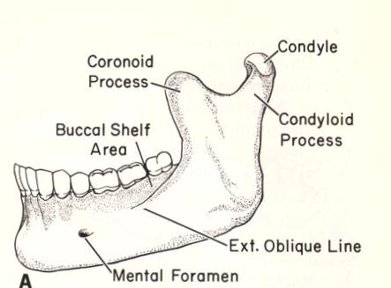
The important external surface landmarks of the mandible are:
Mental Protuberance. A roughly triangular prominence occurring in the midline near the inferior border of the mandible (chin point).
Mental Foramen. The anterior opening of the mandibular canal.
The foramen is usually found between and slightly below the first and second bicuspid root tips.
The inferior alveolar nerve passes within the mandibular canal and exits onto the exterior surface of the mandible through the mental foramen to become the mental nerve.
Compression of the mental nerve by artificial dental replacements must be avoided. It causes a feeling of pain or numbness.

Slide 4
External Oblique Ridge (Line). The external oblique ridge extends at an oblique angle across the external surface of the body of the mandible.
This ridge begins at the lower anterior edge of the ramus, continues onto the body, and progressively thins out to end near the mental foramen.
The external oblique ridge is most prominent in the molar area and forms a distinct ledge with relation to the base of the alveolar process. This ledge is called the buccal shelf.

Slide 5
The significant internal landmarks of the mandible
Mylohyoid Ridge. Located on the internal surface of the mandible, the mylohyoid ridge occupies a position similar to the external oblique ridge on the external surface. The mylohyoid ridge passes forward and downward from the internal aspects of the ramus onto the body of the mandible and fades out near the midline. This ridge serves as the lateral line of origin for the mylohyoid muscle (the mylohyoid muscle forms the major portion of the floor of the mouth).
Genial Tubercles. Slightly above the lower border of the mandible in the midline, the bone is elevated to a more or less sharply defined prominence forming the genial tubercles.

Slide 6
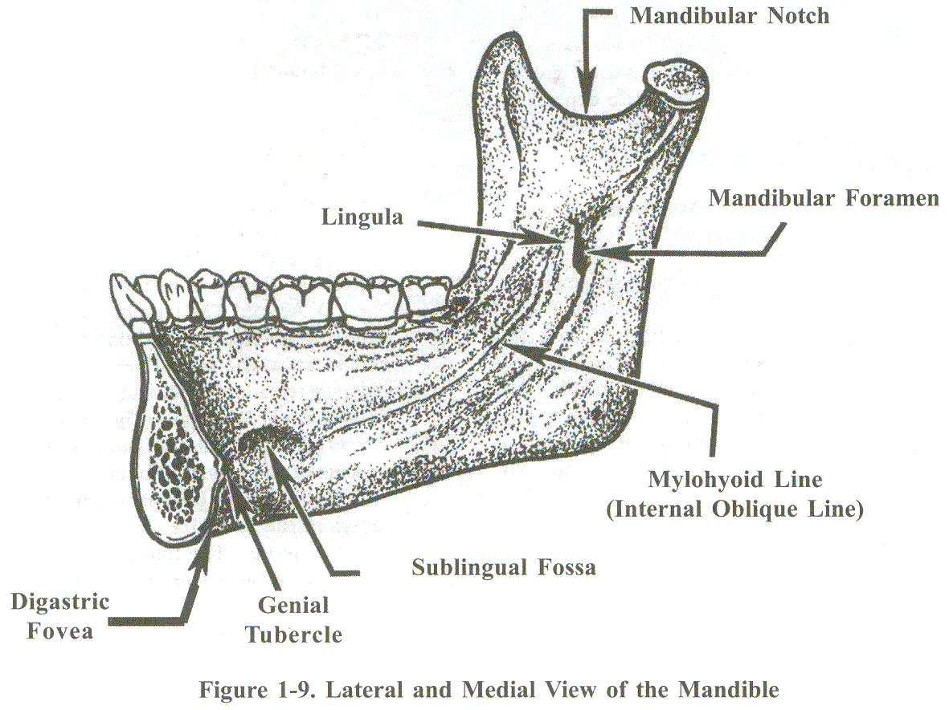
Sublingual Fossa. A shallow concavity which houses a portion of the sublingual gland, this depression occurs just above the anterior part of the mylohyoid ridge.
Mandibular Foramen. The foramen is located in almost the exact center of the inner surface of the mandibular ramus. It opens into the mandibular canal.
Lingula. A bony prominence on the anterior border of the mandibular foramen.
Digastric Fovea. A depression found on both sides of the midline near the inferior lingual border of the mandible.

Slide 7
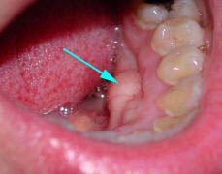
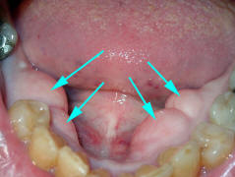
Torus mandibularis
is a bony growth in the mandible along the surface nearest to the tongue. Mandibular tori are usually present near the premolars and above the location of the mylohyoid muscle's attachment to the mandible.

Slide 8
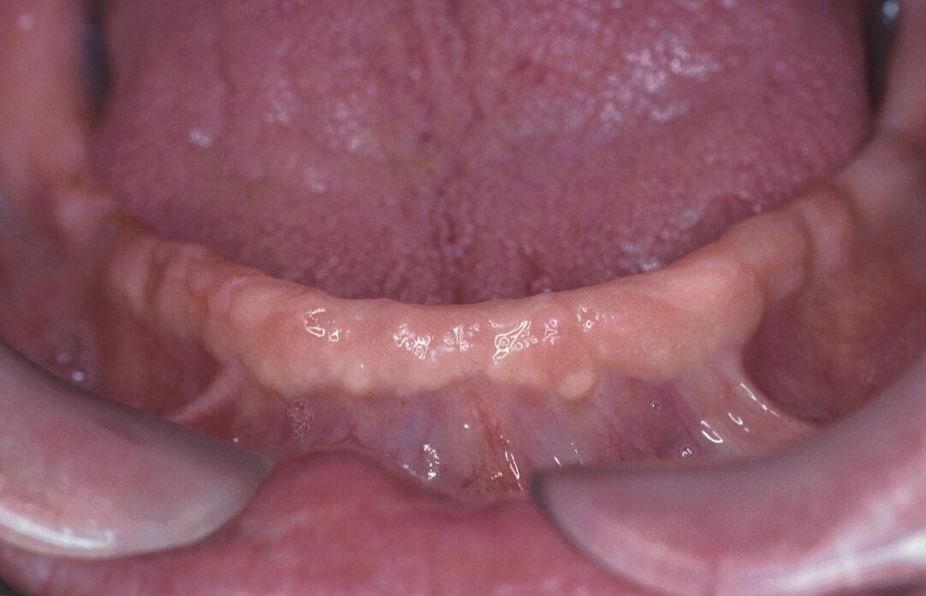
¨ Alveolar Process
The alveolar process is the process of the mandible that surrounds the roots of the natural teeth.
The right and left alveolar processes combine to form the mandibular arch.
After natural teeth are extracted, the remnant of the alveolar process is called the alveolar or residual ridge.
As time goes on, a residual ridge usually resorbs (gets smaller).

Slide 9
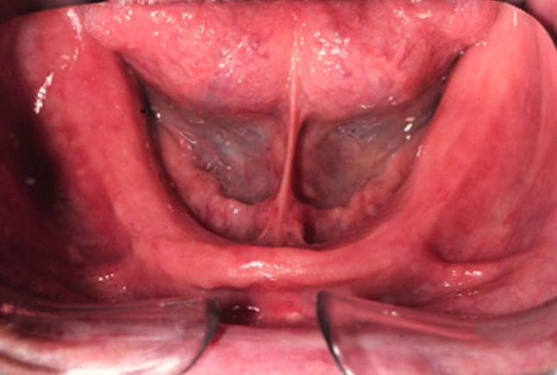
¨ Buccal Shelf
The buccal shelf is a ledge located buccal to the base of the alveolar ridge in the bicuspid and molar regions.
Laterally, the shelf extends from the alveolar ridge to the external oblique line.
The buccal shelf is a support area for a mandibular denture, especially when the remaining alveolar ridge is relatively small.

Slide 10
¨ Mental Foramen
As described previously, the mental foramen is a hole in bone ordinarily found on the buccal surface of the alveolar ridge. It is located between and slightly below the root tips of the first and second bicuspid teeth. There is no tissue bump over the hole as in the case of the incisive foramen.
When resorption of the alveolar ridge is drastic, the mental foramen is found below the oral mucosa on the crest of the alveolar process. In these cases, relief of the denture is necessary to avoid excessive pressure on the nerve fibers which exit from this foramen, compression results in loss of feeling in the lower lip.
Relief in this case is defined as space provided between the under surface of the denture and the soft tissue to reduce or eliminate pressure on certain anatomical structures.

Slide 11
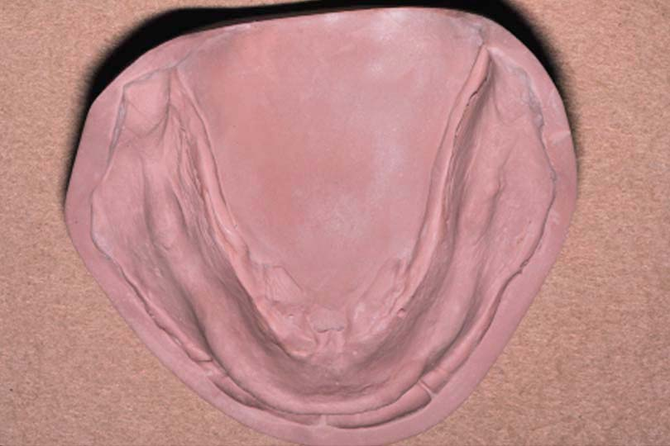
¨ Retromolar Pad
A pear-shaped mass of soft tissue located at the posterior end of the mandibular alveolar ridge.

Slide 12
The retromolar pads are important for these reasons:
When maxillary and mandibular natural teeth are brought together, a plane of contact automatically forms between the occlusal surfaces of the upper and lower teeth (occlusal plane).
When this plane of contact is projected posteriorly, it intersects with the mandible at two points; one point is on each side of the arch. These points are about two-thirds of the way up the height of the retromolar pads. The position of the pads remains constant, even after the natural teeth are extracted.
These facts ensure that the pads are an excellent guide for determining and setting the plane of occlusion between upper and lower denture teeth.
The pads serve as bilateral, distal support for a mandibular denture. Covering the pads with the denture base helps reduce the rate of alveolar ridge resorption.

Slide 13
¨ Frena
The labial and buccal frena of the mandible are in corresponding positions to their counterparts in the upper jaw. Also, a lingual frenum can be seen in the floor of the mouth when the tongue is raised. The lingual frenum is present in the approximate midline and extends from the floor of the mouth to the lingual surface of the alveolar ridge.
¨ Sulci
Labial Sulcus. The labial sulcus of the lower jaw lies at the base of the alveolar ridge between labial and buccal frena.
Buccal Sulcus. The buccal sulcus extends posteriorly from the buccal frenum to the buccal aspect of the retromolar pad.
Lingual Sulcus. The lingual sulcus is the groove formed by the floor of the mouth as it turns up onto the lingual aspect of the alveolar ridge.
Sulci rise and fall with facial expressions and tongue movements.

Slide 14
Lingual frenum
It form the anterior attachment of tongue, it may exist as either abroad band of T or V - shape attachment, it may be close to the crest of alveolar ridge specially in sever resorption so interfere with denture retention ,relief must made, but if its attachment is low ,it is desirable to extend denture boarder posteriorly at this area.

Slide 15
¨ Floor of the Mouth
The anterior two-thirds of the floor of the mouth is formed by the union of the right and left mylohyoid muscles in the midline.
The depth of the floor of the mouth in relation to the mandibular alveolar ridge constantly changes due to factors such as mylohyoid muscle contractions, tongue movements, and swallowing activities.

Slide 16
Landmarks of the lower jaw
Mylohyoid ridge
Crest of the ridge
Buccal shelf area

