Slide 1
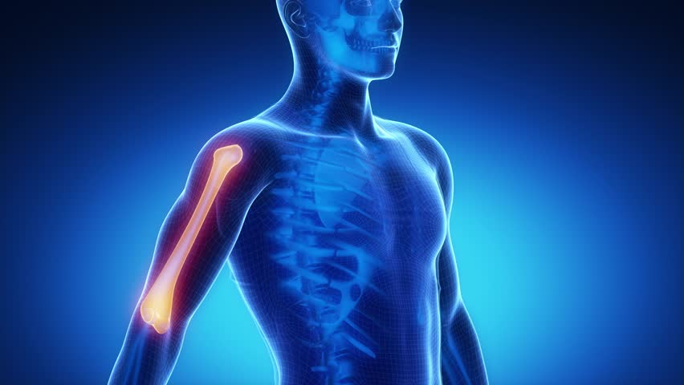
Neer classification
Fracture of proximal humerus

Slide 2
objectives
Anatomy of proximal humerus
Learn the epidemiology of proximal humeral fracture
Mechanism of injury and clinical feature
Understands the fracture patterns with majour emphasis on neer classification
Learn various treatment options
Majour complication

Slide 3
Anatomy of the humerus

Slide 4
epidemiology
5% of all fracture
Higher incidence in elderly
Female 2:1 greater incidence than male
85% are minimally or non displaced & generally treated non operative
MECHANISM OF INJURY
Low energy (most common)
Fall from a standing height
Outstretched arm
Elderly osteoprotic
High energy (young )

Slide 5
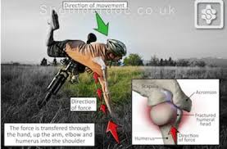
mechanism

Slide 6
Clinical feature

Slide 7
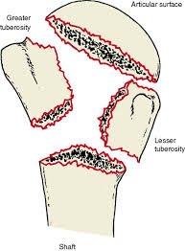
Main components off classification
Two main components
Number of fracture part
displacement

Slide 8
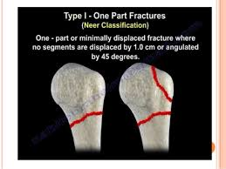
Classification
One _part fracture
Fracture lines involve 1-4parts
Non of the parts are displaced (<1cm&<45degree)
70_80% of all proximal humeral fracture

Slide 9
X RAY

Slide 10
3D CT

Slide 11
MRI

Slide 12
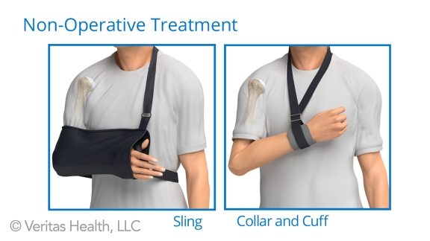
Treatment type one
Conservative

Slide 13
Two part fracture
20% of proximal humeral fracture
Fracture lines involve 2-4 parts
One part is displaced(>1cm&>45degree)

Slide 14
Types of two part fracture
Anatomical neck
Surgical neck (most common)
Greater tuberosity
Lesser tuberosity

Slide 15
X RAY

Slide 16
X RAY

Slide 17
X RAY

Slide 18
X RAY

Slide 19
CT

Slide 20
3D CT

Slide 21
TREATMENT
Close reduction (MUA&sling ) 6weeks and active exercise later if failure
Open reduction & internal fixation by percutaneous pinning plate and screws or intramedullary nailing

Slide 22
Plate and screws

Slide 23
Plate AND SCREWS

Slide 24
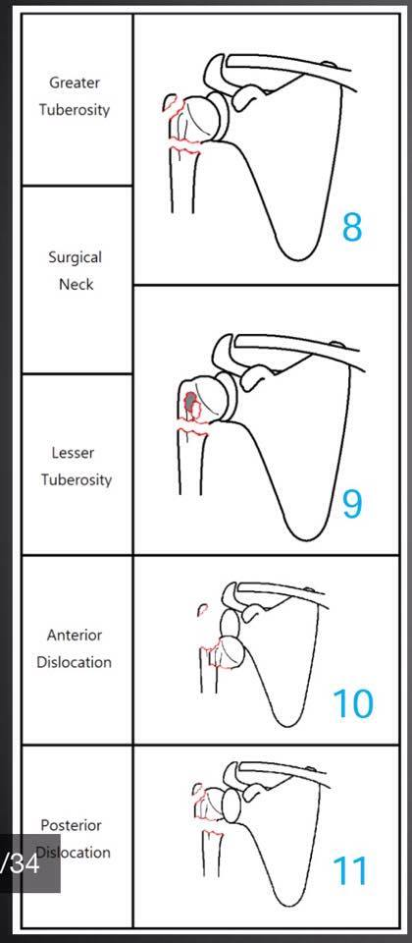
Three part fracture
Its account for 5%of proximal
Humeral fracture
Fracture line involve 3_4 part
Two part are displaced more than
1cm
Or more than 45 degrees

Slide 26
X RAY

Slide 27
X RAY

Slide 28
CT

Slide 29
TREATMENT

Slide 30
ORIF

Slide 31
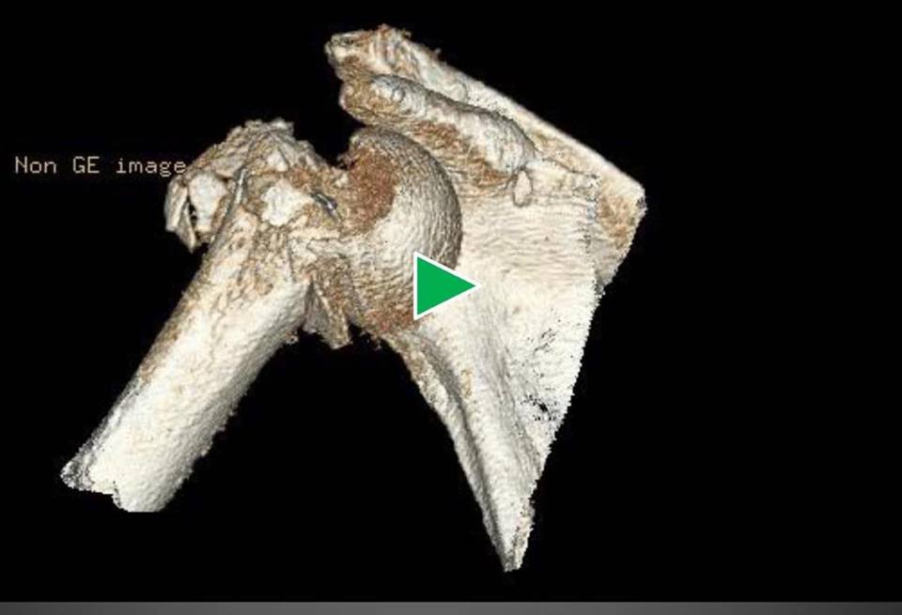
FOUR PART FRACTURE
UNCOOMMON LESS THAN 1%
Three parts are displaced
More than 1cm
Or more than 45degrees

Slide 32
X RAY

Slide 33
CT

Slide 34
TRATMENT IN YOUNG

Slide 35
ARTHROPLASTY

Slide 38
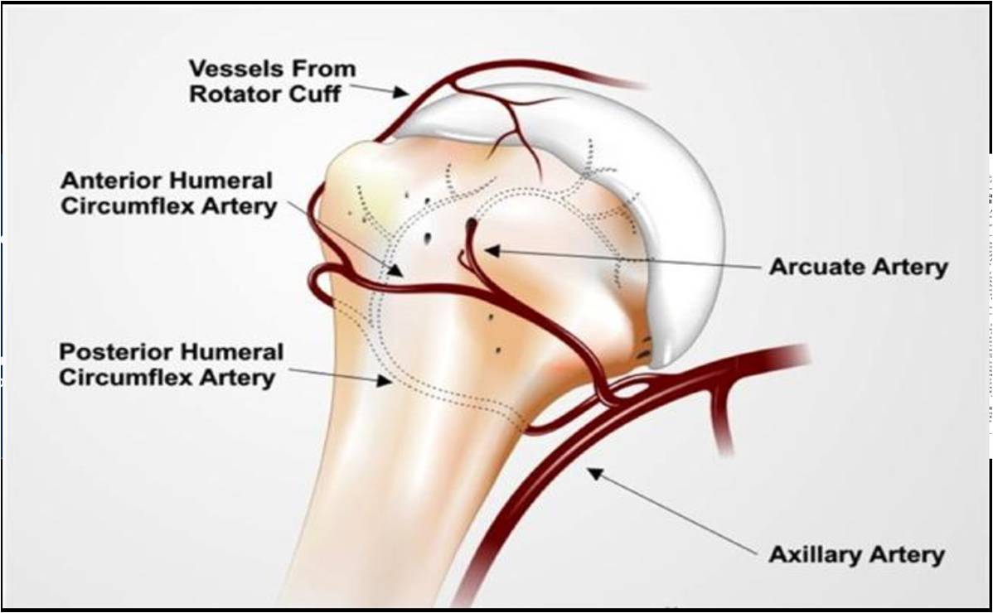
COMPLICATION
1-VASCULAR INJURY

Slide 39
2-STIFFNESS OF SHOULDER

Slide 40
3-MALUNION

Slide 42
4_AVASCULAR NECROSIS

