Slide 1
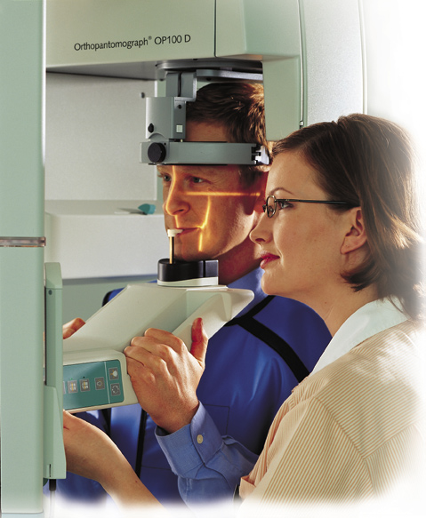
Dental Panoramic Radiography

Slide 2
Dental panoramic radiography has become a very popular radiographic technique in dentistry because:
All teeth & their supporting structures are shown in one film .
Simple technique .
The radiation dose relatively low .

Slide 3
Indication
1.Orthodontic assessment (presence & position of developing teeth) .
2.Lesion such as cysts ,tumors & developmental anomalies in the body & ramie of mandible to establish their size &site.
3.Fractures of all parts of mandible except the anterior part .
4.Investigation of maxillary antrum , to assess the floor, posterior & anterior walls .
5.Investigation of articular surface of the head of the condyle , specially if the patient with the mouth opening limitation .

Slide 4
6.Assessment of any underlying disease before construction of partial & complete denture .
7.Assessment of the presence & position of wisdom teeth .
8.Evaluation of vertical height of alveolar bone before inserting implant .
9.Periodontal condition ; as an overall view of the alveolar bone level but it should be supplemented by periapical radiograph .

Slide 5
Equipment :
X-ray tube head : produce narrow fan-shape x-ray beam angled upward at 8 degree.( narrow x-ray beam emerges from the collimator minimize patient exposure to the radiation).
A cassette & its carrier. (Rare earth screens require less x-ray exposure than calcium tungestate screen & are considered faster).
Patient–positioning apparatus include light beam marker.

Slide 6
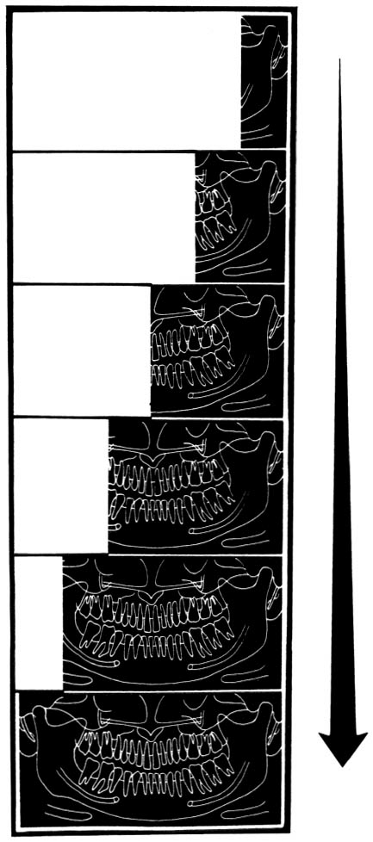
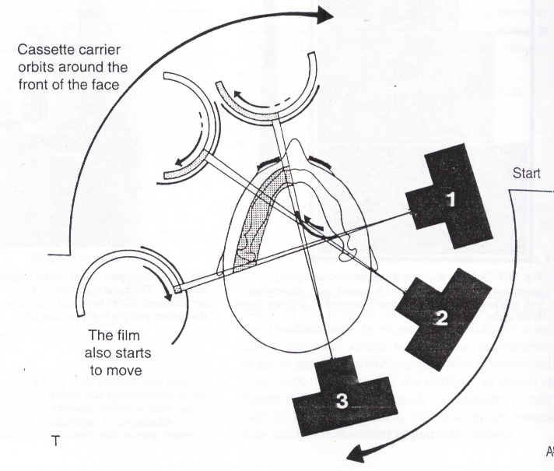
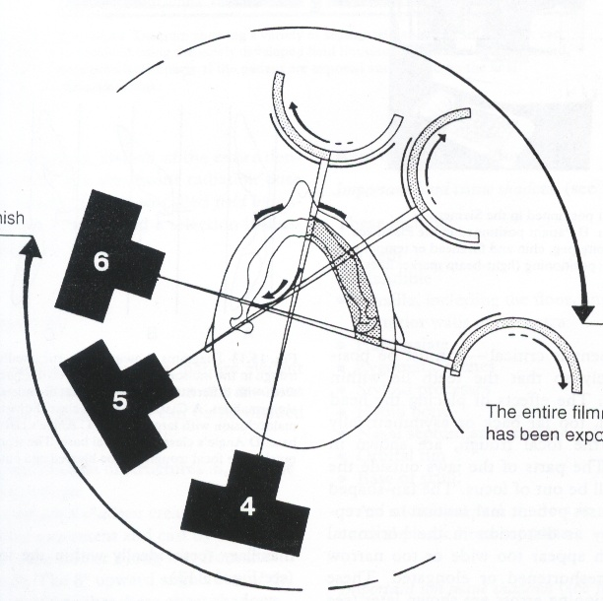
Theory of panoramic radiography

Slide 7
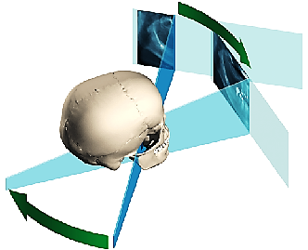
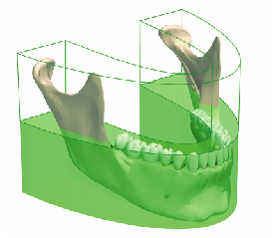
Focal trough or Image Layer
Panoramic Theory
Panoramic radiography is a modified type of tomography or image layer radiography. The patient’s dental arch must be positioned within a narrow zone of sharp focus known as the “focal trough”/imaging plane.

Slide 8
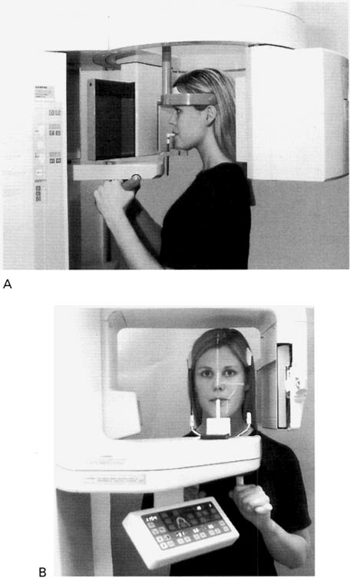
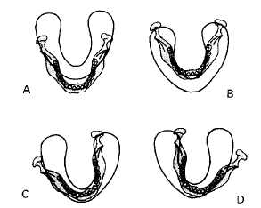
Patient Positioning:
Most panoramic machines offer positioning guides such as lights or plastic guides to position the patient along three major axes:
Anterior-posterior or canine/corner (too far forward or back).
Vertically (alartragus, Frankfort plane, or cantho-meatal lines),
Midsagittal alignment (patient twisted or rotated).

Slide 9
:The Basic Steps
1. Set exposure factors, if required.
2. The patient should remove jewelry.
3. The patient should bite on bite rod.
4. Adjust the:
a. Chin tilt with the Frankfort light.
b. Head rotation with the mid-sagittal light.
c. Forward/backward head position with the canine light.
5. Position the side guides or head support.
6. The patient stand up straight, place the tongue on roof of the mouth, and hold still.
8. X-ray

Slide 10
In a good panoramic radiograph:
The mandible is “U” shaped.
The condyles are positioned about equal distance from the inside edges of the image and 1⁄3 of the way down from the top edge of the image.
The occlusal plane exhibits a slight curve or “smile line,” upwards.
The roots of the maxillary and mandibular anterior teeth are readily visible with minimal distortion.
Magnification is equal on both sides of the midline.

Slide 11
Normal anatomy
The normal anatomical shadows can be subdivided into:
True or actual image of structures in, or close to the focal trough.
Ghost images created by the tomographic movement and cast by structures on the opposite side or a long way from the focal trough. The 8° upward angulation of these ghost shadows appear at a higher level than the structures that have caused them.
Double images: structures that are scanned twice by the rotating X-ray beam.

Slide 12
Important hard tissue images):)True or actual images
These include:
• Teeth.
• Mandible.
• Maxilla, including the floor, medial and posterior walls of the antra.
• Hard palate.
• Zygomatic arches.
• Styloid processes.
• Hyoid bone.
• Nasal septum and conchae.
• Orbital rim.
• Base of skull.
Important soft tissue images
• Ear lobes
• Nasal cartilages
• Soft palate
• Dorsum of tongue
• Lips and cheeks
• Nasolabial folds.
Air images
• Mouth/oral opening
• Oropharynx.
Ghost images
:The more important ghost shadows
• Cervical vertebrae.
• Body, angle and ramus of the contralateral side
of the mandible
• Palate.
Double images
( hyoid bone, the hard palate, epiglottis).

Slide 13
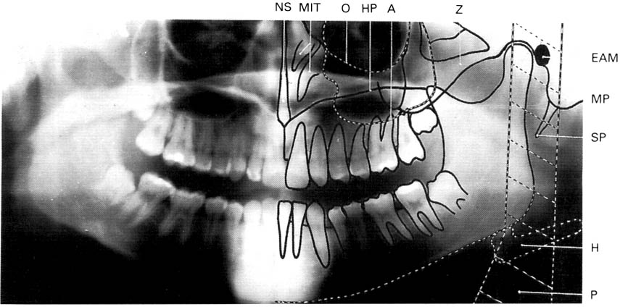
A dental panoramic tomograph showing the main real hard tissue shadows, including the plastic head support, drawn in on one side of the radiograph, NS — nasal septum,
MIT — middle and inferior turbinates, O — orbital margin, HP — hard palate, A — floor of antrum, Z — zygomatic arch, EAM — external auditory meatus, MP — mastoid process,
SP — styloid process, H — hyoid, P — plastic head support.

Slide 14
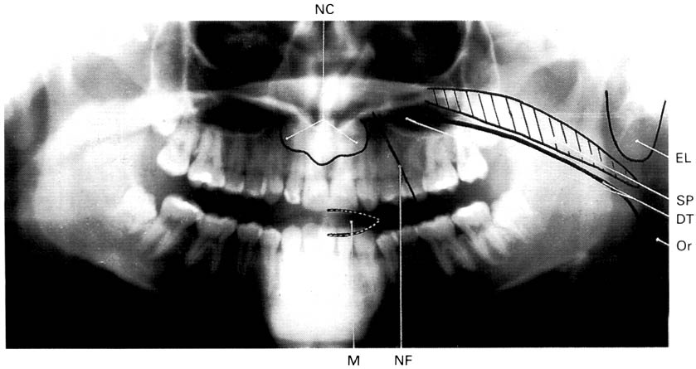
A dental panoramic tomograph showing the main real soft tissue and air shadows drawn in on
one side of the radiograph, NC — nasal cartilages, EL — ear lobe, SP — soft palate,
DT — dorsum of tongue, Or — oropharnyx, NF — naso-labial fold, M — mouth.

Slide 15
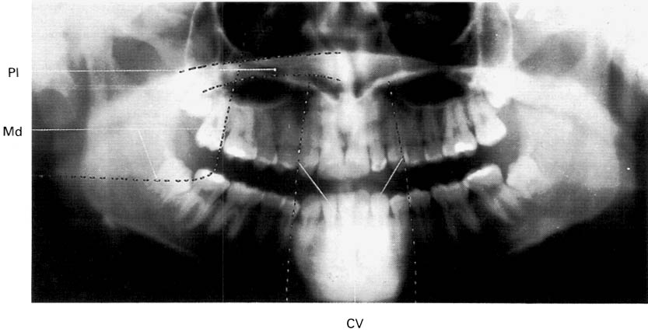
A dental panoramic tomograph showing the main anatomical ghost or artefactual shadows drawn in on one side of the radiograph, PI — palate, Md — mandible, CV — cervical vertebrae.

Slide 16
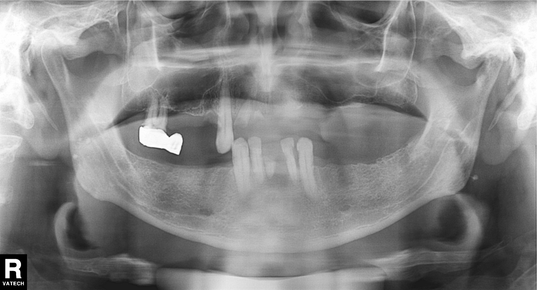
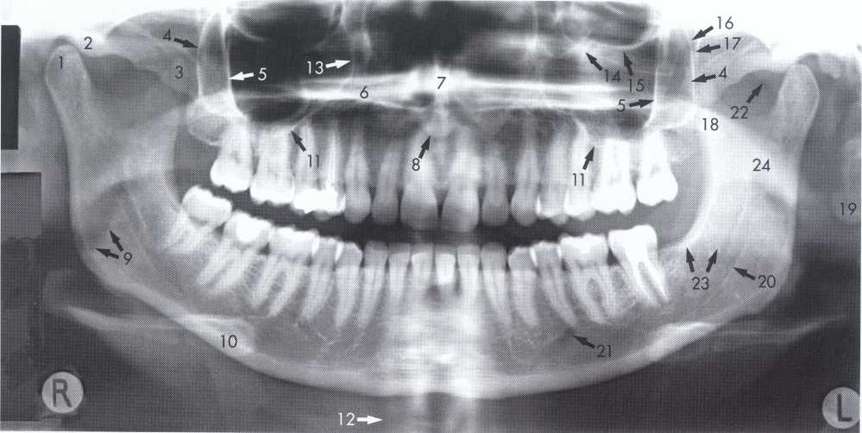

Slide 17
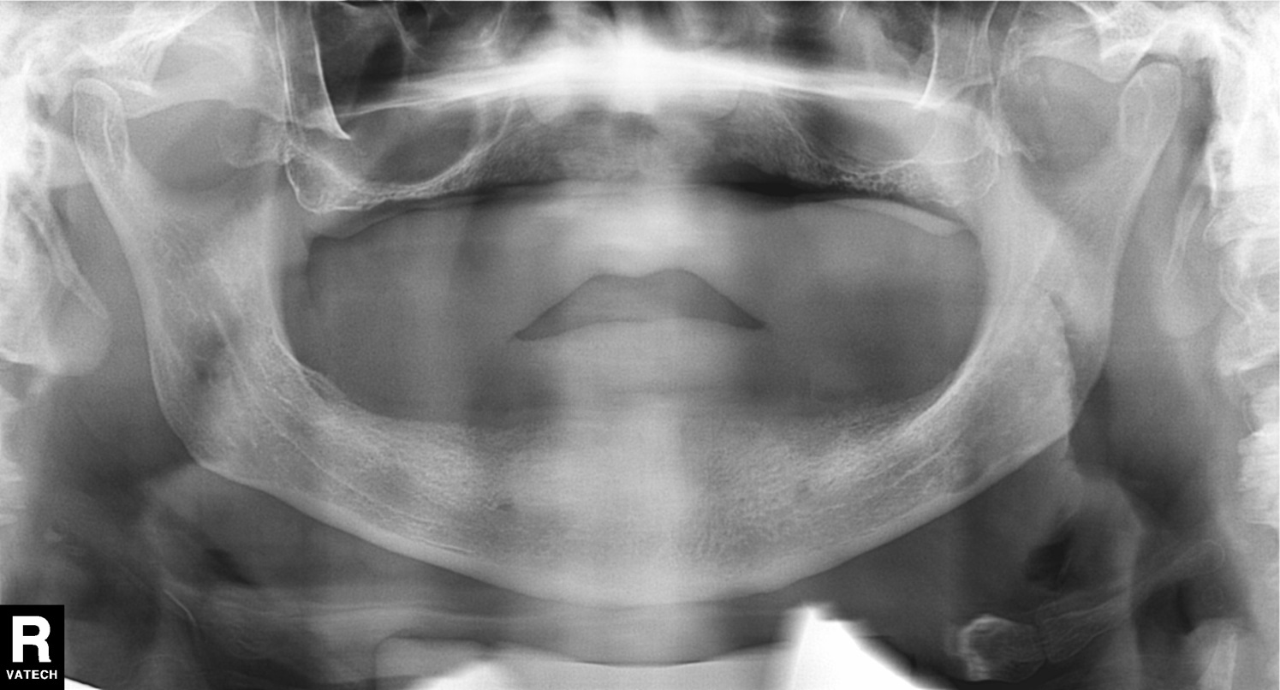
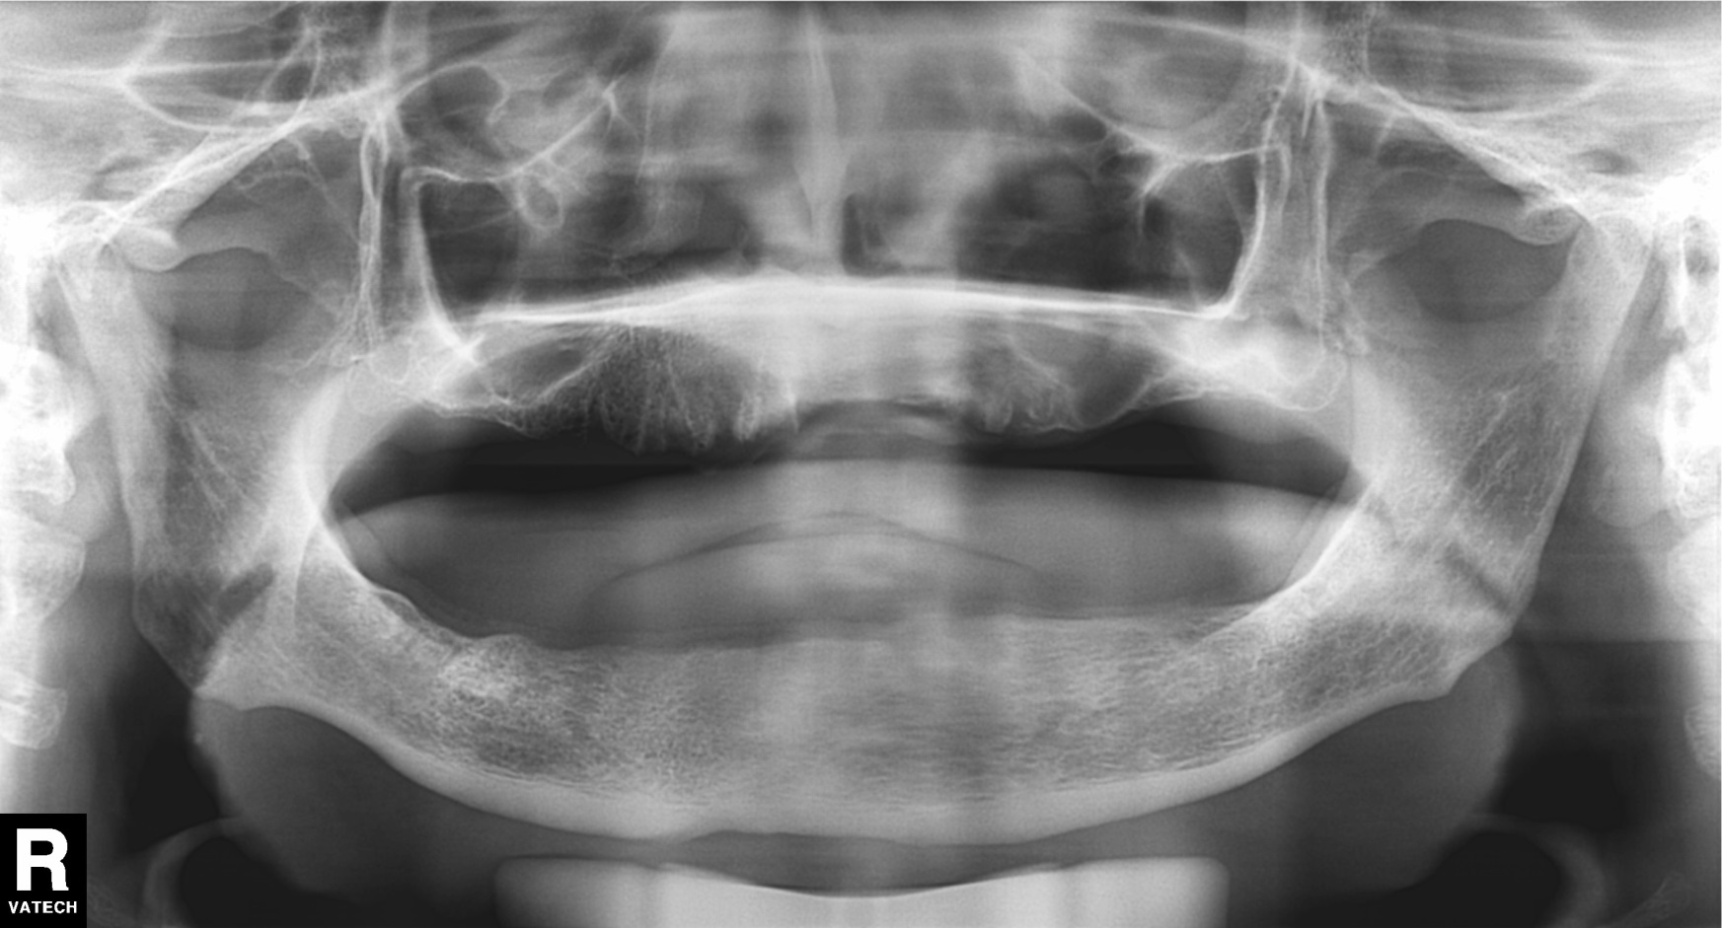

Slide 18
Errors

Slide 19
Step 1: Setting Exposure Factors
Hints | How to Correct | Cause | Problem
Do not confuse with fogging (film), which is an overall grayness | Increase mA or kVp or use next higher setting on machine | Too little exposure | Light, pale image with few dark areas
 | Decrease machine settings | Too much exposure | Dark image with loss of details, amalgams and unex posed areas are still clear

Slide 21
Step 2: Have Patient Remove Jewelry, Place Lead Apron on Patient
Hints | How to Correct | Cause | Problem
Watch out for necklaces | Remove prior to exposure | Ghosts of metal jewelry | White opacities on image; little or no image is visible
Image is projected high onto palate instead of floor of mouth | Remove prior to exposure | Tongue bar | White opacity in palate
 | Watch for bunching at back of neck | Adjust and properly place apron | Lead apron above collar line and in X-ray beam | White opacity at bottom of image shaped like inverted “V” or “shark fin”

Slide 22
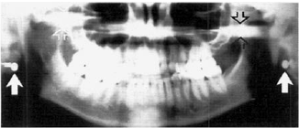
Stud earrings, real shadows (solid arrows)
with ghost shadows (open arrows).

Slide 23
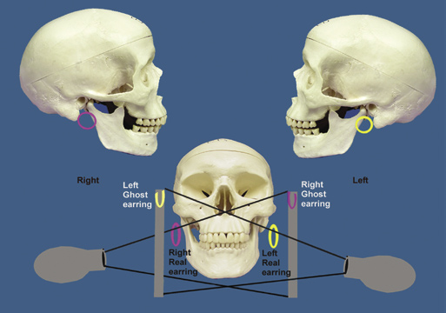

Slide 25
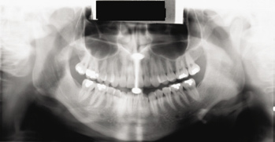
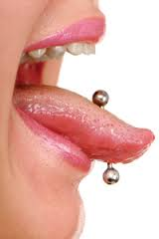
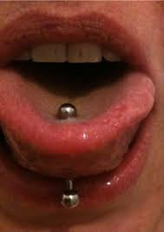
Tongue bar projected over palate

Slide 26
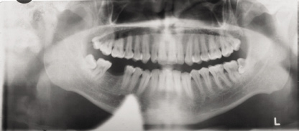
Neck collar artifact

Slide 27
A necklace

Slide 28
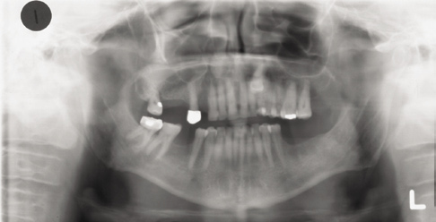
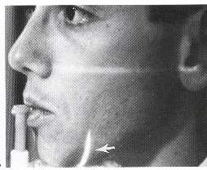
Step 3: Bite on Rod
Hints | How to Correct | Cause | Problem
Make sure mandibular incisors are in groove also, and bite rod is not being bent forward | Make sure anterior teeth are located in grooves on rod | Patient biting too far forward on bite rod | Anterior teeth blurry, too small and narrow, spine visible on sides of image
Patient too far forward; note spine superimposed over rami, blurring, and narrowing of anterior teeth

Slide 29
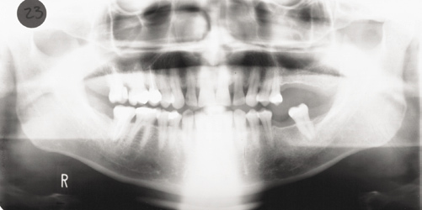
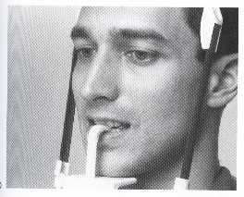
Step 3: Bite on Rod
Hints | How to Correct | Cause | Problem
If anterior teeth are missing use edentulous guide | Make sure anterior teeth are located in grooves on rod | Patient is biting too far back on rod or not at all | Anterior teeth blurry and wide, ghosting of mandible and spine, condyles close to edge of image
Patient too far back; note ghosting of mandible and spine, condyles pushed to outside of film, blurring and widening of anterior teeth

Slide 30
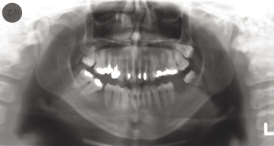
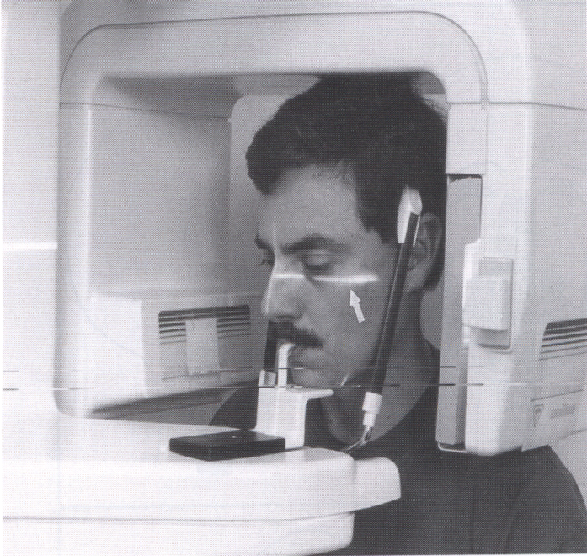
Step 4: Adjust Chin Tilt
Hints | How to Correct | Cause | Problem
Make sure patient does not have unusual occlusal plane orientation | Reposition using proper guidelines for that machine, such as ala-tragus line | Patient’s chin is tipped too far down | Roots of lower incisors blurry, mandible shaped like a “V”, too much smile line, condyles at top of image, spine forms arch
Chin tipped down; note V-shaped mandible, extreme
smile line, arching of spine at top of image, condyles placed high on film, and streaking of the hyoid bone over the mandible

Slide 31
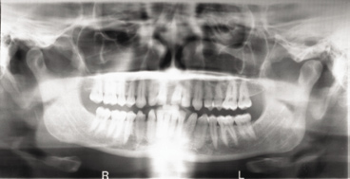
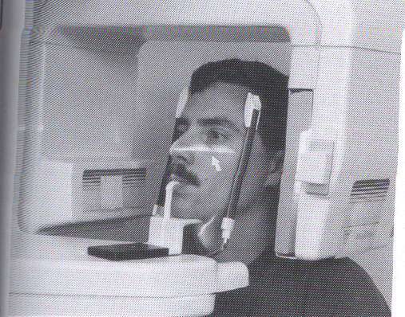
Step 4: Adjust Chin Tilt
Hints | How to Correct | Cause | Problem
Make sure bite rod remains seated in its guide | Reposition using proper guidelines for that machine such as ala-tragus line | Patient’s chin is tipped too far up | Maxillary incisors blurry, hard palate superimposed on roots, flat occlusal plane, mandible is broad and flat, condyles at edge of image
Chin up too high; note flattened occlusal plane, palate superimposed on maxillary tooth roots, and broad flat mandible

Slide 32
Step 5: Position and Close Side Guides
Hints | How to Correct | Cause | Problem
Make sure patient doesn’t try and look towards technician, but straight ahead. Always use front-surface mirror on machine to check alignment | Reposition using proper guidelines for that machine | Patient’s head is twisted in machine causing midline asymmetry | Teeth are wide on one side, narrow on other; ramus is wider on one side than the other; uneven pattern of blurring throughout arch; nasal structures not clear
Make sure patient’s head remains level through ears | Reposition using proper guidelines for that machine | Patient’s head is rotated in machine (tipped) | Condyles are not equal in height, nasal structures distorted

Slide 33
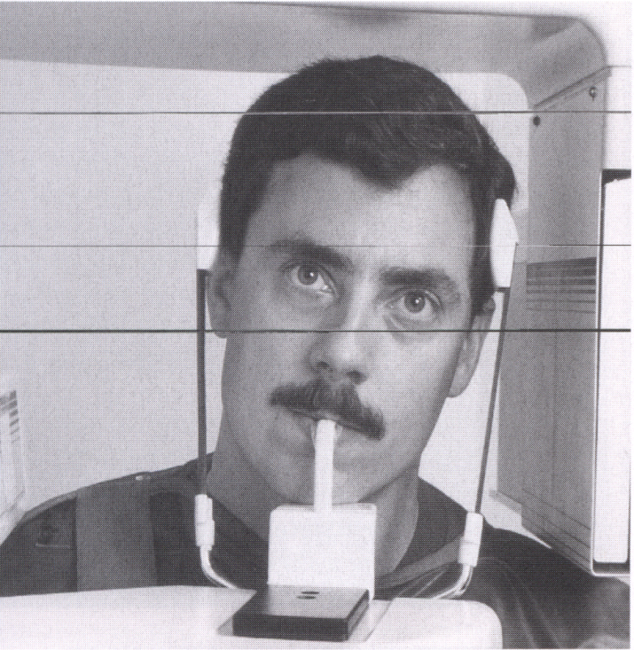
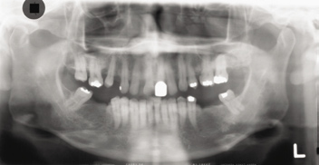
Head twisted; note uneven width of rami,
unequal magnification of teeth, and condyles

Slide 34
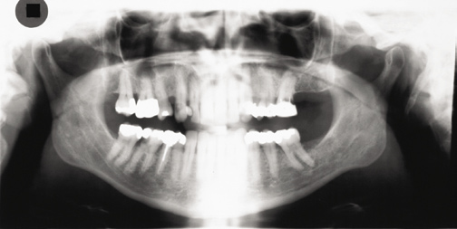
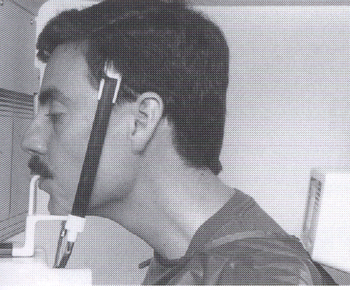
Step 6: Have Patient Stand Up Straight
Hints | How to Correct | Cause | Problem
Do not allow patient to reach forward into machine; make them step forward | Have patient take a step forward and straighten neck | Ghost of spinal column due to slumping | White tapered opacity in middle of image
Slumped; note the white spine shadow in
midline

Slide 35
Advantages:
1.Large anatomic area is imaged on one film , even when patient is unable to open his mouth .
2.The technique is easy .
3.The radiation dose is about 1/3 of the dose from a full mouth survey of intra-oral radiography .
4.Development of field limited technique with resultant dose reduction.
5.The patient position is relatively simple & minimal experience is required.

Slide 36
6.The overall view of both sides of the jaws allow rapid assessment of any underling unsuspected disease .
7.The view of both sides of the mandible on one film is useful to assessing fracture & its comfortable for injured patient.
8.Useful for initial evaluation of periodontal status & in orthodontic assessment .
9.Show the floor , anterior & posterior walls of maxillary antrum.
10.Both condylar heads are shown on one film for comparison.

Slide 37
Disadvantages
1.Structures & abnormality not in focal trough may not evident .
2.Soft tissue & air shadow can overlies the structures in the focal trough.
3.Tomographic movement & the distance between the focal trough zone & the film produce distortion & magnification ( X 1.3 ).
4.Not suitable for children below 5 years.
5.Some patient not conform the shape of focal trough & some structures will be out of focus .
6.Ghost shadow can overlies the structures in the focal trough .

Slide 38
1, Mandibular condyle. 2, Articular eminence. 3, Coronoid process of mandible superimposed on zygomatic arch. 4, Posterior wall of maxillary sinus. 5, Posterior wall of zygomatic process of maxilla. 6, Hard palate. 7, Nasal septum. 8, Tip of nose. 9, Dorsum of tongue. 10, Hyoid superimposed over inferior border of mandible. 11, Inferior border of maxillary sinus. 12, Image of cervical spine. 13, Medial border of maxillary sinus. 14, Infraorbital canal. 15, Infraorbital rim. 16, Pterygomaxillary fissure. 17, Anterior border of the pterygoid plates. 18, Lateral pterygoid plate superimposed over soft palate and coronoid process of mandible. 19, Ear lobe. 20, Inferior border of mandibular canal. 21, Mental foramen. 22, Posterior wall of nasopharynx. 23, Inferior border of mandible superimposed from opposite side. 24, Soft palate over mandibular foramen of mandible.

Slide 39
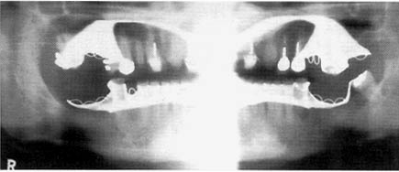

Slide 40
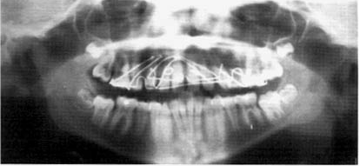
Upper orthodontic appliance

Slide 41
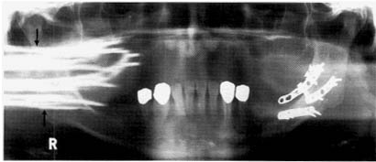
Metallic bone plates used for fixation of a fracture of the left side of the mandible

