Slide 1
تشريح نظري/ ثاني اسنان كركوك
د.سعد
18/12/2017
175
Human Anatomy
Maxillary artery

Slide 2
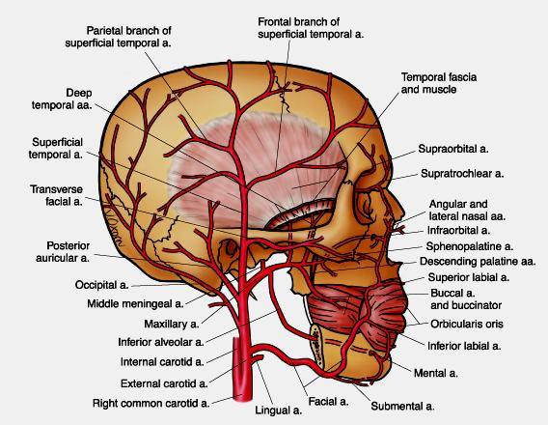
The maxillary artery is a terminal branch of the external carotid artery . It arises within the parotid gland at the level of the neck of the condyle of the mandible . It enters the infratemporal fossa between the deep surface of the condyle and the sphenomandibular ligament . At this point ,it lies below the auriculotemporal nerve and above the maxillary vein . The artery can be quite firmly adherent to the capsule of the temporomandibular joint . In the infratemporal fossa , it is closely related to the lateral pterygoid muscle .

Slide 3
The maxillary artery has many branches . It is convenient to subdivide the artery into three part :
1. First part: Before the lateral pterygoid muscle (retro mandibular part ).
2. Second part : On the lateral pterygoid muscle (pterygoid part ).
3. Third part: And in the pterygopalatine fossa (pterygopalatine part ) .
The relationship of the maxillary artery to the lateral pterygoid muscle is variable, but it runs superficial to the muscle in nearly 60% of cases.

Slide 5
First part (Before Lt. Pt. M.):
deep auricular artery
anterior tympanic artery,
The middle meningeal artery
accessory meningeal artery
inferior alveolar artery

Slide 6
First part (Before Lt. Pt. M.):
The first part of the maxillary artery has five branches and all enter bone. The first branch is the deep auricular artery, supplying the skin of the external acoustic meatus and part of the tympanic membrane . A small branch contributes to the arterial supply of the temporomandibular joint.
The second branch, the anterior tympanic artery, passes through the petrotympanic fissure to supply part of the lining of the middle ear . this is the companion artery to the chorda tympani nerve .

Slide 8
The middle meningeal artery is the main source of blood to the meninges and to the bones of the vault of the skull. The artery may arise either directly from the first part of the maxillary or from a common trunk with the inferior alveolar artery. When the maxillary artery lies superficial to the lateral pterygoid muscle, the middle meningeal artery takes a deep course in relation to the muscle it is not usually the first branch.
The middle meningeal artery ascends between the two root of the auriculotemporal nerve and leaves the infratemporal fossa through the foramen spinosum.

Slide 10
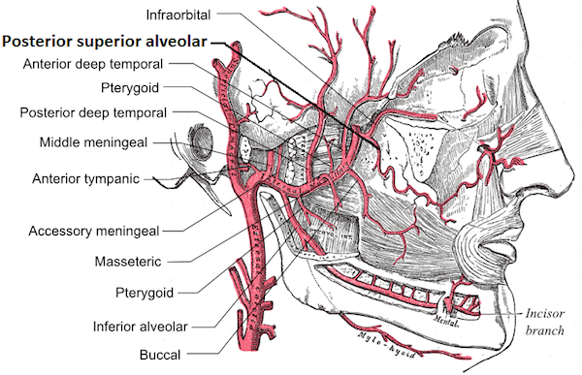
An accessory meningeal artery runs through the foramen ovale into the middle cranial fossa . This artery can arise directly from the maxillary artery or as a branch of the middle meningeal artery. In its course in the infratemporal fossa , it is closely related to the tensor and levator veli palatine muscles and usually runs deep to the mandibular nerve . although the accessory meningeal artery runs intracranially, its blood is mainly distributed extracranially to the pterygoid muscles , tensor veli palatine , the otic ganglion and to branches of the mandibular nerve .

Slide 11
The inferior alveolar artery accompanies the inferior alveolar nerve and has a similar distribution. Immediately before the inferior alveolar artery enters the mandible ( at the mandibular foramen), it gives off a mylohyoid branch. In the mandibular canal, the inferior alveolar artery usually runs lateral to the inferior alveolar nerve . the artery gives off branches supplying the teeth before terminating in mental and incisive branches . the mental artery passes through the mental foramen onto the face to supply the lower lip , chin and the labial mucosa reached to the anterior teeth. The incisive branch continues along the incisive canal to supply the anterior teeth.

Slide 13
Second part :
Muscular branches
include deep temporal arteries
pterygoid arteries and masseteric arteries
. A buccal artery
lingual branch

Slide 14
Second part :
The second part of the maxillary artery also has five branches, but they differ from those of the first part is not entering bone. Muscular branches include deep temporal arteries (anterior, middle and posterior branches), pterygoid arteries and masseteric arteries . the deep temporal arteries pass between the temporalis muscle and the pericranium, producing shallow grooves in the bone. The masseteric arteries pass through the mandibular notch to enter the muscle. They can also supply the temporomandibular joint. A buccal artery accompanies the buccal nerve to supply structures in the cheek. a small lingual branch may be given off to accompany the lingual nerve and supply structures in floor of the mouth.

Slide 16
Third part:
posterior superior alveolar artery
The infraorbital artery
anterior superior alveolar artery
artery of the pterygoid canal
pharyngeal branch
descending palatine artery
greater palatine arteries.
lesser palatine arteries.
sphenopalatine artery

Slide 17
Third part :
The maxillary artery continues from the infratemporal fossa into the pterygopalatine fossa through the pterygomaxillary fissure. It terminates within the pterygopalatine fossa , where it is called the third part of the maxillary artery. The third part of the maxillary artery gives branches that accompany the branches of the maxillary nerve ( including those associated with the pterygopalatine ganglion).
The posterior superior alveolar artery arises from the maxillary artery within the pterygopalatine fossa ( or occasionally from the infraorbital artery) and runs through the pterygopalatine fissure onto the maxillary tuberosity. It supplies the maxillary molar and premolar teeth, their buccal gingivae , and the maxillary air sinus.

Slide 19
The infraorbital artery inters the orbit through the inferior orbital fissure. It runs along the floor of the orbit in the infraorbital groove and the infraorbital canal to emerge onto the face at the infraorbital foramen . The infraorbital artery gives off the anterior superior alveolar artery within the infraorbital canal . This branch runs downwards to supply the anterior teeth and the anterior part of maxillary sinus. The infraorbital artery on the face supplies the lower eyelid, part of the cheek, the side of the external nose, and the upper lip.

Slide 21
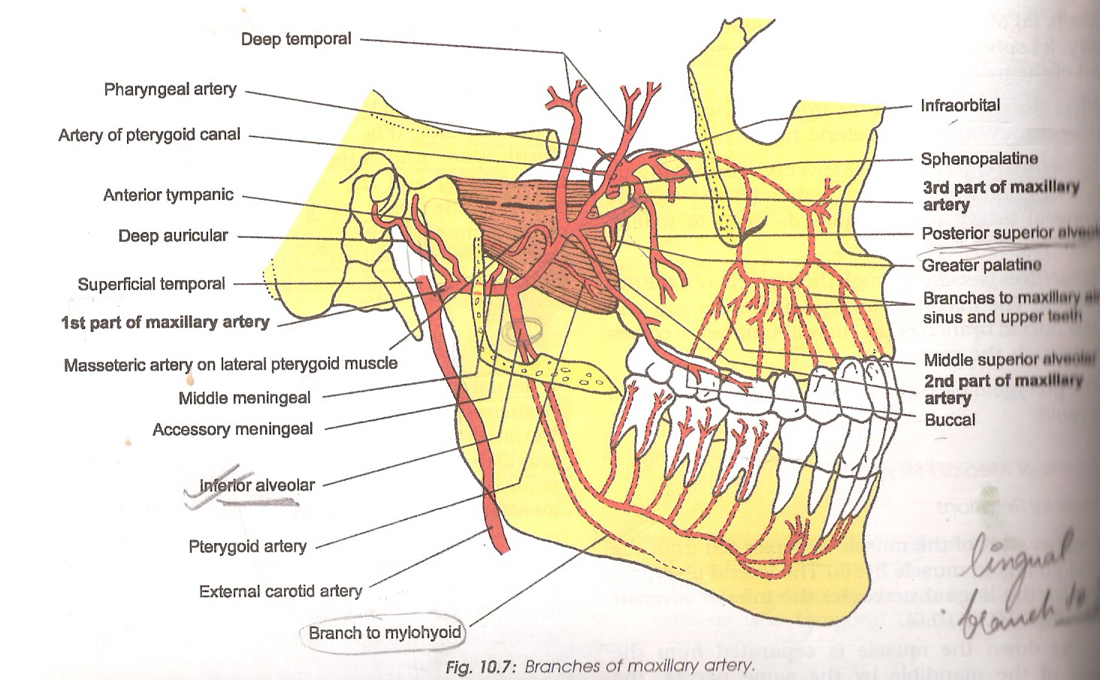
The artery of the pterygoid canal passes through the canal to provide branches to part of the auditory tube and the tympanic cavity of the ear, and the upper part of the pharynx. The maxillary artery also provides a pharyngeal branch which passes through the vomerovaginal canal to the nasopharynx .

Slide 22
The descending palatine artery leaves pterygopalatine fossa through the palatine canal within this canal , it divides into the greater and lesser palatine arteries. The greater palatine artery supplies the inferior meatus of the lateral wall of the nose before passing onto the roof of the palate at the greater palatine foramen. It runs forwards to supply the hard palate and the palatal gingivae of the maxillary teeth . it also provides a branches which runs up into the incisive canal to anastomose with sphenopalatine artery , thereby contributing to the supply of nasal septum . the lesser palatine artery ( or arteries ) emerges on the palate at the greater palatine foramen ( or formina). It supplies the soft palate.

Slide 24
The sphenopalatine artery is the last branch of the maxillary artery to be considered , arising beyond the origin of the descending palatine artery . it enters the lateral wall of the nose through the sphenopalatine foramen. The artery initially accompanies the posterior superior nasal nerve and give off branches to supply much of the posterior part of the lateral wall of the nose . The sphenopalatine artery then crosses the roof of the nose to accompany the nasopalatine nerve and to supply the posteroinferior part of the nasal septum

Slide 25
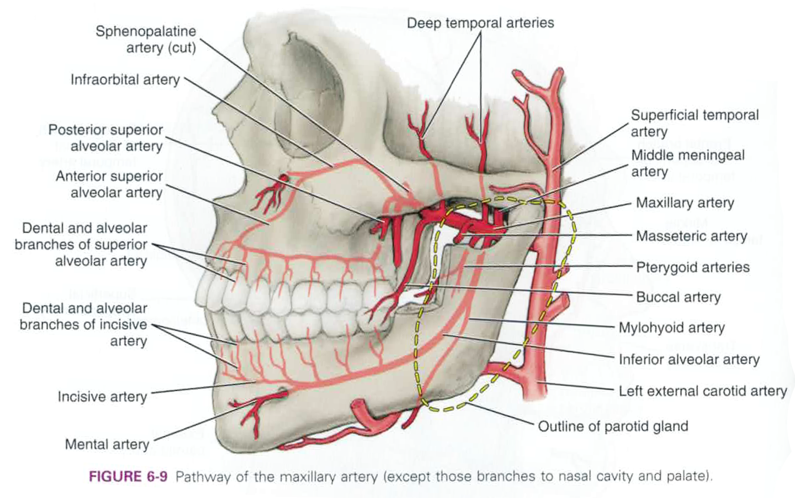

Slide 27
The pterygoid venous plexus
This is situated around , and within , the lateral pterygoid muscles and it surrounds the maxillary artery . its tributaries correspond to the various branches of the maxillary artery ( the plexus receives blood from the pterygoid muscles , the deep temporal veins, the middle meningeal veins and from parotid veins ).
The plexus communicates with the cavernous sinus , the facial vein , the inferior ophthalmic vein and the pharyngeal plexus.

Slide 29
The connections with the cavernous sinus are via emissary veins passing through the foramen ovale , foramen lacerum and , where present , the emissary sphenoidal foramen. The communication with the facial vein is via the deep facial vein which accompanies plexus through a branch passing through the inferior orbital fissure.
The pterygoid venous plexus chiefly drains posteriorly into the maxillary vein. The maxillary vein runs with the first part of the maxillary artery , passing deep to the neck of the condyle of the mandible to enter the gland. Here , it joins the superficial temporal vein to form the retro mandibular vein.

