Slide 1
Final impression objectives and materials

Slide 2
Final impression
Definition
the impression that represents the completion of the registration of the surface or object.
Objectives
To obtain an impression from which a retentive, stable and comfortable denture base can be constructed.
To record as accurately as possible the shape of the mucosa overlying the alveolar ridges and hard palate together with functional depth and width of sulci.

Slide 3
tray
Impression material
impression

Slide 4
Impression materials for complete denture:
Stock tray
Impression material
Primary impression
a) Impression compound
b) Alginate
c) Agar agar

Slide 5
Impression materials for complete denture:
Special tray
Impression material
Final impression
Zinc oxide Eugenol
plaster of paris ( impression plaster)
Elastomeric impression material (light bodied)

Slide 6
Requirements of impression material
Must be a semi-liquid material that will flow and adapt itself around the structure of interest.
It must set and harden into a solid that is rigid enough to be removed from the mouth without becoming deformed.
Copy details accurately.
Dimensional stability after removal from the mouth.
Appropriate working time.
Appropriate time to harden in the mouth (setting time).
Bio-compatibility/Aesthetic, odor/taste.
Chemically compatible with material used to pour cast.

Slide 7
Classification
By Setting Mechanism | By Application or Mechanical Properties
 | non-elastic | Elastic
Chemical reaction (irreversible) | Plaster of Paris ZOE | Alginate hydrocolloid Elastomers
Temperature changes (reversible) | Compound Wax | Agar hydrocolloid

Slide 8
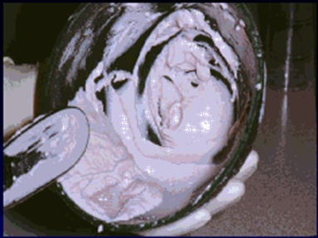
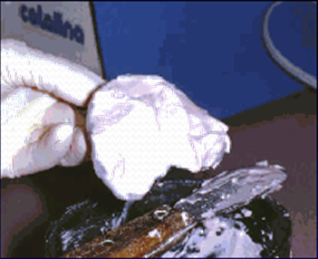
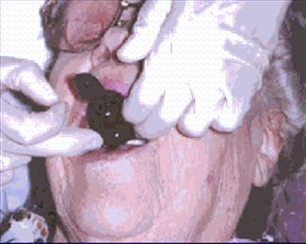
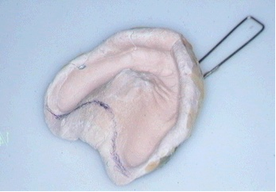
Impression plaster
Used to record final impression for completely edentulous arch.
It is similar in composition to the dental plaster used to construct models and dies.
The material is used at a higher water/powder ratio (approximately 0.60) than is normally used for modelling plasters.
The fluid mix is required to enable fine detail to be recorded in the impression and to give the material mucostatic properties.

Slide 9
Special tray is constructed using a 1–1.5 mm spacer.
Before pouring the impression, the impression must be coated with a separating agent (soap), otherwise separation of the cast is impossible.
The mixed impression material is initially very fluid and is capable of recording soft tissues in the uncompressed state.
In addition, the hemihydrate particles are capable of absorbing moisture from the surface of the oral soft tissues, allowing very intimate contact between the impression material and the tissues.
The fluidity of the material, combined with the ability to remove moisture from tissues and a minimal dimensional change on setting, results in a very accurate impression which may be difficult to remove.
The water-absorbing nature of these materials often causes patients to complain about a very dry sensation after having impressions recorded.
The material is not suitable for use in any undercut situations (rigid material).

Slide 10
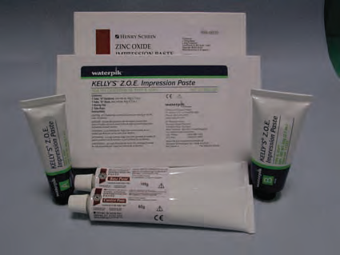
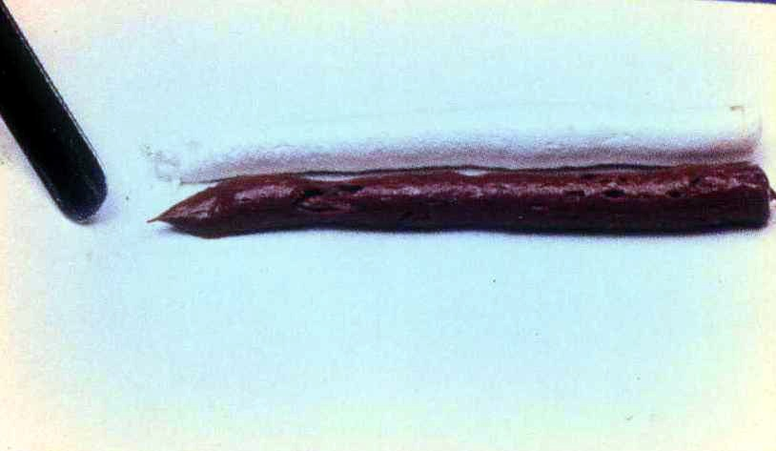
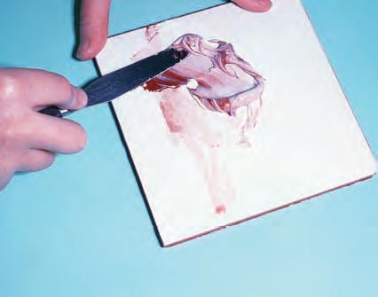
Zinc oxide/eugenol impression material
used to record the final impressions of edentulous arches.
supplied as two pastes which are mixed together on a paper pad or glass slab.
The zinc oxide paste, typically, being white and the eugenol paste, a reddish brown colour.
This enables thorough mixing to be achieved as indicated by a homogeneous colour, free of streaks, in the mixed material.
The pastes are normally dispensed from toothpaste- like tubes and are mixed in equal volumes.
The proportioning is achieved, simply, by expression equal lengths of each paste onto the mixing pad or slab.

Slide 11
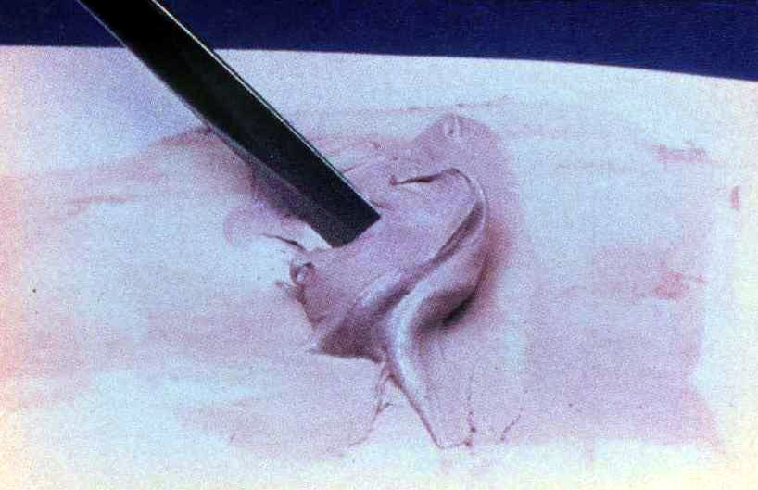
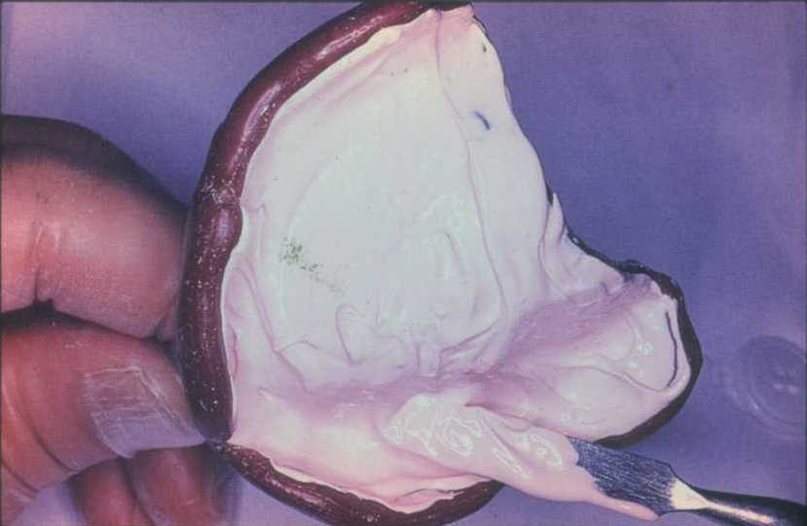
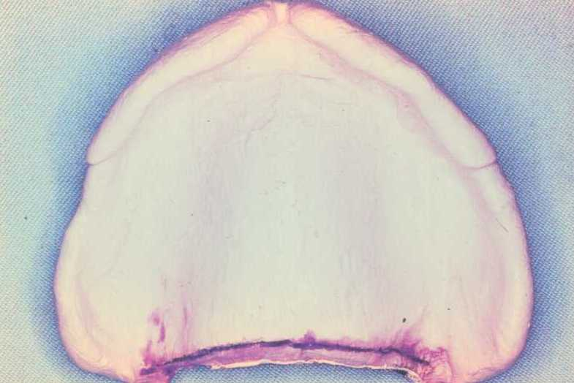
The impression is normally recorded in a close-fitting special tray, constructed on the cast obtained from the primary impression.
Defects sometimes arise on the surface of the impression but these can be corrected using an impression wax.
The material is not suitable for use in any undercut situations (rigid material).

Slide 12
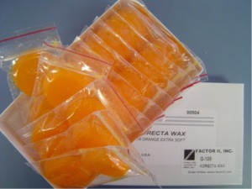
Impression waxes
Impression waxes are rarely used to record complete impressions but are normally used to correct small imperfections in other impressions, particularly those of the zinc oxide/eugenol type.
They are thermoplastic materials which flow readily at mouth temperature and are relatively soft even at room temperature.
They are applied with a brush in small quantities to ‘fill in’ areas of defect.

Slide 13
Elastomers
Often called rubber materials since they have properties similar to rubber.
Clinical uses:
Bridges
Implants
Partial dentures and complete dentures
Indirect esthetic restorations
Four types of elastomers are in general use:
• Polysulphides.
• Silicone rubbers (condensation curing type).
• Silicone rubbers (addition curing type).
• Polyethers.

Slide 14
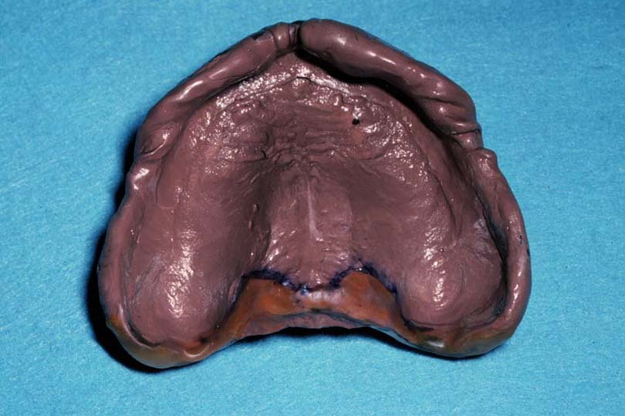
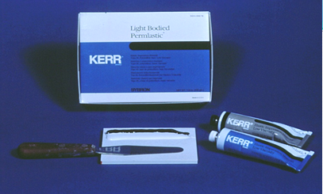
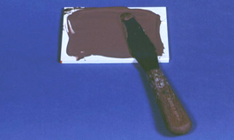
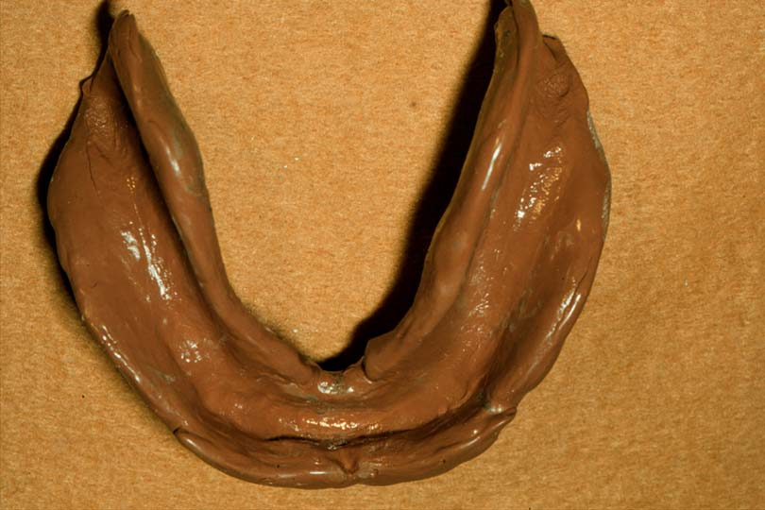
Polysulfides
These materials are generally supplied as two pastes
Setting times of 10 minutes or more particularly for light-bodied materials.
The polysulphide elastomers have very good tear resistance.
It has an unpleasant odour.
The colour contrast between the two pastes is an aid to efficient mixing, which is continued until a homogeneous colour, with no streaks, is achieved.
An adhesive is used to promote adhesion between the impression material and tray.

Slide 15
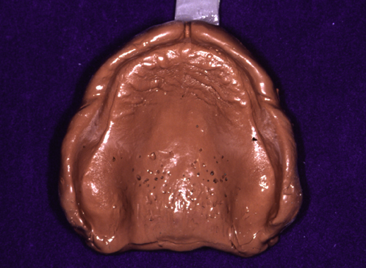
Condensation silicon
Developed as alternative to Polysulfides
Has more desirable qualities in comparison:
Easy mix
Better taste and odorless
Shorter setting time (5-7 minutes)
Proportioning of the paste/liquid materials is by mixing a given volume of paste with a fixed number of drops of liquid.
For paste/paste materials equal lengths of pastes are mixed together. A colour contrast between the pastes enables the operator to see when proper mixing has been achieved.
In order to obtain optimum accuracy, the models should be cast as soon as possible after recording the impression.

Slide 16
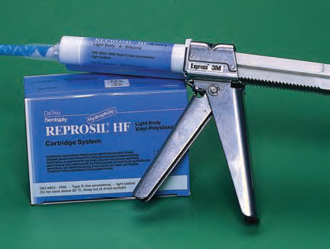
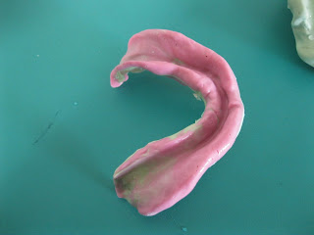
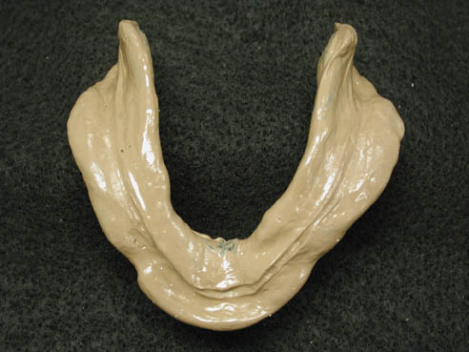
Addition silicon
Desirable clinical qualities:
Dimensional stability
Accuracy
Clean
Easy to mix
No foul odor or taste
However, they are among the most expensive
Proportioning is carried out by extruding equal lengths of each paste onto the mixing pad. A good colour contrast between the pastes enables thorough mixing to be achieved.

Slide 17
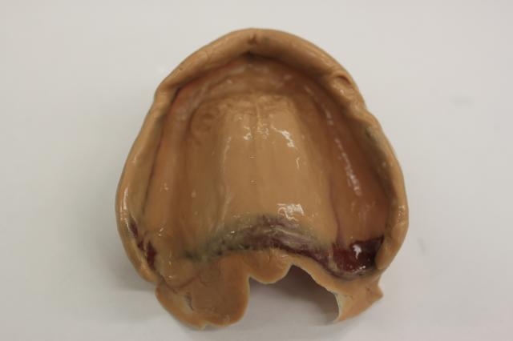
Polyethers
The two pastes are proportioned by volume.
Equal lengths of paste are extruded onto a mixing pad .
The good colour contrast between the pastes aids mixing.
very good dimensional stability.

Slide 18
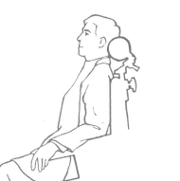
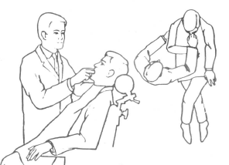
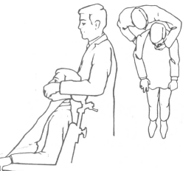
Position of the dentist and pateint
Set the patient in up right position
For mandibular impression the dentist stand in front of the patient
For maxillary impression the dentist stand behind the patient

Slide 19
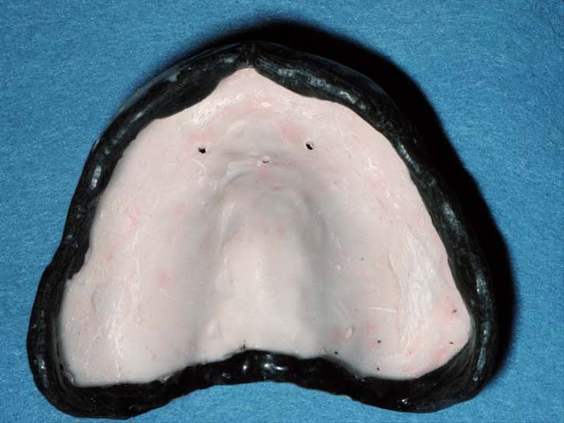
Impression border molding
Objectives
To shape the border of impression in order to allow the muscles to function in harmony with the denture.
To improve the border seal of the denture.

Slide 20
Requirements of materials used for border molding
Should have sufficient strength.
Should allow some preshaping of the form of the borders.
Should have a setting time of 3-5 min.
Should retain adequate flow while seating in the mouth.
Should not cause excessive displacement of the tissues of the vestibule.
Should be readily trimmed and shaped so that excess material can be carved and the border shaped before the final impression is made.

Slide 21
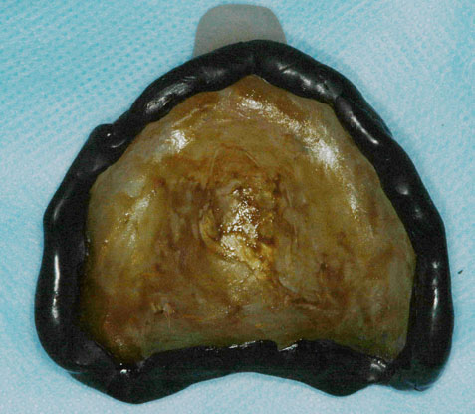
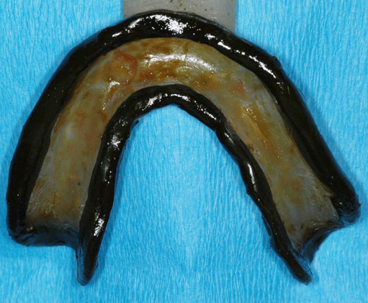
Materials used for border molding
Stick compound.
Autopolymerizing acrylic resin.
Polyether impression paste.
Impression waxes.
Periopack.
Tissue conditioners.

Slide 22
Methods
According to manipulation:
Manual or digital manipulation.
Functional manipulation.
Combination of both.
According to technique:
Open mouth technique.
Closed mouth technique.
Single border molding.
Incremental border molding.

Slide 23
Manual or digital manipulation
The contour of the denture borders is obtained by the dentist with digital (finger) manipulation of lips and cheeks of patient within functional limits.
Functional manipulation
The contour of the denture borders is obtained by the functional movements provided by the patient.

Slide 24
Open mouth technique
In this technique the tissues are recorded in their undisplaced position.
The patients mouth is partly opened and tray is held in position.
Closed mouth technique
In this technique the tissues are recorded in their functional and displaced position.
The patient applies pressure by closing against occlusion rims or teeth and executes muscle actions such as swallowing, grinning or pursing the lips while the impression material flow.

Slide 25
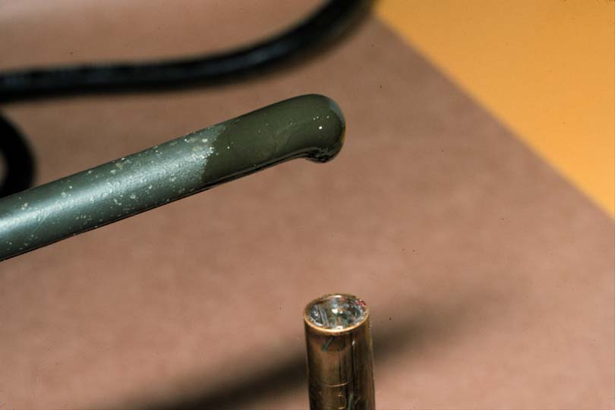
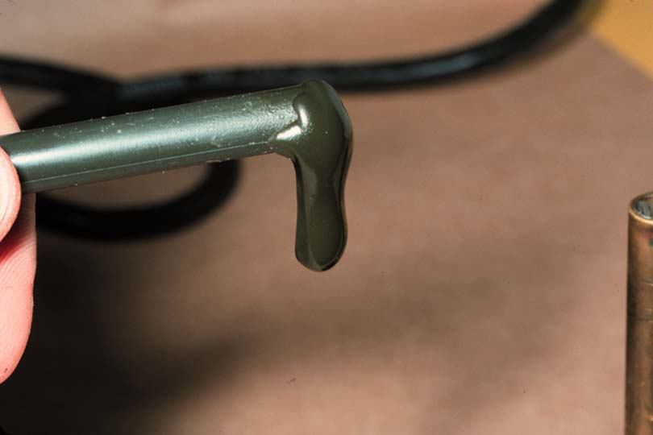
Incremental technique
Use stick compound
Soften over flame by rolling repeatedly to avoid over heating and burning.

Slide 26
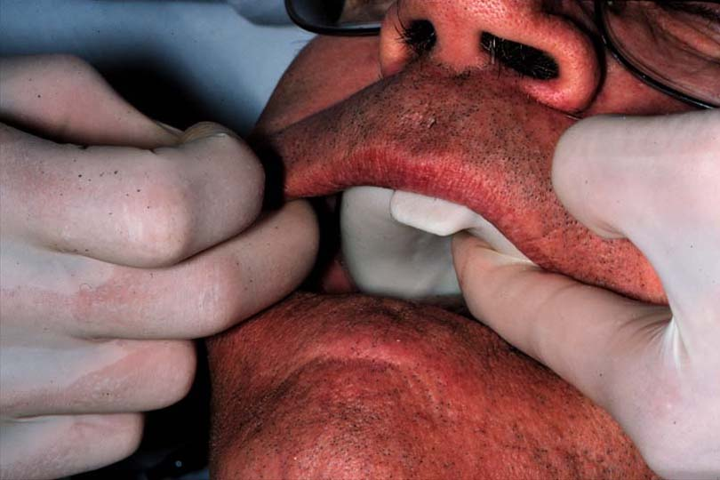
The softened stick compound is flowed along the border of the required segment of the tray.
The tray is tempered in warm water , placed carefully in patient mouth and necessary movements performed by dentist and patient .

Slide 27
Clean the tray.
The borders should be round and smooth with full extension.

Slide 28
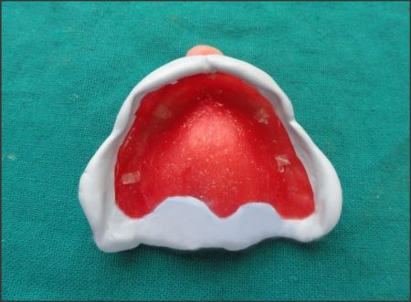
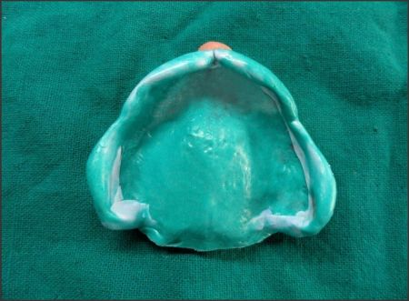
Single border molding
Application of the material to the borders of the special tray (all borders) in one time, and taking the impression of the borders.

