Slide 1
Attachments

Slide 2
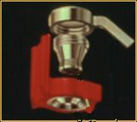
Definition of Attachments
A retainer consisting of a receptacle (matrix) and a closely
fitting part (patrix).
The matrix is usually contained within normal or expanded contours of the crown of an abutment tooth .
The patrix is mostly attached to a pontic or a RPD
Patrix

Slide 3
Classification of Attachments

Slide 4
Classification of Attachments
►Intracoronal
►Extracoronal
►Stud
►Bar
►Auxiliary

Slide 5
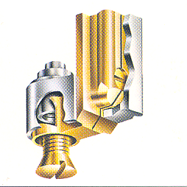
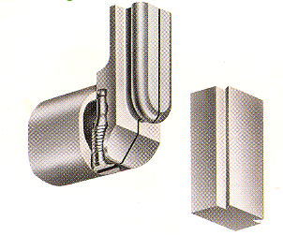
Classification of Attachments
Precision attachments
Semi-Precision attachments
* machined devices with precise
tolerances
* interchangeable and adjustable.
* more expensive
* prepared in the dental laboratory.
* directly cast from plastic or wax with
less precise tolerance
Paralleling mandrel
used for attachment to surveyor
Patrix
Matrix

Slide 6
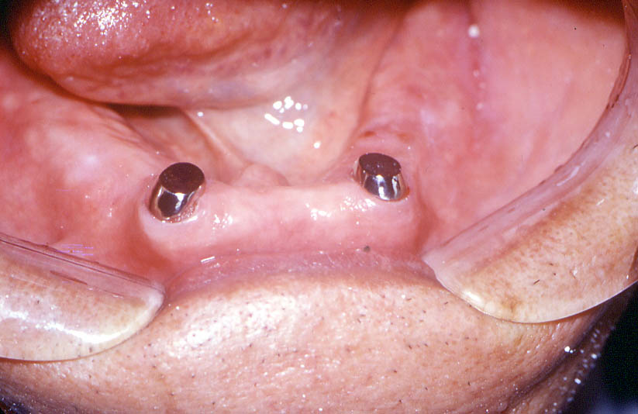
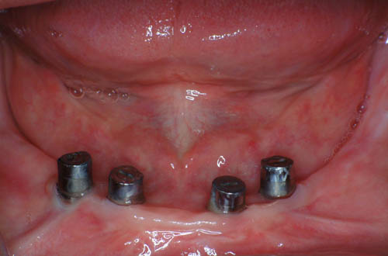
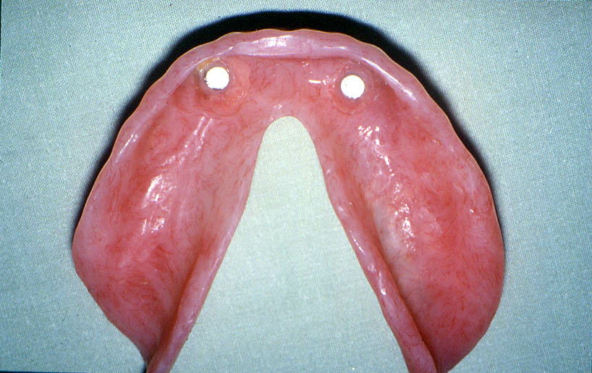
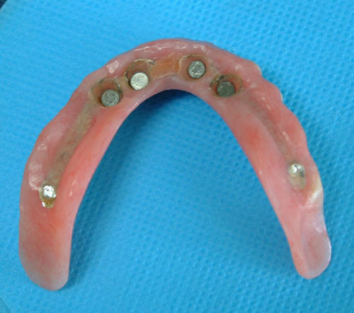
Another distinction is made between mechanical and magnetic attachments. The difference lies in the mechanism of retention.
Keepers
Magnets
Notes:
- CLICK Another distinction is made between mechanical and magnetic attachments. The difference lies in the mechanism of retention as the nomenclature implies.
CLICK Keepers are usually attached to teeth or implants.
CLICK Magnets are incorporated in the superstructure.

Slide 7
Intracoronal Attachments
Notes:
CLICK Intracoronal attachments will be discussed first.

Slide 8
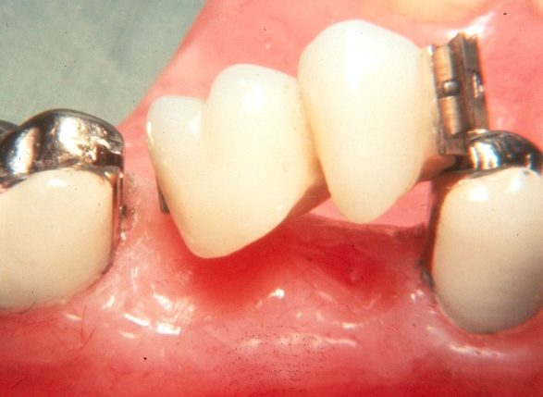
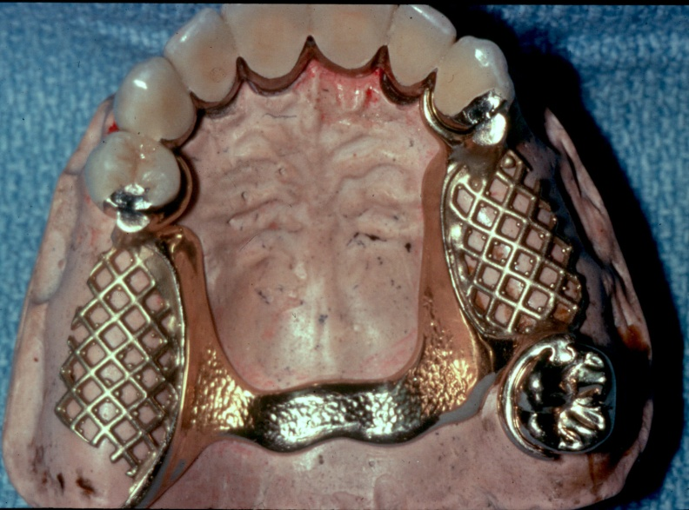
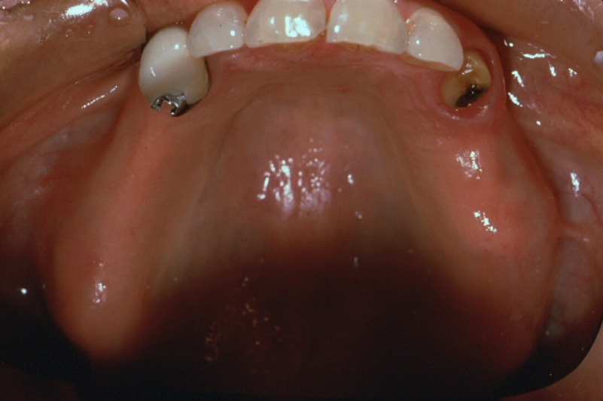
- Splinting is highly indicated when used in distal extension cases,
Intracoronal Attachments
Patrix
-Incorporated entirely within the contour
of the crown. -Non-resilient. -Usually indicated in bounded cases.
Matrix
otherwise the possibility of failure is relatively high.
Splinted Abutments
Fractured Abutment
Notes:
-CLICK Intracoronal are by definition attachments incorporated entirely within the contour of the crown.This group of attachments is non-resilient. -Intracoronal attachments are principally indicated in bounded saddle cases. -CLICK If intracoronal attachments are to be used in distal extension cases, splinting is rather a must,
CLICK otherwise the possibility of failure is relatively high.

Slide 9
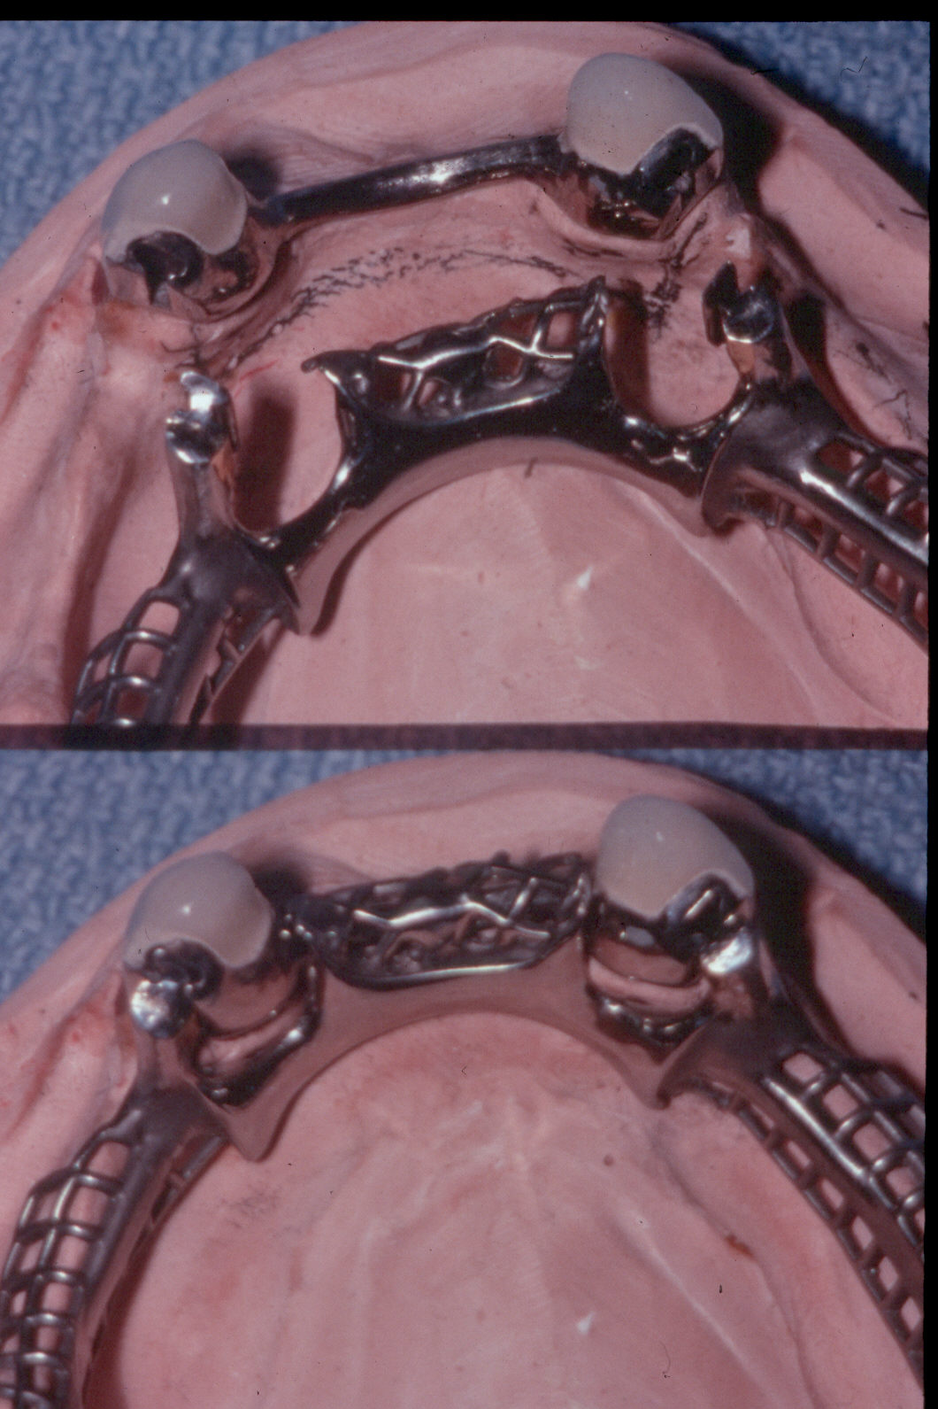
UNFAVORABLE ATTACHMENT APPLICATION:
With Kennedy Class I (Bilateral distal extension);
The anterior bar allows rotation that it’s act as rotational fulcrum.
The distal semi-precision
attachments (Rigid, no resiliency) have same effect as distal rest, that lead to overstress the abutment teeth.

Slide 10
Intracoronal Attachments versus clasp retainers
ADVANTAGES
** Esthetics: elimination of clasps arms.
** More Hygienic: elimination of food stagnation.
** Retention unaffected by crown contour.
** Reduced bulk of the prosthesis: fits within the contour of a tooth crown yet serves the functions of an occlusal rest, retentive clasp arm and bracing arm.
Notes:
-CLICK Intracoronal are by definition attachments incorporated entirely within the contour of the crown.This group of attachments is non-resilient. -Intracoronal attachments are principally indicated in bounded saddle cases. -CLICK If intracoronal attachments are to be used in distal extension cases, splinting is rather a must,
CLICK otherwise the possibility of failure is relatively high.

Slide 11
DISADVANTAGE
** Extensive preparation of the abutment teeth.
LIMITATIONS
** Require a minimum of 4mm vertical space & adequate BL width.

Slide 12
Extracoronal Attachments
Notes:
CLICK Extracoronal attachments

Slide 13
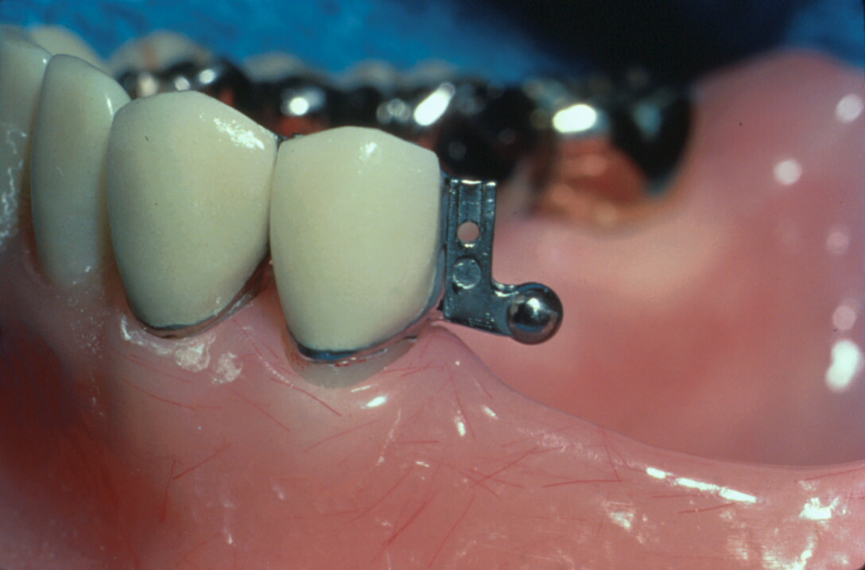
Positioned entirely outside the crown contour ; therefore, the normal tooth contour is maintained & the possibility of devitalizing a tooth is reduced in comparison to the intracoronal variety.
Extracoronal Attachments
Notes:
CLICK Extracoronal attachments are positioned entirely outside the crown contour, therefore the possibility of devitalizing a tooth is reduced in comparison to intracoronal variety.

Slide 14
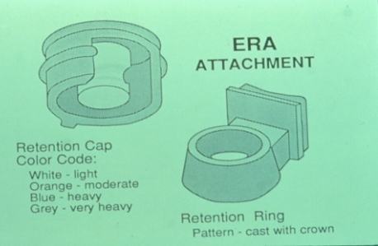
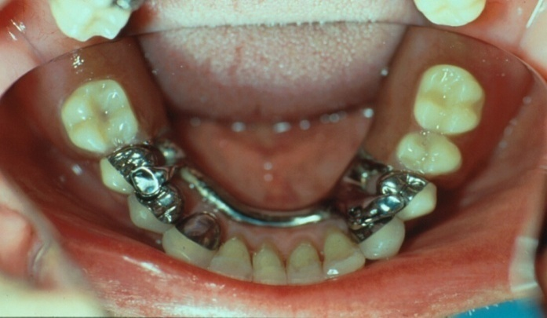
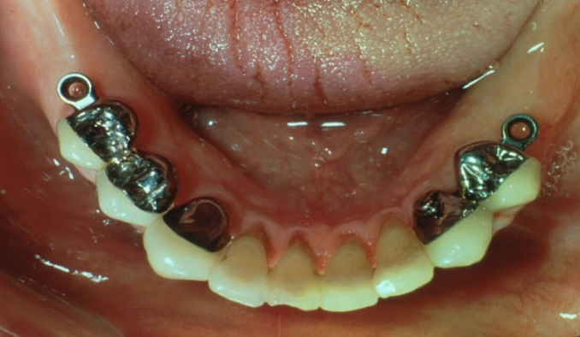
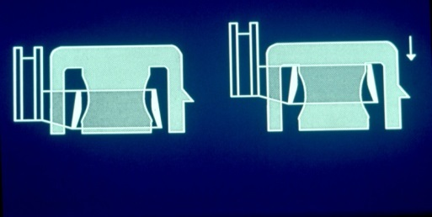
- Resilient variety is usually indicated in distal extension RPDs.
Extracoronal Attachments
- Due to versatility and robust design, extracoronal attachments are among the mostly commonly used attachments both in the precision and semi-precision varieties.
ERA Extracoronal Resilient Semiprecision Attachment
Notes:
- CLICK Because of the resiliency of many extracoronal attachments, this group is most commonly used in distal extension removable partial dentures.
- CLICK Extracoronal attachments are available in both precision and semi-precision varieties. ERA attachment is an example of semi-precision attachments commonly used.

Slide 15
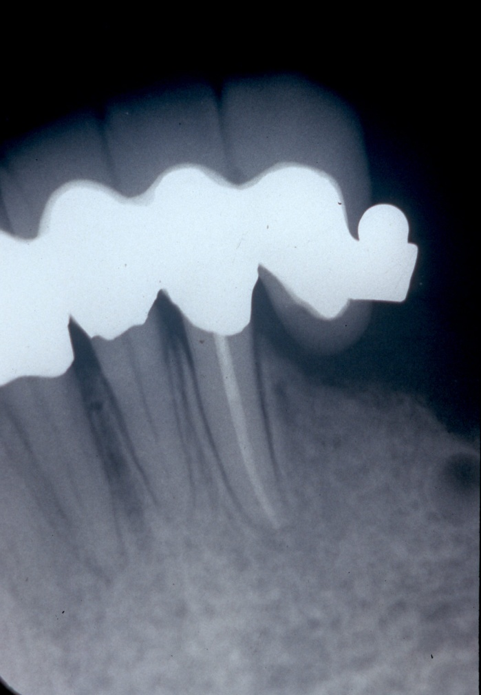
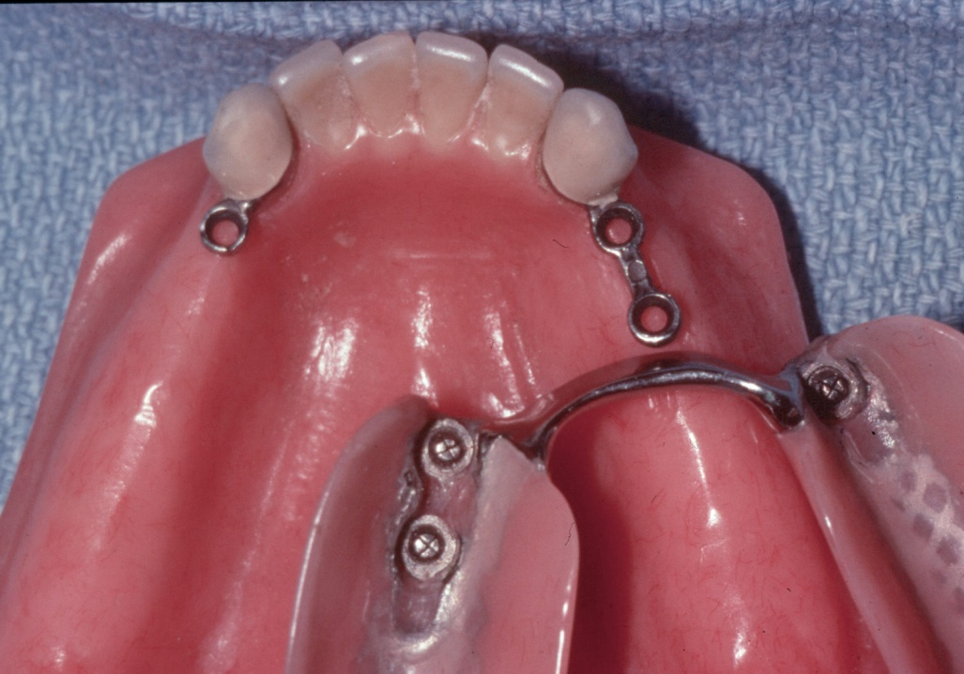
UNFAVORABLE ATTACHMENT APPLICATION CANTILEVERING EFFECT
Ceka
excessive cantilevering
excessive stress
failure of abutment teeth

Slide 16
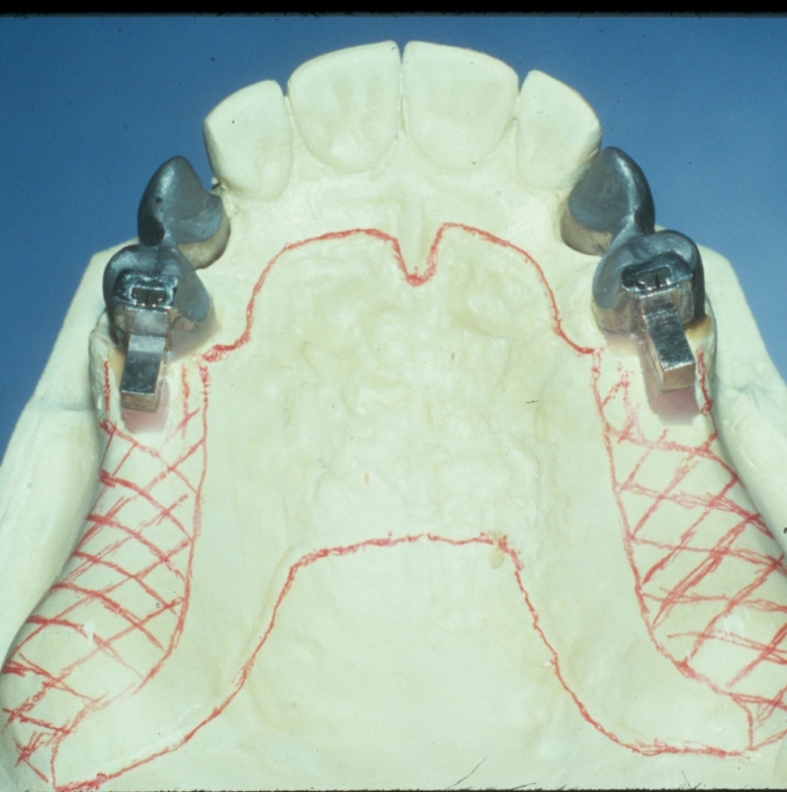
UNFAVORABLE ATTACHMENT APPLICATION:
If we have Kennedy Class I (Bilateral distal extension), using of Rigid extracoronal attachment with un-splinted abutments.
This will cause over-Stress on the distal abutment teeth

Slide 17
Stud Attachments

Slide 18
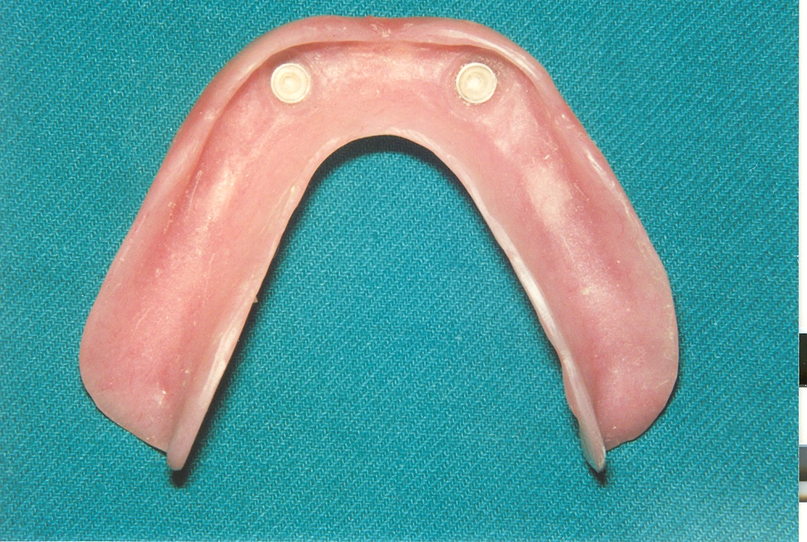
Definition of stud attachments
►Snap fasteners, mainly used for overdenture support, retention & stability.
► They consist of two main components:
Male projection
Female part
► The two components interlock to form a retentive unit, mechanically attaching the superstructure to the abutments.
Notes:
Click: Stud attachments are snap fasteners, mainly used for overdenture support, retention & stability.
Click: They consist of two main components:
Click: The matrix, an attachment component that is incorporated in a coping or cemented in the abutments root.
Click: The Patrix, a receptacle that is embedded within the denture base of the overdenture.
Click: The two components interlock to form a retentive unit, mechanically attaching the superstructure to the abutments.

Slide 19
Advantages of stud attachments
►Among the simplest of all attachments
► Have applications for both root & implant supported prosthesis
► Their retentive elements can be reactivated or replaced
in the denture base.
Notes:
Click: Stud attachments are considered simple and relatively small when compared to other attachments
Click: They have applications for both root
Click and implant-supported prosthesis
Click Their retentive elements can be reactivated or replaced in the denture base.

Slide 20
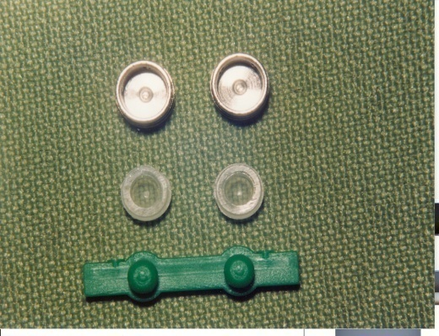
Classification of stud attachments
* Brewer & Morrow (1980), classified stud attachments into:
Resilient Stud attachments
Rigid stud attachments
* Designed so as to permit or
provide for a “controlled”
movement.
* They act as safety valve for
any overload situations.
* Do not allow any movement
* Indicated when interocclusal space
is limited & when no potential
movement of the overdenture is
required
Notes:
Click Stud attachments have been classified according to resiliency into
Click Resilient & Rigid
Click * Designed so as to permit or provide for a “controlled” movement.* They act as safety valve for any overload situations.
Click The most common resilient stud attachments are the ball & socket types. Examples of which are the flexi-overdenture attachment & the OT-cap attachment
Click Rigid attachments on the other hand do not allow any movement. They* Indicated when interocclusal space is limited & when no potential
movement of the overdenture is required.
Click Micro-fix is an example.

Slide 21
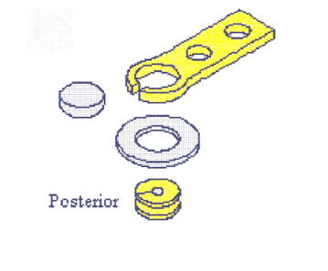
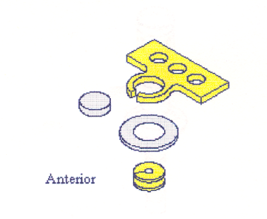
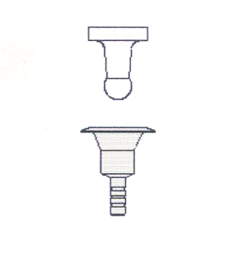
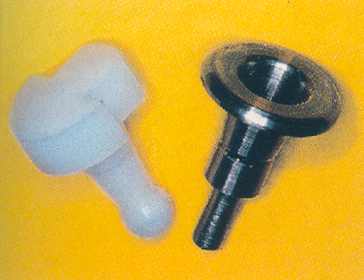
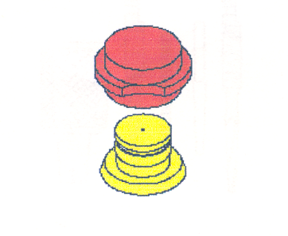
Classification of stud attachments
* Chee & Donavan (1993), classified stud attachments into:
Intra-radicular
Extra-radicular
* The male portion (patrix)
forms part of the denture base
and engages a special depression
within the root contour or implant
* The male portion (patrix)
projects from the root surface
of the preparation or implant.
* Rotherman attachment
* Logic
* Zest
* Micro Fix
* Dalla Bona
Notes:
Click depending on the location of the patrix, Stud attachments are classified into
Click intra & Extra-radicular
Click In the intra-radicular, The male portion (patrix) forms part of the denture base and engages a special depression within the root contour or implant
Click In the extra-radicular, the patrix projects from the root surface of the preparation or implant.
Click the logic attachment and the
Click Zest are Examples of intra-radicular attachments
examples of the extra-radicular attachments include
Click Rotherman,
Click Micro-fix and the
Click Dalla Bona

Slide 22
Requirements of stud attachments
►Adequate periodontal support
►Low caries index
►Adequate zone of attached gingiva
►Controlled plaque & denture hygiene
►Adequate interocclusal clearance to allow for reasonable thickness of acrylic resin around the attachments.
Notes:
Click The use of stud attachments require adequate periodontal support
Click Adequate interocclusal distance is necessary to allow for reasonable thickness of acrylic resin around the attachments, otherwise they will weaken the denture.
Click Other requirements include meticulous plaque control & denture hygiene
Click Low caries index
Click Adequate zone of attached gingiva

Slide 23
Bar Attachments

Slide 24
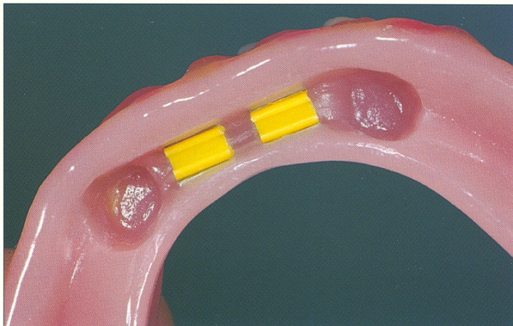
►Bar attachments consist of :
Definition of bar attachments
A bar
Retentive clip(s)

Slide 25
Advantages of Bar Attachments
* Excellent retention & stability for the prosthesis.
* The bar acts as an indirect retainer & provides vertical support for the prosthesis preservation of the alveolar bone.
* Rigid splinting & constant mechanism of abutment stabilization

Slide 26
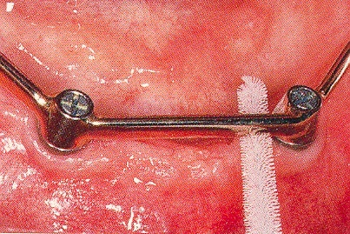
Requirements of Bar Attachments
** Adequate interocclusal
distance
**Adequate clearance beneath
the bar
** Adequate Bony support
** Bar should follow ridge
contour

Slide 27
Classification of Bar Attachments
Bar Joints
Bar Units
* Resilient version
* Some rotational movement
between the bar & the sleeve
more R.R support
Less torque on teeth
* Rigid version
* provides rigid fixation – no
movement between the bar &
the sleeve indicated
when saddle gap is long
► Dolder bar attachment
Resilient
Rigid

Slide 28
Telescopic Retainers

Slide 29
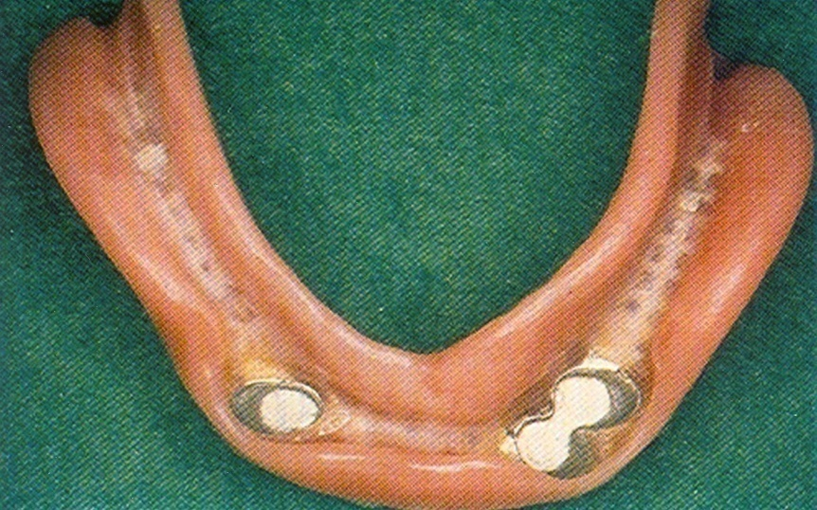
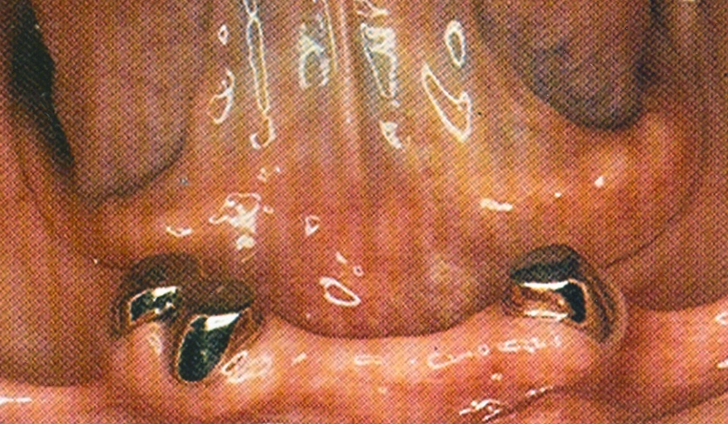
►A telescopic retainer consists of an inner coping. Permanently cemented to an abutment and a congruent detachable outer crown, rigidly connected to a removable prosthesis.
Definition of Telescopic Retainers

Slide 30
*Langer (1981) classified telescopic retainers ( according to resiliency) into:
Classification of Telescopic Retainers
Rigidly interlocked T. Units
T. Units with built-in Resiliency
* involves intersurface friction
during insertion & removal of the superstructure as the parts engage & disengage themselves.
* The forms of the 1ry & 2ry crowns are modified to interrupt the continuity of the intimate contact between them. A stress breaking principle is built into the retainer itself.
* provide support only
►ensures denture retention & stability.
►splinting of abutment teeth
►Healthier, as they take advantage of periodontal tooth support & rely less on mucoperiostal support

Slide 31
*Beschnidt et al (2001) classified telescopic retainers (according to the form of retention) into:
Classification of Telescopic Retainers
1- Parallel-sided (cylindrical)
2- Conical (tapered)
3- T. crowns with additional attachments

Slide 32
Classification of Telescopic Retainers
1- Parallel-sided (cylindrical)
2- Conical (tapered)
*Abutment & inner crown surfaces are prepared so as to be as parallel as possible.
* Retention is achieved through tight contact .
* The tapered configuration of the contacting walls generates a compressing intersurface tension based on a wedging action.
Problems:
* Over-contouring
* challenge for the patient to remove & insert the prosthesis

Slide 33
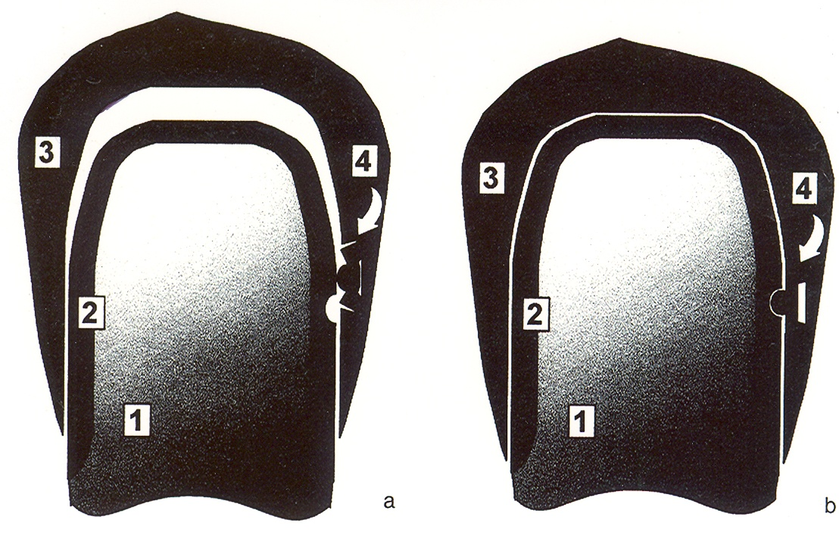
Classification of Telescopic Retainers
3- T. crowns with additional attachments
► Attachments were mainly incorporated in resilient telescope
systems and telescope systems made from base metal alloys
to enhance their retentive qualities.

Slide 34
Advantages of telescopic Retainers
► Longitudinal follow-up studies reported that telescope-
retained prosthesis showed lower failure rates than those
retained by clasps or precision attachments.
Telescopic Retainers are Pericoronal Devices
♦ They transmit the forces with the long axes of abutment
teeth. Therefore they allow for maximization of vertical
forces and minimization of horizontal (destructive) forces.
Telescope-retained Prostheses regarded as
Removable splinting devices
♦ The splinting action occurs when the multiple outer and
fixed inner crowns engage each other in situ.

Slide 35
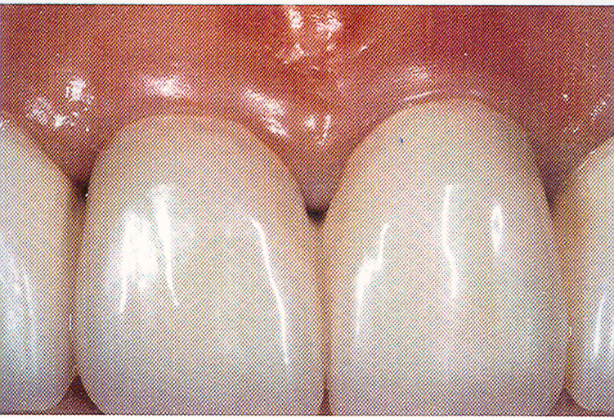
Advantages of telescopic Retainers
Telescope-retained Prostheses are Perioprosthesis
►The telescopic superstructure can be removed by the patient & is easily cleaned.
►The patient has 100 % access to the entire marginal periodontal circumference of the abutments ►promotes effective homecare & oral hygiene.
Esthetics

Slide 36
ATTACHMENT SELECTION (in general):
Criteria for selection:
Location
Available space
Function/type of retention
Cost

Slide 37
ATTACHMENTS IN RPDs
Advantages:
Elimination of visible clasp arms
Disadvantages:
Additional expense
Increased frequency of adjustment and failure
Increased technical expertise required
Unpredictable or unfavorable distribution of forces

