Slide 1
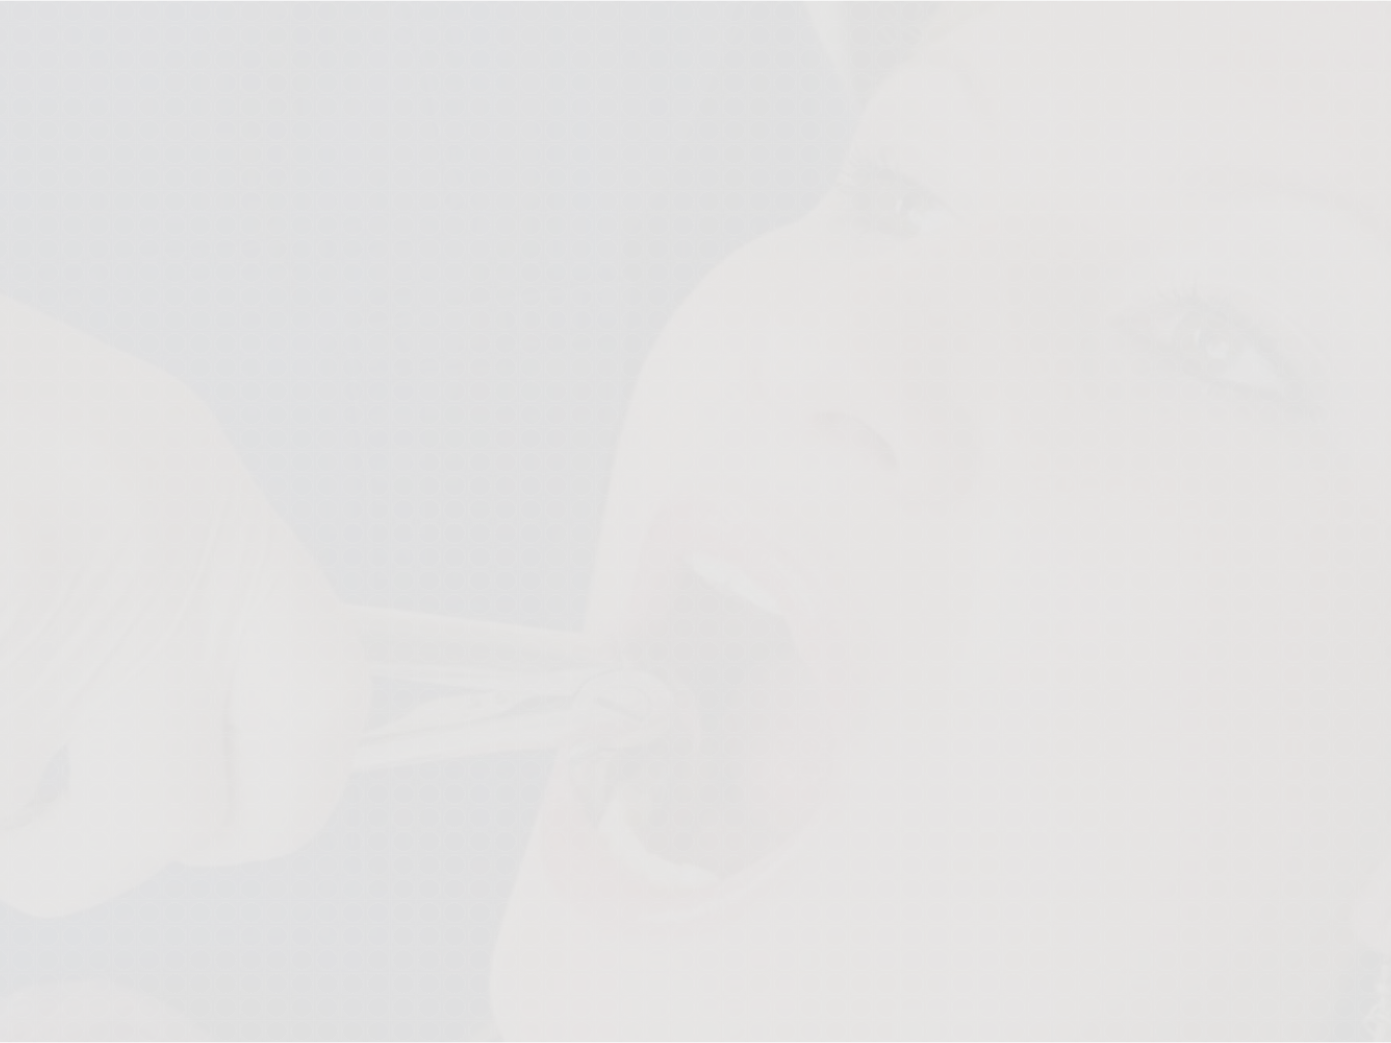
“Extractions In Orthodontics”
Dr. Zaid Al-Dewachi

Slide 2



Introduction
Painless removal of teeth from its socket is termed as Extraction. It is one of the most common methods of gaining space in the arch.

Slide 3
DIFFERENT EXTRACTION
PROCEDURES
Balancing extractions
Compensating extractions
Phased extractions
Enforced extractions
Wilkinson extractions
Stobies extractions
Serial extractions
Driftodontics

Slide 4
Balancing Extractions :-
Balancing extractions may be defined as the removal of a tooth on the opposite side of the same arch (although not necessarily the antimere) in order to preserve symmetry.
Compensating Extractions :-
In this procedure extraction of teeth are carried out in opposing arches to maintain buccal occlusion. In some Class I crowding cases, it is necessary to extract in both the arches to maintain lateral symmetry. Compensating extractions preserve inter-arch relationship by allowing the posterior teeth to drift forward together.

Slide 5
Phased Extractions :-
It may be possible to effect a change in molar occlusion by extracting in one arch only, or a few months earlier than in the other. Thus extractions done in phases, so called as Phased Extractions.
Enforced Extractions :-
These extractions are carried out because they are necessary as in the case of grossly decayed teeth, poor periodontal status, fractured tooth, impacted tooth, etc.

Slide 6
Wilkinson Extraction :-
Wilkinson advocated extraction of all the four first permanent molars between the age of 8 and half to 9 years. The basis of it is the fact that first molars are highly susceptible to caries.
The other benefits of extracting first molars at an early age are:-
To avoid third molar impactions by providing additional
space for their eruption.
To reduce crowding in the arch.
—first molar extraction offers limited space for crowding correction.
Both premolars rotate & may tip into the extraction space.

Slide 7
Stobies Extractions :-
Extractions of two premolars at the same time.
Serial Extractions :-
Concept was introduced by Kjellgren.
Nance is known as the Father of serial Extractions.
It is defined as Extractions of certain deciduous teeth and permanent teeth in selected cases to overcome crowding. Usual sequence of extraction is primary canines, primary first molars & first premolar.
Driftodontics :-
This concept is applicable when extraction of the permanent teeth are done without appliance therapy. Teeth have a natural tendency to drift into the extraction space.
Extraction of the lower first premolars are often associated with spontaneous decrowding of lower anteriors. Such spontaneous decrowding by drifting of teeth is referred to as Driftodontics, & is less frequent in upper arch.

Slide 8
CHOICE OF TEETH FOR EXTRACTION
Choice of teeth to be extracted depends on local
conditions which include:
Direction and amount of jaw growth.
Discrepancy between size of dental arches and basal arches.
State of soundness, position and eruption of teeth.
Facial profile.
Degree of dentoalveolar prognathism.
Age of patient.
State of dentition as a whole.

Slide 9
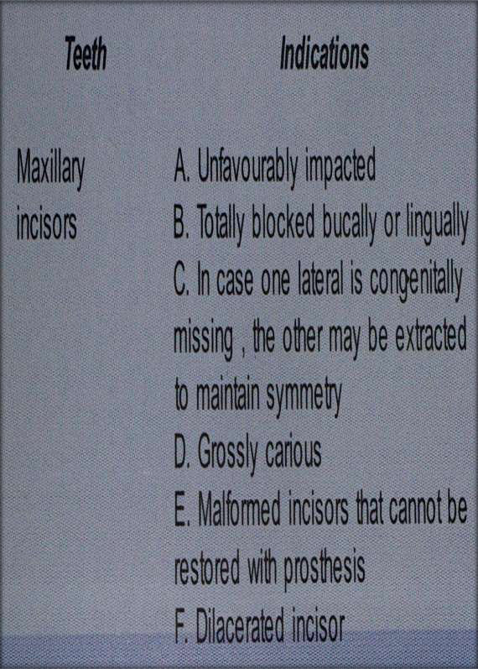
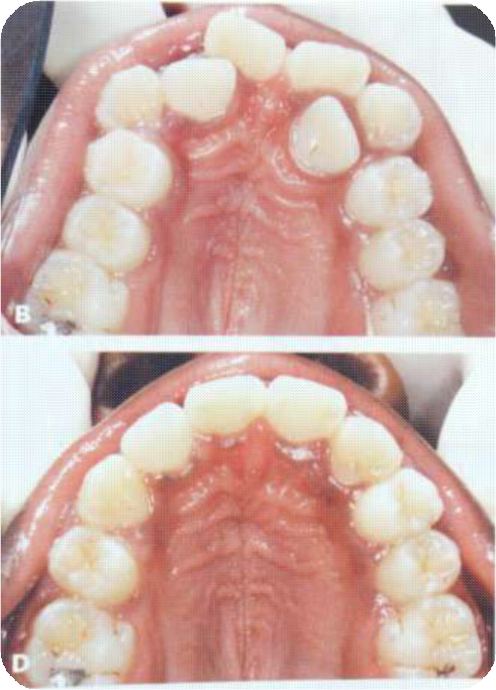

Indications For Extraction Of Different Teeth

Slide 10
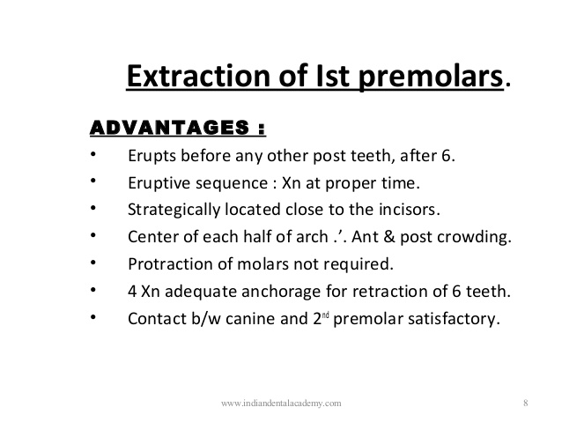

Slide 11
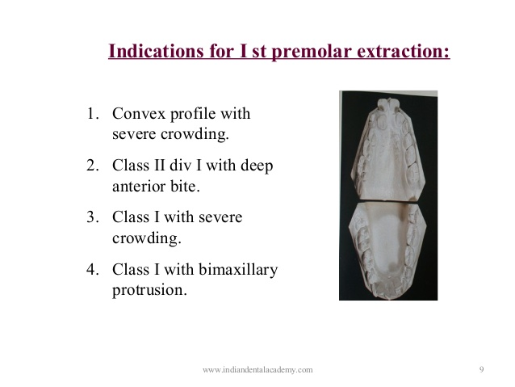

Slide 12
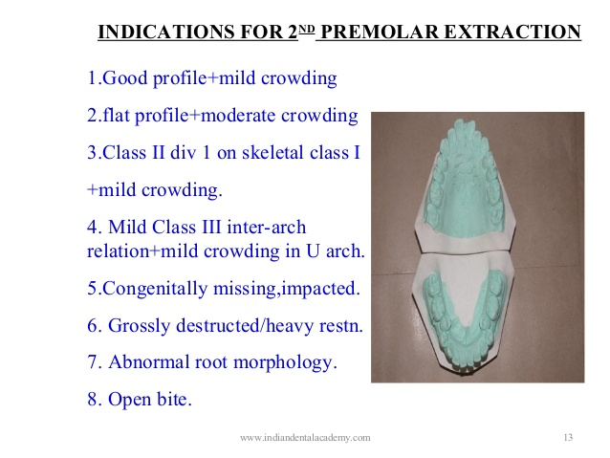

Slide 13
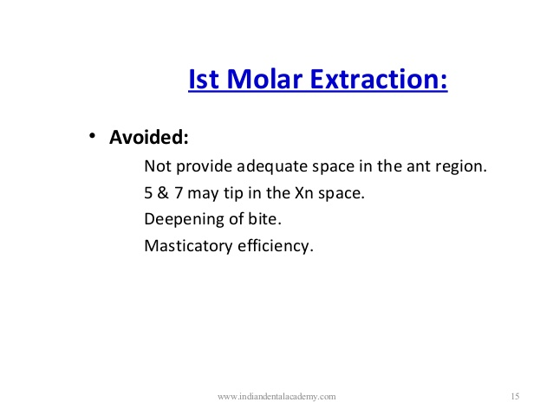

Slide 14
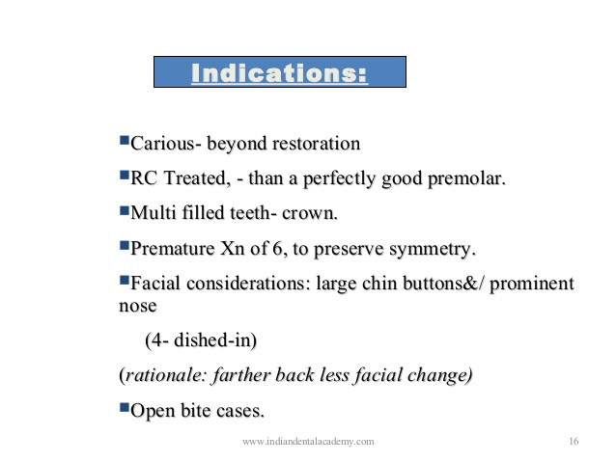

Slide 15
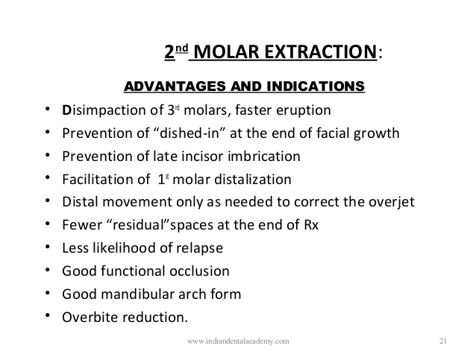

Slide 16
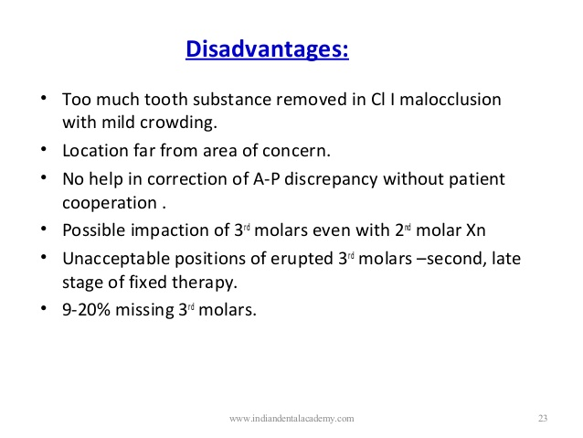

Slide 17
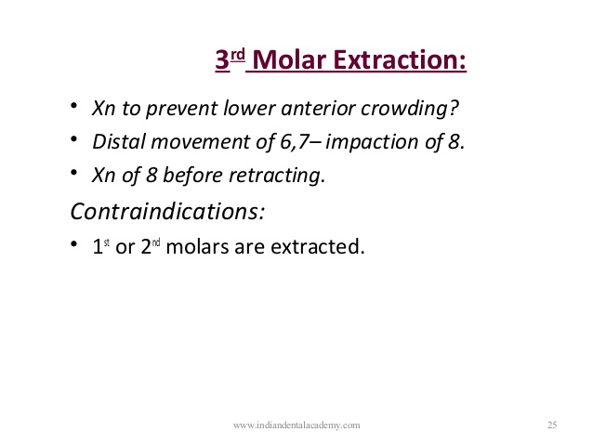

Slide 18
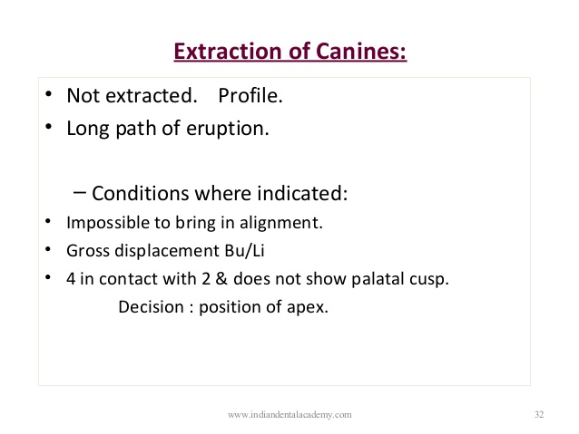

Slide 19
