Slide 1
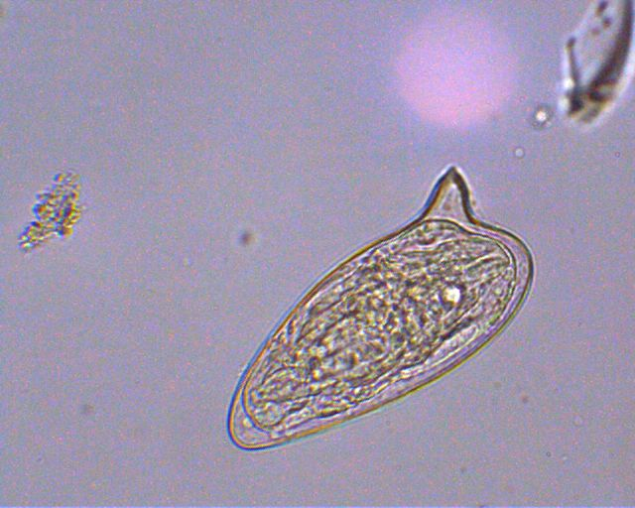
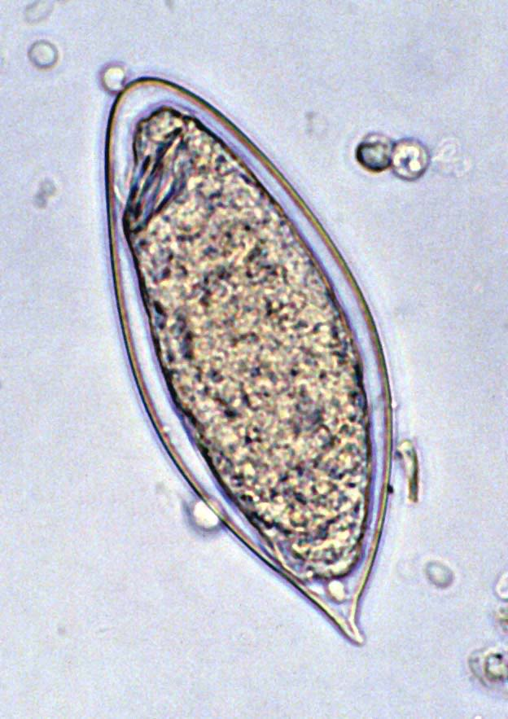
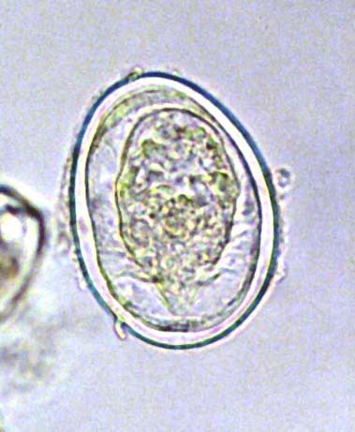
Schistosoma spp.
S. mansoni
S. haematobium
S. japonicum
Lateral spine
Terminal spine
Rounded spine

Slide 2
Schistosoma spp.
Also known as bilharzia, cause schistosomiasis or bilhariziasis.
Schistosoma spp. have 4 stages:
Eggs, miracidia, cercaria, and adult stage.
Eggs are passed through urine or feces to fresh water, where larvae stage can infect a new host by penetrating the skin.

Slide 3
Schistosoma spp.
There are three medically important species:
Schistosoma mansoni, lives in the mesenteric venules of large intestine, and cause intestinal bilharziasis.
Schistosoma japonicum, lives in the mesenteric venules of small intestine.
Schistosoma haematobium, lives in the venous plexus of the urinary bladder and cause schistosomal hematuria or urinary bilhariziasis.
S. mansoni and S. japonicum are produce their eggs in stool, but S. haematobium produce eggs in urine.

Slide 4
Schistosoma spp.
Intermediate host: snail.
Definitive host: human.
infective stage: Cercaria
diagnostic stage: eggs

Slide 5
Morphology
Schistosoma spp. Eggs
Depends on finding the characteristic ova in feces or urine.
Three species can be distinguished by the appearance of their eggs under microscope:
S. mansoni eggs have prominent lateral spine.
S. japonicum eggs have a very small round lateral spine.
S. haematobium eggs have a terminal spine.

Slide 6
Schistosoma spp. Eggs
S. mansoni
S. haematobium
S. japonicum
Lateral spine
Terminal spine
Rounded spine

Slide 7
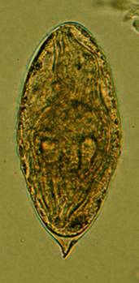
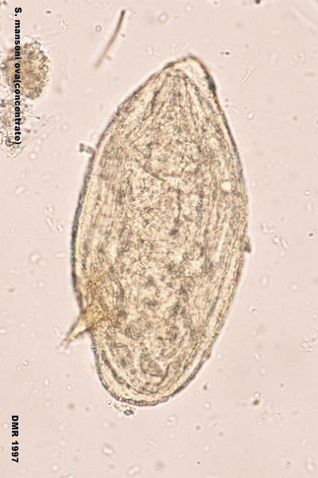
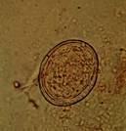
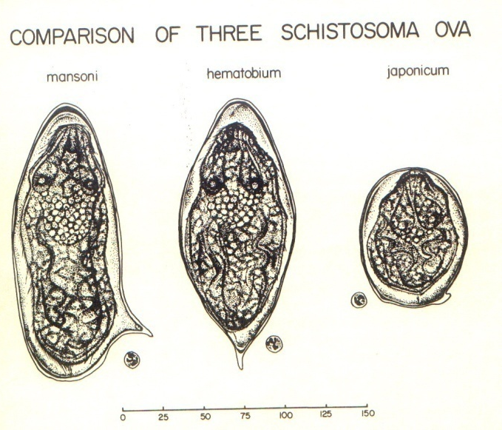
Saline s.
Iodine s.
Schistosoma japonicum Egg
( in stool )
Schistosoma haematobium Egg
Schistosoma mansoni Egg
( in urine )
( in stool )
Figure : Ova of Schistosoma spp.

Slide 8
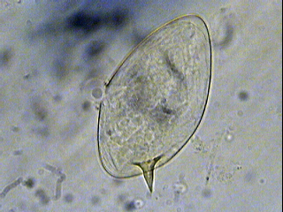
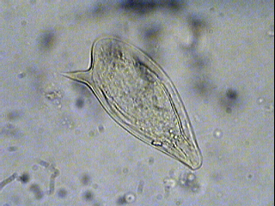
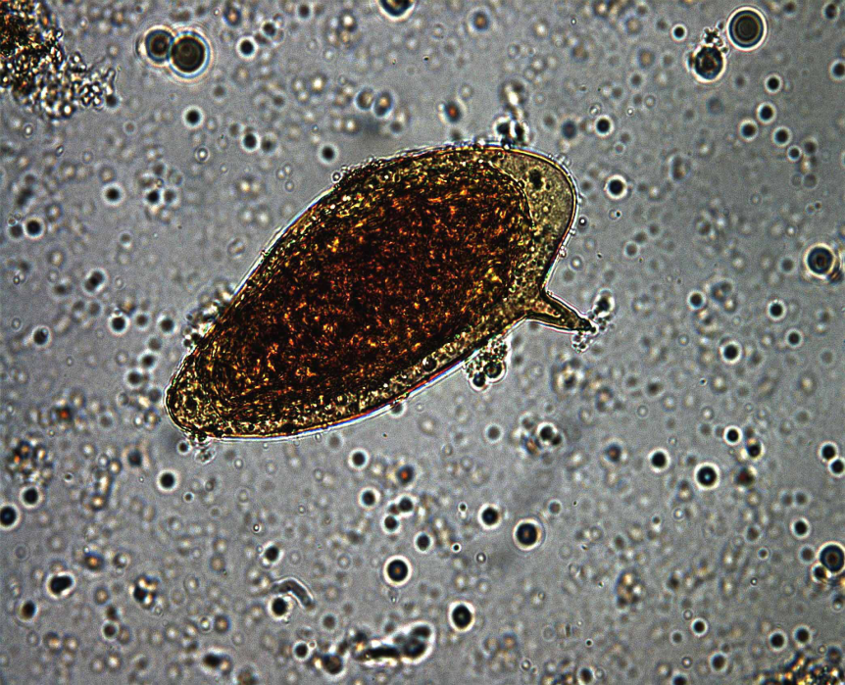
In Saline
R. B. C
Iodine stain
Fig. 5: Schistosoma mansoni Egg

Slide 9
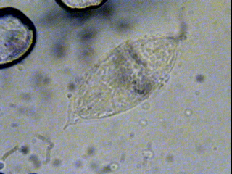
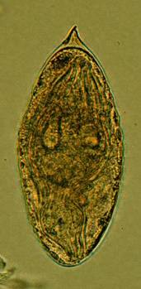
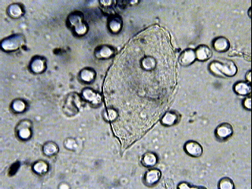
Eggs
Saline s.
Iodine s.
Saline s.
R. B. C
Fig. 12 : S. haematobium eggs

Slide 10
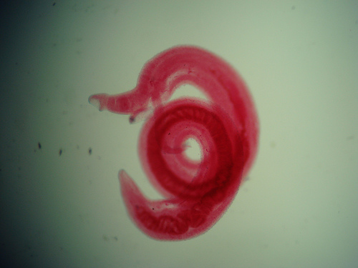
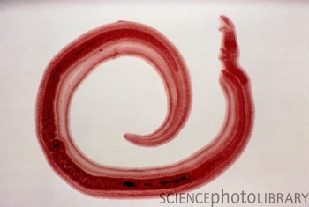
Morphology
Schistosoma adult male:
Adult male short from female.
thick than adult female .
have gyanchophoric canal.

Slide 11
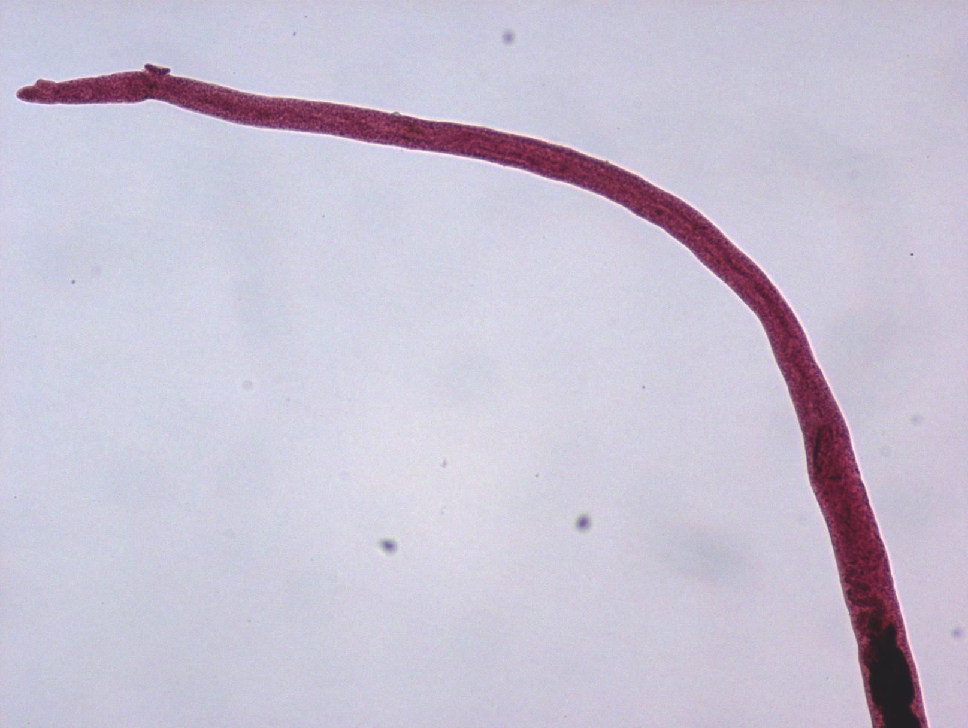
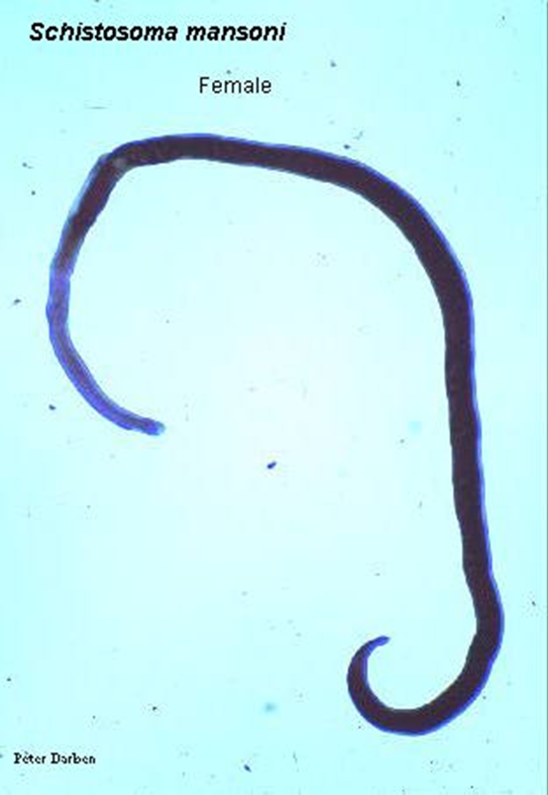
Morphology
Schistosoma adult female
Adult female longer from male.
thinner than adult male.

Slide 13
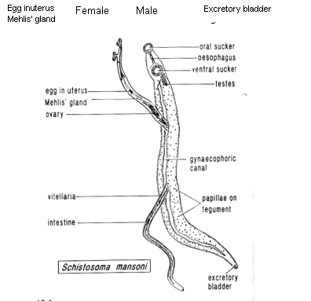

Slide 14
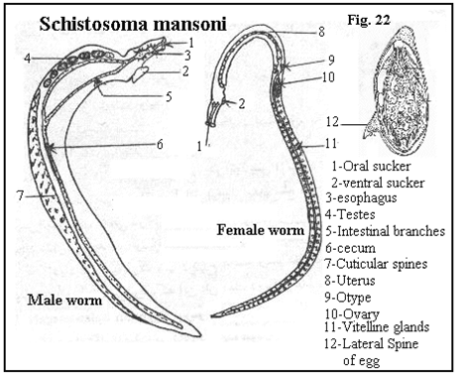

Slide 15
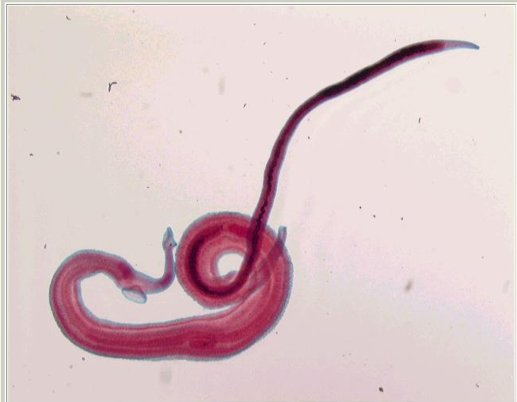
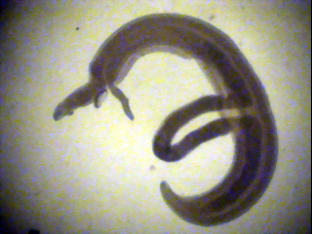
Female
Oral sucker
Ventral sucker
Male
Schistosoma mansoni Male-Female Copula

Slide 16
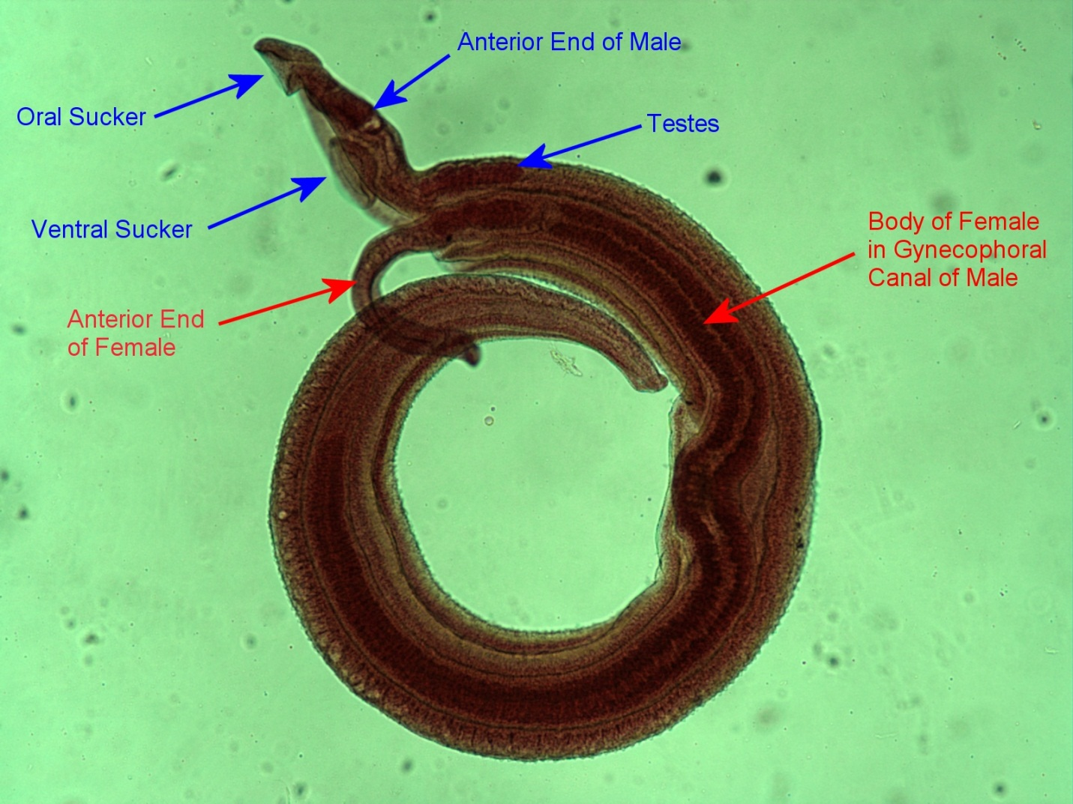
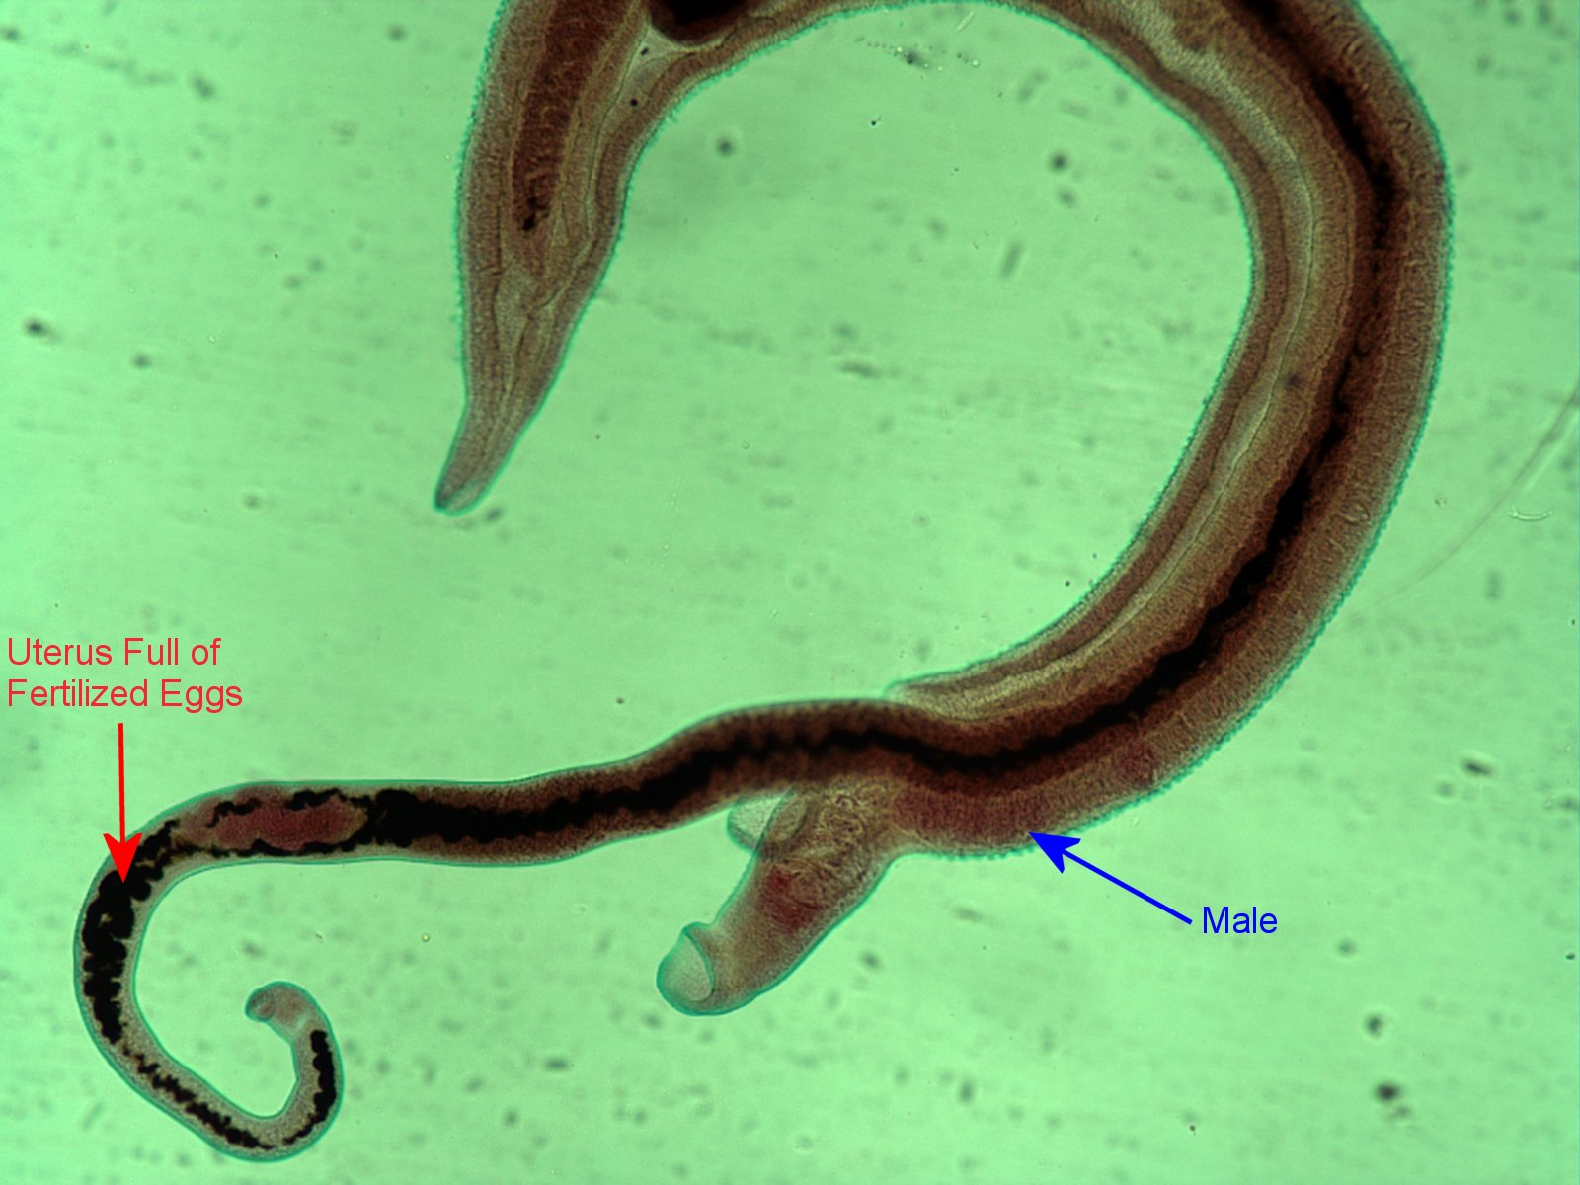
Figure : Schistosoma mansoni male and female in copula

Slide 17
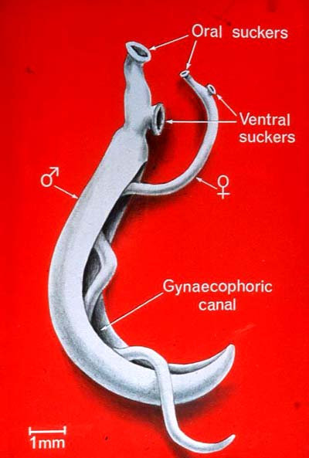
Figure 3: Schistosoma mansoni male and female in copula

Slide 18
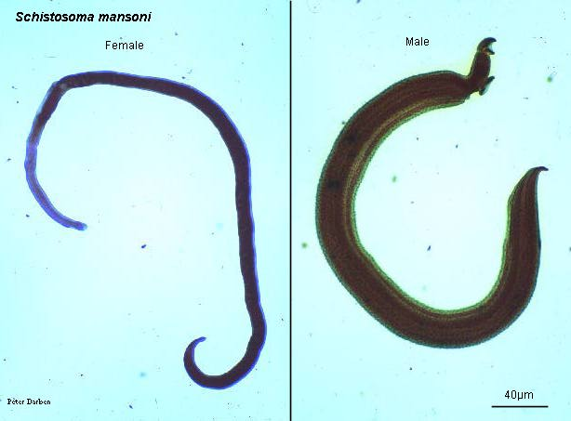
Fig. 4 : S. mansoni, female and male

Slide 19
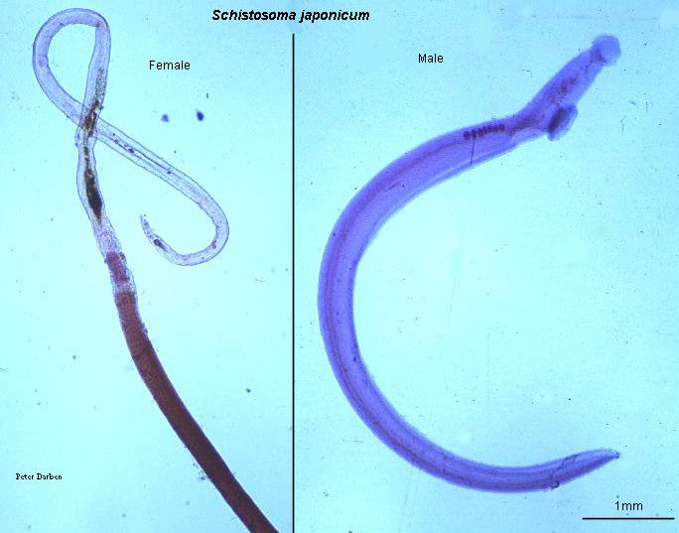
Methylene blue s.
Fig. 8: Schistosoma japonicum female and male

Slide 20
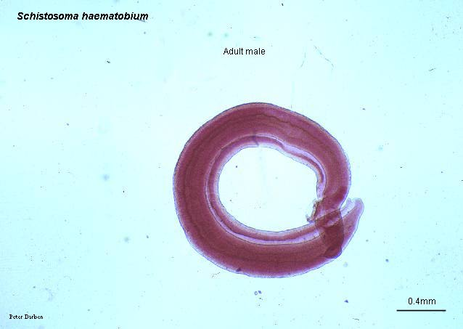
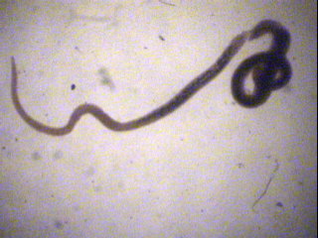
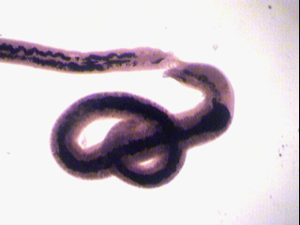
Fig. 11 : Schistosoma haematobium female and male
Eosin s.

Slide 21
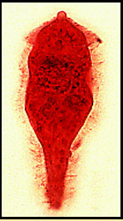
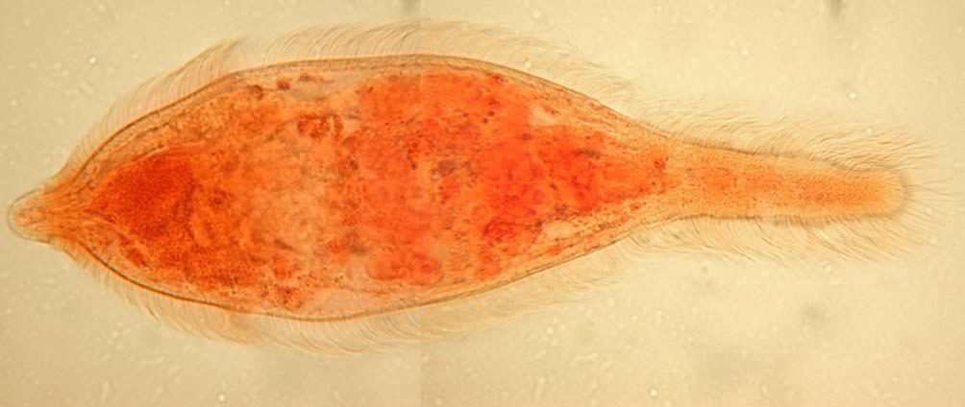
Morphology
Miracidium
A ciliated, swimming larva
Size about 99×35µm
The germinal cells will become sporocysts
Tropism – toward limpidity ; phototrophic .

Slide 22
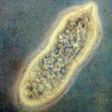
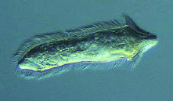
Schistosoma miracidium

Slide 23
(Intermediate host (Snail

Slide 24
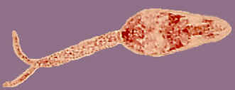
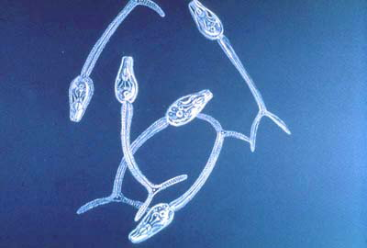
Cercaria
Free- swimming
a forked tail
penetrating glands

Slide 25
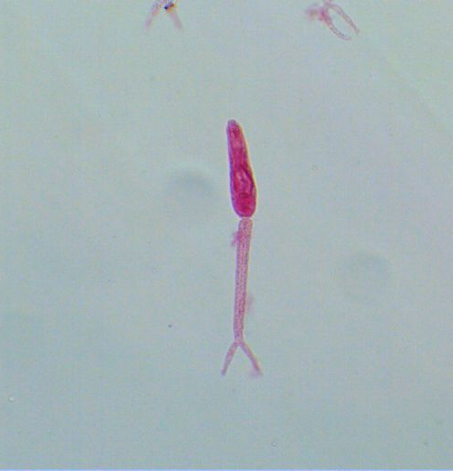
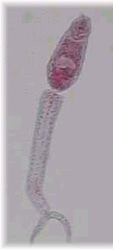
Schistosoma cercaria
Oval head
Bifid tail

Slide 26
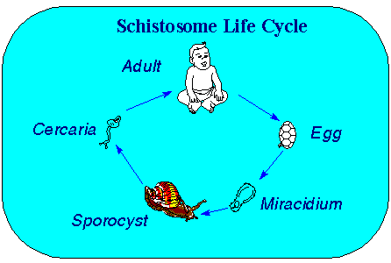

Slide 27
Life Cycle

Slide 28
Laboratory Diagnosis
Microscopic identification of eggs in stool or urine is the most practical method for diagnosis.
Stool examination should be performed when infection with S. mansoni or S. japonicum is suspected,
and urine examination should be performed if S. haematobium is suspected
Tissue biopsy (rectal biopsy for all species and biopsy of the bladder for S. haematobium) may demonstrate eggs when stool or urine examinations are negative

