Slide 1
Necrotizing ulcerative diseases
Dr. huseein al dabbagh

Slide 2
Necrotizing ulcerative gingivitis (NUG) , necrotizing ulcerative periodontitis(NUP), necrotizing stomatitis (NS) are the most severe inflammatory periodontal disorders caused by plaque bacteria.
•

Slide 3
• Trench mouth (Pickard 1973)
• Vincent’s gingivostomatitis
• Phagedenic gingivitis
• Fusospirallary periodontitis
• Plaut-Vincent stomatitis

Slide 4
PREVELANCE
NUG often occurs in groups in an epidemic form.
# NUG occurs at all ages, with the highest incidence reported between ages 20 & 30 yrs & ages 15 -20 yrs.

Slide 5
Clinical features - Oral signs
• NG – an inflammatory destructive gingival condition, characterized :by
ulcerated and necrotic papilla and gingival margins. Punched out crater like depressions at the crest of the interdental papillae is a characteristic Feature
• The surface of the craters is covered by a gray pseudomembranous
slough. The sloughed material has little coherence and is composed of
fibrin, necrotic tissue, RBC,WBC, Bacteria.
• Linear erythema demarcating marginal necrosis and the relatively
unaffected zone
• In some cases the lesions are denuded of the surface
pseudomembrane, exposing the gingival margin which is red, shiny, &
hemorrhagic. The characteristic lesion may progressively destroy the
gingiva & underlying periodontal tissues.

Slide 6
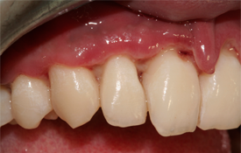

Slide 7
• Spontaneous gingival hemorrhage or pronounced bleeding after the slight stimulation are characteristic clinical signs.
• A characteristic & pronounced foetor ex ore is often associated with this disease . Although it is not always very noticeable.
• Increased salivation.

Slide 8
In NUP:
Progression of the interproximal lesion often results in destruction of the
interdental alveolar bone.
Sequestrum formation: necrosis of a small or large part of the alveolar bone,
which is denoted as sequestrum. The bone fragment is initially immovable, later
on it becomes loose. Sequestrum involves interproximal as well as facial or
palatal cortical bone.

Slide 9
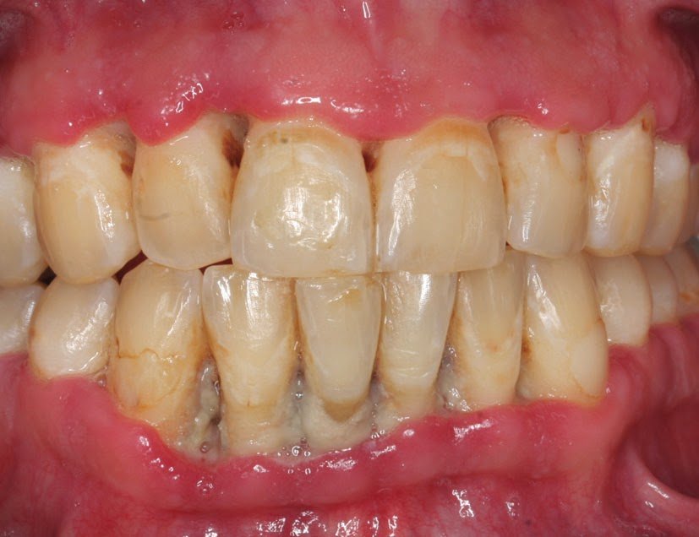

Slide 10
Involvement of the alveolar mucosa : NS
In severe malnutrition or immunocompromised individual as in HIV, the necrotic
process progresses beyond the mucogingival junction affecting the alveolar mucosa.
It may result in extensive denudation of the bone – leading to major sequestration – with the development of oroantral fistula and osteitis.

Slide 11
Oral Symptoms:
• The lesion is extremely sensitive to touch, & the patient may
often complains of a constant radiating, gnawing pain that is
often intensified by eating spicy or hot foods & chewing.
• There is metallic foul taste & an excessive amount of pasty saliva.

Slide 12
Extra oral & systemic signs & symptoms:
 In mild & moderate stages of disease
Local lymphadenopathy & slight elevation in temperature.
 In severe cases
High fever, increased pulse rate, leucocytois, loss of appetite .
 Systemic reactions are more severe in children.
 Insomnia, constipation, gastro-intestinal disorders, headache, &
mental depression sometimes accompany the condition.
 In very rare cases, severe squeal such as gangrenous stomatitis& noma have been described.

Slide 13
Stages of oral necrotizing disease – by
: Horning & Cohen
• Stage 1- necrosis of the tip of the interdental papilla.
• Stage 2- necrosis of entire papilla
• Stage 3- necrosis extending to the gingival margin.
• Stage 4- necrosis extending to the attached gingiva.
• Stage 5– necrosis extending to labial & buccal mucosa.
• Stage 6- necrosis exposing alveolar bone.
• Stage 7– necrosis perforating skin of cheek.

Slide 14
ETIOLOGY
It includes,
• Role of microorganism
• Role of host response
• Predisposing factors includes:
1. Local predisposing factor
2. Systemic predisposing factor

Slide 15
ROLE OF BACTERIA:
• Plaut & Vincent introduced the concept that NUG is caused by bacteria ; fusiform bacillus & spirochetal organism.
• Loesche et al described a predominant constant flora & a variable flora associated with NUG. The constant flora is composed of prevotella intermedia, treponema sp, selenomonas sp, & fusobacterium sp. The variable flora consists of heterogeneous array of bacterial types.

Slide 16
Pathogenic potential of microorganism:
• An important aspects in the pathogenesis is the capacity of the microorganism to invade the host tissues.
• Among the bacteria isolated from necrotizing lesions, spirochetes & fusobacterium can in fact invade the epithelium.
• The spirochetes can also invade the vital connective tissue
• The pathogenic potential is further substantiated by the fact that both fusobacterium & spirochetes can liberate endotoxins

Slide 17
ROLE OF HOST RESPONSE:
• Regardless of whether specific bacteria are implicated in the
etiology of NUG, the presence of these organism is insufficient
to cause the disease.
• The role of an impaired host response in NUG has long been
recognized.
• It is particularly evident for HIV-infected patients that the
disease is associated with diminished host resistance; among
other predisposing factors, the basic mechanism may include
altered host immunity.
• Changes in leukocyte function & the immune system have been
observed.

Slide 18
NUG is not found in well nourished individuals with a fully functional immune system. All the predisposing factor for NUG is associated with immunosuppresion.
•Patients with NG shows marked depression
in polymorphonuclear leukocyte chemotaxis & phagocytosis as compared with control individuals.

Slide 19
:LOCAL PREDISPOSING FACTORS
• It includes poor oral hygiene, preexisting gingivitis , injury to gingiva, & smoking.
• Areas of gingiva traumatized by opposing teeth in malocclusion may predispose to NUG.
• Pindborg et al – 98% of his patients with NUG were smokers & that the frequency of disease increases with an increase exposure to smoke.

Slide 20
:Systemic predisposing factors
• It includes
– nutritional deficiency (malnutrition),
– debilitating diseases,
– fatigue caused by chronic sleep deficiency,
– psychological stress,
– immunodeficiency,
– other health habits like alcohol & drug abuse.

Slide 21
Malnutrition is characterized by marked tissue depletion of the key antioxidant nutrients, & impaired acute phase reactions to the infections. This is due to impairment in the production & cellular action of cytokines.
• Malnutrition – defective mucosal integrity, hormonal imbalance.

Slide 22
:Debilitating disease
• Debilitating systemic disease may predispose the patient to the development of NUG.
• It includes chronic disease ( eg. Syphilis, cancer), severe gastrointestinal disorders such as ulcerative colitis, blood dyscracias (anemia , leukemia) & acquired immunodeficiency
syndrome.

Slide 23
:Diagnostic essentials for NUG
• Lesions are painful.
• Lesions are gingival ulcers, punched out crater like of
interdental papilla & may involve marginal gingiva.
• Non essential clinical features of NUG the absence which does not preclude the diagnosis of NUG
• Pseudomembrane of sloughed necrotic debris & bacteria
covering the ulcerated area.
• Foetor ex ore.
• Fever, malaise & lymphadenopathy

Slide 24
TREATMENT
• The treatment of necrotizing periodontal disease is divided into
two phases,
1)acute phase treatment
2)maintenance phase treatment

Slide 25
ACUTE PHASE TREATMENT:
• The aim is to eliminate the disease activity as manifest by ongoing tissue necrosis developing laterally & apically.
• It is also to avoid pain & general discomfort which may severely compromise food intake.

Slide 26
FIRST VISIT:
• General examination of the patient
• The oral cavity is examined for the characteristic feature of NUG, its distribution & possible involvement of oropharyngeal region.
• Oral hygiene is evaluated with special attention to the presence of pericoronal flaps, periodontal pockets & local factors.
• History taking – history of present illness, diet, socio-economic background, diet, smoking, chances of HIV infection, stress.

Slide 27
Treatment during initial visits includes:
• It is mainly confined to the acutely involved areas
• After application of topical anesthetics, the pseudomembrane & non attached surface debris is removed using a moistened cotton
pellet.

Slide 28
• After the area is cleansed with warm water
supragingival calculus is removed using ultrasonic
scalers.
• Subgingival scaling & curettage is contraindicated at
؟؟؟؟؟؟؟this time.
• Procedures such as extractions or periodontal surgery
are postponed until the patient has been symptom freefor 4 weeks, to minimize the likelihood of exacerbating the acute symptoms.
• Patients with moderate or severe NUG & local
lymphadenopathy or systemic signs or symptoms are
placed on an antibiotic regimen.

Slide 29
First Choice : Metronidazole( 500 mg *3 for 10 days)
• Other antibiotics such as Amoxycillin(500mg) in every 6
hours for 10 days or erythromycin (500mg every 6 hrs)
are used.
• Topical application of antibiotics is not indicated in the treatment of NPD because intralesional bacteria are frequent &topical application does not results in
sufficient intralesional concentration of antibiotics.

Slide 30
Hydrogen peroxide & other oxygen releasing agents
also have a long standing tradition in the treatment
of NPD.
• Hydrogen peroxide (3%) is used for debridement in
necrotic areas & as a mouth rinse (equal portions 3%
H2O2 & warm water).
• Favorable effects of hydrogen peroxide may be due to mechanical cleaning,& the influence on anaerobic bacterial flora of the liberated oxygen.

Slide 31
Twice daily rinsing with a 0.2% chlorhexidine solution is a very effective adjunct to reduce plaque formation, when particularly tooth brushing is not performed. It also assists self performed oral hygiene during the first weeks of treatment.
 Appropriate treatment alleviates symptoms with in few days.(5 days)
 Physical rest advised.
 Brushing instructions

Slide 32
Second visit
 Systematic subgingival scaling should be continued with increasing intensity as the symptoms subside.
 Correction of restoration margins
 Polishing of restorations & root surfaces should be completed after healing of ulcers.
 When ulcerated areas are healed local treatment is supplemented with oral hygiene & patient motivation.

Slide 33
Third Visit:
• Approximately 5 days after 2nd visit
• Patient counseling : Nutrition, Smoking cessation
• H2O2 rinse discontinued
• CHX maintained for 2-3 weeks
• Maintenance Therapy

Slide 34
:Supportive systemic treatment
• In addition to systemic antibiotics, supportive treatment consists of copious fluid consumption & administration of
analgesics for relief of pain.
• Bed rest is necessary for the patients with systemic complication such as high fever, malaise, anorexia & general debility.

Slide 35
MAINTENANCE PHASE TREATMENT
On further visits,
• When the acute phase treatment has been completed, necrosis & acute symptoms in NPD have disappeared.
• The formerly necrotic areas are healed & the gingival craters are reduced in size, although some defects usually persists.
• Bacterial plaque accumulates & therefore may predispose to recurrences of NPD or to further destruction because of
persisting chronic inflammatory process or both.
• These sites therefore requires surgical correction.

Slide 36
:Persistent or recurrent cases
• Adequate local therapy with optimal home care will resolve most
cases of NUG. If it persists despite therapy or recurs , the patient
should be revaluated with the focus on the following factors,
• Reassessment of differential diagnosis to rule out the disease that
resembles NUG.
• Underlying systemic disease that cause immunosuppresion.
• Inadequate local therapy.
• Inadequate compliance

Slide 37
thank u

