Slide 1
Anatomy & histology

Slide 2
Learning objectives
By the end of this lecture; the student should be able to:
1-List the components of the integumentary system, including their physical relationships.
2-Specify the functions of the integumentary system.
3-Describe the main features and functions of the epidermis and dermis.
4-Explain the structure and function of the various skin appendages.

Slide 3
Largest organ in the body
Surafce
about 2 sq meters
Thickness varies according to area:
0.2-0.5 mm on eyelid & prepuce
3-5 mm on palm & sole
Weight
4-5 kg
20 kg with hypodermis

Slide 5
Functions of the skin
The most important function is protection:
Serving as a barrier against infection, UV light & disease
Helping to regulate body temperature
Removing waste products from the body
Vitamin D₃ synthesis
Sensory organ
Calorie reserve & heat insulation
Beauty organ

Slide 7
Layers of skin
Epidermis
Dermis
Subcutaneous fatty layer:
not part of skin

Slide 8
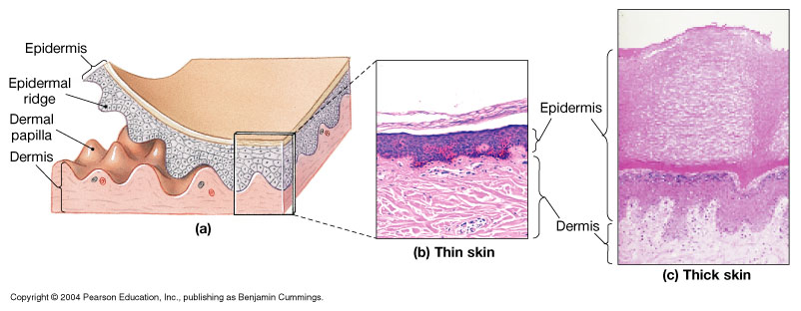
The Epidermis
The epidermis is the outer most layer of the skin
composed of layers keratinocytes, some undergo rapid mitosis
Thin skin = four layers (strata) as in hairy skin
Thick skin = five layers as in glabrous skin (palm & sole)

Slide 9
Histology of epidermis
Avascular stratified squamous epithelium
1- Keratinocytes: arranged in 5 layers
Stratum germinativum (basal cell layer)
Stratum spinosum (prickle cell layer)
Stratum granulosum (granular cell layer)
Stratum lucidum: only in palm & sole
stratum corneum(horny layer)- non-viable epidermis
2-Dendritic cells: melanocytes, Langerhans's cells, merkel’s cells
Viable epidermis

Slide 10
The ultimate function of epidermis is to produce keratin
As new cells are produced, they push older cells to the surface of the skin where they become flattened, lose their cellular content & start making keratin
It is a tough fibrous protein which forms the basic structure of hair, nail & skin
Eventually the keratin producing cells(keratinocytes) die & form a tough, flexible, waterproof covering of the surface of the body
This is shed or washed away once every 14-28 days

Slide 11
Where do you expect this section of skin was taken from:
A- Sole. B- abdomen

Slide 12
1-Basal cell layer
Single layer, tall columnar cells, have nuclei & all organelles
Site of DNA synthesis & mitosis
Connected to each other by desmosomes
& to basement membrane by
hemidesmosome

Slide 13
2-Prickle cell layer
5-20 layers, polygonal, nucleated, cytoplasm become full of keratin bundles that are attached to desmosomes: which are small interlocking cytoplasmic processes which are thickenings on the cell membrane of two opposing cell surfaces,
allowing the sliding of adjacent cells on
each other without separation upon trauma,
links are so strong that dead cells are shed
in sheets not individually.

Slide 14
Prickle cell layer
The upper part of this layer contain lamellar granules (Odland’s bodies, keratinosomes)
which contain lipids &
polysaccharides & their
contents are discharged into
the intercellular space at the
interface with granular layer
Forming the hydrophobic
barrier

Slide 15
Granular cell layer
3-10 layers, flattened cells, cytoplasm
full of basophilic keratohyaline granules
Dissolution of nucleus & other cell
organelles
Keratin filaments in large bundles
Keratinosomes migrate to the periphery of cells & discharge their lipid content

Slide 16
Horny cell layer
Flattened cells arranged in vertical
stacks that have lost nuclei &
cellular organelles
Keratin filaments arranged into macro fibers under influence of fillagrin
Highly insoluble cornified envelope within plasma membrane
Desmosomes are lost

Slide 17
Epidermal cell cycle
After reaching the surface, corneocytes are shed continuously being replaced by newer cells from beneath
The whole cell cycle takes around 4 weeks normally from basal layer to be shed at the surface as a scale.
This rate is accelerated in certain
disease conditions such as
psoriasis to be less
than 1 week

Slide 18
Dendritic cells: 1- melanocytes
Dendritic cells of neuronal origin
localized between basal cells at a
rate of one in ten, fixed in all races
Contain melanosomes:
specialized organelles that synthetize
melanin from tyrosine under action
of tyrosinase enzyme then transfer
it to surrounding keratinocytes,
forming epidermal-melanin unit

Slide 19
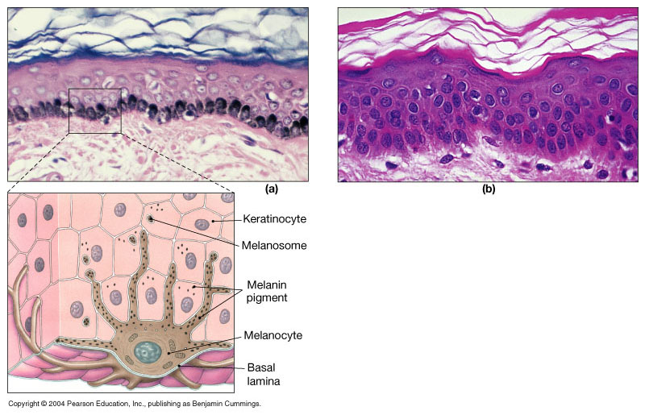
Melanocytes

Slide 20
melanosomes are
responsible for the
difference in
normal skin color
between races;
being more in no.,
Larger & more
dispersed in darker
skin

Slide 21
Question What would happen to the skin if tyrosinase enzyme was deficient?

Slide 22
2- Langerhans's cell
Dendritic cell of mesenchymal origin, localized in suprabasal layer
By electron microscope show Birbeck granules in cytoplasm
Antigen presenting cell in the skin: process antigens encountered on skin & present it to local
lymph nodes, thus have
a key role in adaptive
immune response.

Slide 23
3- Merkel’s cells:
Dendritic cells localized between basal cells directly above basement membrane
Associated with unmyelinated nerve endings & act as mechano-sensory receptors in response to touch
4- indeterminate cells:
they have the same ultrastructure of Langerhans’s cells but without Birbeck granules

Slide 24
Dermo- epidermal junction
In light microscope is one layer, actually it is 3 layers:
The upper part is formed by the
basement membrane of basal layer
with its attached hemidesmosomes
Lamina lucida
Lamina densa
Sub laminal fibrous band

Slide 25
The dermis
Dermis organization
Papillary layer
Contains blood vessels,
lymphatics, sensory nerves of
epidermis
Reticular layer
Contains network of collagen and elastic fibers to resist tension

Slide 26
Dermis
The dermis forms the main bulk of the skin, lies under the epidermis & supports it both structurally and nutritionally, they interdigitate so that upward projections of the dermis (the dermal papillae) interlock with downward ridges of the epidermis (the rete-pegs), this increases the force of adhesion & the contact area.

Slide 27
Composition of dermis
Components of dermis:
Cells: fibroblasts, mast cells, macrophages & all the cells in the blood
Fibers: 80-85% is collagen mainly type I & III, the remainder is composed of elastic & reticular fibers
Ground substance: composed of glycosaminoglycan/ proteoglycan macromolecules, they constitute 0.1-0.3% of the weight of dry dermis but are responsible for the hydration of the dermis due to the high water binding capacity of hyaluronic acid.
60% of the weight of the dermis is water

Slide 28
Skin appendages: Hair
Hair types
1-Lanugo hair: intrauterine life, fine long hair
2-Vellus hair: peach fuzz; all over body, fine short hair
3-Terminal hair: coarse long
hair on scalp

Slide 29
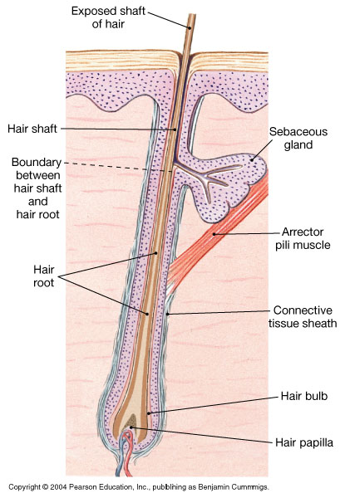
the Anatomy of a Single Hair

Slide 30
Composition of hair
Originate in hair follicle
Composed of root and shaft
Root base (hair papilla) surrounded by hair bulb and root hair plexus
Hairs have soft medulla and hard cortex
Cuticle = superficial dead protective layer

Slide 31
Hair
A bundle of smooth muscle, the arrector pili,
extends at an angle between
the surface of the dermis
and a point in the follicle wall.
supplied by adrenergic fibers
causing hair erection during
fear, anger, & cold.

Slide 32
Cycles of hair growth
Anagen: growth phase lasts 2-3 years
Catagen: transition phase 2-3 weeks
Telogen: resting phase 2-3months, after which a club hair is shed

Slide 33
Sebaceous glands

Slide 34
Sebaceous glands
Present all over body but mostly in seborrheic areas: scalp, face, upper part of: chest, shoulders & back
Attached to hair follicles
Secrete sebum: a complex lipid which is bactericidal & fungistatic
Holocrine type of secretion: degeneration of the whole gland after it is filled & release of sebum

Slide 35
Pilosebaceous follicles

Slide 36
Eccrine sweat glands
2-4 millions
All over body, mostly palms, soles & axillae
Two parts : 1- the secretory coil deep in the dermis
2- the duct: extends from the gland & opens directly onto skin surface independent of hair follicles
Sweat glands are innervated by cholinergic fibers of the sympathetic nervous system
Important in thermoregulation

Slide 37
Apocrine sweat glands
modified sweat glands limited to the axillae, nipples, periumbilical area, perineum & genitalia
Opens directly into hair follicle
Secretion by decapitation
Responsible for the odor of the body
Under action of androgen hormone

Slide 38
The nail
1) Nail plate
2) Nail matrix
3) Nail bed
4) Nail folds
5)The cuticle

Slide 39
Blood supply of skin
The dermis is the source of nutrition of
the skin, the blood vessels lie in 2
horizontal layers:
1- the deep plexus: just above the subcutaneous fat
2- a superficial plexus: in the papillary dermis
with interconnecting channels between the two.

Slide 40
summary
Now you should be familiar with:
The components of the integumentary system, including their physical relationships.
The functions of the integumentary system.
The main features and functions of the epidermis and dermis.
The structure and function of the various accessory organs of the skin.
Thank you

