Slide 1
Urticaria
By
Dr.Alaa A. Al-sahlany
Dec 23, 2018

Slide 2
Urticaria
Wheal(lesion): pruritic evenescent pink or pale swelling of superficial dermis
Angioedema(lesion): swelling of deep dermis and subcutaneous or submucosal tissue
Urticaria(disease): recurrent wheal or/and angioedema of skin
Urticaria affects 1-5% of population
Overall, urticaria is more common in women than men

Slide 3
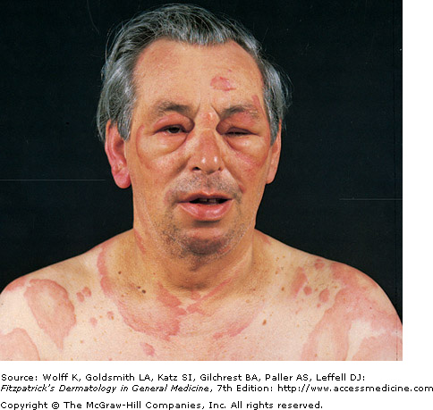

Slide 4
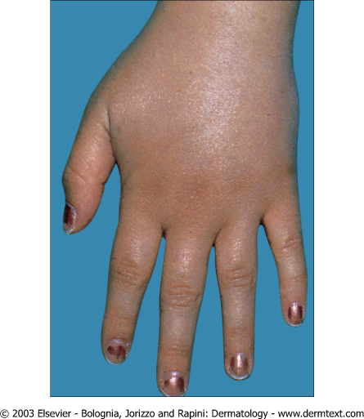

Slide 5
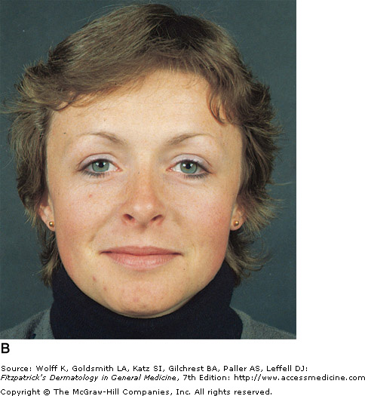
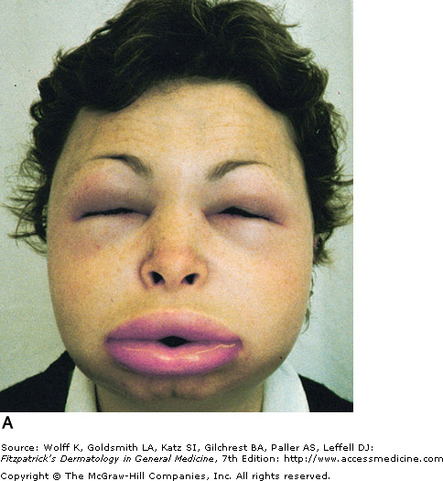

Slide 6
Wheals and Angioedema
Angioedema | Wheals
Swelling of deep dermis, subcutaneous tissue | Swelling of upper dermis
Skin-colored, painful and ill-defined | Red and itchy and well-defined
Last more than 24 hours | Last less than 24 hours
Involves skin and mucosae | Involves skin only

Slide 7
Urticaria
Type I hyperensitivity reaction
The allergen bind with the receptor bound IgE leading to cross-linking of two or more IgE receptors on mast cell membrane that result in degranulation

Slide 8
Pathogenesis
. Mast cells are distributed throughout the body
. Mast cells express high affinity IgE receptors.
. Types of degranulating stimuli are (1)immunological i.e. penicillin and (2)non-immunological i.e. opiates, NSAIDS

Slide 9
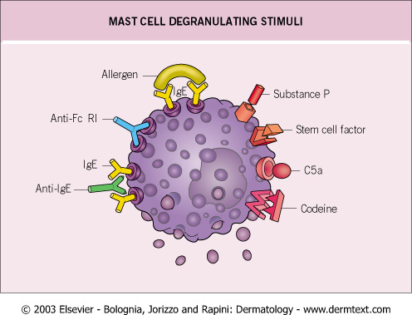
Degranulators

Slide 10
Autoimmune urticaria
Anti-IgE receptor and to lesser extent anti-IgE antibodies are detected in sera of 25- 50% of patients with a chronic ordinary urticaria and this can be detected by autologous serum skin test(ASST)

Slide 11
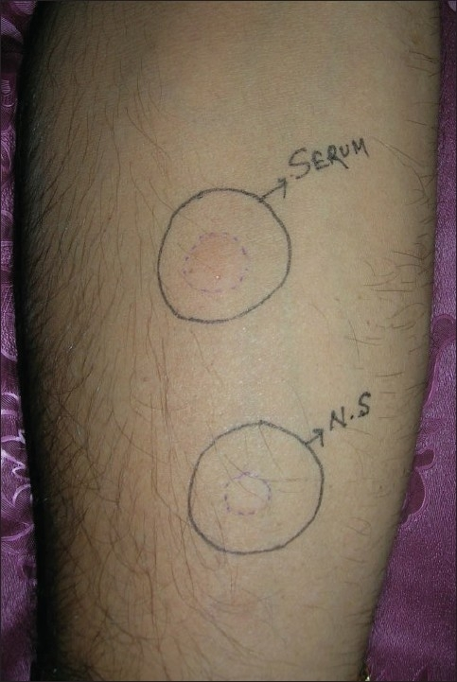
Autologous serum skin test

Slide 12
Pathogenesis
Many proinflammatory mediators are involved; the most important are histamine(produced by mast cells), PGs (has an inhibitory effect on degranulation) and LTs(has a stimulatory effect) and kinins (stimulatory effects)
Other WBCs may be involved such as basophils (produce histamine) and eosinophils (produce major basic protein)

Slide 13
Mediatorts of urticaria
Leukotriens | bradykinin | Histamine | The mediator
Aspirin sensitive urticaria | ACE inhibitors And C1 estase inhibitor deficiency | Urticaria and angioedema | Example
Treated by lipoxygenase inhibitors i.e. monteleukast | Treated by bradykinin receptor antagonists e.i. icatibant | Treated by antihistamines | Treatment

Slide 14
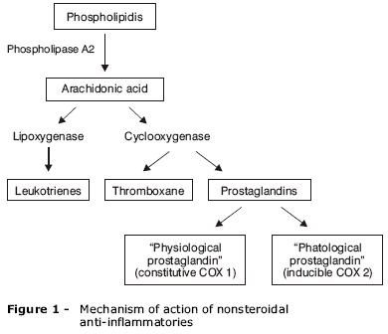

Slide 15
Classification
(I) Acute and chronic (the cut-off is 6 wks)
(II) Immunological e.g. penicillins and non-immunological e.g. opiates directly degranulates mast cells
(III) Clinical classification:
1. Ordinary urticaria
2. Physical urticaria
3. Urticarial vasculitis
4. Contact urticaria
5. Angioedema without wheals
6. Urticarial syndromes e.g. Familial meditranean fever

Slide 16
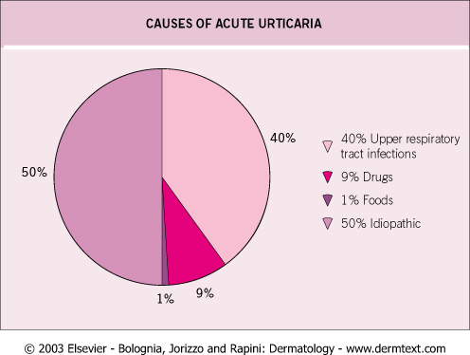

Slide 17
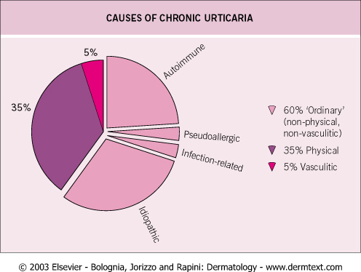

Slide 18
Physical urticaria
Linear wheals at site of scratching and friction | Dermographism
Deep swelling after at least 30 min of sustained pressure, may last for few days e.g. Palms after manual work and soles after walk | Delayed pressure urticaria
Pins and needles sensation after sweat-inducing stimuli e.g. exertion, hot bath, stress Occurs usually in young adult with atopic tendency | Cholinergic urticaria
Wheals appears within minutes after cold exposure Cold swimming can cause anaphylaxis Associated with cryoglobulinemia or cryofibrinogenemia | Cold contact urticaria: (1)Primary (idiopathic) 95% (2)Secondary
Wheals after contact with water of any temperature | Aquagenic urticaria
Wheals appears within minutes of sun exposure | Solar urticaria
Appears within minutes after contact with heat | Heat contact urticaria

Slide 19
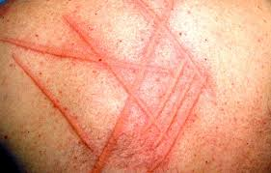
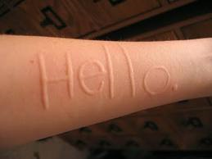
Dermographism

Slide 20
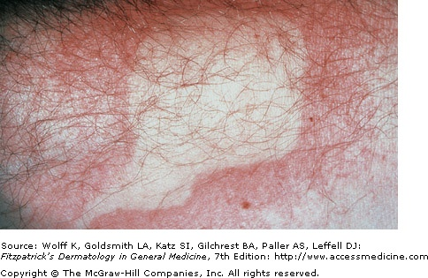
Cold urticaria(after ice cube test)

Slide 21
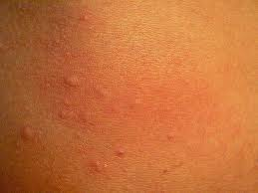
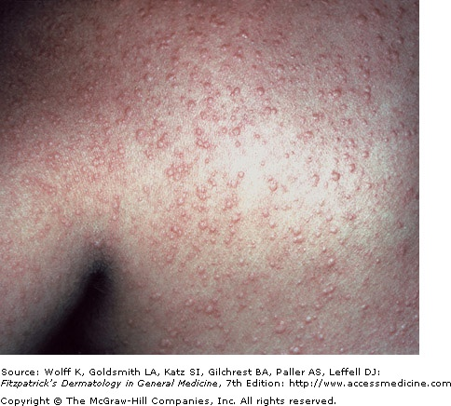
Cholinergic urticaria

Slide 22
Angioedema without wheals
C1 estrase inhibitor deiciency( C4)
Acquired angioedema | Hereditary angioedema (Autosomal dominant)
Type 1: lymphoproliferative disease Type 2: autoAb to C1 estrase inhibitor e.g. SLE | Type 1: low level of C1 estrase inhibitor Type 2: normal level of dysfunctional
C4: decreased C1q: decreased | C4 : decreased C1q: normal
Provocative factors: surgey, trauma and stress | Provocative factors: surgery, stress, trauma

Slide 23
Contact urticaria
Non-immunological | Immunological (IgE mediated) | Type Wheals appears within minutes of contact with skin or mucosa
Caused by direct effect on mast cells | Mediated by IgE | Pathogenesis
Nettle sting has histamine | Those who develop hand urticaria after contact with latex in gloves | Example
Respond to NSAIDs | Respond to anti-histamine | Treatment

Slide 24
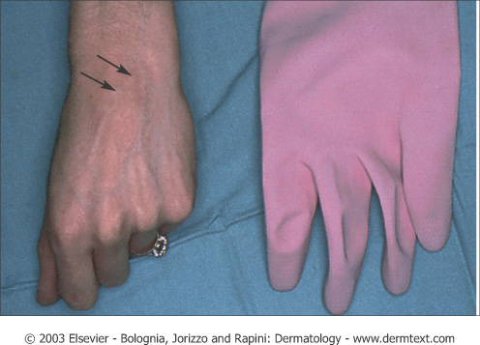
Contact urticaria

Slide 25
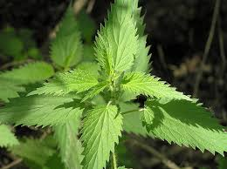
Nettle

Slide 26
Urticaria and urticarial vasculitis
Urticarial vasculitis | Ordinary urticaria | Type
Last longer than 24 hours | Individual lesion Last less than 24 hours | Duration
It leaves pigmentation | Does not leave pigmentation after it disappears | Signs
Burn, pain | Pruritic | Symptoms
Small vessel vasculitis | dermal edema | Pathology

Slide 27
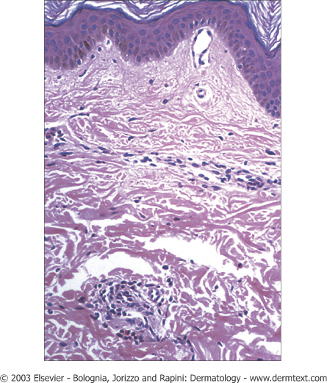
Histopathology

Slide 28
Diagnosis
Detailed history: a Hx of infection, drugs (in acute urticaria), duration, a Hx of exacerbationg factors, family history (hereditary angioedema)
Physical exam: circling the wheal e.g. more than 24 hours or pigment left after disappearance of wheal
Investigation:
. Acute urticaria: no need except(1) if not responsive to Rx ,(2) last longer than 24 hrs
. Chronic urticaria: CBC, ESR, WBC differential, C4 and if this is normal ASST
. Urticarial vasculitis biopsy
.

Slide 29
Physical urticaria challenge test
Cold urticaria: ice cube test for cold urticaria and if positive check cryoproteins such as cryoglobulin, cryofibrinogens and cold agglutinin
solar uricaria ANA
Delayed pressure urticaria: apply a weight
Cholinergic urticaria: make the patient run
Dermographism: stroke the skin

Slide 30
Treatment
Classic anti-histamines: hydroxyzine, chlorpheniramine
Second generation anti-histamines (less sedative and anti-cholinergic properties) : citrizine, loratadine
Rx of C1 estrase inhibitor deficiency :
Newer second generation : fexofenadine, desloratadine, levocitrizine
Emergency : fresh frozen plasma, C1 INH concentrate or icatibant
Maintainence: tranexamic acid (antifibrinolytic) or anabolic steroid i.e. danazol

Slide 31
Treatment paradigm
First line
Classic anti-histamines: hydroxyzine, chlorpheniramine
Second generation anti-histamines (less sedative and anti-cholinergic properties) : citrizine, loratadine
Third line
Rx of C1 estrase inhibitor deficiency :
Newer second generation : fexofenadine, desloratadine, levocitrizine
Emergency : fresh frozen plasma, C1 INH concentrate, kalbitor or icatibant
Maintainence:tranexamic acid (antifibrinolytic) or anabolic steroid e.g. danazol
Pre-operative prophylaxis: tranexamic acid or danazol
Second line
Prednisolone, cyclosporine, omalizumab
Leukotriene receptor antagonist e.g. montelukast in case of aspirin-sensitive urticaria

Slide 33
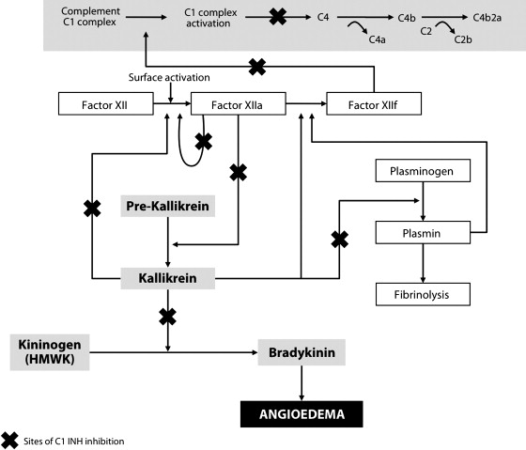
C1 estrase inhibitor is serine protease inhibitor that regulate the (1) Kallikrein-Kinin , (2) fibrinolytic and (3) complement systems

Slide 34
Tranexamic acid may work as C1 INH–sparing agents by freeing up C1 INH from its role within the fibrinolytic pathway, thereby increasing availability to the contact and complement systems

Slide 35
Thanks

