Slide 1
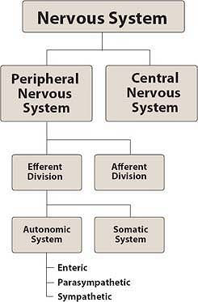

Slide 4
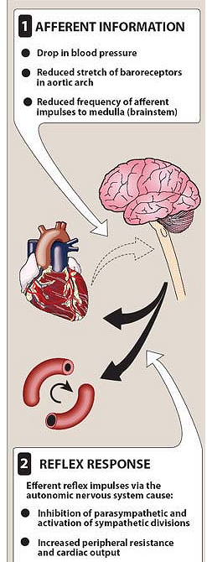

Slide 5
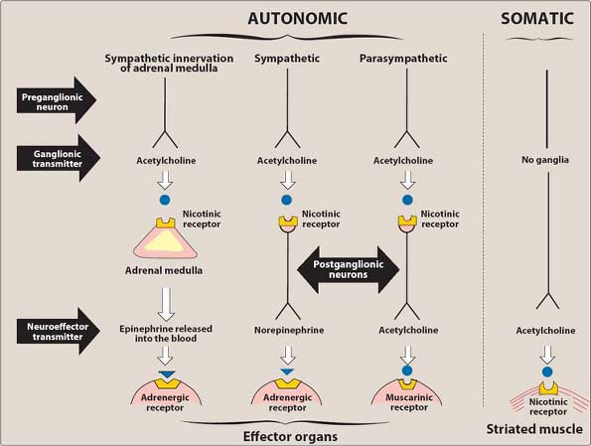

Slide 6
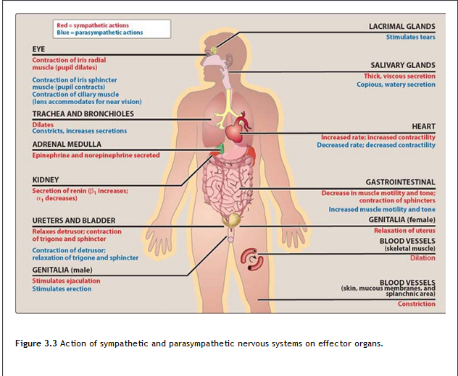

Slide 7
Functions of sympathetic nervous system
1.In response to stressful situations such as trauma, fear, hypoglycemia, cold and exercise
The effect of stimulation of sympathetic division is increase heart rate and blood pressure, to mobilize energy stores of the body and to increase blood flow to skeletal muscle and the heart divert flow from skin and internal organs vasodilatation in coronary artery of the heart dilatation of pupils and bronchioles, also affect GIT motility, function of bladder and sexual organs.
2. Fight or flight response stimulate adrenal medulla to release epinephrine and norepinephrine

Slide 8
Functions of parasympathetic nervous system
It maintain homeostasis within the body it required for life such as digestion and eliminations of waste (rest and digest), urination and defecation.
Reflex arcs: decrease blood pressure cause pressure sensitive neuron such as baroreceptor in heart, venacava, aortic arch and carotid sinus send impulse to CV center in brain lead to reflex increase sympathetic out put to heart and cause compensatory increase blood pressure and tachycardia

Slide 9
Classification
1- cholinoceptor activating drugs
2- cholinoceptor blocking drugs
3- Ganglionic blocking drugs
4- Adrenoceptor activating drugs
5- Adreoceptor blocking drugs

Slide 10
1- cholinoceptor activating drugs
A- Direct acting cholinoceptor agonist
Cholines
Alkaloids
B- Anticholinestrase (Indirect)
♦ Reversible
♦ Irreversible
1- Carbamate
2- Phosphates

Slide 11
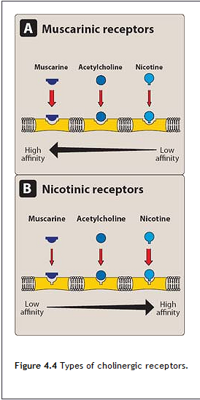

Slide 12
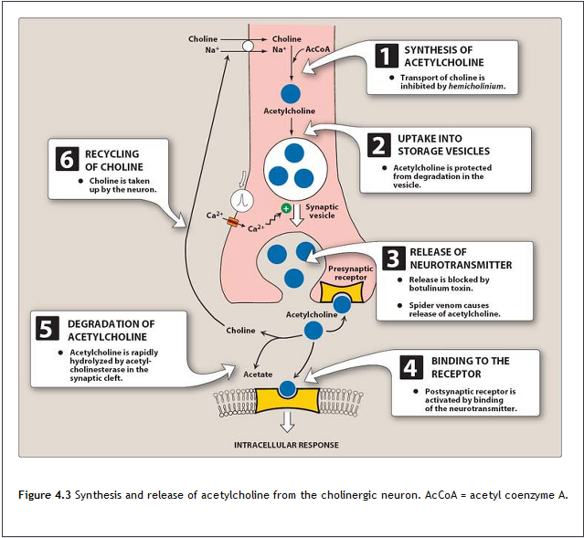

Slide 13
1- cholinoceptor activating drugs (continued)
A- Direct acting cholinoceptor agonist
cholines
a- Acetylcholine
It is a quaternary ammonium compound. It is a neurotransmitter of parasympathetic and somatic nerves as well as gangelia. It is not used therapeutically because of multiplicity of action and rapid inactivation by cholinestrases.
1- Decreases in heart rate and cardiac output
2- Decrease in blood pressure
3- Other actions: increase salivary secretion and stimulate intestinal secretion and motility, Bronchial secretion are also increased. In the eye, miosis and a contraction of ciliary muscle
b- bethanechol-
It is a quaternary amine structurally related to Ach, it not hydrolyzed by Ache, its inactivated by another estrase, it lack nicotinic action due to addition of methyl group but has strong muscarinic activity on smooth muscle of bladder and Gitract, duration 1hour, stimulate muscarinic receptor cause intestinal motility and tone, stimulate the detrusor muscle of the bladder and sphincter relaxed produce urination.
Theraputic uses: stimulate atonic bladder in post partum or post operative non obstructive urinary retention, treat urogenic atony and mega colon.
Adverse effect: sweating, salivation, flushing, decrease blood pressure, nausea, abdominal pain, diarrhea, bronchospasm.

Slide 14
c- Carbachol-
has both muscarinic and nicotinic action, biotransformed by other estrase
Action on both cardiovascular and GI system
Uses: on eye as miotic agent in glaucoma
No adverse effect because it uesd as eye drop

Slide 16
Alkaloids
a- Pilocarpine-
Tertiary amine (penetrate CNS) hydrolyzed by Achestrase have muscarinic activity, used in ophthalmology.
Uses: in glaucoma a drug of choice in emergency lowering itraocular pressure in open and closed angle glaucoma it open trabecular mesh work of schlemme canal increase drainage of aqueous humor 4-8hr action, also use topical carbonic anhydrase inhibitors dorsolamide and b-blocker timolol for treating glaucoma.
Adverse effect: sweating(diaphoresis) and salivation, blurred vision, night blindness, brow ache

Slide 17
b- Muscarine
It is of no therapeutic use but it has pharmacological interest. It is present in the fungus Amanta muscaria
c- Arecoline
It is derived from seed known as betal nut which is chewed in the east. It produces a mild dependence. It stimulates the brain and euphoria.
d- Nicotine
It is not used as a therapeutic agent but it is studied for
1- It is used to characterized nicotine receptor
2- Nicotine is pharmacologically the most active ingredient in tobacoo
3- Nicotine is a potent and rapidly acting poison

Slide 18
Nicotine at low dose stimulate to ganglia, euphoria, increase learning thought, increase blood pressure, heart rate, nausea, vomiting, urge to defecate
Nicotine in high dose ganglionic blocking, hypotension, central and respiratory paralysis, psychological and physical dependence, and medullary paralysis.

Slide 19
1- cholinoceptor activating drugs (continued)
B- Anticholinestrase ( indirect )
♦ Reversible
Physostigmine-
Neostigmine-
Edrophonium-
♦ Irreversible
Phosphates
Echothiophate –
Malathion-insecticide
Parathion-insecticide
Nerve gas- tabun, soman, sarin ( chemical weapon)

Slide 20
Physostigmine-
Tertiary amine alkaloid from plant, act on muscarinic, nicotinic, and neuro muscular junction, 2-4 hrs
Uses: increase intestinal and bladder motility, place topically to the eye with pilocarpine to decrease IOP in glaucoma, used in treatment of atropine overdose and TCA phenothiazine.
Adverse effect: on CNS lead to convulsion in high dose, bradycardia, paralysis of skeletal muscle, and GIT distress.

Slide 21
Edrophonium-
Quaternary amine, used IV in diagnosis of myasthenia gravis (an autoimmune disease caused by antibody to nicotinic receptor at NMJ) lead to increase muscle strength, structurally related to neostigmine but brief action 10-20 minutes, used to differentiate between myasthenia crises and cholinergic crises.

Slide 22
Neostigmine-
Its synthetic compound quaternary amine, its effect on skeletal muscle, moderate duration 30min-2hr, it stimulate bladder and GIT, used in treatment of myasthenia gravis used as antidote for competitive neuromuscular blocking agent (tubocurarine) in surgical operation.
Adverse effect:
Salivation, flushing, decrease blood pressure, nausea abdominal pain, diarrhea and bronchospasm , miosis,
not used as antidote to atropine
Pyridostigmine-
Used in chronic management of myasthenia gravis, 4-8hrs, as self injection
Tacrine, donepezil, rivastigmine: used in Alzheimer ( a deficiency of cholinergic neurone in CNS)
Side effect: GIT distress

Slide 23
Irreversible synthetic organophosphate compound have capacity to bind covalently to Ach Estrase result in long lasting Ach at all sites. Its toxic and used as a nerve military agent.
ecothiophate its organophosphate that covalently bind to the active site of AchE so the enzyme is permanently inactivated and restoration of AchE activity required the synthesis of new enzymes, the loss of alkyl group which is called aging make it impossible for reactivation by pralidoxime.
Action generalized cholinergic stimulation, paralysis of motor function cause breathing difficulty and convulsion, ecothiophate produce miosis, atropine reverse the muscarinic and CNS effect of ecothiophate
Uses: eye drop for chronic treatment of open angle glaucoma 1week duration
Side effect catarct

Slide 24
Organophosphate toxicity
Salivation, vomiting, abdominal cramp, diarrhea, involuntary urination and defecation, bronchoconstriction, sweating, bradycardia, hypotension, twitching, muscle weakness, miosis, convulsion, respiratory paralysis.
Treatment: prevent the source by remove the contaminated clothes, wash skin, gastric lavage, atropine IV 2mg every 15-60 min till heart rate become 70, dryness of mouth, mydriasis, artificial ventilation, diazipam for convulsion, pralidoxime IV within 12hr of toxicity

Slide 25
2- cholinoceptor blocking drugs
A- Antimuscarinic compounds
Atropine
B- Anti nicotinic:
- ganglionic blocking drugs
-neuromuscular blocking drugs

Slide 26
Atropine
Tertiary amine bind with muscarinic receptor competitively act both centrally and peripherally. When put topically to eye cause mydriasis unresponsive to light, cycloplegia (un ability to focus to near vision), last few days, increase intraocular pressure contraindicated in glaucoma
GIT antispasmodic, decrease peristalsis, decrease gastric acidity (pirenzepine)
Urinary retention, used in enuresis in children
CVS bradycardia
Anti secretary agent to block secretion of upper and lower respiratory tract in surgery
Anti dote for Cholinergic agonist crisis (poisoning)
Adverse effect: dry mouth, blurred vision (sandy eye), tachycardia, urinary retention and constipation
CNS restlessness, confusion, hallucination, collapse of circulatory and respiratory system and death

Slide 27
2- cholinoceptor blocking drugs
A- Antimuscarinic compounds
1- Tertiary amines
Atropine (Hyoscyamine) - prototype- Atropa Belladonna leaf-
Scopolamine- used in motion sickness
Homotropine- Mydrisis in eye
Tropicamide- Mydriasis, the best the duration 12 hours
Dicyclamine- Antispasmodic
Trihexyphenedyl- Parkisonism to treat extrapyramidal symptom due to anti psychotic drug

Slide 28
2- cholinoceptor blocking drugs (continued)
2- Quaternary ammonium compound
They can not penetrate CNS
Clidinium bromide (Librax)
Fridinium bromide
Isopropamide
has also ganglionic blocking, it is used as smooth muscle relaxant.
It is used in irritable bowl syndrome
probantheline
also has ganglionic blocking. It is a smooth muscle relaxant. It is used in irritable bowl syndrome
Hyoscine N-butyl bromide (antispasmine)
blocks ganglia. It is effective as a relaxant of smooth muscle.
Pipenzolate: drops for colic in children
Ipratropium: inhalation useful in asthma

Slide 29
3- Ganglionic blocking drugs ((see Lippincott
A- Non-depolarizing competitive antagonist
Trimethophan
Mecamylamine
B- Depolarizing blockers
Nicotine

Slide 30
4- Adrenoceptor activating drugs
A- Direct acting drugs
a- catecholamines
b- Non-catecholamines
i- β2 adrenoceptor agonists-
ii- α1-receptor agonist
iii- Selective α 2 –receptor agonist
B- Drugs that release noradrenaline from nerve ending
C- Drugs that block the reuptake of noradrenaline

Slide 31
4- Adrenoceptor activating drugs
A- Direct acting drugs
a- catecholamines
Adrenaline- α and β receptors
Therapeutic uses
Anaphylactic shock, increase blood pressure and bronchodilation. It is injected directly in cardiac arrest. It is mixed with local anesthesia to prolong the action of local anesthesia and reduce bleeding
Noradrenaline- mainly on α receptor
It is neurotransmitter, it is not used in therapy due to sever vasoconstriction
Isoprenaline- mainly on β receptor
It was used as bronchodilator since it causes arrhythmia
Dopamine – mainly on dopamine receptor (see Lippincott)

Slide 32
4- Adrenoceptor activating drugs (continued)
b- Non-catecholamines
i- β2 adrenoceptor agonists-
Salbutamol, Terbutaline
It used as bronchodilator and to inhibit uterine contraction in pregnancy.
ii- α1-receptor agonist
Phenylephrine
It is used topically as nasal decongest and produces prolonged vasoconstriction.
Metaraminol
It is used in hypotension associated with spinal anesthesia
Side effect : hypertensive headache and nausea
Methoxamine
It is used to overcome hypotension during surgery involving halothane anesthesia.
a Side effect : hypertensive headache and nausea
Other drugs
Naphzoline - Nasal decongestant
Zylometazoline - Nasal decongestant
Oxymetazoline - Nasal decongestant

Slide 33
iii- Selective α 2 –receptor agonist
Clonidine
It is used in essential hypertension. It can be used to minimize the withdrawal symptoms of opiates and benzodiazepine. Clonidine acts centrally to produce inhibition of sympathetic vasomotor center. Its use is limited because it causes rebound hypertension.
Xylazine
It used in veterinary medicine with anesthesia

Slide 34
3- Adrenoceptor activating drugs (continued)
B- Drugs that release noradrenaline from nerve ending
Ephedrine
It is a plant alkaloid. It has mixed action direct and indirect action. It is less effective than adrenaline and has long duration of action. Its use is declining and replaced by drugs with less side effects.
Amphetamine- see Lippincott
Tyramine- see Lippincott
C- Drugs that block the reuptake of noradrenaline
Imipramine
Antidepressant drug
Cocaine

Slide 35
Cocaine
It is a local anesthetic with peripheral adrenergic activity. It readily enters CNS and produces an amphetamine like action that is shorter lasting and more intense.
The major action of cocaine in the CNS is to inhibit dopamine reuptake into neurons in the pleasure centers of the brain. These properties and the fact that it can be smoked “snorted” or injected for rapid onset of effect have made it a very heavily a bused drug.
Adverse effects
Elevation of the blood pressure which may cause cerebral hemorrhage. Increased cardiac output may precipitate sever angina or myocardial infarction. β-stimulation cause tachycardia and may produce serious ventricular arrhythmia.

Slide 36
5- Adrenoceptor blocking drugs
A- α-receptor blocking drugs
a- Reversible
i- Non-selective- Phentolamine
It produces a competitive block of α1 and α2 receptors. The drug lasts about 4 hours. It produces postural hypotension and causes epinephrine reversal. Phentolamine-induced reflex cardiac stimulation and tachycardia are mediated by baroreceptor reflex and by blocking α2 receptor of the cardiac muscle

Slide 37
ii- Selective- (α1- antagonist) see lippincott
Prazosine, terazosin, doxazosin, tamsulosin
1- Cardiovascular effects
2- Therapeutic uses
3- Adverse effects

Slide 38
b- Irreversible- Phenoxybenzamine
It is non-selective, linking covalently to both α1 and α2 receptors.
The block is irreversible and non-competitive. Therefore the actions of phenoxybenzamine last about 24 hours after a single administration. It is used in chronic pheochromocytoma. It is also used prior to surgical removal of the tumor to prevent hypertensive crisis that result from manipulation of tissue tumor.
Side effects: It can cause postural hypotension, nasal stuffiness, nausea and vomiting. It can induce tachycardia.

Slide 39
5- Adrenoceptor blocking drugs (continued)
B- β-receptor blocking drugs- see Lippincott
a- Non-selective β-blockers
Propranolol
b- non-selective β-blockers
Nadolol, timolol
c- Selective β1-blockers
Atenolol , acebutolol, metoprolols, and esmolol
d- Antagonist with partial agonist activity
Pindolol and acebutalol
e- Antagonist of both α and β receptor
Carvedilol and labetalol

Slide 40
5- Adrenoceptor blocking drugs (continued)
C- Adrenergic neuronal blocking drugs
i- Inhibition of synthesis of catecholamine
Methyldopa
ii- Interference with intraneural vesicle
Reserpine
iii- Blockade of the release of noradrenaline
Guanithidine, clonidine

