Slide 1
Cleft lip and palate

Slide 3
Cleft lip and palate
Orofacial clefts include a range of congenital deformities most commonly
presenting as cleft lip with or without cleft palate or isolated cleft palate.
Cleft lip and palate (CLP) is a three-dimensional deformity involving soft and hard tissue that changes with growth and function

Slide 5
Epidemiology
The estimated incidence of CLP ranges from 1:500 live births to 1: 2000 live births, the incidence is highest in Asians (1:500) followed by whites(1:1000) while the lowest incidence is in African-Americans (1:2000), but this racial variation is not observed in cases of isolated cleft palate (CP) with reported incidence of 1:2000 live births.

Slide 6
Isolated cleft lip (CL) is reported in 21%-25% of the cases.
Isolated CP is reported in 33%-40% of the cases.
CLP is reported in 35%-46%.
Unilateral clefts are 9 times more common than bilateral clefts and they are more frequent on the left side than on the right.
Males are predominant in CLP population, whereas isolated CP occurs more commonly in females.
CLP can be associated with syndromes such as Van der Woude syndrome, hemifacial microsomia , velocardiofacial syndrome or DiGeorge syndrome, ectrodactyly-ectodermal dysplasia-clefting syndrome, Stickler syndrome, trisomy 13 and trisomy 18.

Slide 7
Etiology
Clefts can occur as part of a syndrome or as isolated clefts, and they are thought to be of a multifactorial etiology with a number of potential environmental and genetic contributing factors. Multiple genes have been implicated in the etiology of cleft, in addition to disturbances in growth factors or their receptors.

Slide 8
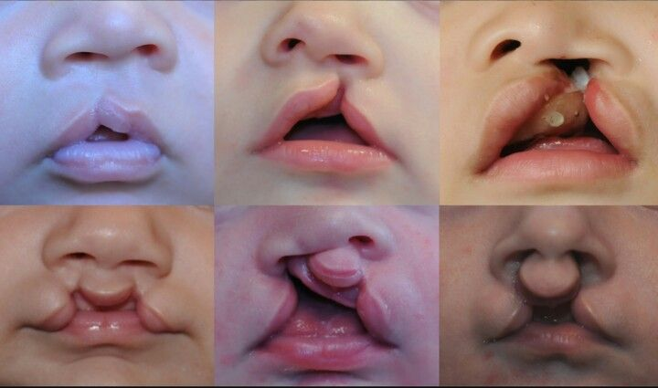
The environmental factors during pregnancy that have been established in the etiology of CLP include; smoking, alcohol, anticonvulsants, steroids, folic acid deficiency, hypoxia, retinoid, radiation, viral infections in addition to mechanical factors.

Slide 9
Classification
Many classification systems were proposed for CLP starting in 1920s. Clefts need to be described rather than categorized and the description of CLP phenotypes should include:
1. The laterality (unilateral/bilateral/median) and severity (complete/
incomplete) of the labial defect.
2. Acknowledgment of an alveolar defect.
3. Morphological characterization of the palatal defect;

Slide 10
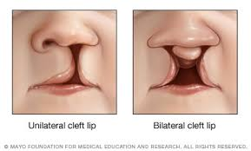
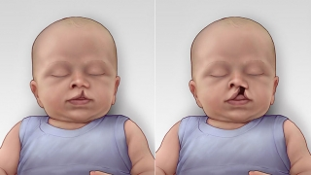

Slide 11
one of the most widely accepted classification of palatal defects is that of Victor Veau introduced in 1931
Group 1: Cleft of soft palate only.
Group 2: Cleft of hard and soft palate up to the incisive foramen, involving secondary palate alone.
Group 3: Complete unilateral cleft, extending from uvula to the incisive foramen in midline, than deviating to one side and usually extending through the alveolus at the position of the future lateral incisor tooth.
Group 4: Complete bilateral cleft, same as group 3 with two clefts extending forward from the incisive foramen through the alveolus

Slide 13
Prenatal diagnosis
Recent advances in ultrasound imaging have revolutionized prenatal
diagnosis of facial clefts, ultrasound images of clefts of the lip can be
visualized as early as 12-16 weeks (67%-93% detection rate), whereas
diagnostic images of the palate are more difficult to acquire (7%-22%
detection rate).

Slide 14
Genetic counseling should be offered to parents especially in syndromic cases. The risk of having a second child with CLP is 2-4%, this percentage increases to about 10% when 2 previous children had CLP. When one parent and one child had CLP the risk of having a second child with CLP is 17%.

Slide 15
Clinical manifestations Cleft Lip may be microform, incomplete or complete (involving the full vertical height of the lip). Complete cleft lips are often associated with an alveolar cleft.
In unilateral CL there is rotation and distortion of the vermillion of Cupid's bow and philtral landmarks on the cleft side.

Slide 16
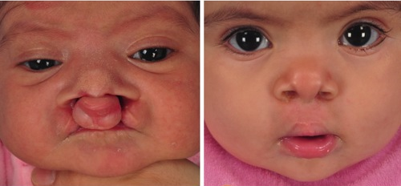
In bilateral CL, the premaxilla grows independently of the maxillae on either side and may protrude considerably, particularly in complete clefts. The prolabium, consisting of soft tissues of the premaxilla without muscle fibers, also lacks Cupid's bow and philtral columns bilaterally.

Slide 17
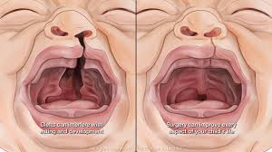
The spectrum of CP ranges from a submucous cleft to complete clefting of the primary and secondary palate. CP is primarily characterized by disorientation of palatal muscles which lead to feeding difficulties, velopharyngeal insufficiency, and speech problems.

Slide 18
Management:
Successful management of the child born with CLP requires coordinated care provided by a number of different specialties including oral and maxillofacial surgery, plastic surgery, otolaryngology, genetics, speech therapy, orthodontics, prosthodontics and others.

Slide 19
Specific goals of treatment include the following:
Normalized esthetic appearance of the lip and nose
Intact primary and secondary palate
Normal speech, language, and hearing
Nasal airway patency
Class I occlusion with normal masticatory function
Good dental and periodontal health
Normal psychosocial development

Slide 20
The management of CLP patients can be divided into:
1. Preoperative management.
2. Primary operative management.
3. Secondary operative management

Slide 21
Preoperative management
Feeding
One of the major concerns during this phase of management is feeding, this concerns not very critical in children born with isolated Cl, as they can feed quite well and even have the opportunity to breastfeed in most instances. Infants with cleft palate, on the other hand, can have difficulty in feeding due to the inability to form an adequate seal between the tongue and palate for creation of sufficient negative pressure to suck fluid from a bottle. Specialized nipples and bottles are necessary to improve feeding.

Slide 22
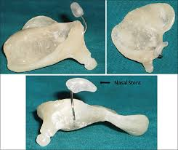
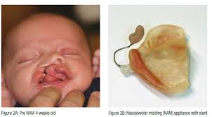
Presurgical orthopedics (PSO)
PSO entails using devices to mold the perioral structures of the infant with a CLP to reposition the nasolabial and axillary segments closer to each other. It is mainly used in the first few weeks after birth and in the months prior to palate repair.

Slide 23
The main objectives of PSO are:
Facilitating intra-oral feeding.
Improving maxillary growth.
Improving the projection of the nasal tip.
Reducing nasal deformity.
Facilitating primary lip, nasal, and alveolar surgeries.
Retracting and repositioning the premaxilla more posteriorly in patients with bilateral cleft.

Slide 24
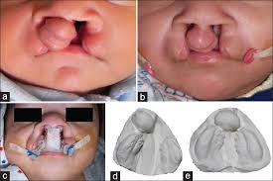
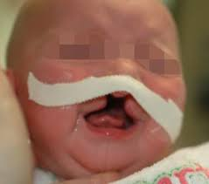
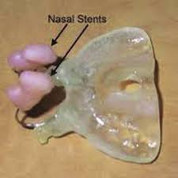
PSO treatment can be achieved by intraoral or extraoral devices or appliances or a combination of the two, examples of PSO are:
Alveolar molding
Lip strap/lip taping
Nasoalveolar molding (NAM)

Slide 25
Primary operative management
Treatment planning and timing
the safest time period for Surgery in this population of infants could be outlined simply by using the child was at least 10 weeks old, 10 pounds in weight, and with a minimum hemoglobin value of 10 g/dl.

Slide 27
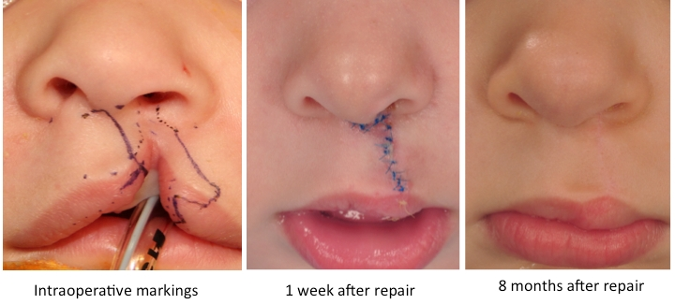
Surgical procedures for CL
The basic premise of the repair is to create a three-layered closure of
skin, muscle, and mucosa that approximates normal tissue and excises
hypoplastic tissue at the cleft margins.

Slide 28
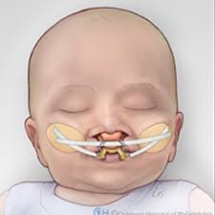
Lip adhesion
This procedure is carried out in an attempt to surgically approximate the segments of the cleft lip prior to definitive lip repair to achieve a better relationship of both the lip structures and the dental arches. It is usually used in wide bilateral clefts. It is usually completed at 3 months of age while definitive lip repair is 3-9 months later.

Slide 29
Straight line repair
Straight line closure, or the Rose-Thompson closure may be indicated for microform clefts and it is rarely used as primary technique for cleft repair as it results in notching of the lip and vertical scar contracture.

Slide 31
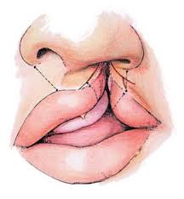
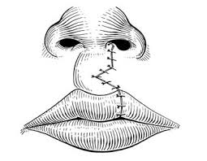
Tennison-Randall triangular flap repair
It utilizes the inter-digitation of triangular flaps (geometric design). The concept underlying the technique can be similarly compared to a Z- plasty reconstruction of the lip. This technique is based on careful measurements of specific landmarks.

Slide 32
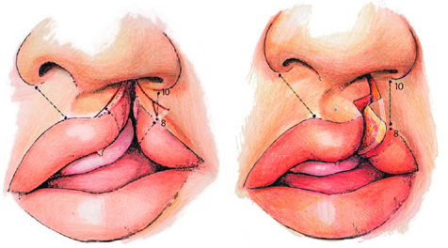
Millard's rotation-advancement flap repair
It is the most prevalently used technique in cleft lip repair. The technique utilizes downward rotation of the superiorly displaced medial lip segment with advancement of the lateral lip flap to correct the defect below the nose. Many modifications for the original procedure were described.

Slide 33
Bilateral CL repair
Repair of the bilateral CL is often significantly more difficult than the unilateral CL repair due to the presence of the premaxilla and prolabium. The prolabium is oftentimes deficient in muscle and vermillion, is small, and attached to the nasal tip with little or no columella present. The commonly discussed treatment options include; cleft repair that may or may not include a primary rhinoplasty, and a lip adhesion with a delayed lip repair several months later. Infant orthopedics, nasoalveolar molding, and taping of the lip can be considered as an option with any of the techniques described earlier.

Slide 34
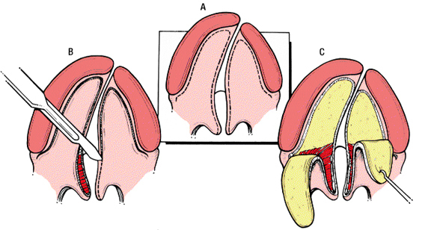
Surgical procedures for CP
CP repair requires the mobilization of multilayered flaps to reconstruct
the defect in a layered fashion by first closing the nasal mucosa and then the oral mucosa, the surgeon must also reconstruct the musculature of the velopharyngeal mechanism. Therefore, the soft palate is closed in three layers by approximating the nasal mucosa, velar musculature, and the oral mucosa.

Slide 35
The hard palate portion is closed in two layers using nasal mucosa flaps and then oral mucosa flaps. Both the hard and soft palate repairs must be done in a tension-free manner to avoid wound breakdown and fistula formation. Many techniques have been described in the literature with many variations, each method having its theoretical advantages and limitations:

Slide 37
The von Langenbeck technique:
It involves creating bi-pedicled mucoperiosteal flaps on both sides of the cleft. The nasal side of the cleft is closed first, using redundant mucoperiosteum from the incision along the cleft edge. Then the bipedicled flaps are approximated to cover the oral surface of the cleft.

Slide 38
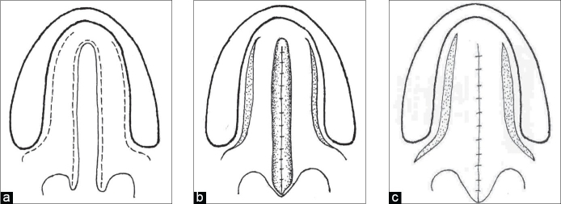

Slide 39
V-Y pushback technique
Many authors believed that the von Langenbeck procedure resulted in
insufficient length of the soft palate and advocated the V-Y pushback technique. It has the advantage of lengthening the palate and repositioning the levator muscle in a more favorable position. This technique also has a higher rate of fistula in complete cleft palate.

Slide 41
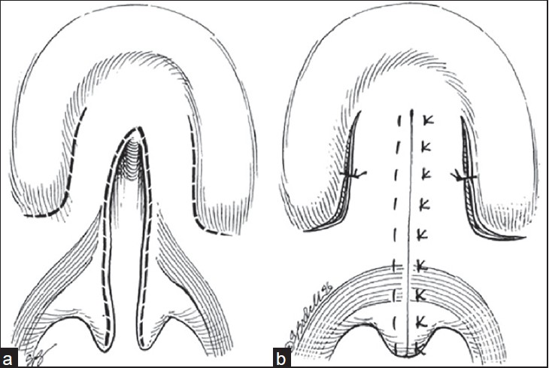
Two-flap technique
In this procedure a full-thickness mucoperiosteal flap is elevated on each side of the cleft, which preserves the palatal neurovascular bundle.

Slide 42
The Furlow technique
It essentially consists of repairing palatal clefts using Z-plasties of the
oral and nasal mucosa. The theoretical advantage is that the soft palate may be lengthened while preventing longitudinal scar contracture and palatal shortening.

Slide 43
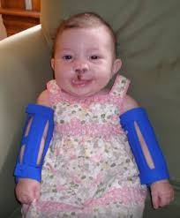
Postoperative care
Normal feeding can resume as soon as the infant is stable, with the exception that active sucking is to be avoided for at least 2 weeks.
Elbow immobilizers maybe used.
Regular follow-up.

Slide 44
Complications
Immediate postoperative complications include breakdown of the repair due to tension, palatal ischemia, secondary pressure, secondary trauma, or bleeding. It may result in the formation of an oro-nasal fistula which most commonly forms at the junction of the hard and soft palate, The risks of fistula development relate to the type of palate repair, surgical experience, cleft width, cleft type, and even age at closure. Other long-term complications include midface growth deficiency, velopharyngeal incompetence, recurrent fistula, and sleep apnea.

Slide 45
Secondary operative management
Alveolar bone grafting
Goals of alveolar bone reconstruction
1. To provide bone support and adequate attached gingival width for teeth adjacent to the cleft.
2. To close the remaining oro-nasal fistula.
3. To improve support of the nasal alar base and lip on the affected side(s).
4. To allow normal eruption of the permanent teeth in the cleft area and providing sufficient bone for the placement of dental implants, where needed.

Slide 46
5. To create an appropriate ridge form to allow for optimization of orthodontic care and dental alignment.
6. To allow for stabilization of the premaxillary segment and to provide continuity of the maxilla as a whole.
7. To improve nasal symmetry.
8. To provide support for the upper lip.

Slide 47
Timing of the alveolar bone reconstruction was one of the most controversial issues. Generally it can be grouped according to timing into:
Primary (early) grafting; which was defined as that performed simultaneously with lip repair, performed at younger than 2 years of age is considered primary grafting, or as grafting performed before the palate is repaired.

Slide 48
Secondary (delayed) grafting: which can also be divided into:
Early secondary: before the eruption of the permanent incisor teeth (3-6 years). The literature does not support early secondary grafting.
Secondary (mixed dentition): before the eruption of the maxillary canine, (6-12 years), it can also be divided into early (6-8 years) and late secondary (8-12 years).

Slide 49
Ideally the patient is grafted between the ages of 8 and 12 years with a maxillary canine root that is one half to two thirds developed, some authors advocated the early secondary grafting (6-8 years) to preserve the lateral incisor especially if present in the posterior segment.
Late grafting: after 12 or 13 years of age, after the eruption of the permanent canine.

Slide 50
Common presenting problems
Discharge and smell from the nose.
Oral food/fluids leaking from the nose.
Poor speech.
Inability to suck up a straw or low up balloons.
Poor appearance of the incisor teeth.
Missing or supernumerary teeth within the cleft area.
Difficulty cleaning teeth in the cleft area.
Poor facial appearance

Slide 51
Assessment of the patient
history and clinical examination
radiographic examination panoramic (OPG), occlusal and periapical films are essential for treatment planning. CBCT
Study models
Inter-occlusal acrylic wafer
Orthodontic treatment

Slide 52
Sources of bone graft materials
A variety of autologous, allogeneic, and xenogeneic bone materials;
rhBMP; and growth factors have been used for correcting alveolar cleft. Of these, fresh autologous cancellous bone is the ideal bone graft source. Both cortical and cancellous bones can be used for a bone graft, but cancellous bone is known to be better because of the cell transfer and revacularization in osteo-induction and osteoconduction.

Slide 53
lliac crest, is the most commonly used bone in bone grafting because
it is easy to harvest, it can provide a large amount of cancellous bone, and cleft preparation can be performed at the same time. However, the disadvantages of using this bone are possible scar postoperative pain, delayed ambulation, and risk of cutaneous nerve injury

Slide 54
- Cranium; it has little resorption, less postoperative pain, and the advantage of a concealed scar. However, a long operative time and serious side effects such as hematoma, seroma, dural tear, dural exposure, and cerebrospinal fluid leakage are possible.

Slide 55
Tibia it results in less bleeding, postoperative pain, operative time, and scarring, as well as faster ambulation and a shorter hospital stay. However, it yields relatively small amounts of bone in adult patients, and it may be necessary to obtain the product from both legs if a large amount is required. Moreover, in children there is possibility of growth disturbance due to injury of the epiphyseal cartilage.

Slide 56
- Mandibular symphysis; the mandible has the same embryonic origin as the maxilla which may contribute to low resorption, surgery is in the same operative field and postoperative discomfort is reduced. However, there is a risk of roots and mental nerve damage, and the amount that can be collected depends on the development of the mandible.

Slide 57
Bone graft substitutes; including demineralized freeze-dried bone (DFDB), freeze-dried bone (FDB), freeze-dried matrix (FDM) hydroxyapatite (HA) or tricalcium phosphate (TCP). Recently the addition of growth factors such as platelet-rich plasma (PRP) and platelet rich fibrin (PRF) with graft materials have used.

Slide 58
Postoperative care
Antibiotics usually start before the incision and continue postoperatively
for 7-10 days along with chlorhexidine mouth wash, excellent oral hygiene and good nutrition are encouraged, patients and parents are instructed to liquid and soft diet for 2-3 weeks and to avoid any trauma to the operative site.

Slide 59
Complications
- Wound dehiscence which is managed by debridement and antimicrobial mouth washes with or without systemic antibiotics.
- Infection which is managed by conservative debridement, daily irrigation and packing with oral antibiotics.
- Persistent fistula which may require subsequent procedures.

