Slide 1
Frozen shoulder ( adhesive capsulitis)
Dr. Ihsan Alshamy
F.I.B.M.S

Slide 2
definition
Frozen shoulder is :characterized by progressive pain and stiffness of the shoulder which usually resolves spontaneously after about 18 months.

Slide 3
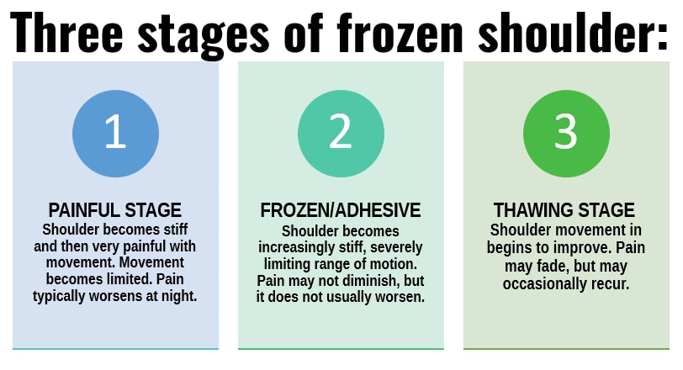
Clinical features

Slide 4
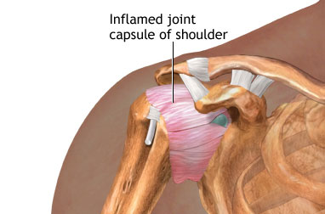
pathology
active ﬁbroblastic and myoﬁbroblastic proliferation in the rotator interval, anterior capsule and coracohumeral ligament.

Slide 5
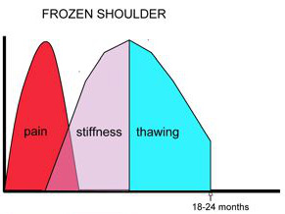
diagnosis
Usually clinical ; typical successive phases of pain, stiffness , thawing phase in presence of normal x-ray.

Slide 6
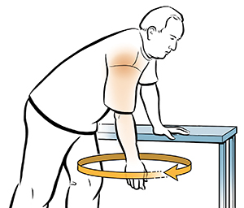
Treatment
1- Conservative treatment
* NSAI
* Physiotherapy ( pendulum exercises)
* Intraarticular injection of steroid

Slide 7
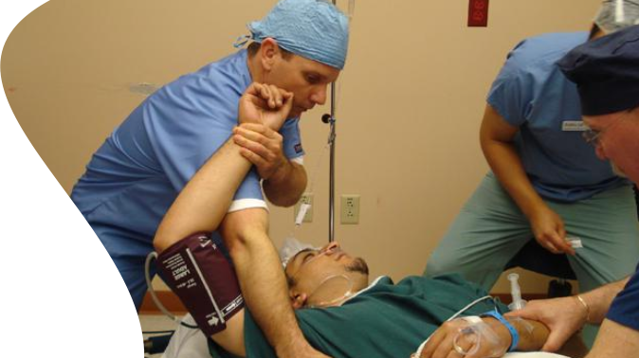
2- MAU ( Manipulation under anesthesia) external rotation --abduction -- flexion

Slide 8
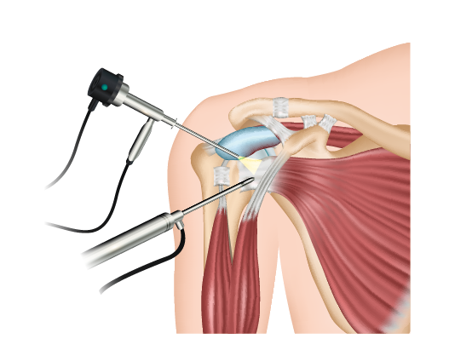
3- surgery ( open or arthroscopic capsular release)

Slide 9
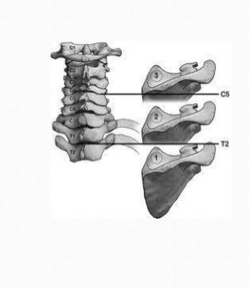
Congenital elevation of the scapula
The scapulae normally complete their descent from the neck by the third month of fetal life; occasionally one or both scapulae remain incompletely descended, 2 recognized syndromes ; sprengle deformity and klippel-feil syndrome.

Slide 10
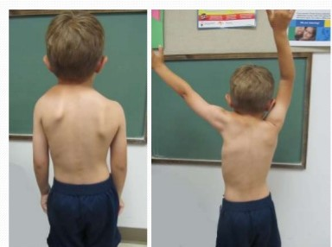
Sprengel’s deformity
Usually unilateral, may associated with cervical spine anomalies, the scapula on affected side looks high and prominent, the shoulder movement is limited

Slide 11
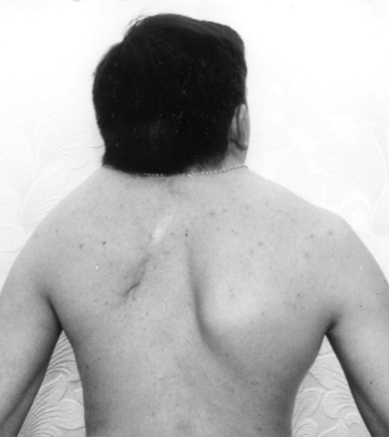
Klippel–Feil syndrome
Usually bilateral ,associated with marked anomalies of the cervical spine, short neck, low hair line

Slide 12
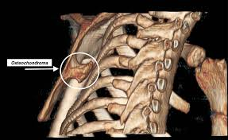
GRATING (SNAPPING) SCAPULA
grating sensation or clicking on moving the arm; the condition is often painless, Usually no cause is found.
X-rays and CT scan of the scapula should be obtained to exclude an osteochondroma on the undersurface of the scapula. If so; excision of the osteochondroma, if not, just conservative treatment.

Slide 13
Problems of elbow joint

Slide 14
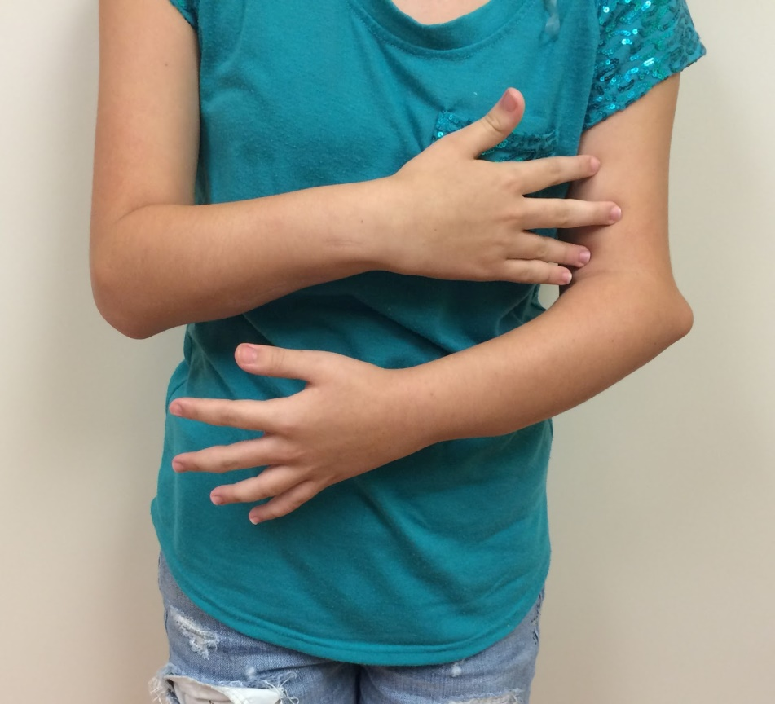
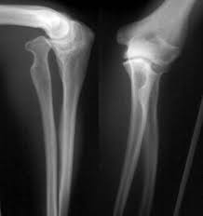
CONGENITAL DISLOCATION OF THE RADIAL HEA
usually dorsal dislocations, the radial head present as a lump on the lateral side of the elbow. It become dome shaped dueto unrestrained growth.
Treatment: excision of radial head.

Slide 15
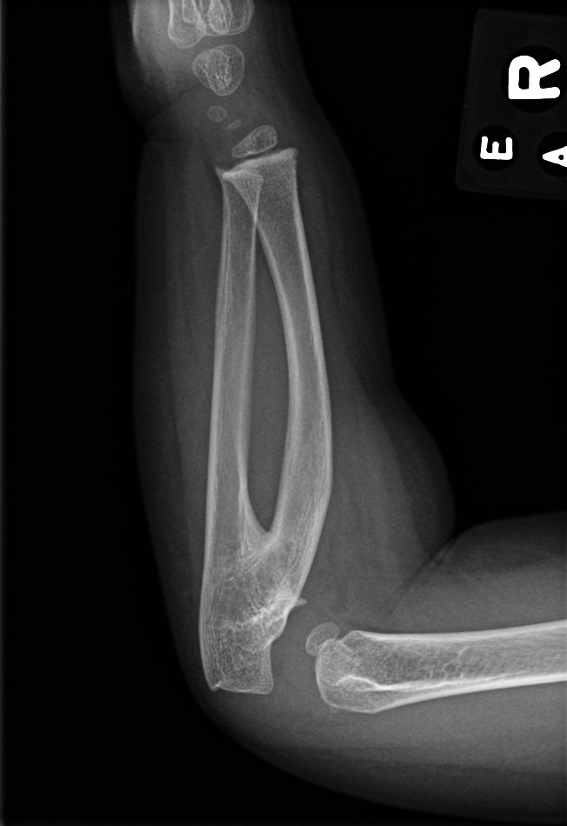
Radioulnar synostosis
Fusion of proximal ulna to the radius, results in sever limitation of forearm pronation and supination. Excision of synostosis is unsuccessful, rotation osteotomy in functional position is the only treatment.

Slide 16
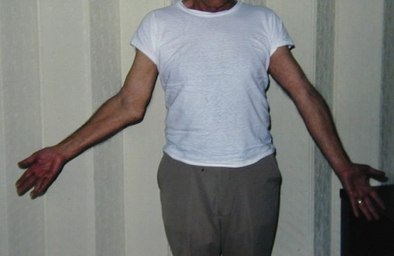
CUBITUS VALGUS
The most common cause is long-standing non-union of a fractured lateral condyle, there is an increased risk of a delayed or tardy ulnar nerve palsy, The deformity itself requires no treatment but the ulnar nerve should be transposed anterior to the medial epicondyle.

Slide 17
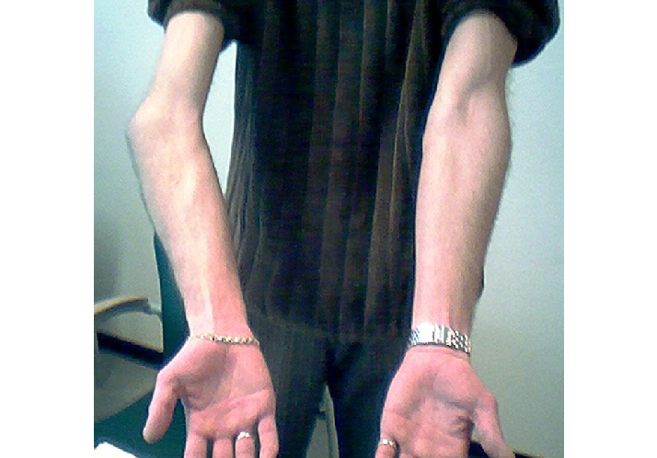
CUBITUS VARUS (‘GUNSTOCK’ DEFORMITY)
The most common cause is malunion of a supracondylar fracture in childhood. The deformity corrected at skeletal maturity, the surgery called wedge osteotomy of distal humerus

