Slide 1
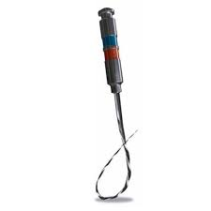
NiTi intracanal instruments
Balsam M. Mirdan

Slide 2
Classification
They are divide in to 6 Groups:
Group I: Manually-operated instruments, such as barbed broaches and K-type and H-type instruments.
Group II: Low-speed instruments with a latch-type attachment. Typical instruments in this group are Gates-Glidden (GG) burs and Peeso reamers. They are typically used in the coronal part of the canal and never used in a canal curvature.
Group III: Engine-driven nickel-titanium rotary instruments. They consist of a rotating blade that can safely be operated in, and adapt itself to, curved root canals. Most engine- driven instruments available today belong to this group.

Slide 3
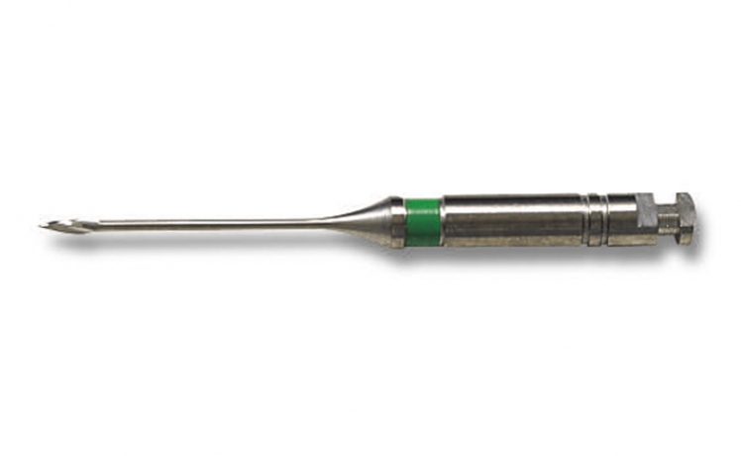
classification
Increase cutting efficiency
Gates glidden

Slide 4
Classification
Group IV: Engine-driven instruments that adapt themselves three-dimensionally to the shape of the root canal. Like other nickel-titanium instruments, they adapt to the shape of the root canal longitudinally but additionally they adapt also to the cross-section of the root canal. There is currently only one instrument in this group: the self-adjusting file (SAF).
Group V: Engine-driven reciprocating instruments.
Group VI: Ultrasonic instruments.

Slide 5
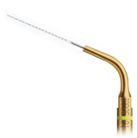
Ultra sound tips

Slide 6
Engine-driven reciprocating instruments

Slide 7
From Stainless Steel to Nickel Titanium
Stainless steel
stiffness
Inherent in the material used, stainless steel files have a high stiffness that increases with increasing instrument size and causes high lateral forces in curved canals
These restoring forces attempt to return the instrument to its original shape and act on the canal wall during preparation, influencing the amount of dentin removed.

Slide 8
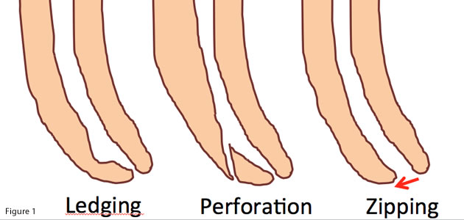
Resulting
transportation and canal aberrations (including ledges, zippings and perforations) leave a significant portion of the canal wall un-instrumented, along with the creation of an irregular cross-sectional shape that is harder to obturat

Slide 9
“shape memory alloys”
NiTi behaves like two different metals, as it may exist in one of two crystalline forms. The alloy normally exists in an austenitic crystalline phase that transforms to a martensitic structure on stressing at a constant temperature. In this martensitic phase only a light force is required for bending. If the stress is released, the structure recovers to an austenitic phase and its original shape

Slide 10
“shape memory alloys”

Slide 11
Fracture in rotary instrumeny
torsion
mode
flexural
A crown-down approach is recommended to reduce torsional loads (and thus the risk of fracture) by preventing a large portion instrument from engaging root dentin (known as taper lock)
n of the tapered rotating

Slide 12
Rotary file

Slide 13
precaution
Avoid too much pressure is applied to the file. Never force a file! These instruments require a passive technique.
If resistance is encountered, stop immediately, and before continuing, increase the coronal taper and negotiate additional length, using a smaller, 0.02 taper stainless steel hand tile.
A nickel-titanium instrument should not be used to bypass ledges.

Slide 14
Component of endodontic instrument
Flute:
Groove in the working surface used to collect soft tissue and dentine chips removed from the canal wall.
The effectiveness of the flute depends on its depth, width, configuration, and surface finish.
Its effectiveness depends on its angle of incidence and sharpness.

Slide 15
Flute
Flutes are grinding out a groove of specific profile in a cylindrical or conical blanck NiTi.
Adjoining flutes creat a cutting blade.
Flutes are characterize by:
Depth of the flutting.
Pitch.
Helical angle
Confegration of flutting

Slide 16
Flute

Slide 17
Component of endodontic instrument
Radial land/ marginal width:
Is a flat cutting surface present between two grooves/ flutes.
The land touches the canal walls at the periphery of the file and reduces the tendency of the file to screw into the canal,
Reduces transportation of the canal.
Reduces the propagation of microcracks on its circumference,
Supports the cutting edge, and Limits the depth of cut.

Slide 18
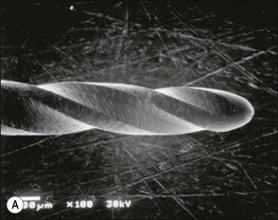
Disadvantages:
Clogging of the instruments,
Friction and heat build-up,
Inefficient cutting.

Slide 19
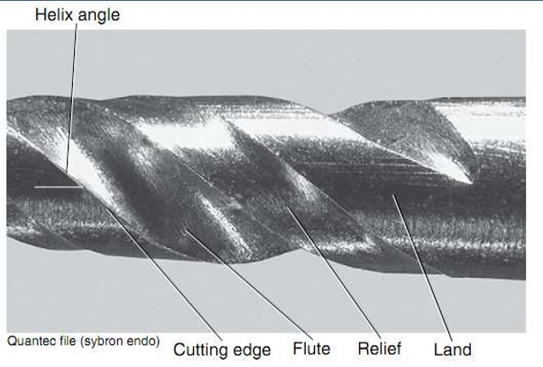
Relief:
Surface area of land that is reduced to a certain extent to reduce frictional resistance.
Helix angle:
The angle the cutting edge forms with the long axis of the file. Augers debris collected in the flute from the canal.
This angle is important for determining which file technique to use.

Slide 20
Tips
Is the element of the working part that perform the guiding function, it is the first part that starts cutting through then the blades will enlarge the canal wall.
The tipe might have sharp end ( active tip)
or blunt end( passive tip)

Slide 21
Tips

Slide 22
Tips
The passive tip reduce the deviation from the canal axis
Limits canal perforation of transportation or ledge formation

Slide 23
Tapering

Slide 24
Rake angle
If the file is sectioned perpendicular to its long axis, the rake angle is the angle formed by the leading edge and the radius of the file. If the angle formed by the leading edge and the surface to be cut (its tangent) is obtuse, the rake angle is said to be positive or cutting.
If the angle formed by the leading edge and the surface to be cut is acute, the rake angle is said to be negative or scraping.

Slide 25
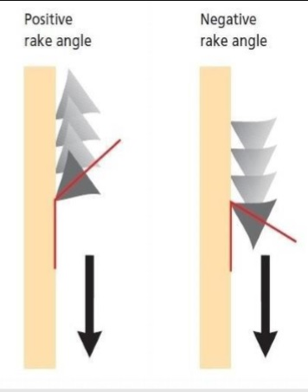
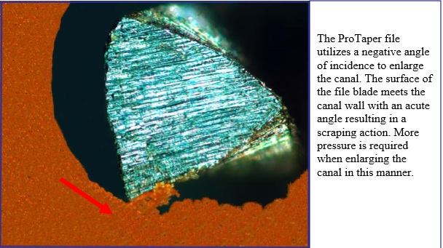
Rake angle

Slide 26
Non ISO systems
Profile system was introduce in 1994
Have increase tapering compared with conventional hand instrument.
The tips of the profile series 29 rotary instrument had a constant proportion of diameter increment (29%).
The constant percentage increase offers a smooth, progressive enlargement of the canal. They're also designed with the same U file flute and safety transition angle as our Profile ISO files.
Radial lands and parallel central core to increase the flexibility
Lateral views show a 20 degres helix angle, constant pitch, bulet shaped non cutting tips and with slight negative rake angle.
This configuration facilitates a reaming action.
Debris is transported coronally and effectively from the root canals
The prefered speed 275-325 rpm

Slide 27
Profile system

Slide 28
Profile GT files

Slide 29
Profile GT
Greater tapering
Comes in four tapering
0.06, 0.08, 0.10 and 0.12
Maximum diameter of working part coronally 1mm
Have variable pitch and increasing number of flutes in progression to the tip.
The apical instrument diameter is 0.2mm
The instrument tips are non cutting and round

Slide 30
ProTaper universal system

Slide 31
Reduces the contact area between the file and dentin

Slide 32
Compere

Slide 33
Shows modified K-type file with sharp cutting edges and no radial lands

Slide 34
Protaper stable core and flexible for smaller files

Slide 35
3 shapping 3 finishing

Slide 36
ProTaper Universal system
The set is increased by 2 larger finishing file
The 3 finishing files and a set designed for retreatment procedure.
Varies tapering for this system along the long axes.
The 3 shaping files have taper increase coronally, and the reverse pattern is seen in the fifth finishing file.

Slide 37
The difference between

Slide 38
Smart taper
name | Diameter @ tip | Diameter @ D no.
S1 | 0.18 | @D14=1.2
S2 | 0.2 | @D14=1.1
F1-F2-F3-F4&F5 | 0.2,0.25,0.3,0.4&0.5 | @D3=0.07,0.08,0.09,0.05,0.04
Fishing file tips are rounded non cutting end

Slide 39
Recommended for the ProTaper
Preparation of glide path
The use of lateral brushing working stroke. Such a stroke allows the clinician to direct larger files coronally a way from danger zones and counteract any “threading-in” effect.

Slide 40
RaCe, Bio Race
The RaCe was manufactured since 1999 by FKG.
The name stands for remear with ulternating cutting edges. This design aimed at reducing the tendency to thread the file into the root canal.
Cross sections are triangular or square for #02 instruments with size #15 and #20 tips.
The surface quality of RaCe instrument is done by electropolishing.
The tips are round and non cutting

Slide 41
RaCe endofile
Alternating cutting edges
The exclusive patented file design avoids screwing-in effect and allows a better control of the instrument’s progression
1- Sharp edges for an optimum cutting.
2- Thin core for increased flexibility.
3- More space for debris removal

Slide 42
RaCe
Optimal cutting efficiency Triangular cross-section with sharp edges Cuts better and faster, without any pressure
(1) The smaller core grants a higher flexibility
(2) and allows a better progression in curved canals More space for debris removal
(3), improving debris evacuation to avoid instrument blocking

Slide 43
RaCe
Exclusive rounded safety tip* Perfect centering of the instrument in the canal Bypasses irregularities and avoids lateral canals Less risk of perforations and ledges *Except for D-Race first instrument (DR1) which has an active tip.
Electrochemical polishing Enhanced resistance against fatigue and corrosion The treatment eliminates surface imperfections, reducing drastically the risk of weak points (micro-cracks) The resulting shiny surface allows better cleaning and disinfection, improving the sterilization process

Slide 44
Twisted file
In 2008, SybronEndo presented the first fluted NiTi file.
Manufactured by plastic deformation, a process similar to the twisting process that is used to produce stainless steel K-files.
According to the manufacturer, a thermal process allows twisting during a phase transformation into the so called R-phase of nickel-titanium.
The instrument is currently available with size #25 tip sizes only, in taper .04 up to .12.

Slide 45
Twisted file

Slide 46
Twisted file
Twisted Files size #25 .06 taper were more flexible than ProFiles of the same size.
The manufacturer recommends a conventional crown-down technique after securing a glide path with a size #15 K-file.
Specifically, for a “large” canal, tapers .10 to .06 should be used, and in a “small” canal, tapers .08 to .04 are recommended.

Slide 47
ProTaper Next
Protaper Next
The convergence of a variable tapered design on a given file (ProTaper Universal), innovative MWire technology, and a unique offset mass of rotation.
Off-centred, rectangular cross section giving the files a unique, snake-like swaggering movement.
This improved action creates an enlarged space for debris removal, optimizes the canal tracking and reduces binding.
X1, X2, X3, X4, and X5
Corresponding to sizes: 17/04, 25/06, 30/07, 40/06, and 50/06, respectively.
Recommended speed is 300RPM with a

Slide 48
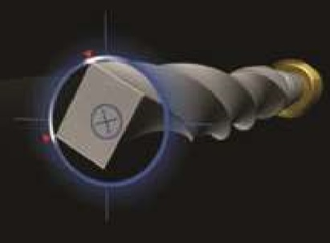
ProTaper Next
M-Wire technology: Improves the resistance to cyclic fatigue by almost 400% when comparing files of the same tip diameter, taper and cross-section.
Offset mass of rotation: Asymmetrical rotary motion and, at any given crosssection, the file only contacts the wall at 2 points.

Slide 49
X1, X2, X3, X4, and X5
Corresponding to sizes: 17/04, 25/06, 30/07, 40/06, and 50/06, respectively

Slide 50
PTNext
Clinically, this provides 3 significant advantages: Reduced engagement due to the swaggering effect which limits undesirable taper lock.
Affords more cross-sectional space for enhanced cutting, loading, and augering debris.
Allows any PTN file to cut a bigger envelope of motion compared to a similarly-sized file with a symmetrical mass and axis of rotation.
This means a smaller-sized and more flexible PTN file can cut the same-size preparation as a larger and stiffer file with a centered mass and axis of rotation.

Slide 51
Wave one file
The WaveOne single-file reciprocating system
Single-use, Single-file system to shape the root canal completely from start to finish.
M-Wire technology.
Improving strength and resistance to cyclic fatigue by up to nearly four times in comparison with other rotary NiTi files.
At present, there are three files in the WaveOne single-file reciprocating system available in lengths of 21, 25 and 31 mm

Slide 52
Wave one file

Slide 53
Wave one file
The WaveOne Small file is used in fine canals. The tip size is ISO 21 with a continuous taper of 6 %.
The WaveOne Primary file is used in the majority of anals. The tip size is ISO 25 with an apical taper of 8 % that reduces towards the coronal end.
The WaveOne Large file is used in large canals. The tip size is ISO 40 with an apical taper of 8 % that reduces towards the coronal end

Slide 54
Wave one file
The instruments are designed to work with a reverse cutting action.
All instruments have a modified convex triangular crosssection at the tip end, and a convex triangular cross-section at the coronal end . This design improves instrument flexibility overall

Slide 55
Wave one file
The specially designed NiTi files work in a similar but reverse “balanced force” action using a preprogrammed motor to move the files in a back and forth “reciprocal motion”
The counter-clockwise (CCW) movement is greater than the clock-wise (CW) movement. CCW movement advances the instrument, engaging and cutting the dentine.
CW movement disengages the instrument from the dentine before it can (taper) lock into the canal.
Three reciprocating cycles complete one complete reverse rotation and the instrument gradually advances into the canal with little apical pressure required.

Slide 56
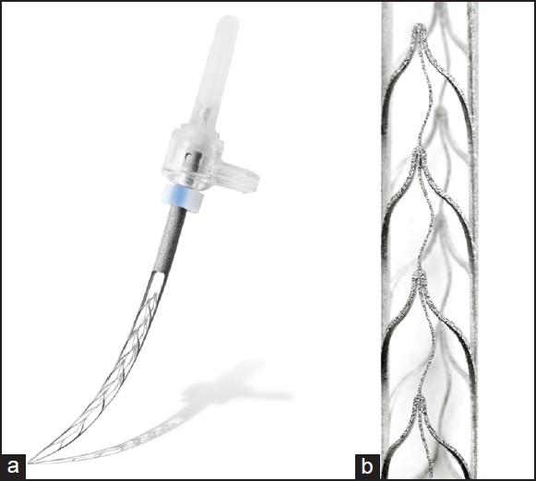
Self-adjusting file
The instrument is made as a hollow, thin NiTi lattice cylinder that is compressed when inserted into the root canal and adapts to the canal’s cross-section.
It is attached to a vibrating handpiece.
Continuous irrigation is applied through a special hub on the side of its shank.

Slide 57
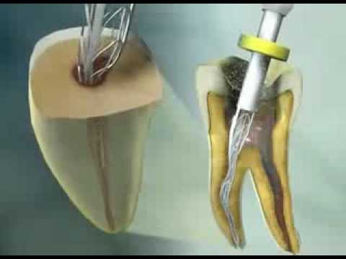
Self-adjusting file
The SAF instrument adapted into a root canal that was initially prepared with #20 K-file.
Right: A#20 K-file in the canal.
Left: The SAF file in its relaxed form.
Center: The SAF file inserted into the same narrow canal.
It will apply delicate pressure on the canal wall, attempting to resume its original shape.

Slide 58
Self-adjusting file
The abrasive surface and details of the lattice of the SAFinstrument.
The extreme elasticity is the total of the elasticity of each of the delicate NiTi segments.
During operating requirements are:
continuous irrigation unit used with the SAF instrument.
The unit has two containers and provides a continuous flow (low pressure, 5 ml/min) of either irrigant (i.e., sodium hypo-chlorite and edTA) through double silicon tubes that are connected to the hubs on the front of the device.
It is controlled by finger-operated switches located on the handpiece

Slide 59
Thank you

