Slide 1
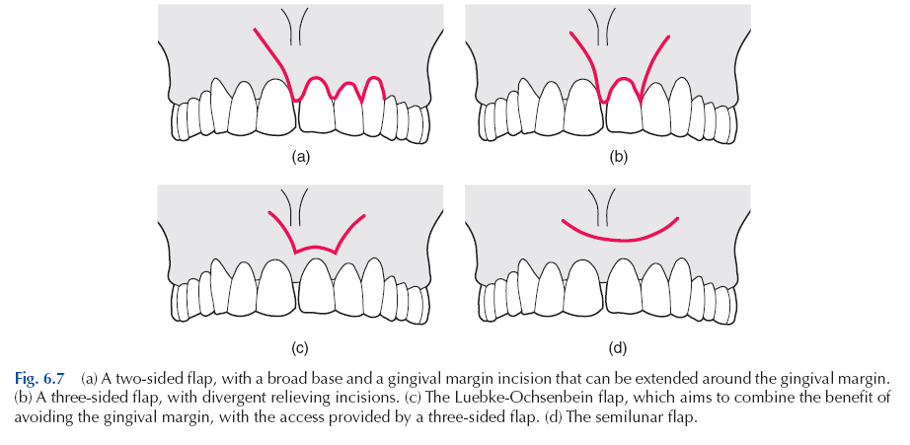
TYPES OF FLAPS

Slide 2
SOFT TISSUE MANAGEMENT
A: CONSIDERATIONS IN FLAP DESIGN
1. Number of teeth involved
2. Length and shape of roots involved
3. Presence or absence of periradicular pathosis
4. Extent of periradicular lesion
5. Sulcular depth
6. Location and size of frenum and muscle attachments
7. Approximating anatomic structures.
8. Access needed.
9. Types of restorations in surgical area.
10. Width of attached gingiva.

Slide 3
B: (Principles of flap design)
1. Incision is made with a firm, continuous stroke.
2. Incision should not cross underlying bony defect that existed prior to surgery, or is produced by surgery…….
Vertical incisions are made in the concavities between bony eminences.
Termination of the vertical incision at the gingival crest must be at the line angle of the tooth, dental papilla should be included or excluded.
5. Do not extend the vertical incision beyond the depth of the muco-buccal fold
6. Base of the flap must be broader than free edge (Supraperiosteal blood vessels run vertically, try not to transect them)
7. Periosteum must be reflected as an integral part of the flap.
8. Retractor must rest on bone and not impinge on soft tissue
9. Any tissue removed must be submitted for biopsy
10. Suture from unattached to attached tissue.

Slide 4
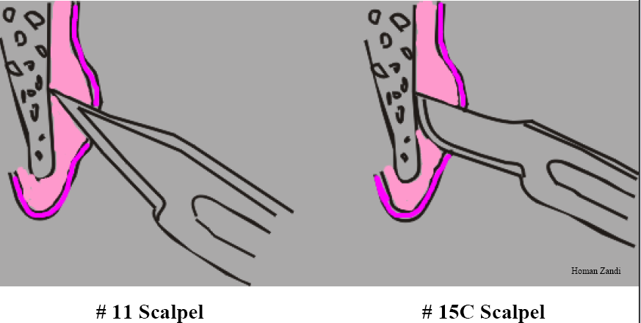
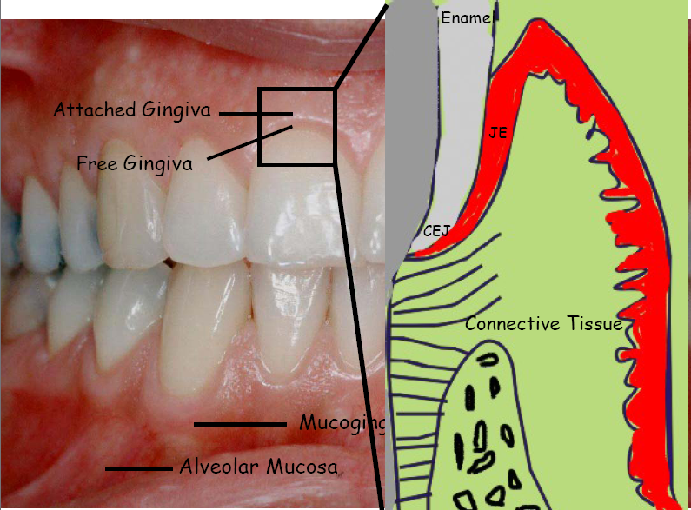
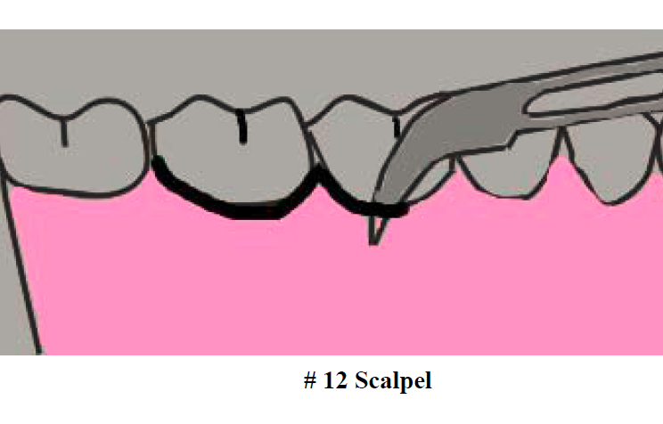

Slide 5
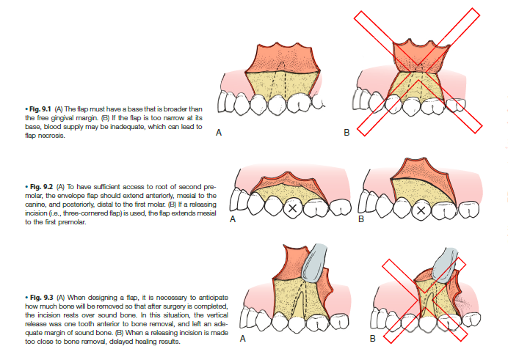

Slide 6
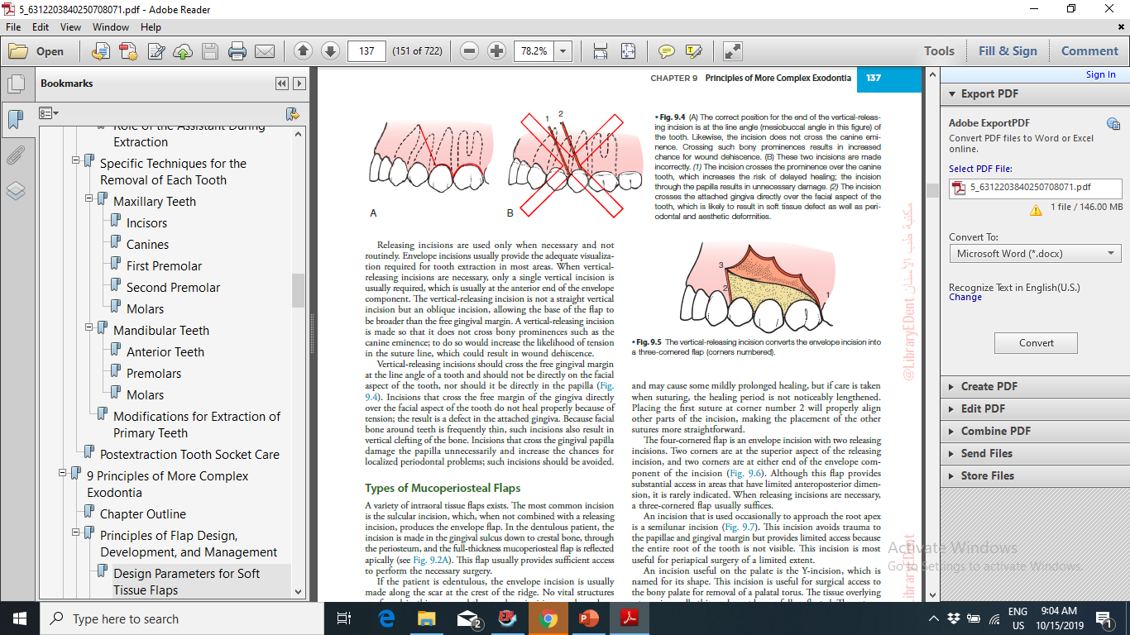

Slide 7
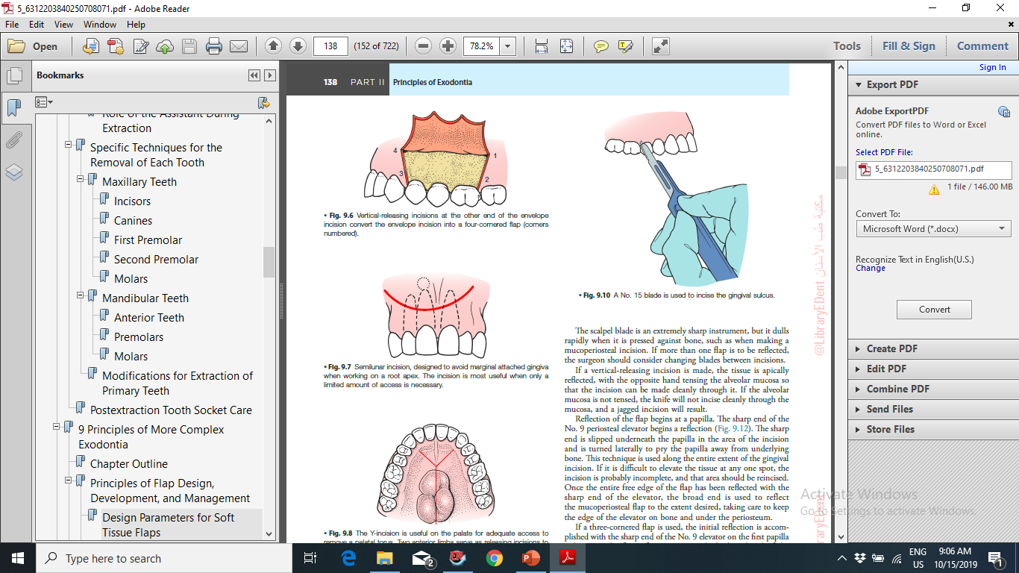
1-Semilunar flap
Advantages
- Fast, easy to reflect
- Marginal and interdental gingiva are not involved
- Unaltered soft tissue attachment level
- Crestal bone is not exposed
- May be used for an extremely long root in certain situations (long maxillary canine)

Slide 8
1-Semilunar flap
Disadvantages:-
Excessive scarring
Disruption of blood supply to unflapped tissues
Flap shrinkage
Difficult flap re-approximation and wound closure
Delayed, secondary intention healing with more postsurgical sequelae
Limited apical orientation (cannot visualize root eminences and other landmarks)
Limited use in mandibular surgery
May cross bony cavity
Cannot extend flap
Least amount of access and convenience

Slide 9
2-Triangular (intrasulcular) - One vertical releasing incision
Advantages
- Excellent wound healing potential
- Minimal disruption of vascular supply to flapped tissues
- Excellent visibility
- Can view the entire root and overlying cortical and crestal bone; good for viewing and treating periodontal defects and root fractures
- Easy to extend, if needed
- Good flap re-approximation
- Easy to suture

Slide 10
2-Triangular (intrasulcular) - One vertical releasing incision
Disadvantages
More difficult to incise and reflect
Surgical access slightly limited due to the single releasing incision
Possibility of slight gingival recession

Slide 11
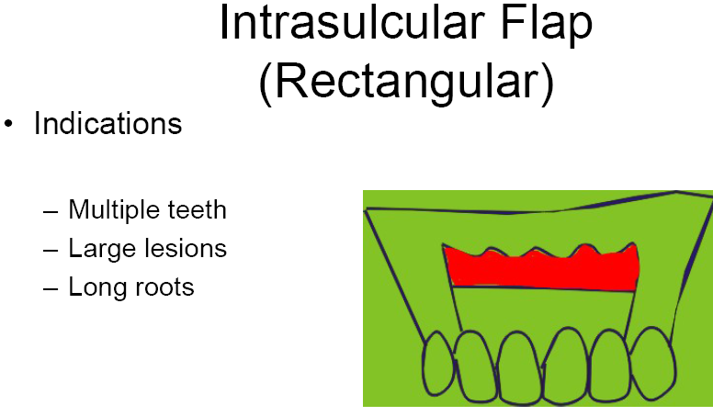
3. Rectangular or Trapezoidal (intrasulcular) - Two vertical releasing incisions, horizontal intrasulcular incision

Slide 12
3. Rectangular or Trapezoidal (intrasulcular) - Two vertical releasing incisions,
Disadvantages
- More difficult to incise and reflect
- Possibility of gingival recession
- Flap re-approximation, wound closure, suturing, and post-surgical stabilization is more difficult than with the triangular flap

Slide 13
4. Submarginal (Ochsenbein-Luebke)
Formed by scalloped horizontal incision in attached gingiva and two vertical releasing incisions.
Scalloped incision corresponds to the contour of the marginal gingiva.
There must be an adequate band of attached gingiva present (4-5mm).
This requires a very careful analysis of attachment level along the entire length of the horizontal incision.

Slide 14
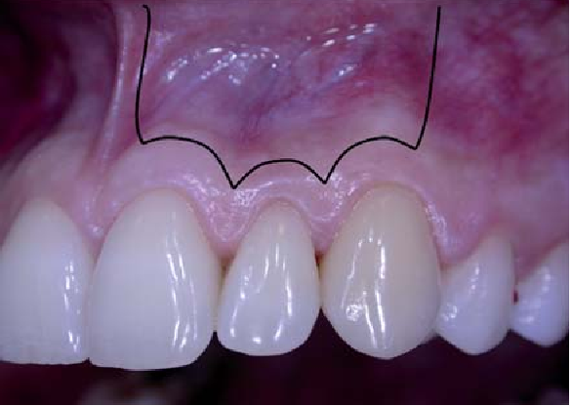
4. Submarginal (Ochsenbein-Luebke)
Advantages
- Does not involve marginal or interdental gingiva.
- Does not expose crestal bone
- Minimizes gingival recession where crowns are in place and esthetics is a concern.
- Minimizes crestal bone loss.
- Easy to reapproximate flap.

Slide 15
Disadvantages
4. Submarginal (Ochsenbein-Luebke)
-Unable to extend flap, if needed
- Disruption of blood supply to marginal gingival tissues, must rely on collateral circulation (which may not exist resulting in sloughing of marginal gingiva)
- Limited use in mandibular surgery
- Possible delayed healing- Possible scarring-Possible flap shrinkage
- Full root and crestal bone are not exposed, so periodontal defects and root fractures are difficult to visualize and treat

Slide 16
5- Gingival (envelope)
Intrasulcular horizontal incision without vertical releasing
incisions.
Generally not used for surgery in the apical area except occasionally for palatal roots of maxillary molars.
Used for root resections, root amputations, hemisections, and repair of cervical perforations or resorptive defects.

Slide 17
Palatal flap:
1.palatal torus
2.canine impaction
3. palatal lesion\cyst.
The anterolateral extensions of the midline incision are anterior to the region of the canine teeth???

