Slide 1
Surgical removal of impacted lower third molar
Waseem Khalid Mahmood
2019-2020

Slide 2
Anesthesia
Local : indications, agents, techniques
General : indications

Slide 3
1-elevation of an adequate mucoperiosteal flap
There are 3 types of mucoperiosteal flap design for removal of impacted lower third molar :
1- envelope flap :
2- standard flap :
3- modified standard flap :
Benefits of flap:

Slide 6
Modified standard flap (Ward-Terrence)

Slide 7
Types (sizes) of surgical blades

Slide 8
Mounting of blade on scalpel handle

Slide 9
Grasp

Slide 10
Reflection(elevation)

Slide 12
Bone removal
Purpose of bone removal :
1- exposure of the impacted tooth
2- reduction of resistance (removal of bone in the path of removal)
3-exposure of a point for elevator application( at the cemento enamel junction )

Slide 13
Types of bone removal
Guttering with surgical bur
Postage stamp method with surgical bur
Chisel and hammer
Bone removal should be accompanied by copious irrigation….why?
Internal irrigation
External irrigation
Irrigation solutions

Slide 14
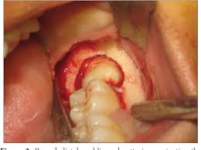
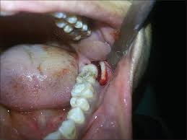

Slide 15
Lingual split technique (Sir William Kelsy fry)?

Slide 16
Tooth delivery
1- whole tooth delivery without tooth division . Total delivery by application of force using elevator , mesial or buccal elevator application.
2- tooth division : division is indicated to reduce resistance , create space or remove interlocked cusps of the tooth

Slide 17
Tooth division/ 3 types
1- decapitation : division of the crown of the tooth at cervical margin level. It is indicated in horizontal mandibular and maxillary third molar impaction and palataly impacted canine.
2 – longitudinal tooth division : indicated when the impacted tooth has a widely divergent straight roots or when one root is straight and the other is curved .

Slide 23
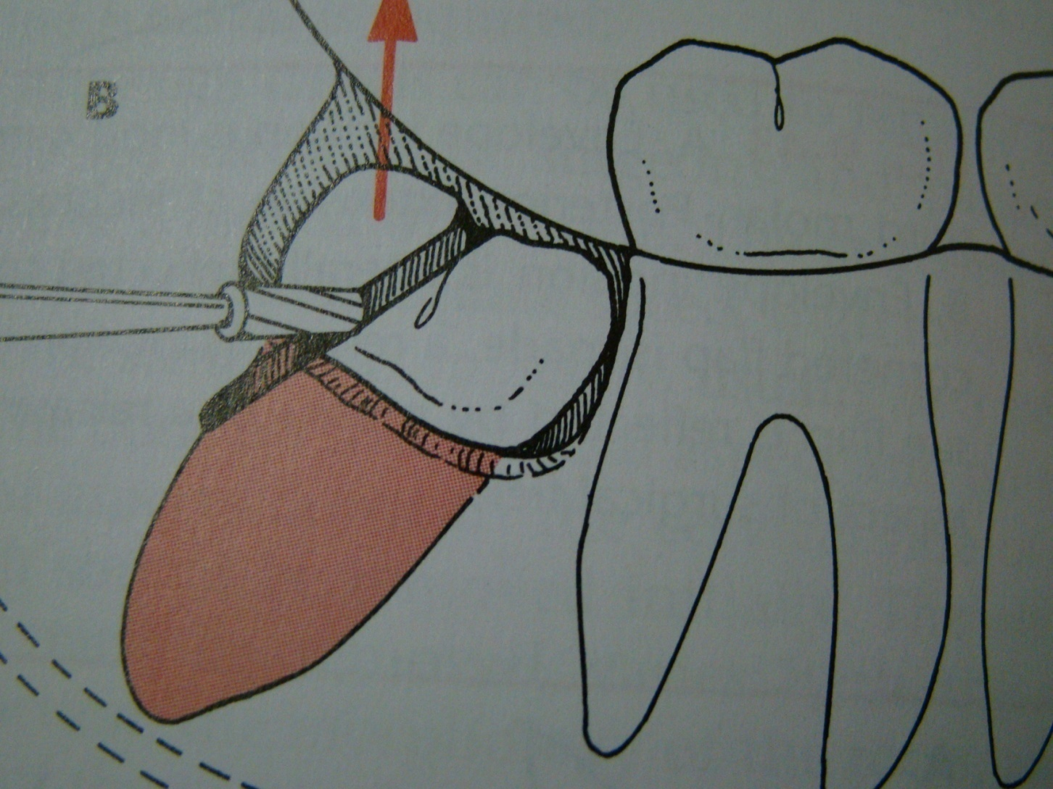
3- division of the interlocking cusp: indicated for mesioangular impaction , removal of the interlocking segment of the tooth ,usually located under the distal surface of the second molar

Slide 25
Toilet of the socket or preparation for wound closure
After removal of the tooth from its socket the wound is gently irrigated with sterile normal saline or chlorehexidine solution and inspected for :
1- Any remnant of the residual tooth sac (follicle) is removed .
2- Remnants of tooth structure or fragment of bone debris is gently removed.

Slide 26
Closure of the wound
3- small fragment of detached bone .
4- sharp edges of interseptal or alveolar bone
is trimmed and smoothed .then final irrigation and wound now is ready for closure
Well designed and properly reflected flap can be easily repositioned into its place ,using 000 black silk suture .

Slide 28
Post operative care
1- a pressure pack is held in place for 1 hour. Usually use wet gauze or wet cotton .
2- post operative instruction is given to the patient :
A/ cold packs at the angle of the mandible in case of lower 8 ,or on the infra orbital area in case of upper 3 or on the cheek in case of upper 8 .for 20 minutes 5 times daily.

Slide 29
B / proper antibiotic and analgesic therapy
C / maintaining good oral hygiene including mouth washes and teeth brushing
D / soft diet
3- appointment for check up after 2 days .
4 – appointment suture removal after 5-7 days

Slide 30
Complications associated with surgical removal of impacted teeth
Complication during the surgery :
1 – laceration of the soft tissue flap due to ;
A / improper incision design.
B / improper elevation of the flap and improper retraction , this lead to delayed healing .
2 – fracture of the jaw at the angle of the mandible due to improper use of the elevators with uncontrolled force.

Slide 31
3 – fracture of the tuberosity : this occur with erupted rather than unerupted tooth due to improper use of the force .
4 - Complications related to injury of adjacent structure :
A / injury to inferior alveolar canal occur in deeply seated vertical impaction
B / damage to the nasal floor
C / involvement of the maxillary sinus

Slide 32
D / pushing the maxillary tooth into the maxillary sinus .
E / pushing the maxillary third molar into the pterygopalatine fossa
F / pushing of the mandibular third molar into the pterygomandibular space or into the submandibular space.
G / aspiration or swallowing of the impacted tooth .

Slide 33
Post operative sequelae :
Sequelae ?
1 – post operative pain
2- post operative swelling or edema that reaches peak at 2nd to 3rd postoperative day.
3- trismus
cause?
How to reduce these sequelae?

Slide 35
Postoperative complications:
1 - Post operative bleeding which is greatly reduced if complete homeostasis is secured before suturing .
2- osteomyelitis
3-pain at the TMJ
4-pain with swallowing (dysphagia) due to edema of the pharynx or hematoma formation
5-Post operative infection .

Slide 36
danke

