Slide 1
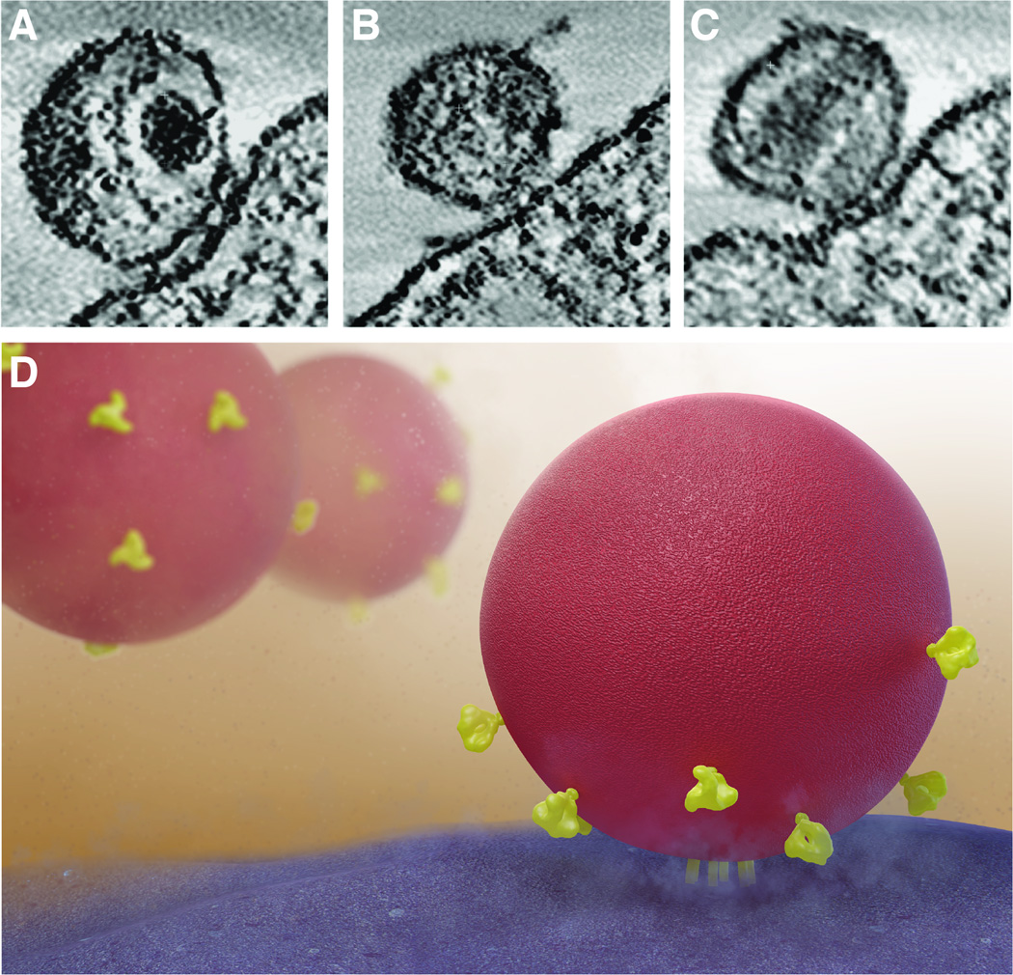
Human Immunodeficiency Virus (HIV)
د. انتظار علاوي جعفر / فرع الاحياء المجهريه / كليه الطب /
جامعه ذي قار
PhD. M.Sc. Microbiology
The nature of the HIV–cell contact and clustering of Env spikes on the surface of the virion.
Source: Earl, L. et al 2013

Slide 2
Introduction
Due to gaps in HIV services, 770 000 people died from HIV-related causes in 2018 and 1.7 million people were newly infected according to WHO.
There were approximately 37.9 million people living with HIV at the end of 2018.
However, with increasing access to effective HIV prevention, diagnosis, treatment and care, including for opportunistic infections, HIV infection has become a manageable chronic health condition, enabling people living with HIV to lead long and healthy lives.

Slide 3
Classification
Human immunodeficiency virus (HIV) is a Lentivirus , a sub family of Lentiviridae in the family Retrovirus that causes
Acquired immunodeficiency syndrome (AIDS).
HIV is this family includes the viruses known for:
(i ) Poor host immune responses, (ii ) Latency.
(iii ) Persistent viremia.
(iv ) Infection of the central nervous system.

Slide 4
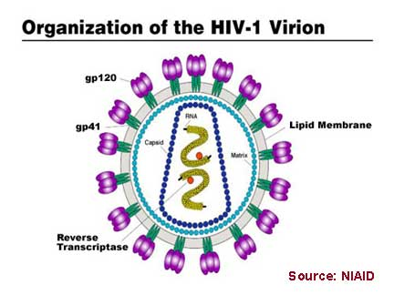
Morphology
HIV is a spherical, enveloped virus, which measures up to
120 nm in diameter (See-Fig). HIV, is an enveloped RNA viruses, possessing an RNA-dependent DNA polymerase called Reverse transcriptase.
It has a unique three-layered structure:
The innermost genome layer,
Middle cone shaped nucleocapsid
(iii) An outer membrane of glycoprotein surrounded by lipoprotein envelope.

Slide 5
Viral genome
HIV genome is most complex of human retroviruses. The genome consists of two identical copies of single-stranded positive-sense RNA genome. The HIV contains three major genes gag , pol , and env , characteristic of all retroviruses. All these genes encode for the structural proteins.
HIV shows two distinct antigenic types: HIV-1 and HIV-2. They are based on sequence analysis of either gag or env genes.

Slide 6
The gag gene encodes for internal capsid and matrix “core” proteins (p15, p18, and p24).
Of these three proteins, p24 is the major antigen, which is demonstrated in serum of HIV patients during the early stage of infection and persists till the appearance of serum antibodies. Detection of p24 antigen in serum, therefore, is of diagnostic value.

Slide 7
The pol gene encodes for several proteins, including the enzymes reverse transcriptase, integrase, and protease. The enzyme reverse transcriptase synthesizes DNA by using the genome RNA as a template. The enzyme integrase integrates the viral DNA into the cellular DNA, and the enzyme protease cleaves various viral precursor proteins.

Slide 8
The env gene codes gp160, a precursor glycoprotein that is split to form two envelope glycoproteins, gp120 and gp41, which form the surface spikes and transmembrane tissue proteins, respectively.
HIV also consists of six other regulatory genes (tat , rev , nef , vif , and vpr).
These genes encode several proteins, which are essential for transcription and invasion of virion into host cells

Slide 9
tat gene is the most important one, which encodes a protein called Tat protein that facilitates viral gene transcription.
Tat protein along with other HIV-encoded regulatory protein called Nef suppresses the synthesis of class I MHC proteins thereby reducing the ability of cytotoxic T cells to kill the HIV-infected cells.

Slide 10
Nucleocapsid: The viral genome is surrounded by a nucleocapsid consisting of proteins.
Three enzymes are located in the nucleocapsid:
(i) Reverse transcriptase.
(ii) Integrase.
(iii) Protease.
Reverse transcriptase transcribes the RNA genome into the proviral genome.

Slide 11
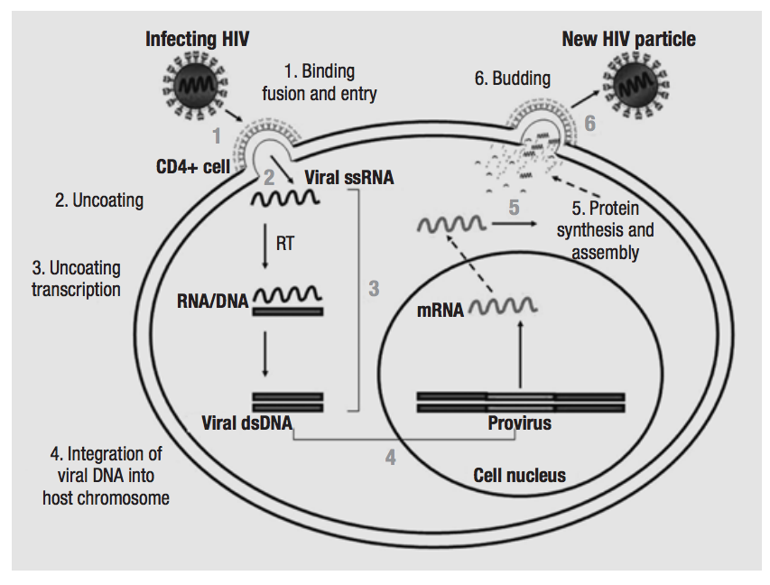
HIV replication cycle

Slide 12
Viral replication
The virus binds to the CD4 proteins on the cell surface(T lymphocyte and macrophage) with the help of its gp120 envelope protein (See-Fig). This protein also interacts with chemokine receptors on the cell surface including the CXCR4 and CCR5, which are essential for entry of HIV into CD4 cells.
Then gp41 of the virus mediates fusion of the viral envelope with the cell membrane followed by entry of the virus into the cell.

Slide 13
Once inside the cell, after uncoating, the virion RNA-dependent DNA polymerase transcribes the genome RNA into double-stranded DNA, which subsequently integrates with the host cell DNA. Integration is mediated by the viral enzyme integrase. The host cell RNA polymerase transcribes the viral mRNA from the proviral DNA.
The viral mRNA encodes several proteins, protease to form the main core protein (p24), the matrix protein (p17), and several smaller proteins. Such as reverse transcriptase, integrase, and protease.

Slide 14
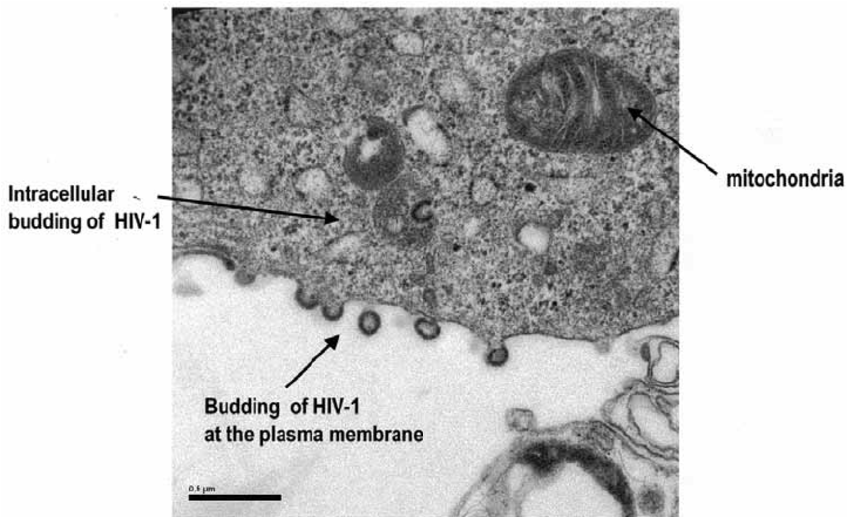
The immature virions containing the precursor polyproteins are assembled in the cytoplasm, and cleavage by the viral protease occurs as the immature virion buds from the cell membrane, resulting in the production of mature infectious HIV.
Grigorov, et al. (2005).

Slide 15
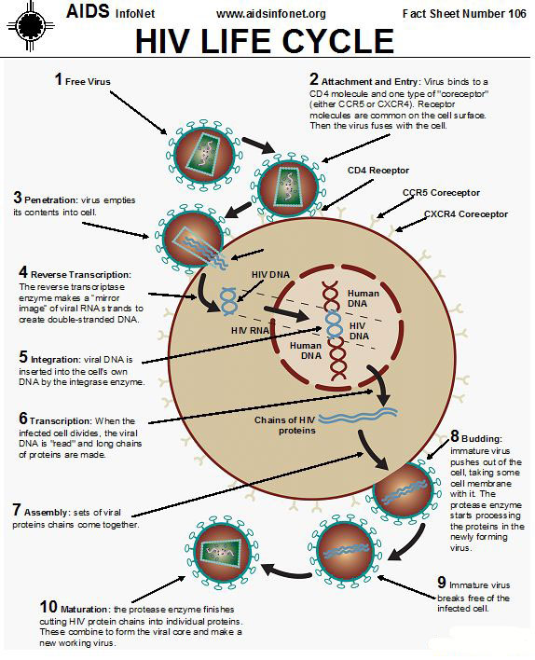

Slide 16
HIV inactivation
HIV is a thermolabile virus.
It is readily inactivated at 60°C in 10 minutes and at 100°C in seconds.
HIV is inactivated by treatment with 50% ethanol, 0.5% formaldehyde, 0.3% hydrogen peroxide, and 10% bleaching powder in 10 minutes.
A 2% solution of glutaraldehyde is effective for disinfection of medical instruments.
It is also inactivated at a very low pH (1) and high pH (13).

Slide 17
Pathogenesis and Immunity
HIV is primarily a sexually transmitted pathogen transmitted by high-risk behaviors, such as unprotected intercourse, male homosexual intercourse, and also by intravenous (IV) drug abuse.

Slide 18
Pathogenesis and Immunity
The tropism of the HIV for CD4-expressing T-cells and macrophages is the principal determinant of the pathogenicity of HIV.
The CD4 antigens act as receptors for HIV. The virus infects helper T cells and kills them, resulting in HIV-induced immunosuppression, leading to full-blown AIDS—a key feature of the pathogenesis of HIV infection. This makes the patient most susceptible to opportunistic infections and certain cancerous conditions, such as Kaposi’s sarcoma and lymphoma. However, the virus does not directly cause any tumor, because HIV genes are not found in these tumor cells.

Slide 19
The virus replicates continuously in the lymph nodes, thereby releasing the virions and infected T cells into the blood.
During the course of infection, the virus causes a drastic reduction in the number of CD4 T cells, which may occur due to direct HIV mediated cytopathic effect, virus specific immune response, or apoptosis induced by viral proteins.

Slide 20
The deficiency or reduction of CD4 T cells leads to depression of cellular immune response and impairment of humeral responses. The reduction of CD4 T cells is responsible for producing delayed-type hypersensitivity reaction that leads to opportunistic infections caused by many opportunistic pathogens.

Slide 21
Clinical Syndromes
The course of untreated HIV infection is usually 10 years or longer. The disease progresses through the stages of
(a ) Primary infection (flu like disease).
(b ) Dissemination of virus to lymphoid organs.
(c ) Clinical latency.
(d ) A late stage of profound immunosuppression known as full-blown Acquired Immune Deficiency Syndrome (AIDS).

Slide 22
Acute HIV infection
Is characterized by rapid rise in plasma viremia with a concomitant drop in CD4 count after an incubation period of 3–6 weeks. The symptoms of HIV are nonspecific and include low-grade fever, fatigue, malaise, rash, headache, and lymphadenopathy; spontaneous resolution may occur within weeks.

Slide 23
Asymptomatic HIV infection
This period is followed by an asymptomatic or clinically latent stage during which the patient continues to remain asymptomatic for several months to years. This stage is characterized by a low level of viral replication and a gradual fall in CD4 count. The serum is positive for HIV antibodies in these patients. Another characteristic of the stage of latency is persistent generalized lymphadenopathy, which may last for several years or a period of asymptomatic infection. During this stage, virus continues to replicate in the lymph node.

Slide 24
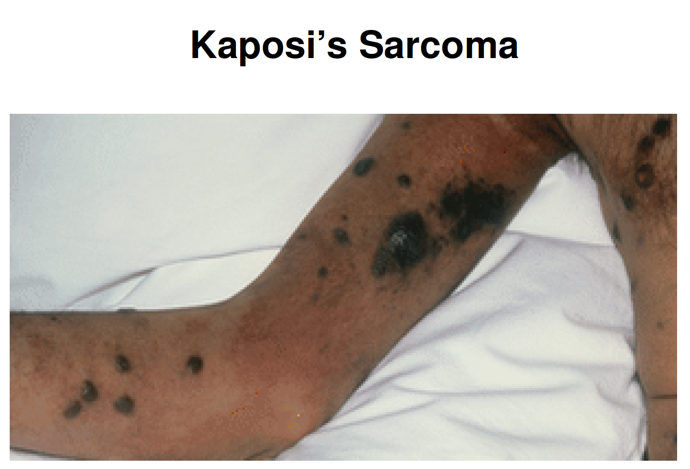
Acquired Immune Deficiency Syndrome (AIDS)
Is characterized by lymphadenopathy and fever.
AIDS is the end-stage disease of the HIV infection. It denotes the irreversible breakdown of immune system of the host, making the infected host highly susceptible to a wide range of progressive opportunistic infections such as tuberculosis, Pneumocystis carinii pneumonia, toxoplasmosis, cryptococcal meningitis or unusual malignancies, such as Kaposi’s sarcoma, non- Hodgkin’s lymphoma, Hodgkin’s lymphoma, cervical cancer, and Burkitt’s lymphoma.

Slide 25
AIDS is characterized by deterioration of immune response as evidenced by CD4 T cell decrease response. The onset of clinical manifestations correlates with:
A reduction in number of CD4 T cells to less than 450/L.
Increased level of virus in the blood.
Presence of p24 antigen in the blood.

Slide 27
Transmission of infection
HIV is primarily a human infection. Humans infected with HIV and AIDS are the reservoir of infection.
The high titer of HIV is found in the body fluids including blood, semen, and vaginal secretions of the infected people; hence these are important sources of infection.
HIV can also transmitted from a mother to her child during pregnancy and delivery. The virus is also present in the breast milk of an infected mother.

Slide 28
HIV transmission occurs in following ways
Sexual transmission.
Transmission by blood transfusion.
Parenteral transmission occurs largely among IV drug users through the use of contaminated needles.
Mother-to-child transmission: can occur by vertical transmission through the placenta or through the amniotic membrane or by perinatal transmission during delivery through infected birth canal.
Breast feeding

Slide 29
Laboratory Diagnosis
Specimens: these include serum and plasma for HIV serology and lymphocytes for isolation of HIV.
Serodiagnosis: Detection of specific antibodies to envelope glycoproteins gp41, gp120, and gp160 and to viral core p24 antigens using ELISA assay. The level of these antibodies is demonstrated in most individuals within 6–12 weeks after infection and in all the individuals within 6 months of infection.

Slide 30
Molecular Diagnosis:
The circulating virus count (viral load) is determined by means of quantitative RT-PCR.
It can also be used to monitor the success of therapy with RT and protease inhibitors.

Slide 31
Monitoring status of HIV infection
CD4 T cell count: This is an important indicator for monitoring HIV infection. This count reflects the immunological competence of the patients with HIV or AIDS. A rapid decrease in the CD4 count below 500/L in adults and in infants is a poor prognostic sign and requires the initiation or alteration of antiviral therapy.
When the count falls below 200/L, it indicates a very poor prognosis and shows the increased risk for serious infection of patient, particularly opportunistic infections.

Slide 32
Measurement of HIV RNA: HIV RNA level in serum is an important predictive marker of disease progression and are used as prognostic marker to monitor the effectiveness of anti-HIV therapies.

Slide 33
Treatment
There is no cure for HIV infection. However, effective antiretroviral drugs (ARVs) can control the virus and help prevent onward transmission to other people.
The anti-HIV drugs can be broadly classified as:
(a) Nucleoside analoge reverse transcriptase inhibitors (NRTIs) e.g Zidovudine, Didanosine, Zalcitabine and Lamivudine.
(b) Nonnucleoside reverse transcriptase inhibitors (NNRTIs) e.g Nevirapine, Delaviridine, Efavirenz.
(c ) Protease inhibitors e.g Ritonavir and Indinavir.

Slide 34
Therapy with combination of Highly active antiretroviral therapy, referred to as HAART, is effective in inhibition of HIV replication.
HAART has improved efficacy of the therapy, minimized toxicity following therapy, and delayed emergence of drug resistance
It is usually recommended to initiate double and triple drug therapy with two NRTIs Or two NRTIs an NNRTI or a protease inhibitor.

