Slide 1
Small and large intestine

Slide 2
ANATOMY OF THE SMALL AND LARGE INTESTINES Small intestine The small intestine starts at the pylorus and extends to the ileocaecal valve. It is approximately 7 m in length and is divided into the duodenum, jejunum and ileum. Its main function is in the breakdown and absorption of food products. The small bowel is present in the central and lower portion of the abdominal cavity. Its relations consist of the greater omentum and abdominal wall anteriorly. Posteriorly, it is fixed to the vertebral column by way of its mesentery. The duodenum is present proximally and is about 25 cm in length. It has no mesentery and, therefore, is the most fixed part of the small bowel.

Slide 3
It merges into the jejunum at the duodenojejunal flexure. The remainder of the small bowel is made up of the jejunum and ileum. The jejunum makes up the proximal twofifths and is wider, thicker and more vascular than the ileum. It consists of circular folds of mucous membrane (valvulae conniventes) that can be used to distinguish it from the ileum. The ileum contains larger lymph node aggregates (Peyer’s patches and these can sometimes be lead points in cases of intussusception in the young.

Slide 4
The arterial supply of the duodenum consists of the right gastric, the superior pancreaticoduodenal branch of the hepatic artery and the inferior pancreaticoduodenal branch of the superior mesenteric artery. The veins drain into the superior mesenteric. The nerves are supplied from the coeliac plexus. The jejunum and ileum are vascularised by the superior mesenteric artery through a rich plexus of vessels. The veins run a similar course. The nerve supply to the small intestines arises from sympathetic nerves around the superior mesenteric artery. Pathology such as obstruction causes visceral pain, which is felt in the peri-umbilical region.

Slide 5
Large intestine The large intestine extends from the ileum to the anus. The colon is approximately 1.5 m in length. It is relatively more fixed than the small bowel It also differs in that it possesses appendices epiploicae on its surface, which are peritoneal folds containing fat, and the presence of taenia, which consist of longitudinal bands of the outer muscle coat. It can be divided into the caecal, ascending, transverse, descending and sigmoid colonic segments.

Slide 6
The blood supply of the colon is derived from ileocolic, right colic and middle colic branches of the superior mesenteric vessels. The descending colon receives its blood supply from the left colic branch from the inferior mesenteric but also communicates with the superior mesenteric system via the marginal artery of Drummond. The veins run in a similar distribution. The nerve supply is derived from the sympathetic plexus surrounding the superior and inferior mesenteric arteries. Visceral pain is felt in the peri-umbilical region in the proximal colon and in the hypogastric region in the distal colon.

Slide 7
FUNCTIONAL ABNORMALITIES Megacolon and non-megacolon constipation There is no single definition of constipation; however, a bowel frequency of less than one every 3 days would be consider abnormal by some. This group of conditions can be divided into: 1 megacolon: a Hirschsprung’s disease; b non-Hirschsprung’s megarectum and megacolon; 2 non-megacolon: a slow transit; b normal transit.

Slide 8
Idiopathic megarectum and megacolon This is a rare condition and the cause is not known, although in some it may result from poor toilet training during infancy and in others from a congenital abnormality of the intestinal myenteric plexus. Clinical features It presents usually in the first 20 years with severe constipation. Patients with idiopathic megarectum often present with faecal incontinence due to rectal faecal loading that requires manual evacuation. Patients with megacolon are more likely to present with abdominal distension and pain. On clinical examination, there may be a hard faecal mass arising out of the pelvis and, on rectal examination, there is a large faecaloma in the lumen. The anus is usually patulous, perianal soiling is common, and sigmoidoscopy is usually impossible.

Slide 9
Investigation Imaging As there is an enlarged rectum, often with distension of the colon over a variable length, a radiograph should be taken without prior bowel preparation, using a small quantity of water-soluble contrast to prevent barium impaction. There is usually gross faecal loading of the enlarged rectum and colon and, when a contrast examination is carried out, the width of the colon measured at the pelvic brim is usually more than 6.5 cm.

Slide 10
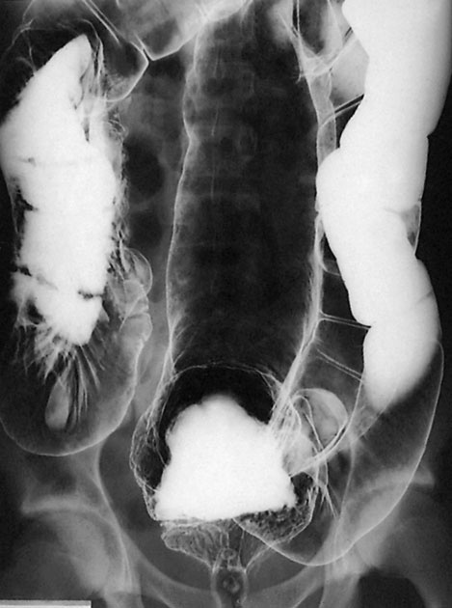

Slide 11
Anorectal physiology tests Anorectal physiology tests demonstrate delayed first sensation and raised maximum tolerated volume. Full-thickness rectal biopsy shows normal ganglion cells, a finding that definitively distinguishes this condition from Hirschsprung’s disease.

Slide 12
Medical treatment This is directed at emptying the rectum and keeping it empty with enemas, washouts and sometimes manual evacuation under anaesthesia. Thereafter, the patient is encouraged to develop a regular daily bowel habit, with the use of osmotic laxatives to help the passage of semiformed stool.

Slide 13
Surgical treatment Surgical treatment is sometimes necessary if medical therapy fails. Options that are available include: 1 resection of the dilated rectum and colon back to normal-diameter colon with normal ganglion cells confirmed by frozen section at the time of surgery, which is followed by reconstruction with a coloanal anastomosis; 2 colectomy with the formation of an ileorectal anastomosis; 3 restorative proctocolectomy; 4 vertical reduction rectoplasty, which is a new procedure designed to reduce the volume of the rectum by at least 50%. 5 stoma formation, which may be used either as a salvage operation for failure of previous surgery or as a primary intervention.

Slide 14
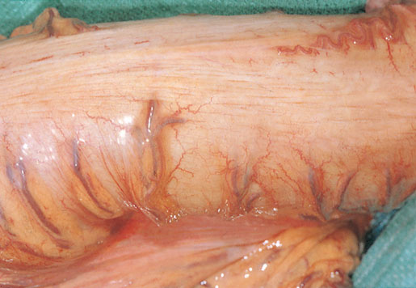

Slide 15
Non-megacolon constipation These are usually otherwise healthy individuals who seek help for constipation but eat a normal diet and have a normal colon on endoscopy and barium enema. Its cause is thought to involve slow whole-gut transit or a rectal evacuation problem. Factors influencing bowel transit time include: • drugs: opiates, anti-cholinergics and ferrous sulphate; • diseases: neurological conditions (Parkinson’s disease, multiple sclerosis and diabetic nephropathy): – hypothyroidism; – hypercalcaemia.

Slide 16
Investigation Whole-gut transit time can be measured by asking the patient to stop all laxatives and take a capsule containing radio-opaque markers . Retention of more than 80% of the shapes, 120 hours after ingestion, is abnormal.

Slide 17
Treatment This can be done in several ways: 1 Dietary fibre. This is the first-line treatment for people with mild constipation. Constipation only resolves after several weeks of therapy . 2 Laxatives. It is important that patients do not fall into a cycle of laxative abuse. A number of types are available which include bulk, osmotic and stimulant agents. 3 Biofeedback. This involves conditioning and coordination of the abdominal and pelvic compartments. It has been shown to be effective in those with a rectal evacuation problem.

Slide 18
VASCULAR ANOMALIES (ANGIODYSPLASIA) Capillary or cavernous haemangiomas are a cause of haemorrhage from the colon at any age. In the middle-aged or elderly patient, haemangioma needs to be distinguished from other causes of sudden massive haemorrhage, such as diverticulitis, ulcerative colitis (UC) or ischaemic colitis. Angiodysplasia is a vascular malformation associated with ageing. Its true incidence is from 5 to 25% over the age of 60 years. Angiodysplasias occur particularly in the ascending colon and caecum of elderly patients. The malformations consist of dilated tortuous submucosal veins and, in severe cases, the mucosa is replaced by massive dilated deformed vessels.

Slide 19
Clinical features In the majority, the symptoms are subtle and patients can present with anaemia. About 10–15% can have brisk bleeds, which may present as melaena or significant per rectum bleeding that is often intermittent. There is an association with aortic stenosis. Heyde’s syndrome describes the association of aortic valve stenosis with gastrointestinal bleeding from colonic angiodysplasia. A mild form of von Willebrand’s disease has been thought to be involved.

Slide 20
Investigation -Barium enema is usually unhelpful and should be avoided, because it may mask the lesion at subsequent endoscopy. -colonoscopy may show the characteristic lesion in the right colon. The lesions are only a few millimetres in size and appear as reddish, raised areas at endoscopy. ‘Pill’ endoscopy is a relatively new technology that may detect small bowel lesions. -Selective superior and inferior mesenteric angiography shows the site and extent of the lesion - a radioactive test using technetium-99m (99mTc)-labelled red cells may confirm and localise the source of haemorrhage.

Slide 21
Treatment The first principle is to stabilise an unstable patient. Following this, the bleeding needs to be localised by colonoscopy. This allows simple therapeutic procedures such as cauterisation to be carried out. In severe uncontrolled bleeding, surgery becomes necessary. On-table colonoscopy is carried out to confirm the site of bleeding. Angiodysplastic lesions are sometimes demonstrated by transillumination through the caecum . If it is still not clear exactly which segment of the colon is involved, then a total abdominal colectomy with ileorectal anastomosis may be necessary.

Slide 22
BLIND LOOP SYNDROME if a blind loop of the small intestine is made referred to as the blind loop syndrome. Essentially, the stasis produces an abnormal bacterial flora, which prevents proper breakdown of the food (especially fat) and mops up the vitamins that are present. Sometimes, the only manifestation is anaemia, resulting from vitamin B12 deficiency but, if steatorrhoea occurs, other serious malabsorption features follow. In general, high loops produce steatorrhoea, whereas low loops tend to produce anaemia.

Slide 23
Temporary improvement will follow the use of antibiotics to destroy the bacteria causing the trouble, but the main treatment is surgical excision of the cause of the stasis where applicable.

Slide 24
DIVERTICULAR DISEASE Types Diverticula can occur in a wide number of positions in the gut, from the oesophagus to the rectosigmoid. There are two 1- Congenital. All three coats of the bowel are present in the wall of the diverticulum, e.g. Meckel’s diverticulum. 2- Acquired. The wall of the diverticulum lacks a proper muscular coat. Most alimentary diverticula are thought to be acquired.varieties:

Slide 25
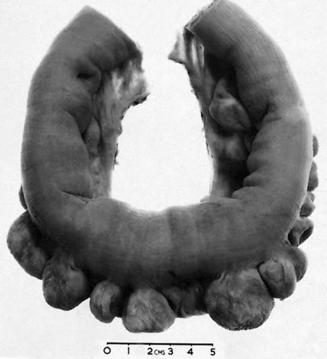

Slide 26
Duodenal diverticula There are two types: 1 Primary. Mostly occurring in older patients on the inner wall of the second and third parts , these diverticula are found incidentally on barium meal and are usually asymptomatic. 2 Secondary. Diverticula of the duodenal cap result from longstanding duodenal ulceration .

Slide 27
Jejunal diverticula These are usually of variable size and multiple (Fig. 65.8). Clinically, they may (1) be symptomless, (2) give rise to abdominal pain, (3) produce a malabsorption syndrome or (4) present as an acute abdomen with acute inflammation and occasionally perforation. In patients with major malabsorption problems giving rise to anaemia, steatorrhoea, hypoproteinaemia or vitamin B12 deficiency, resection of the affected segment with end-to-end anastomosis can be effective.

Slide 29
Meckel’s diverticulum Meckel’s diverticulum is present in 2% of the population; it is situated on the anti-mesenteric border of the small intestine, commonly 60 cm from the ileocaecal valve, and is usually 3–5 cm long. Many variations occur (2% – 2 feet – 2 inches is a useful aide-mémoire) . It represents the patent intestinal end of the vitellointestinal duct

Slide 31
A Meckel’s diverticulum possesses all three coats of the intestinal wall and has its own blood supply. It is therefore vulnerable to infection and obstruction in the same way as the appendix. indeed, when a normal appendix is found at surgery for suspected appendicitis, a Meckel’s diverticulum should be sought by inspection of an appropriate length of terminal ileum. In 20% of cases, the mucosa contains heterotopic epithelium, namely gastric, colonic or sometimes pancreatic tissue. In order of frequency, these symptoms are as follows:

Slide 32
1 Severe haemorrhage, caused by peptic ulceration. Painless bleeding occurs per rectum and is maroon in colour. 2 Intussusception.In most cases, the apex of the intussusception is the swollen, inflamed, heterotopic epithelium at the mouth of the diverticulum. 3 Meckel’s diverticulitis may be difficult to distinguish from the symptoms of acute appendicitis. When a diverticulum perforates, the symptoms may simulate those of a perforated duodenal ulcer. At operation, an inflamed diverticulum should be sought as soon as it has been demonstrated that the appendix and fallopian tubes are not involved.

Slide 33
4 Chronic peptic ulceration. As the diverticulum is part of the mid-gut, the pain, although related to meals, is felt around the umbilicus. 5 Intestinal obstruction. The presence of a band between the apex of the diverticulum and the umbilicus may cause obstruction either by the band itself or by a volvulus around it.

Slide 34
Imaging Meckel’s diverticulum can be very difficult to demonstrate by contrast radiology; small bowel enema would be the most accurate investigation. Technetium-99m scanning may be useful in identifying Meckel’s diverticulum as a source of gastrointestinal bleeding.

Slide 35
‘Silent’ Meckel’s diverticulum. A Meckel’s diverticulum usually remains symptomless throughout life and is found only at necropsy. When a silent Meckel’s diverticulum is encountered in the course of an abdominal operation, it can be left provided it is wide mouthed and the wall of the diverticulum does not feel thickened. Where there is doubt and it can be removed without appreciable additional risk, it should be resected. Exceptionally, a Meckel’s diverticulum is found in an inguinal or a femoral hernia sac – Littre’s hernia.

Slide 36
Meckel’s diverticulectomy A Meckel’s diverticulum that is broad based should not be amputated at its base and invaginated in the same way as a vermiform appendix due to risk of stricture

Slide 37
diverticular disease of Colon Introduction The prevalence of diverticular disease in the western world is 60% over the age of 60 years. The condition is found in the sigmoid colon in 90% of cases, but the caecum can also be involved and, on occasion, the entire large bowel can be affected. The main morbidity of the disease is due to sepsis. Aetiology Diverticula of the colon are acquired herniations of colonic mucosa, protruding through the circular muscle at the points where the blood vessels penetrate the colonic wall. They tend to occur in rows between the strips of longitudinal muscle, sometimes partly covered by appendices epiploicae. The rectum with its complete muscle layers is not affected. It is thought to be related to reduced fibre in the western diet. This results in low stool bulk with resulting segmentation and hypertrophy of the colonic wall musculature, thus causing increased intraluminal pressure. Diverticular disease is rare in Africans and Asians, who eat a diet that is rich in natural fibre.

Slide 38
Diverticulosis It is important to distinguish between diverticulosis, which may be asymptomatic, and clinical diverticular disease in which the diverticula are causing symptoms. On histological investigation, the diverticulum consists of a protrusion of mucous membranes covered with peritoneum. There is thickening of the circular muscle fibres of the intestine, which develops saw-tooth appearance on barium enema

Slide 39
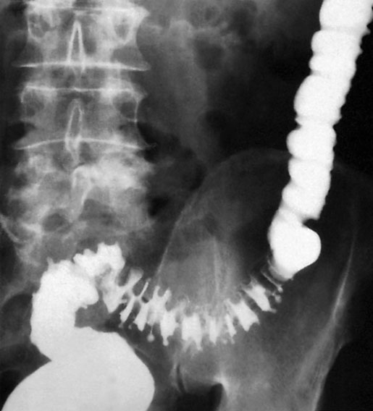

Slide 40
Diverticulitis Diverticulitis is the result of inflammation of one or more diverticula,usually with some pericolitis. It is not a premalignant condition, but cancer may coexist

Slide 41
The complications of diverticular disease are the following: 1 Recurrent periodic inflammation and pain . 2 Perforation leading to general peritonitis or local (pericolic) abscess formation. 3 Intestinal obstruction: a in the sigmoid as a result of progressive fibrosis causing stenosis; b in the small intestine caused by adherent loops of small intestine on the pericolitis. 4 Haemorrhage: diverticulitis may present with profuse colonic haemorrhage in 17% of cases, often requiring blood transfusions. 5 Fistula formation (vesicocolic, vaginocolic, enterocolic, colocutaneous) occurs in 5% of cases, with vesicocolic being the most common.

Slide 42
Clinical features Elective In mild cases, symptoms such as distension, flatulence and a sensation of heaviness in the lower abdomen may be indistinguishable from those of irritable bowel syndrome. Emergency Persistent lower abdominal pain, usually in the left iliac fossa, with or without peritonitis, could be caused by diverticulitis. Fever, malaise and leucocytosis can differentiate diverticulitis from painful diverticulosis. The patient may pass loose stools or may be constipated; the lower abdomen is tender, especially on the left, but occasionally also in the right iliac fossa if the sigmoid loop lies across the midline. The sigmoid colon is often palpable, tender and thickened. Rectal examination may, but does not usually, reveal a tender mass. Any urinary symptoms may herald the formation of a vesicocolic fistula, which leads to pneumaturia (flatus in the urine) and even faeces in the urine.

Slide 43
1 Pericolic abscess or phlegmon 2 Pelvic or intra-abdominal abscess 3 Non-faeculent peritonitis 4 Faeculent peritonitis
Classification of diverticulitis (Hinchey)

Slide 44
Diagnosis Radiology Although the diagnosis of acute diverticulitis is made on clinical grounds, it can be confirmed during the acute phase by computerised tomography (CT). It is particularly good at identifying bowel wall thickening, abscess formation and extraluminal disease. , drainage may be carried out percutaneously. Such an option may delay or postpone further operative procedures.

Slide 45
Barium enemas and sigmoidoscopy are usually reserved for patients who have recovered from an attack of acute diverticulitis, for fear of causing perforation or peritonitis. Watersoluble contrast enemas may, however, be helpful in sorting out patients with large bowel obstruction. In the acute situation, it is good at detecting intraluminal changes and leakage. The sensitivity for this is of the order of 90%. Barium radiology is carried out to exclude a carcinoma and to assess the extent of the disease.

Slide 46
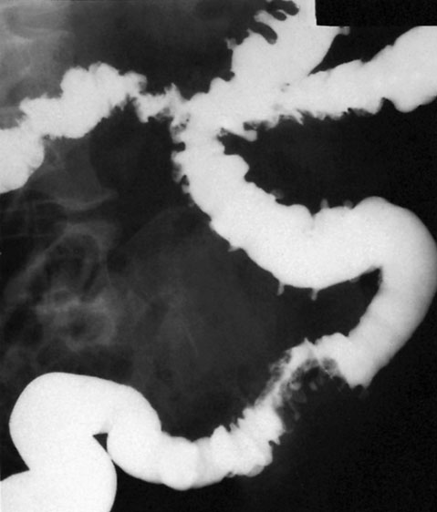

Slide 47
Where the sigmoid colon is thickened and narrowed, a ‘sawtooth’ appearance may be seen. Some strictures can be very difficult to distinguish by radiology alone and, in those circumstances, colonoscopy will be necessary to rule out a carcinoma. Vesicocolic fistulae should be evaluated with cystoscopy and biopsy in addition to colonoscopy. Contrast examinations may show the fistula itself. The differential diagnosis for vesicocolic fistulae (and other fistulae) includes cancer, radiation damage, Crohn’s disease (CD), tuberculosis and actinomycosis.

Slide 48
Colonoscopy Colonoscopy may reveal the necks of diverticula within the bowel lumen . The differential diagnosis from a carcinoma can be impossible if a tight stenosis prevents colonoscopy. In equivocal cases, biopsies may be taken

Slide 49
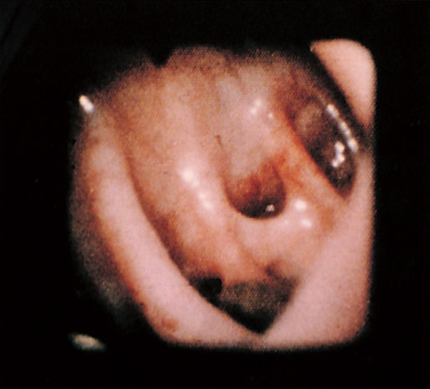

Slide 50
Management Non-complicated Diverticulosis should be treated with a high-residue diet containing bread, flour, fruit and vegetables. Bulk formers such as bran, Isogel and Fybogel may be given

Slide 51
until the stools are soft. Painful diverticular disease may require antispasmodics. Acute diverticulitis is treated by bed rest and intravenous antibiotics (usually cefuroxime and metronidazole).

Slide 52
Operative procedures for diverticular disease The aim of surgery is to control sepsis in the peritoneum and circulation. Indications for operation include general peritonitis and failure to resolve on conservative treatment. Postoperative mortality and reoperation rate for elective resection are 5% and 12%, respectively

Slide 53
The ideal operation carried out as after careful preparation of the gut is a one-stage resection. This involves removal of the affected segment and restoration of continuity by end-to-end anastomosis

Slide 54
If there is obstruction, inflammatory oedema and adhesions or the bowel is loaded with faeces, a Hartmann’s operation is the procedure of choice

Slide 55
In acute perforation, peritonitis soon becomes general and may be purulent, with a mortality rate of about 15%. Gross faecal peritonitis carries a mortality rate of more than 50% and pneumoperitoneum is usually present; the diagnosis may not be confirmed until emergency laparotomy. There is a choice of procedures: a primary resection and Hartmann’s procedure ; b primary resection and anastomosis after on-table lavage in selected cases; c exteriorisation of the affected bowel, which is then opened as a colostomy, a procedure now rarely used. Fistulae can be cured only by resection of the diseased bowel and closure of the fistula. In the case of a colovesical fistula

Slide 56
Haemorrhage from diverticulitis must be distinguished from angiodysplasia. It usually responds to conservative management and occasionally requires resection On-table lavage and colonoscopy may be necessary to localise the bleeding site. If the source cannot be located, then subtotal colectomy and ileostomy is the safest option..

Slide 57
Solitary diverticulum of the caecum and ascending colon is rare and congenital, and may present with symptoms and signs identical to those of acute appendicitis

Slide 58
Hirschsprung’s disease Hirschsprung’s disease is characterised by the congenital absence of intramural ganglion cells and the presence of hypertrophic nerves in the distal large bowel. The affected gut is tonically contracted causing functional bowel obstruction. The aganglionosis is restricted to the rectum and sigmoid colon in 75% of patients (short segment), involves the proximal colon in 15% (long segment) and affects the entire colon

