Slide 3
Senile Cataract (Age-Related Cataract)

Slide 4
Did you know types of senile Cataracts?

Slide 5
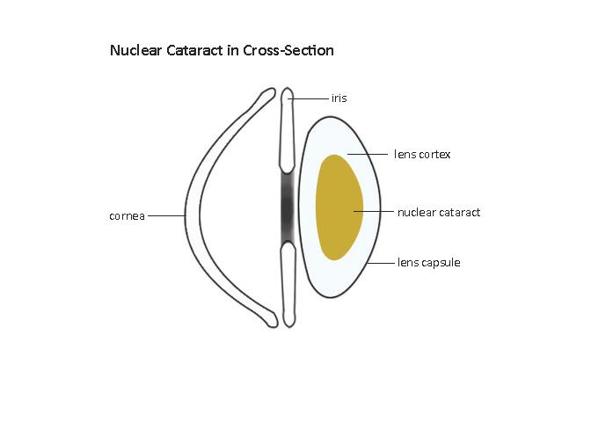
Nuclear cataract

Slide 6
Cortical cataract

Slide 7
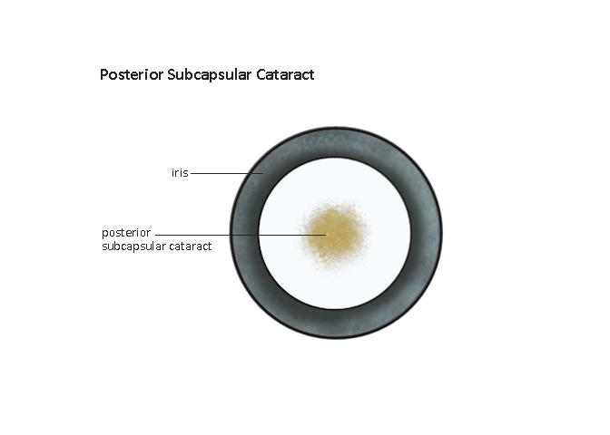
Posterior Subcapsular Cataract

