Slide 1
tonsillitis

Slide 4
Aetiology
Viral infection : 50%
influenza ,parainfluenza, adenovirus, &
rhinovirus
Bacterial infection:
- B-haemolytic streptococcus
- Strept.pneumonia,
- H influenzae
- Staph. Aureus
- Moraxella catarrahlis
- Anaerobic organisms

Slide 8
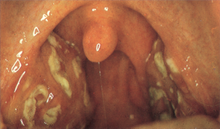
Acute follicular ts. :
Crypts of ts. filled with pus giving a spotted appearance

Slide 10
Clinical features:
Sorethroat
Pyrexia
Odynophagia
Malaise
Earache /referred otalgia
Thickened speech
In severe cases rigor & signs of toxaemia
Appendicitis may simulated/ mesenteric adenitis.

Slide 11
Examination:
Congested & enlarged ts.
Congested pillars.
Spots of pus or fibrin fill the crypts
Furred tongue & halitosis
Enlarged tender cx Ln.

Slide 12
Investigation:
Throat swab for c/s
Complete blood feature
Blood film / mono spot test (I.m.n.)

Slide 13
DDX:
Scarlet fever
Diphtheria
Vincent`s infection
Agranulocytosis
I.M.N. ( glandular fever)

Slide 14
Treatment:
Bed rest , soft diet ,fluid intake
Analgesic drug
Systemic AB.

Slide 15
Complications:
Peritonsillar abscess
Parapharyngeal abscess
Retropharyngeal abscess
Edema of the larynx
Acute rheumatism
Acute nephritis
Septicemia
Acute OM.

Slide 16
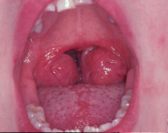
Recurrent acute tonsillitis
Clinical features:
1. persistent or recurrent sore throat
2. marked ts. enlargment.
3. injected ant. pillars
4. halitosis
5. persistent cx. adenitis.
treatment:
tonsillectomy

Slide 17
tonsillectomy
Indications:
1- recurrent ts. : 7//1 year
or 4//2 years
2- recurrent episodes of
peritonsillar abscess (2nd attack)
3- suspected neoplasm
( unilateral enlargement, or ulceration)

Slide 18
Contraindications:
Recent ts. infection or URTI < 2wks
Bleeding disorders
Using of contraceptive pills
Cleft palate
Epidemics of poilo , viral infection (corona v.)

Slide 19
Complications of tonsillectomy:
Peroperative:
1- anaesthetic reaction
2- haemorrhage
3- damage to teeth, uvula, or
to post. Pharyngeal wall
4- dislocation of the
temporomandibular joint

Slide 20
B. Post operative:
Reactionary hemorrhage / 1st,24hs
Anaesthetic complications
Secondary haemorrhage / 5th – 10th day
Infection of the ts. bed
Earache
Pneumonia
Tonsillar remanant

Slide 21
Post ts, haemorrhage
Reactionary (primary):
secondary

Slide 22
Reactionary haemorrhage:
~2%
Within 24hs
Signs of the bleeding :
- obvious bleeding
- gurgling sound in throat during breathing
- repeated swallowing
- vomiting
- rising pulse rate & lowering of Blood p.

Slide 23
Management:
Blood sample for cross matching
IV, infusion
Identifying the bleeding site
Application of 1:1000 adrenaline soaked gauze or using hydrogen peroxide gurgle
If failed >>> 2nd anaesthesia >>stop the bleeding

Slide 24
Secondary haemorrhage
5th- 10th day
Infection
R/: admission & observation
Blood for cross match
AB.
H2O2 gargle (20 minutes waiting)
Adrenaline socked gauze in the fossa (20 minutes)
If failed 2nd anaesthesia/ suturing the pillars .

Slide 25
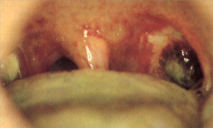
Post ts pictures ,healthy /infected

Slide 26
Peritonsillar abscess(quinsy)
Def;
pus collects between ts. & sup. Cons.m.
Aetiology;
- follows tonsillitis
- mostly unilateral

Slide 27
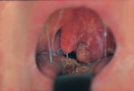
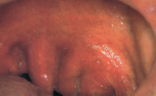
Clinical features:
-Severe pain
-pyrexia up to 40 C°
-Headache & malaise
-Trismus
-Earache
-Intense salivation
-Thickened speech
-Foetor oris

Slide 28
examination
Marked hyperaemic edematous tonsil and palatal region
Oedematous uvula & pushed towards other side

Slide 29
complications
Parapharyngeal abscess
Oedema of the larynx
septicemia

Slide 30
treatment
1. Conservative in early stage( cellulitis)
- rest , AB. , analgesia
2. Surgery :
- incision of the abscess
- abscess-tonsillectomy

