Slide 1
Fall in elderly
Adel Gassab Mohammed
MD, CABMS, MSc of Medicine Specialist Endocrinologist, Thi-Qar Specialized Diabetes, Endocrine and Metabolism Center, Lecturer Diabetes, Endocrine and Metabolism Division, Department of Medicine, College of Medicine, University of Thi-Qar,

Slide 2
Outline:
Introductions of falls in elderly.
Cause and risk factors of falls.
Consequences of falls in elderly.
Assessment of fall in elderly.
Preventing falls in older people.
Summary.

Slide 3
Definition of Falls
A fall is defined as an event which results in a person coming to rest inadvertently on the ground or floor or other lower level.

Slide 4
Introduction
Falls and fall-related injuries are a common& serious problem for older people.
Fall potentially life- threatening events and may be simply the first signs of single problem.
It lead to hospitalization and increase cost and burden on society and even lead to death .

Slide 9
Intrinsic risk factors:
Age Related changes (Visual function Neurological function, Musculoskeletal function)
Diseases Female sex
Extrinsic risk factors:
Drugs Environmental Improper assistive
devices

Slide 11
(I HATE FALLING)
I: Inflammation of joints (or joint deformity)
H: Hypotension (orthostatic blood pressure changes)
A: Auditory and visual abnormalities
T: Tremor (Parkinson's disease or other causes of tremor)
E: Equilibrium (balance) problem
F: Foot problems
A: Arrhythmia, heart block or valvular disease
L: Leg-length discrepancy
L: Lack of conditioning (generalized weakness)
I: Illness
N: Nutrition (poor; weight loss)
G: Gait disturbance

Slide 13
Consequence of falls
Physical:
Skin tear internal bleeding
subdural hematoma Hip fracture Immobilization /
disability
Hospitalization
Psychological:
Fear of falling increased dependency Depression
Anxiety
loss of confidence social withdrawal

Slide 15
ASSESSMENT OF FALL

Slide 16
How to approach elderly with fall
History
Examination
Investigations

Slide 17
History
A thorough history is essential to determine:
Fall ( mechanism of fall, Location, Activity, Injury related to the fall, witness/help)
Associated symptoms concurrent with a fall (change in level of or loss of consciousness, chest pain, palpitations, dizziness, vertigo or lightheadedness, Symptoms related to a change in position ,headache, weakness/tingling/numbness or acute change in mental status)

Slide 18
previous falls and whether the falls were the same or different in character.
medical history
Medications
Functional history
Social history

Slide 19
Physical Examination
General looking Hydration status postural changes
Vital signs( orthostatic hypotension) Visual & Hearing abnormalities

Slide 20
Cardiovascular: murmur ,presence of arrhythmias & carotid bruits
Neurologic and mental evaluation: looking for focal deficits, assessment of lower extremity peripheral nerves,
proprioception, vibration sense, and tests for cortical, cerebellar, and extrapyramidal functions is important.

Slide 21
Musculoskeletal: lower-extremity weakness, presence of contractures, limitations or pain in range of motion
Gait and balance: abnormalities, lower extremity strength, and joint function.
Environmental assessment: Lighting, walking surface, furniture, clothing, and equipment

Slide 22
Testing and imaging
Complete blood count, Electrolyte, Blood urea nitrogen , Creatinine , Glucose , Thyroid function, Vitamin B₁₂ levels
X-ray
ECG, ECHO, EEG
Brain imaging(CT/MRI)
DEXA(dual-energy x-ray absorptiometry)

Slide 23
The American Geriatrics Society and British Geriatrics Society recommend that all adults older than 65 years be screened annually for a history of falls or balance impairment.

Slide 27
Evaluate gait, strength, and balance
Recommended test:
Timed Up and Go
Optional tests:
30-Second Chair Stand 4-Stage Balance tests

Slide 31
https://youtu.be/Ng-UOHjTejY
https://youtu.be/3HvMLLIGY6c
https://youtu.be/BA7Y_oLElGY

Slide 32
PREVENTION OF FALL

Slide 33
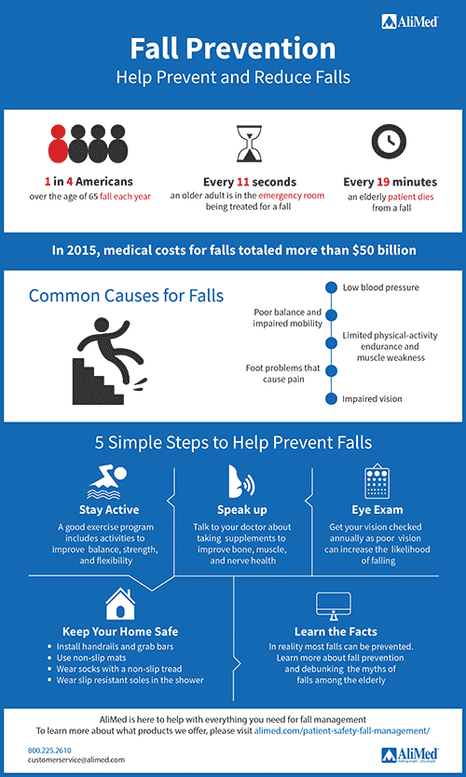

Slide 34
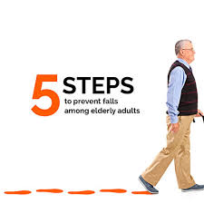
Five Safe Steps to Prevent Falls Among Elderly
Participate in regular physical activity. Exercise makes you stronger, increases flexibility and improves balance and coordination. ...
Remove hazards in your home. ...
Review your medications regularly. ...
Have your vision and hearing checked once a year. ...
Talk to your family members and enlist their help.

Slide 35
Multifactorial falls risk assessment
identification of falls history
assessment of visual impairment
assessment of cognitive impairment and neurological examination
cardiovascular examination and medication review.
assessment of gait, balance and mobility, and muscle weakness
assessment of osteoporosis risk
assessment of the older person's perceived functional ability and fear relating to falling
assessment of urinary incontinence
assessment of home hazards

Slide 36
Multifactorial interventions
An intervention with multiple components that aims to address the risk factors for falling that are identified in a person's multifactorial assessment.

Slide 37
MULTIFACTORIAL INTERVENTIONS
Multifactorial interventions should include: Exercise, particularly balance, strength, and gait training
Vitamin D supplementation with or without calcium
Management of medications Home environment modification
Management of postural hypotension, vision problems, foot problems, and footwear.

Slide 38
Improve home supports.
Provide opportunities for socialization and encouragement.
Involve the family.
Provide follow-up.

Slide 39
Rehabilitation
Adequate rehabilitation physically, socially, and psychologically of injured person is very important post fall.

Slide 40
SUMMARY

Slide 41
Elderly aged 65 or above
Healthcare professional should routinely ask about falls
Identify if being at risk of falling Multifactorial risk assessment Multifactorial risk intervention
Encourage participation in falls prevention programmes & provide information and education

