Slide 1
Patent Ductus Arteriosus
Normally, the ductus arteriosus closes before the 4th week of life
Failure of closure of the ductus is more common in females

Slide 2
PDA: Pathophysiology
Pressure gradient between the aorta & PA occurs throughout the cardiac cycle
This leads to continuous flow of blood from the aorta to PA

Slide 3
Adult life

Slide 4
Fetal Life

Slide 5
Adult with PDA
Adult

Slide 6
PDA: Pathophysiology
The shunt involves PA, LA, LV, & aorta
The RV and RA are not involved in the shunt

Slide 7
PDA: Pathophysiology
The magnitude of the shunt depends on the size of the communication
Usually there is LV volume overload and increased flow through the mitral valve

Slide 8
PDA: Clinical Presentation
Exertional dyspnea
Recurrent chest infections
Congestive heart failure

Slide 9
PDA: Physical Findings
Large volume pulse
Left ventricular dilatation (displaced apex beat)
Systolic & diastolic thrills in the pulmonary area
Palpable systolic expansion of the pulmonary artery

Slide 10
PDA: Physical Findings
Left parasternal heave (RVH due to PHT)
Auscultation: continuous murmur in the pulmonary area (machinery murmur)

Slide 11
PDA: Clinical Presentation
Eisenmenger syndrome with differential cyanosis:
Cyanosis of the toes but not the fingers
The right to left shunt bypasses the cerebral and upper limb vessels & flows directly into the aorta

Slide 12
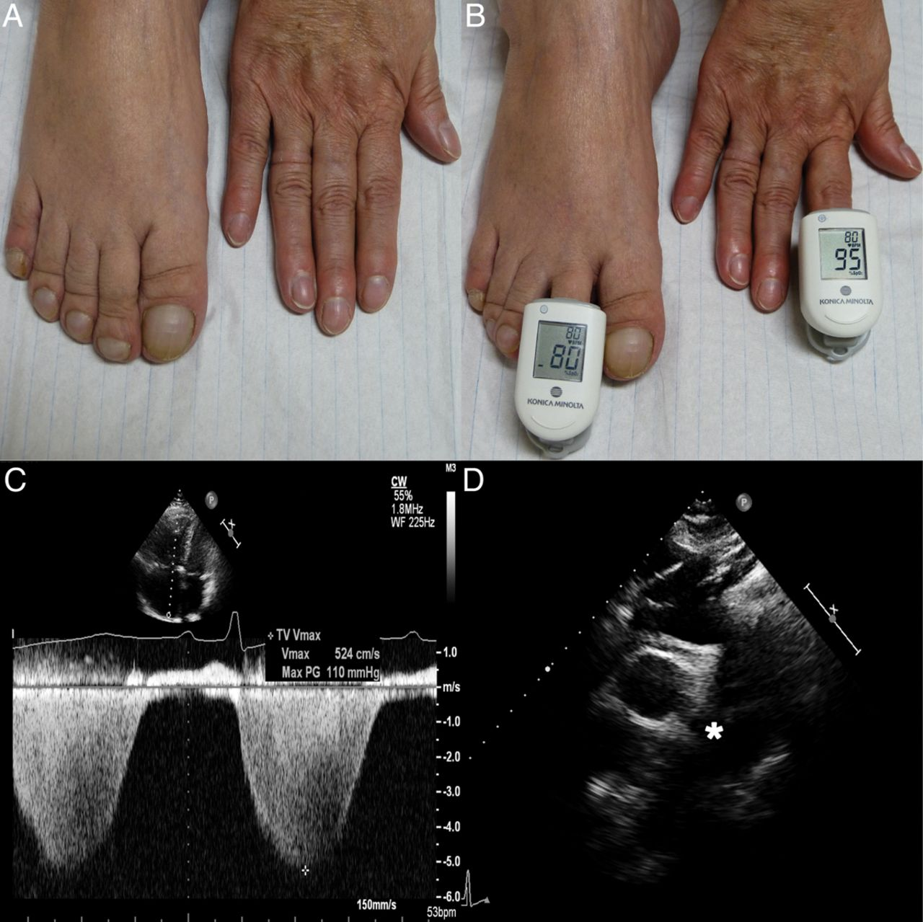
Moccetti F et al. Eur Heart J 2014;35:1410
Published on behalf of the European Society of Cardiology. All rights reserved. © The Author 2014. For permissions please email: journals.permissions@oup.com

Slide 13
PDA: Investigations: CXR
LV & LA dilatation
Prominent main pulmonary artery
Plethoric lungs (increased pulmonary vascular markings: arterial and venous)
Prominent aorta
In older patients: the ductus may be calcified

Slide 15
PDA: Investigations
ECG: LVH
tall R waves in chest leads V5 & V6
Deep S waves in chest leads V1 & V2
Echocardiography & Doppler: Demonstrates the site of the ductus and the continuous flow by Doppler

Slide 16
PDA: Management
Closure of the ductus whatever the size
Usually closed through catheterization
Large ducts are closed surgically

Slide 17
Valvular Pulmonary Stenosis
Increased resistance for RV ejection
Pressure gradient between RV & PA
This leads to right ventricular hypertrophy
The forceful jet into the PA leads to dilatation of the main pulmonary artery

Slide 18
Valvular PS: Clinical Picture
Raised JVP
RVH: left parasternal heave
Systolic thrill in the pulmonary area
Faint pulmonary second sound
Systolic ejection murmur at the pulmonary area

Slide 19
Valvular PS: Investigations
ECG:
RVH: tall R waves in V1 & V2
CXR:
Oligemic lungs: reduced pulmonary blood flow
Prominent main pulmonary artery (post-stenotic dilatation)

Slide 20
ECG in PS

Slide 22
Valvular PS: Investigations
Echocardiography:
Reduced pulmonary valve motion
Doppler: estimation of the gradient across the pulmonary valve

Slide 23
Valvular PS: Treatment
Transcatheter dilatation of the stenotic pulmonary valve using a balloon inflated at the pulmonary valve
If this fails: surgery

Slide 24
Coarctation of the Aorta
Narrowing of the aorta just distal to the origin of the left SCA

Slide 25
Coarctation of the Aorta
With age, collaterals form around the narrowing to bridge the proximal & distal parts

Slide 26
Coarctation of the Aorta
Usually associated with bicuspid aortic valve
More common in males

Slide 27
Coarctation of the Aorta: Clinical
Co A is an important cause of congestive heart failure in neonates
Often undetected during physical examination

Slide 28
Coarctation of the Aorta: Clinical
The hallmark is radio-femoral delay of the pulse

Slide 29
Hypertension may cause headache
Leg cramps: reduced circulation in the lower limbs

Slide 30
Coarctation of the Aorta: Clinical
BP is raised in the arms, normal in the legs
Auscultation:
systolic murmur over the coarctation (heard over the back)
Systolic ejection click (dilated aorta, bicuspid aortic valve)
Continuous murmur from flow into collaterals: heard best over the spine

Slide 31
Coarctation of the Aorta: Investigations
CXR:
Rib notching: from enlarged collaterals
Prestenotic and post-stenotic dilatation form the “3 sign” of the descending aorta

Slide 34
Coarctation of the Aorta: Investigations
Echocardiography:
Shows the site of stenosis & pressure gradient across it
CT & MRI: can show the entire extent of the aorta

Slide 36
Coarctation of the Aorta: treatment
Early relief of obstruction: by surgery or catheter-based intervention
BP returns to normal
If intervention is delayed, HT may persist

Slide 37
Tetralogy of Fallot (TOF)
The four components of TOF are:
Ventricular septal defect
Over-riding aorta
Pulmonary stenosis, RV outflow tract obstruction
Right ventricular hypertrophy

Slide 39
TOF: Clinical Picture
Cyanosis & clubbing
Squatting: sudden assumption of the sitting position in the upright patient:
This increases the LV afterload and reduces the magnitude of right -to-left shunt

Slide 40
TOF: Clinical Picture
Cyanotic spells: sudden lethargy and weakness with increased depth of cyanosis:
Fever
Crying
Exertion
Cause: Reduced pulmonary blood flow & increased shunting of blood to the left side

Slide 41
TOF: Physical findings
Clubbing
Cyanosis
Prominent RV impulse
No thrill (≠ valvular PS): reduced pulmonary blood flow

Slide 42
TOF: Physical findings
Auscultation:
single second heart sound
Faint systolic ejection murmur at the pulmonary area

Slide 43
TOF: investigation
ECG:
Right ventricular hypertrophy
Chest X ray:
Right ventricular enlargement
Pulmonary bay (underdeveloped pulmonary artery)
The combination of these findings gives the “boot-shaped heart”

Slide 46
TOF: Treatment
Surgical correction
If the PA is very small & underdeveloped: the aorta is anastomosed to the pulmonary arteries to enhance their growth before total correction ( Blalock-Taussig shunt)

