Slide 1
The Digestive System

Slide 2
The Esophagus
Gastroesophageal Reflux Disease (GERD)
Gastroesophageal reflux (GER) : retrograde movement of gastric contents across the lower esophageal sphincter (LES) into the esophagus.

Slide 3
It is occasionally physiologic (regurgitation of normal infants), but when the episodes of reflux are more frequent or persistent, and thus produce esophagitis or esophageal symptoms, or in those who have respiratory sequelae, the reflux becomes pathologic (GERD).

Slide 4
Pathophysiology
Antireflux barrier:
*lower esophageal sphincter (LES)
*the crura of the diaphragm
*gastroesophageal junction anatomy

Slide 6
The mechanisms involved in the pathogenesis of GERD are multiple and include:
1. impaired LES resting tone
2. increased number of transient LES relaxations (TLESR)
3. Gastric distention (delayed gastric emptying, large fatty meals)
4. hiatal hernia (promoting lower esophageal sphincter dysfunction)

Slide 7
5. Impaired esophageal acid clearance lead to prolonged acid exposure of the mucosa.
6. increase intra-abdominal pressure (straining, obesity, coughing, wheezing) .

Slide 10
Epidemiology :
Infant reflux becomes symptomatic during the first few months of life, peaking at about 4 mo and resolving in most by 12 mo and nearly all by 24 mo.
A genetic predisposition as an autosomal dominant form is present.

Slide 11
Clinical Manifestations
Infantile reflux manifests with:
*regurgitation (especially postprandially)
*signs of esophagitis (irritability, arching, choking, feeding aversion) and, rarely, as hematemesis, anemia)
*failure to thrive
These symptoms resolve spontaneously in the majority by 12 to 24 mo.

Slide 12
In older children:
*regurgitation during the preschool years.
*abdominal and chest pain.
*Occasional children present with neck contortions (arching, turning of head) designated Sandifer syndrome.
The respiratory (extraesophageal) presentations are also age dependent:
In infants :

Slide 13
obstructive apnea or as stridor or lower airway disease.
Otitis media, sinusitis, hoarseness, and laryngeal edema .
In older children are more frequently related to asthma , laryngitis or sinusitis.

Slide 14
Diagnosis
1. Thorough history and physical examination: GERD should differentiated from other causes of chronic vomiting like milk and other food allergies, pyloric stenosis, intestinal obstruction, and increased intracranial pressure.

Slide 15
2. Contrast (barium) radiographic to evaluate for achalasia, esophageal strictures and stenosis, hiatal hernia, and gastric outlet obstruction.
3. esophageal pH monitoring of the distal esophagus.

Slide 16
4. Endoscopy : allows diagnosis of erosive esophagitis and complications such as strictures or Barrett esophagus; biopsies can be taken.
5. Laryngotracheobronchoscopy : posterior laryngeal inflammation and vocal cord nodules.
6. Empirical antireflux therapy

Slide 17
Management
1. Conservative therapy and lifestyle modification
* Dietary measures for infants include:
Normalization of feeding techniques, volumes, and frequency if abnormal.
Thickening of formula with a tablespoon of rice or oat cereal per oz of formula results in a greater caloric density (30 kcal/oz) ), and reduced crying time.
Or use of commercially prethickened formulas.

Slide 18
In older children : avoid acidic foods (tomatoes, chocolate, mint) and beverages (juices, carbonated and caffeinated drinks), weight reduction for obese patients.
*Positioning measures: During awake periods when the infant is observed, prone position and upright carried position. Supine positioning during sleep.
For older children: left side position and head elevation during sleep.

Slide 19
2. Pharmacotherapy
* Antacids: They provide rapid but transient relief of symptoms by acid neutralization.
* Histamine-2 receptor antagonists (H2RAs; cimetidine, famotidine, and ranitidine) are antisecretory agents.There is a benefit of H2RAs in treatment of mild-to-moderate reflux esophagitis.

Slide 20
*Proton pump inhibitors (PPIs; omeprazole, lansoprazole, pantoprazole,) provide the most potent antireflux effect.
Also benefit in the treatment of severe and erosive esophagitis. Doses of omeprazole for children (0.7–3.3 mg/kg/day).

Slide 21
* Prokinetic agents: metoclopramide, and erythromycin (motilin receptor agonist) ,these increase LES pressure; some improve gastric emptying or esophageal clearance.
3. Surgery( fundoplication): for intractable GERD in children, particularly those with refractory esophagitis or strictures and those at risk for significant morbidity from chronic pulmonary disease.

Slide 22
Complications of GERD
1.Esophageal
*Esophagitis and Stricture.
* Barrett Esophagus
*Adenocarcinoma
2. Nutritional: failure to thrive because of caloric deficits.

Slide 25
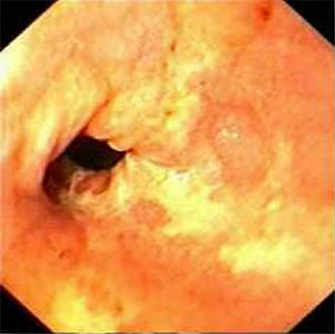

Slide 26
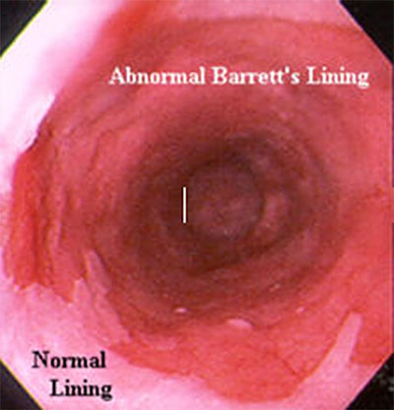

Slide 27
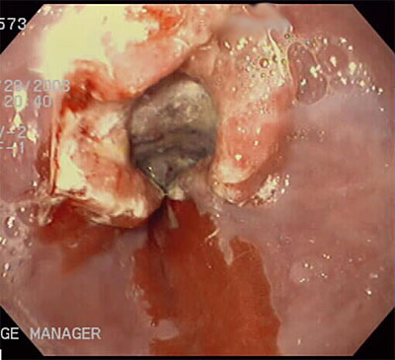

Slide 28
3. Extraesophageal: Respiratory ("Atypical") Presentations:
Apnea, stridor, reflux laryngitis, hoarseness, chronic cough, pharyngitis, sinusitis, otitis media. Asthma may co-occur with GERD in about 50% of asthmatic children.
4. Dental erosions.

Slide 29
Thank you

