Slide 1
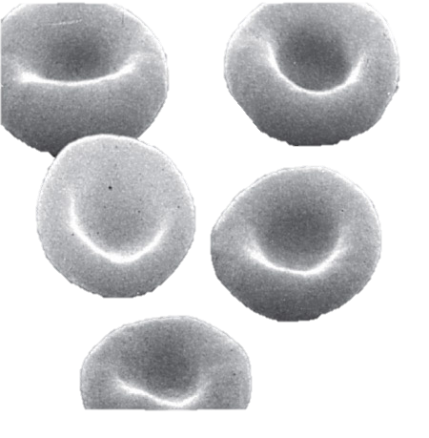
BLOOD

Slide 2
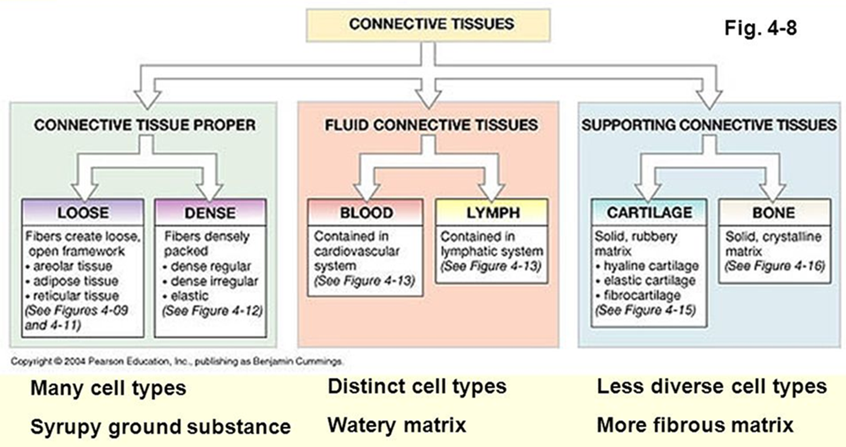

Slide 3
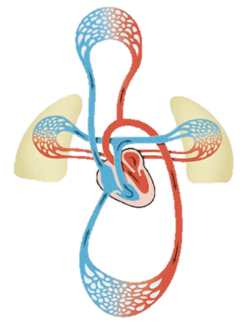
Provides a mechanism for rapid transport of nutrients, waste products, respiratory gases and cells
Powered by the pumping action of the heart

Slide 4
Introduction
Cardiovascular System
System made up of blood vessels, blood and heart. Major function is to transport nutrients, gases and hormones to the cells and pick up wastes from cells to transport them to areas of body where they are excreted
Lymphatic System
Network of vessels that return the fluid escaped from blood vessels back to the bloodstream. Includes lymphocytes, lymphoid tissue and lymphoid organs which fight infections and give immunity to disease
Circulatory System
Together the cardiovascular system and lymphatic system make up the circulatory system

Slide 5
Functions of blood
Transportation (dissolved gases, nutrients, hormones and metabolic wastes).
Protection - Platelets in the blood and clotting proteins minimize blood loss when a blood vessel is damaged.
Regulation
Blood regulates the pH and electrolyte composition of the interstitial fluids.
Blood regulates body temperature.

Slide 6
Composition Of Blood
A specialized connective tissue. Contains cellular and liquid components
Blood cells : formed elements
Plasma : fluid portion and fibrinogen
Blood volume
Males: 5 – 6 liters
Females: 4 – 5 liters
The pH of blood is about 7.35-7.45

Slide 7
Blood Plasma
Straw-colored, sticky fluid portion of blood
Approximately 90% water
Contains:
Ions : Na+ and Cl-
Nutrients : sugars, amino acids, lipids, cholesterol, vitamins and trace elements
Three main proteins : Albumin (60%), globulin (35%), fibrinogen (4%)
Dissolved Gasses : including O2 and CO2
Waste Products : other protein wastes such as urea and bilirubin

Slide 8
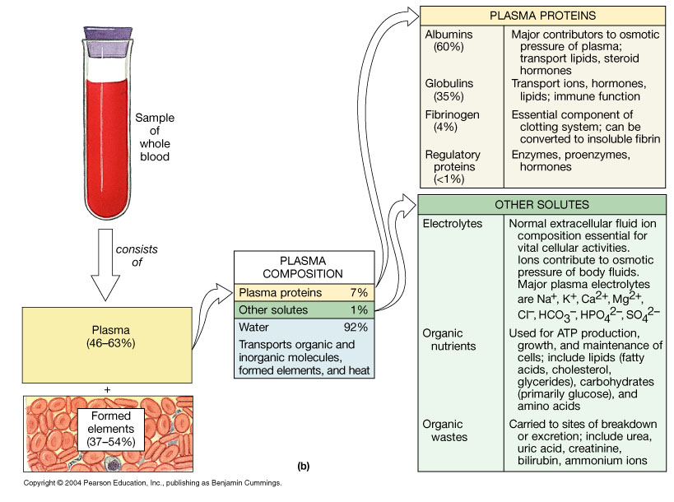
Composition of Whole Blood
Figure 19.1b

Slide 9
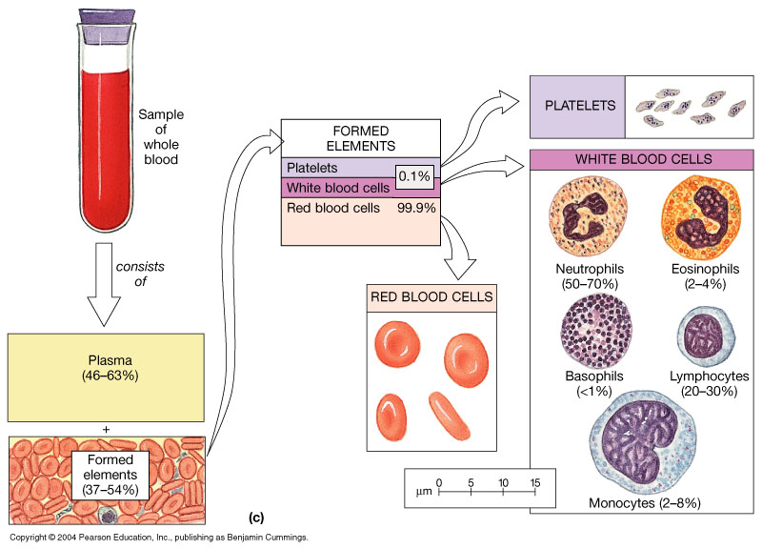
Composition of Whole Blood
Figure 19.1c

Slide 10
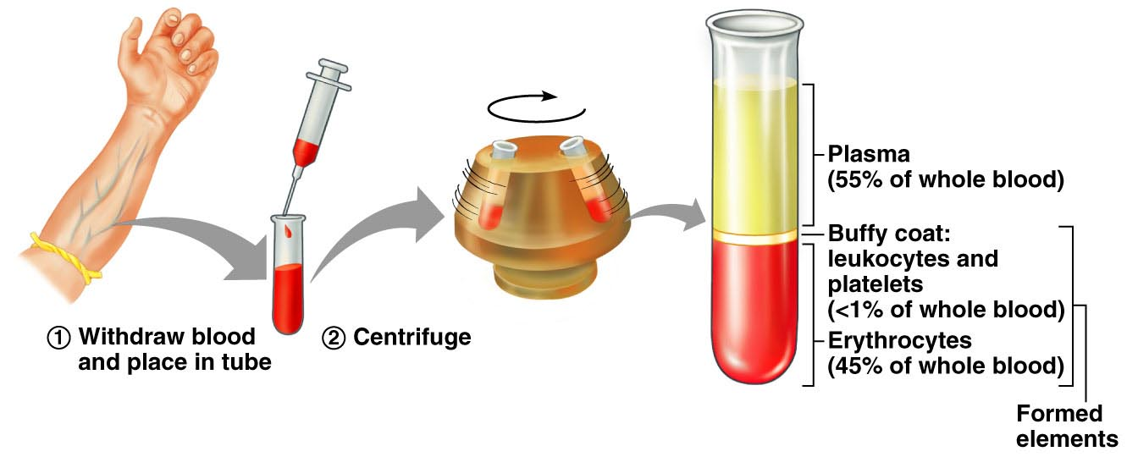
Overview: Composition of Blood
Hematocrit – measure of % RBC
Males: 47% ± 5%
Females: 42% ± 5%
Figure 17.1

Slide 11
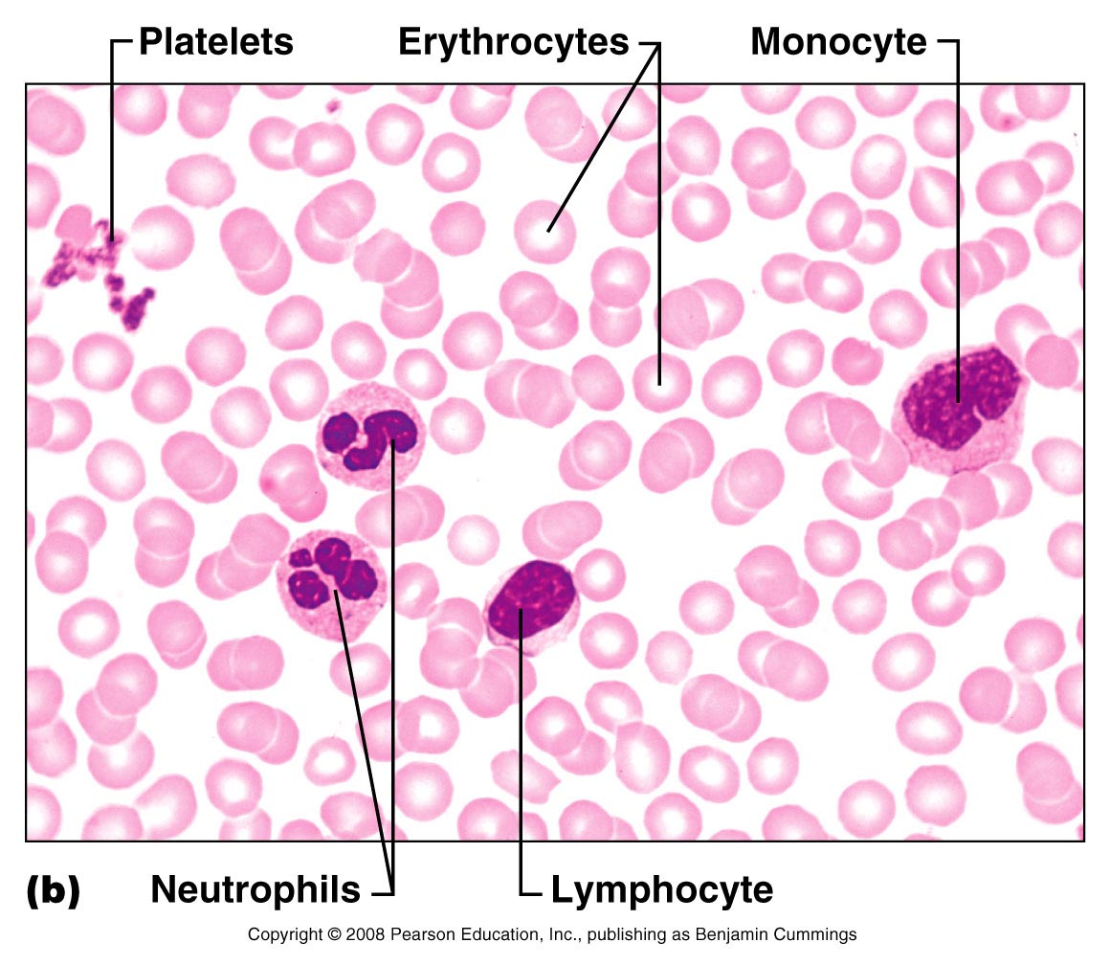
Wright’s Stain
Figure 17.2b

Slide 12
Erythrocytes – Red Blood Cells (RBCs)
Oxygen-transporting cells
7.5 µm in diameter (diameter of capillary 8 – 10µm)
Most numerous of the formed elements
Females: 4.3 – 5.2 million cells/cubic millimeter
Males: 5.2 – 5.8 million cells/cubic millimeter
Made in the red bone marrow in long bones, cranial bones, ribs, sternum, and vertebrae
Average lifespan 100 – 120 days

Slide 13
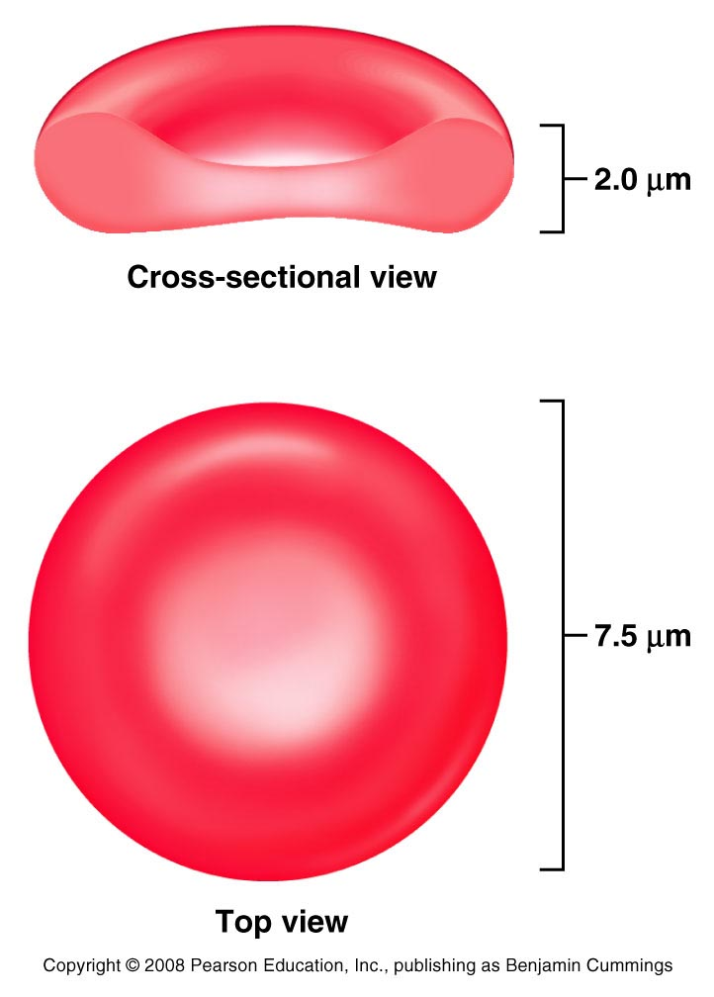
RBC Structure And Function
Have no organelles or nuclei
Hemoglobin : oxygen carrying protein. Each RBC has about 280 million hemoglobin molecules
Biconcave shape – 30% more surface area

Slide 14
Leukocytes – White Blood Cells (WBCs)
Protect the body from infectious microorganisms
4,800 – 11,000/cubic millimeter
Function outside the bloodstream in loose connective tissue
Diapedesis (circulating leukocytes leave the capillaries)
WBCs have a nucleus and are larger than RBCs
Most produced in bone marrow
Lifespan of 12 hours to several years

Slide 15
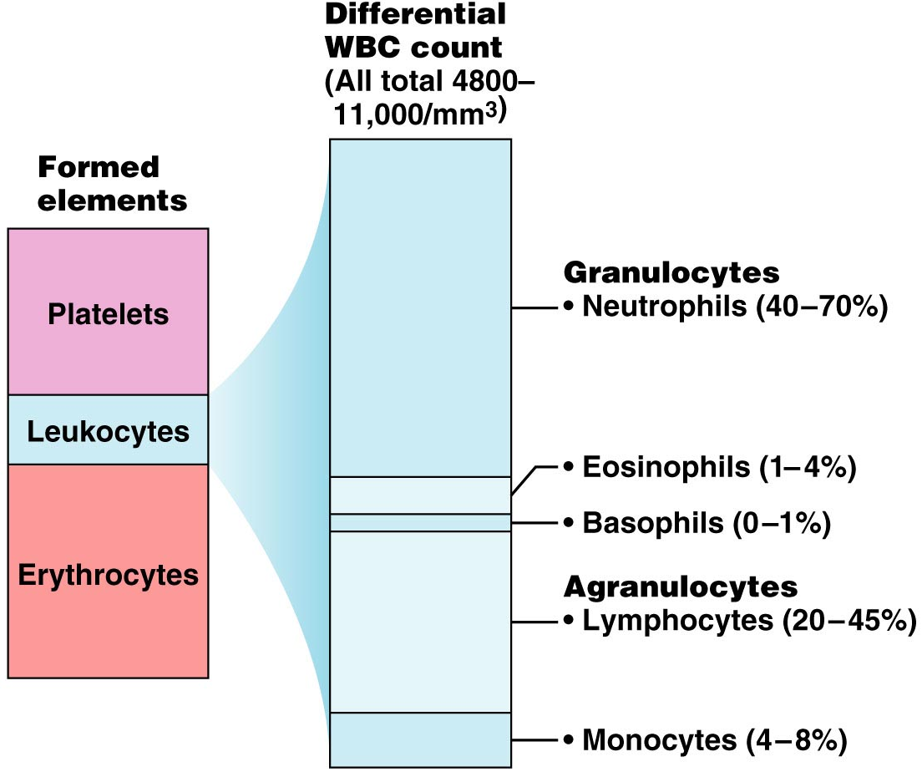
Leukocytes – White Blood Cells (WBCs)
Two types of leukocytes
Granulocytes
Agranulocytes
Figure 17.5

Slide 16
White Blood Cells
Type Of White Blood Cells | % By Volume Of WBC | Description | Function
Neutrophils | 60 – 70 % | Nucleus has many interconnected lobes; blue granules | Phagocytize and destory bacteria; most numerous WBC
Eosinophils | 2 – 4 % | Nucleus has bilobed nuclei; red or yellow granules containing digestive enzymes | Play a role in ending allergic reactions
Basophils | < 1 % | Bilobed nuclei hidden by large purple granules full of chemical mediators of inflammation | Function in inflammation medication; similar in function to mast cells
Lymphocytes (B Cells and T Cells) | 20 – 25 % | Dense, purple staining, round nucleus; little cytoplasm | the most important cells of the immune system; effective in fighting infectious organisms; act against a specific foreign molecule (antigen)
Monocytes | 4 – 8 % | Largest leukocyte; kidney shaped nucleus | Transform into macrophages; phagocytic cells

Slide 17
Granulocytes
Neutrophils – most numerous WBC
Phagocytize and destroy bacteria
Nucleus – has two to six lobes
Granules pick up acidic and basic stains
Figure 17.4a

Slide 18
Granulocytes
Eosinophils – compose 1 – 4% of all WBCs
Play roles in ending allergic reactions, parasitic infections
Figure 17.4b

Slide 19
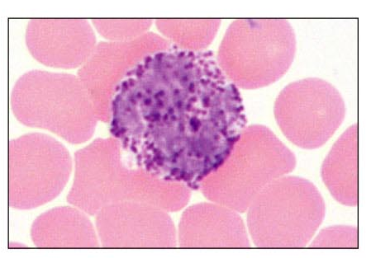
Granulocytes
Basophils – about 0.5% of all leukocytes
Nucleus – usually two lobes
Granules secrete histamines
Function in inflammation mediation, similar in function to mast cells

Slide 20
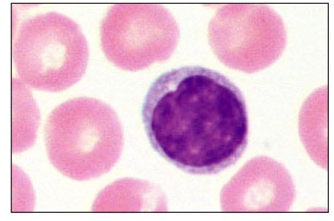
Agranulocytes
Lymphocytes – compose 20 – 45% of WBCs
The most important cells of the immune system
Nucleus – stains dark purple
Effective in fighting infectious organisms
Act against a specific foreign molecule (antigen)
Two main classes of lymphocyte
T cells – attack foreign cells directly
B cells – multiply to become plasma cells that secrete antibodies
Figure 17.4d

Slide 21
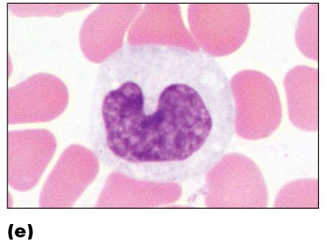
Agranulocytes
Monocytes – compose 4–8% of WBCs
The largest leukocytes
Nucleus – kidney shaped
Transform into macrophages
Phagocytic cells
Figure 17.4e

Slide 22
Platelets
Structure
Small cellular fragments; originate in bone marrow from giant cell (megakaryocyte)
Contain several clotting factors (calcium ions, ADP, serotonin)
Function
Involved in stopping bleeding when a blood vessel is damaged; Process is called hemostasis

Slide 23
Blood Cell Formation
Hematopoiesis – process by which blood cells are formed
100 billion new blood cells formed each day
Takes place in the red bone marrow of the humerus, femur, sternum, ribs, vertebra and pelvis
Red marrow – actively generates new blood cells
Contains immature erythrocytes
Remains in epiphyses, girdles, and axial skeleton
Yellow marrow – dormant
Contains many fat cells
Located in the long bones of adults
Tissue framework for red marrow
Reticular connective tissue
Notes:
Epiphyses كردوس
Girdles الاحزمة

