Slide 1
Prostate Cancer

Slide 2
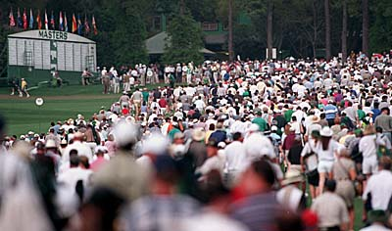
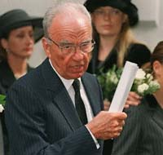
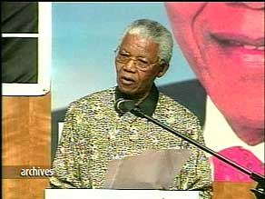
Notes:
What is in common between these photographs?

Slide 3
Carcinoma of the prostate
Is the second most common cause of cancer related death in men older than 50 years of age after carcinoma of the lung with peak incidence between the ages of 65-75 years.
Autopsy studies show that 30% to 40% of men over 50, who had no symptoms of prostate cancer whilst alive, have histological evidence of prostate cancer at the time of death. This percentage rises to 60% to 70% in men over 80 years of age.

Slide 4
Proposed Risk Factors
Family history
Diet, fat, obesity, alcohol
Hormones
Smoking
Sexual activity (early, multiple partners, STD)
Chemicals, toxins, radiation
Viruses (Herpes 2, CMV)
Vasectomy
BPH
Notes:
As in most cancers, some members of certain families have an increased risk of cancer. All the above factors have been mentioned in various studies as having an association with prostate cancer. The role of vasectomy is debatable. Benign prostatic hyperplasia is very common and therefore it is difficult to prove how strong is the association (in the same way as fibrocystic change in the breast and whether it is associated with cancer or not!!).

Slide 5
Pathology:- 70-80% of Ca prostate arise in the outer peripheral glands and hence may be palpable as irregular hard nodules by rectal digital examination and because of its peripheral location. Ca prostate less likely to cause urethral obstruction in early stage than nodular hyperplasia.
Grossly:- early lesions appear as ill defined mass just beneath the capsule of the prostate. On cut section foci of CA appear as firm gray white to yellow lesions that infiltrate the adjacent gland with ill defined margin.

Slide 6
Metastases to regional pelvic lymph nodes may occur early. In advance cancers invasion to seminal vesicles, periurethral zones of the prostate, wall of the bladder may occur but the rectum is rarely involved by invasion that is because there is a connective tissue separating the lower genitourinary tract structures from the rectum which prevent the growth of the tumor posteriorly.

Slide 7
Well differentiated adenocarcinomas are composed of small glands infiltrate the adjacent stroma in irregular haphazard fashion. In contrast to normal and hyperplastic prostate
the glands in carcinoma doe not encircled by collagen or stromal cells but they appear to have (back to back) appearance.
The neoplastic glands are lined by a single layer of cuboidal cells with conspicuous nucleoli;( the basal layer seen in normal and hyperplastic glands is absent).

Slide 8
The undifferentiated adenocarcinoma characterized by
1) increasing variability of gland size and configuration
2) papillary and cribriform patterns
3) some times there is no gland formation but there is a solid cord or sheet of infiltrating malignant tumor cells within the stroma.

Slide 9
Clinical features: Ca prostate are often clinically silent especially during early stages, but
20% of localized ca are discovered accidently during histological examination for biopsy removed for nodular hyperplasia.
Discovered accidently during routine digital rectal examination as hard firm nodules under the capsule of peripheral glands.
More extensive Ca may produce signs and symptoms of prostatism due to lower UT obstruction.

Slide 10
More aggressive tumor may give clinical presentation of metastases. Bone metastases especially to axial skeleton is the most common and prostatic Ca may cause either osteolytic (destructive lesion) or more commonly osteoblastic lesions(bone producing lesions).
The presence of osteoblastic metastases is strongly suggestive of advance prostatic Ca.

Slide 11
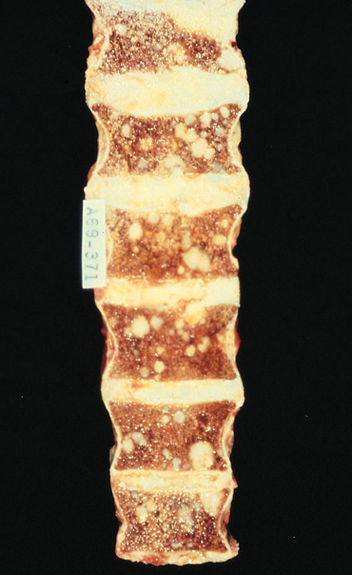
Bone Metastases
Spinal mets ->
Painful
May cause lots of reactive bone growth at the site of the met
Osteoblastic
May cause bone destruction
Osteolytic

Slide 12
Microscopically:- most Ca prostate are adenocarcinomas with variable degree of differentiation. They originate from intraductal dysplastic foci termed prostatic intra epithelial neoplasia (PIN) which is a premalignant state in which the prostatic ducts lined by cytologically a typical luminal cells and a concomitant diminution in the number of the basal cells.
PIN is of low and high grade patterns and it precedes the appearance of invasive carcinoma by two decades and there severity increases with increasing age.

Slide 13
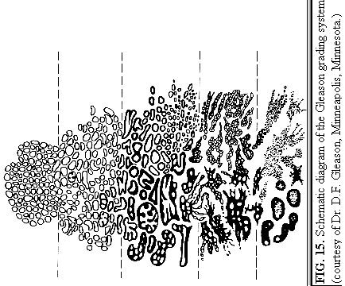
Gleason system
Based on architectural pattern
Cytological features not factored in
Overall grade is not based on highest grade component
Score = Primary pattern (1-5)+ secondary pattern (1-5)
Notes:
It was found that the prognosis of prostate cancer is intermediate between the most predominant pattern and the second most predominant pattern. Recently people are talking about tertiary pattern.

Slide 14
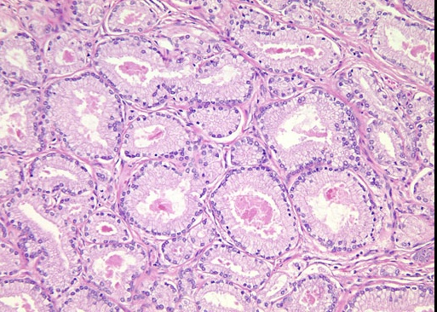
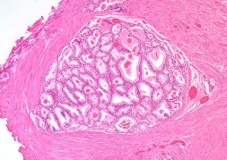
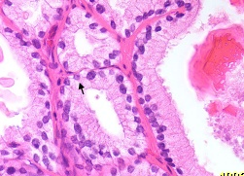
Pattern 1
Notes:
Circumscribed nodules of uniform single separate closely packed glands. Very uncommon in TURPs & even rarer in Needle bxs.

Slide 15
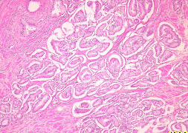
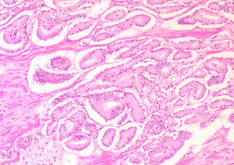
Pattern 2
Notes:
Fairly well circumscribed with minimal extension at the edge of neoplastic glands into the stroma. Moor loosely arranged and less uniform than pattern 1. Both pattern 1 & 2 often exhibit pale cells.

Slide 16
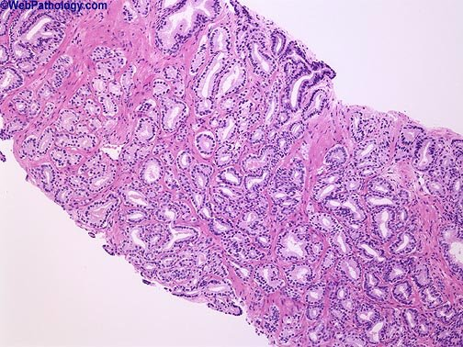
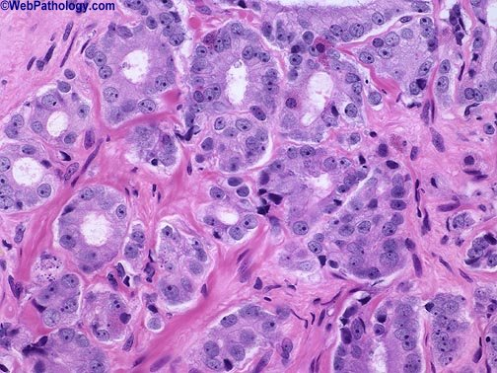
Gleason Pattern 3

Slide 17
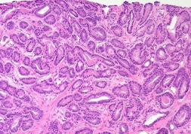
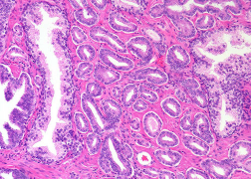
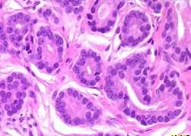
Pattern 3
Notes:
Malignant glands infiltrating between benign glands. Marked variation in size & shape of the glands. Some smaller glands than those seen in pattern’s 1 & 2. The glands are discreet and you can imagine drowning a circle around each one.

Slide 18
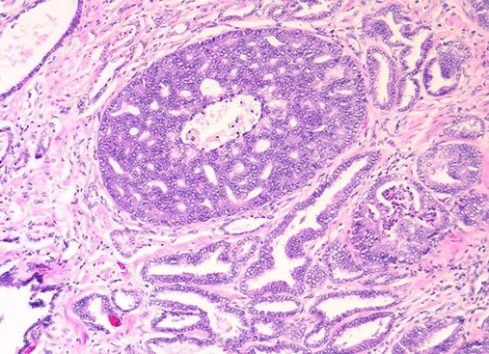
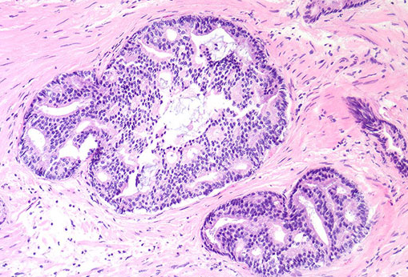
Pattern 4

Slide 19
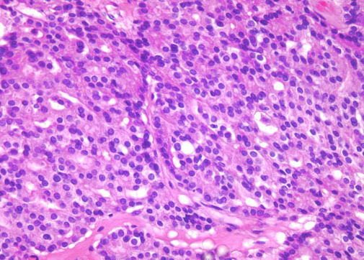
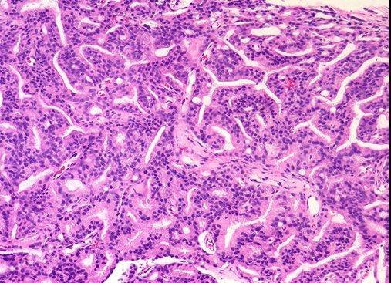
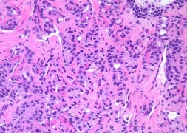
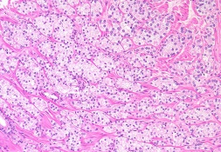

Slide 20
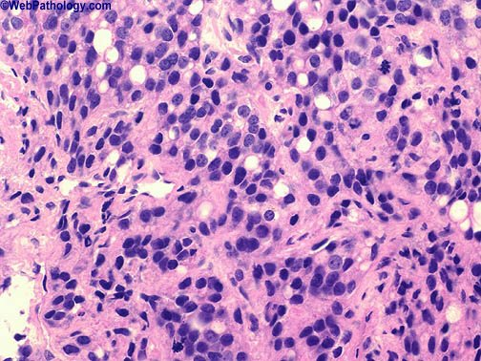
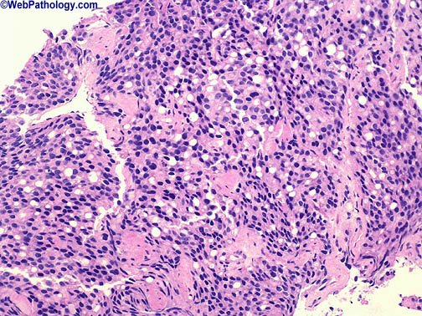
Gleason Pattern 5

Slide 21
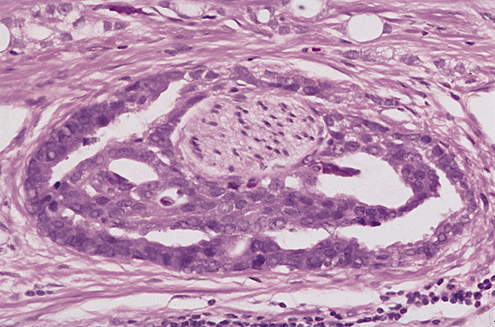
Prostate Cancer

Slide 22
Diagnostic tests
DRE
PSA
TRUS
To identify lesions of suspected malignancy
To improve the accuracy of prostate biopsies
Prostate biopsies

Slide 23
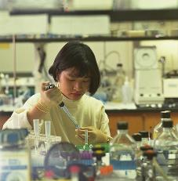
Causes of increased incidence
A- Early detection:
PSA
Notes:
PSA is a protease which helps to liquefy the seminal clot thus allowing the spermatozoa to move/be released. It is synthesised in the prostatic ducts and glands. It diffuses into the serum and is usually raised in cancer but also can be raised in other situations to a lesser extent.

Slide 24
prostatic –specific antigen (PSA) is proteolytic enzyme produced by both normal and neoplastic epithelium. It secreted into prostatic acini then into the seminal fluid where it increases the motility of the sperm by maintaining the seminal secretion in a liquid state.
It s upper normal limit value 4ng/L. it is used in the diagnosis of early Ca but it is of limited that due to

Slide 25
Causes of Raised PSA:
Prostaitc cancer
BPH
Prostatic infarction
Prostatic manipulation
Prostatic biopsy
Acute urinary retention
Urethral catheterisation

Slide 26
Age related reference limits:
<49y
50-59y
60-69y
70-79y
<2.5 μg/l
<3.5
<4.5
<6.5
Notes:
The normal value for PSA is not a straight forward issue. When the level is between 4 & 10 in men with normal D rectal examination, the incidence of ca is 25%.

Slide 27
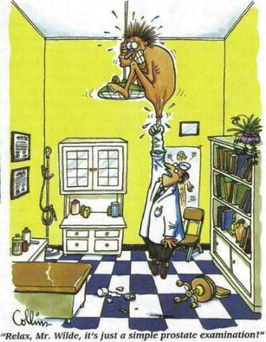
Early Detection
2. Digital Rectal Examination (DRE)
Notes:
Asymmetry, induration and discrete hard nodules are what one is looking for on DRE. Marked indurations or a nodule are more likely to be cancer than a mild induration. The positive predictive value of DRE is 22-36%. It is also of low sensitivity. Approximately 50% of cancers found at Radical prostatectomy are impalpable by DRE.

Slide 29
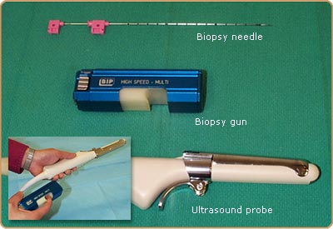
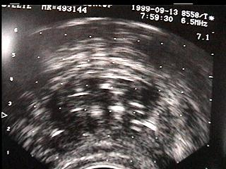
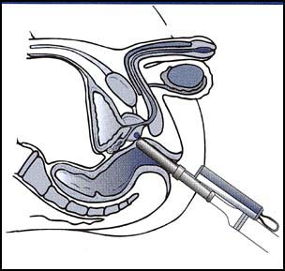
Early Detection
3. TRUS and Biopsy
Notes:
The majority of p Ca appear as hypoechoic areas relative to the peripheral zone although occasionally some cancers are hyperechoic or isoechoic. Therefore this method of diagnosis is not very sensitive or specific on its own.
The positive predictive value of finding ca on bx increases if all modalities of dx are used. Therefore it is important to use the findings of all tests together (i.e. PSA, DRE & TRUS bx) to improve cancer detection.
Another use of TRUS is to estimate p volume and correlate with PSA level to work out PSA density. Even this is not very accurate. Part of the limitation is the differences of the equipment used and is heavily operator dependent.

Slide 30
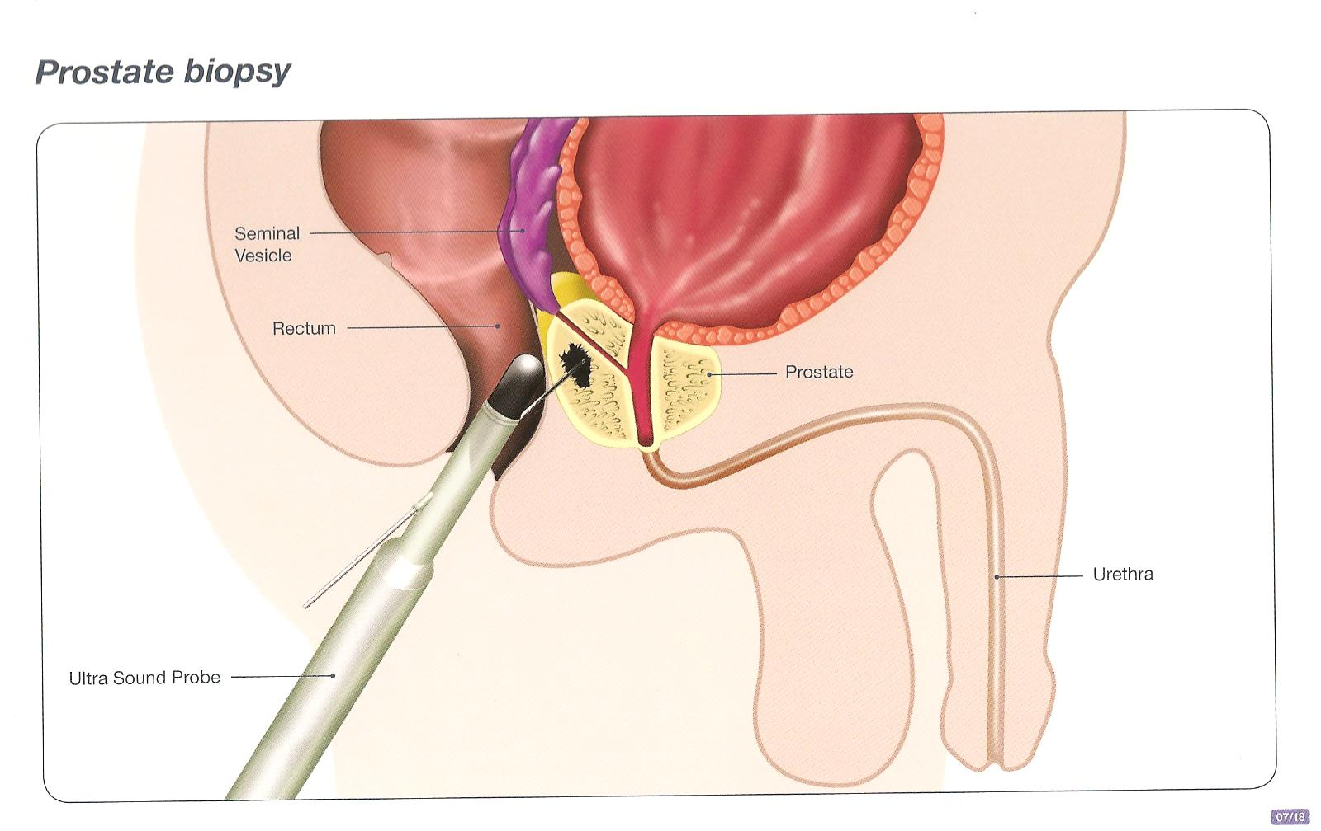
TRUS

Slide 31
Early Detection
4. Increased awareness

Slide 32
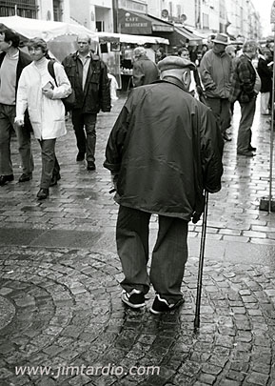
Causes of Increased Incidence
B. Longer life
Notes:
It is said that all men will develop P ca if they live long enough. As life is getting longer, you would expect a rise in diseases of old age including P ca

Slide 33
Incidence versus Age
Rare < 40
latent cancer (at autopsy) =
10% at 50 years
80% by 80 years

Slide 34
Grading of Prostatic Ca. Gleason’s System
Grades 1-5
Scores 2-10
Strongest predictor of biologic behaviour
Should be included with other prognostic factors in therapeutic decision making
e.g- age, health status, clinical stage, PSA

Slide 35
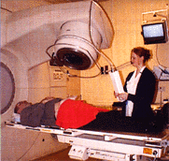
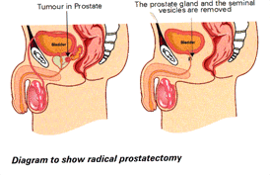
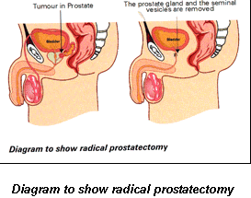
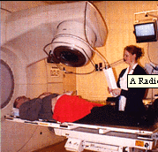
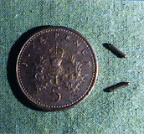
The most common treatments for prostate cancer include :
Surgery
external beam radiotherapy
hotmone therapy,
radioactive seed implants(internal radiotherapy),
watchful waiting
The most common treatments for prostate cancer include :
Surgery
external beam radiotherapy
hotmone therapy,
radioactive seed implants(internal radiotherapy),
watchful waiting
The most common treatments for prostate cancer include :
Surgery
external beam radiotherapy
hotmone therapy,
radioactive seed implants(internal radiotherapy),
watchful waiting
The most common treatments for prostate cancer include :
Surgery
external beam radiotherapy
hotmone therapy,
radioactive seed implants(internal radiotherapy),
watchful waiting
The most common treatments for prostate cancer include :
Surgery
external beam radiotherapy
hotmone therapy,
radioactive seed implants(internal radiotherapy),
watchful waiting

Slide 36
Transitional cell carcinoma
3 types are identified:
Direct extension/invasion from the bladder
Spread from the bladder along prostatic ducts
Primary TCC of prostatic urethral lining with no lesion in bladder

Slide 37
Mesynchymal Tumours
Phyllodes (Benign & Malignant)
STUMP
Leiomyoma & Leiomyosarcoma
Spindle cell nodule (post operative)
Pseudosarcomatous fibromyxoid tumour
Solitary fibrous tumour
Embryonal rhabdomyosarcoma

Slide 38
Notes:
Please note the variation in mortality from prostate ca through out the world. The question which comes to mind is : Is this true difference or is it because due to variation in collection of statistics between the different countries? The low mortality in Japan may partly be related to the taboo re cancer dx. Japanese men in the USA have similar incidence of prostate cancer closer to that of the natives

Slide 40
Dilemma of Prostate Cancer
30 - 50% of patients undergoing radical surgery for localised disease have extra capsular extension at the time of surgery.
Current staging tests are inadequate to accurately identify these patients.

Slide 41
THE FUTURE ?

Slide 42
The Future
1- PIN versus CANCER
Notes:
We are hoping to achieve for prostate cancer what has been achieved for cervical cancer. Our aim is to detect precancerous lesions early to allow timely treatment or even reversal of the process.

Slide 43
The Future
2- To understand the biological behaviour of prostate cancer

Slide 44
The Future
2- To understand the biological behaviour of prostate cancer

Slide 45
The Future
3- To improve staging methods

Slide 46
The Future
4- Standardisation of Treatment

Slide 47
To achieve a good quality of life for men with
Prostatic Cancer

