Slide 1
Anatomy of skin By Dr.Alaa Naif Dec 07, 2020

Slide 2
Is the largest organ in the body

Slide 3
Function

Slide 4
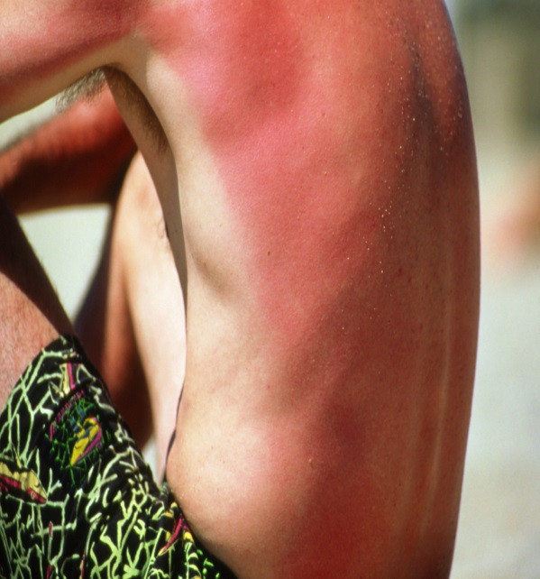
Photoprotection from skin cancer and sunburn
Albinism
(No melanin)
are liable
to skin cancer and
sunburn

Slide 5
Barrier against microorganisms
Steven Johnson syndrome
(sloughing of skin)
caused by drugs
liable to infection and
septicemia

Slide 6
Thermoregulation
Ectodrmal dysplasia
(no sweat glands)
Liable to heat stroke in hot weather

Slide 7
Vit D synthesis

Slide 8
Immunological protection
Liable to skin cancer
Renal transplant recipients

Slide 9
Beauty organ

Slide 10
Sensory organ

Slide 11
Skin is composed of three layers:
(1) Epidermis
(2) Dermis
(3) subcutaneous fat (panniculus)
There is considerable regional variation in the relative thickness of these layers

Slide 13
The epidermis is thickest on the palms and soles and thinnest on eyelids
The dermis is thickest on the back
The subcutaneous fat is thickest on the abdomen and buttocks

Slide 14
Epidermis
Composed of:
(1) Keratinocytes
(2) Melanocytes
(3) Langerhans cells
(4) Merkel cells
(5) Skin appendages

Slide 15
Keratinocytes
Ectodermal origin
Produce filamentous protein(keratin) that form a surface coat(stratum corneum) and is the structural protein of hair and nail
Mutation of this protein cause many diseases

Slide 16
Mutation of keratin Epidermolysis bullosa

Slide 17
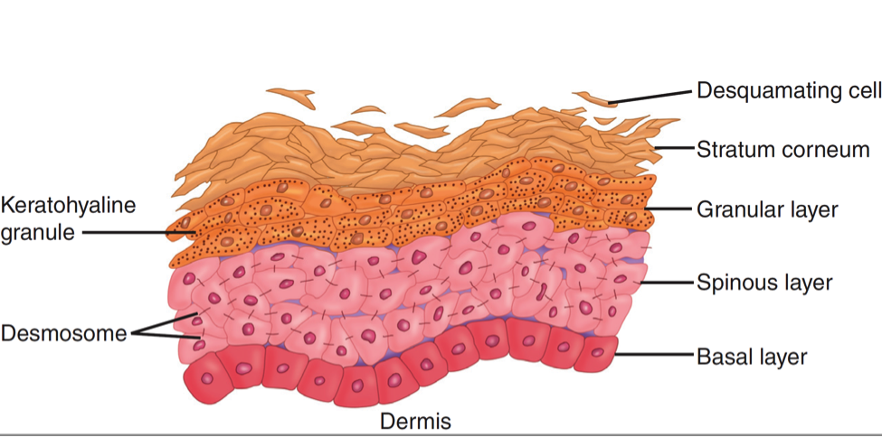
Keratinocytes are composed of many layers:
Basal layer(stratum basale)
Stratum lucidum (on thick skin only)
Prickle layer(stratum spinosum)
Granular layer(stratum granulosum)
Horny layer(stratum corneum)

Slide 19
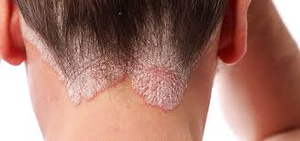
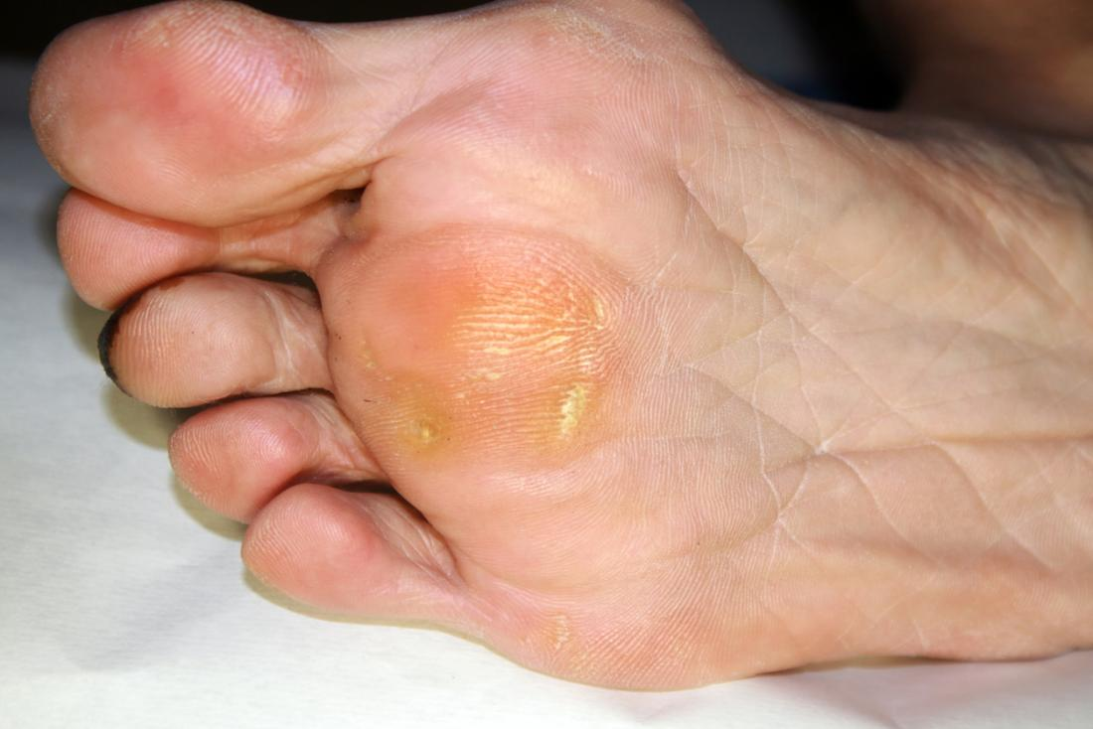
The horny layer is nonviable cells and does not have nuclei
Parakeratosis is when the horny layer keep their nuclei as in psoriasis
Hyperkeratosis is when the horny layer get thicker as in corn

Slide 20
Granular layer has keratohyalin granules

Slide 21
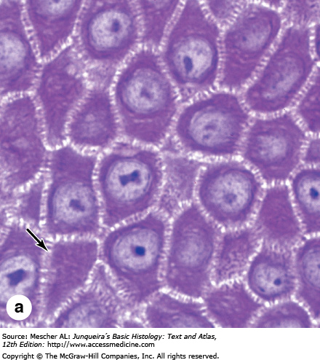
Stem cells provide a reservoir for regeneration of the epidermis located the deepest portions of the basal layer and hair bulge
Keratinocytes play an active role in the immune function and secrete a wide array of cytokines and inflammatory mediator
Keratinocytes are attached
to each other by bridges called
desmosomes

Slide 22
Epidermal cell cycle
After the cells are produced by basal layer, they ascend and by reaching the surface they lose their nuclei and become corneocytes that are shed continuously as scales to be replace by new ones
This cycle take 4 week
This cycle is accelerated in ceratin diseases such as psoriasis

Slide 23
Melanocytes
Are dendritic cell and derived from the neural crest
Reside in the basal layer at a frequency of about 1 in every 10 basal keratinocytes.
Face and genitalia and sun damaged skin has a higher density of melanocytes

Slide 24
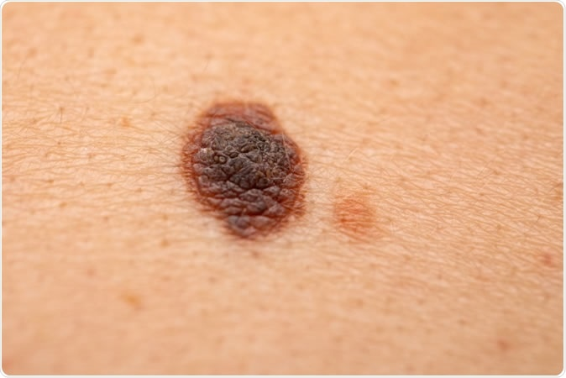
Decreased melanocytes
Increased melanocytes

Slide 25
Racial differences in skin color are not caused by differences in the number of melanocytes. It is caused by the number, size, and distribution of the melanosomes (pigment granules) within keratinocytes
Melanocytes in red-haired individuals produce more pheomelanin and in other skin type produce more eumelanin

Slide 26
Within keratinocytes, melanin typically forms a umbrella over the nucleus, functions principally as photoprotective

Slide 27
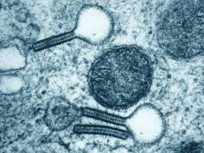
Langerhans Cells
Originte in bone marrow and found scattered among keratinocytes of the stratum spinosum
Cytoplasm contain Birbeck granules that appear as a tennis racquet
Responsible for the recognition, uptake, processing, and presentation of antigens to sensitized T lymphocytes (antigen presenting cells)

Slide 28
Merkel cell
Have neuroendocrine functions
Found in basal layer of epidermis

Slide 29
Skin appendages

Slide 30
Apocrine glands | Eccrine glands
Open into infundibulum of hair follicle | Open directly onto skin surface
Secretion is mediated by adrenergic innervation and androgen | Secretion is Mediated by cholinergic innervation
Found at axillae, areolae, anogenital region, external auditory canal and eyelids | Are found at all skin sites (mostly palms, soles and axilla)
Apocrine sweat is odorless until it reaches the skin surface, where it is altered by bacteria (responsible for odor of body) | The play a role in cooling when it is hot (thermoreguation)

Slide 31
Hair Follicles
Infundibulum is the uppermost part, extend from the skin surface to opening of sebaceous gland
The isthmus is middle part, extend between opening of sebaceous gland and insertion of arrector pili muscle is isthmus
hair bulb is the lower part

Slide 33
The hair shaft is produced by matrix
(in hair bulb)

Slide 34
Hair goes through three phases:
Anagen: growth phase last for three years
Catagen: involution phase last or three weeks
Telogen: resting phase last for three months
Anagen length determine the length of hair

Slide 35
Sebaceous Glands
Sebaceous duct open into the infundibular portion of the hair follicle
They are distributed throughout all skin sites except the palms and soles
They are found in large numbers in face, scalp, upper chest, back and shoulder(seborreic areas)

Slide 36
They are always associated with hair follicles, except :
Eyelids (meibomian glands)
Buccal mucosa and the lip (Fordyce spots)
Penile mucosa (Tyson glands),
labia minora and Female areola (Montgomery tubercles)

Slide 37
Nails
Is composed of thick keratin
The nail plate is produced by nail matrix
Parts of nail:
Nail plate
Nail bed
Nail matrix
Nail bed
Cuticle

Slide 39
Dermis
The constituents of the dermis are mesodermal in origin except for nerves
Support the epidermis structurally and nutritionally(source of the nutrition to the skin)

Slide 40
Dermis is comoposed of:
Cells: fibroblast, mast cells, macrophages
Fibers: Collagen fibres type I and III constitute the bulk, other fibers are elastic and reticular
Ground substance: composed of glycosaminoglycan e.g. hyaluronic acid due to its high water binding capacity is responsible for hydration of skin

