Slide 1
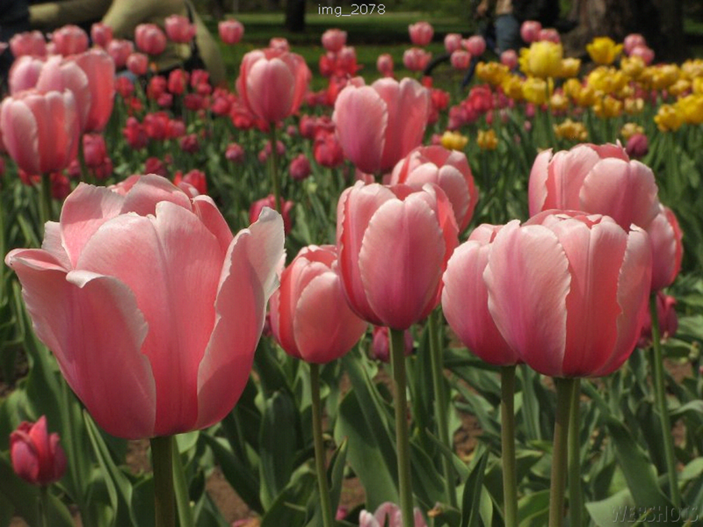
بسم الله الرحمن الرحيم

Slide 2
Blood Physiology
By Dr. Suroor Mohamed
MBChB. MSc, Physiology

Slide 3
OBJECTIVES:
1-Describe Cellular and non-cellular components of blood
2-Recognise features of blood and functions
3-Define Erythropoiesis, leucopoiesis and thrombopoiesis.
4-Recognize sites of RBC formation at different developmental age.

Slide 4
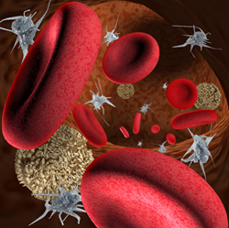

Slide 5
Blood:
It is a specialized circulating fluid connective tissue composed of cells suspended in fluid intercellular substances called plasma.
It supplies O₂ and nutrients & removes CO₂ with waste products to all regions of the body.
Characteristics of Blood
1-Bright red (oxygenated)
2-Dark red/purplish (unoxygenated)
3-Much more dense than pure water
4-pH range from 7.35 to 7.45 (slightly alkaline)
5-Slightly warmer than body temperature 100.4 F
6-Typical volume in adult male 5-6 liters
in adult female 4-5 liters
7-Nearly 7-8% of body weight

Slide 6
Major Functions of Blood
1. Distribution & Transport
A-oxygen from lungs to body cells
. B-carbon dioxide from body cells to lungs
. C-nutrients from GI tract to body cells
. D-nitrogenous wastes from body cells to kidneys
. E-hormones from glands to body cells
2. Regulation (maintenance of homeostasis)
a. maintenance of normal body pH by buffer system through blood proteins (albumin) & bicarbonate
b. maintenance of circulatory/interstitial fluid by electrolytes
c. maintenance of temperature by absorbing and distributing heat
3. Protection
. A-platelets and proteins "seal" vessel damage
B-protection from foreign material & infections by leukocytes, antibodies& complement proteins

Slide 7
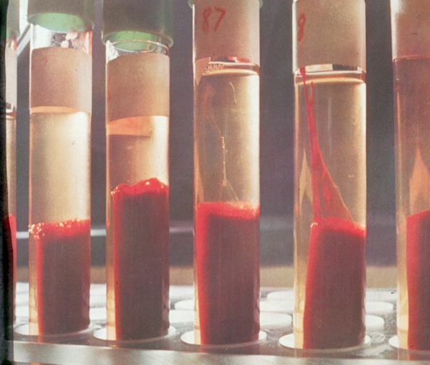
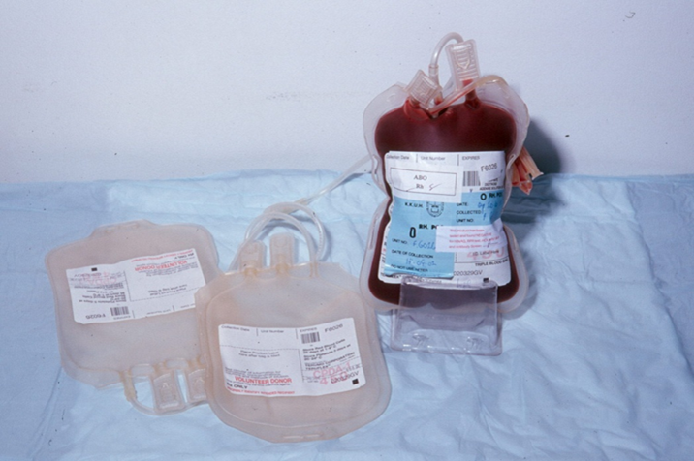

Slide 8
Cellular components:
Red Blood Cells (Erythrocytes) transport O2
White Blood Cells (Leucocytes) part of the immune system
Platelets (Thrombocytes) cell fragments involved in clotting
Plasma ( liquid “ non cellular” part )
98% water, ions, plasma proteins (Albumin, globulin, Fibrinogen , enzymes and hormones)
Same ionic composition as interstitial fluid

Slide 9
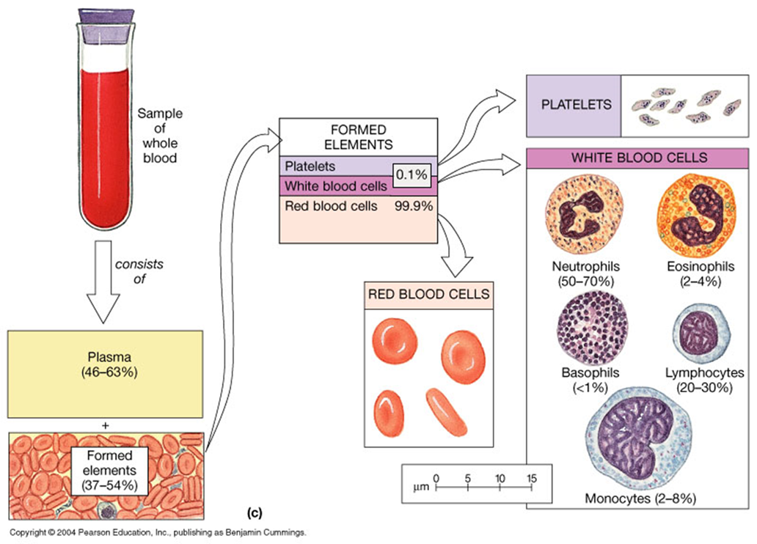

Slide 10
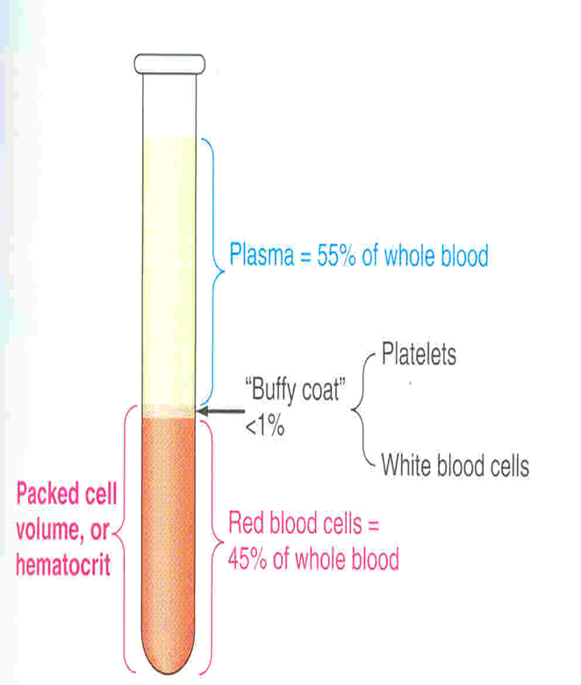
5 liter in adult
45% is packed cells volume (PCV)
55% is plasma volume

Slide 11
Plasma component

Slide 12
Hemopoiesis
Hematopoiesis → the formation and development of blood cells
In adults the cellular elements are produced in the bone marrow.
Some WBCs are produced in the lymphatic tissue and bone marrow.
***All blood cells formed come from a hematopoietic stem cell.
Process of producing formed elements by myeloid and lymphoid stem cells
Erythropoiesis: Formation of RBC (erythrocytes)
Leucopoiesis: Formation of WBC (leucocytes)
Thrombopoiesis: Formation of platelets (thrombocytes)

Slide 13
In the adult, red blood cells, many white blood cells, and platelets are formed in the bone marrow. In the fetus, blood cells are also formed in the liver and spleen, and in adults such extramedullary hematopoiesis may occur in diseases in which the bone marrow becomes destroyed or fibrosed.
In children, blood cells are actively produced in the marrow cavities of all the bones. By age 20, the marrow in the cavities of the long bones, except for the upper humerus and femur, has become inactive . Active cellular marrow is called red marrow; inactive marrow that is infiltrated with fat is called yellow marrow.

Slide 14
Normally, 75% of the cells in the marrow belong to the white blood cell-producing myeloid series and only 25% are maturing red cells, even though there are over 500 times as many red cells in the circulation as there are white cells. This difference in the marrow reflects the fact that the average life span of white cells is short, whereas that of red cells is long.
The bone marrow contains multipotent uncommitted stem cells (pluripotential stem cells) that differentiate into one or another type of committed stem cells (progenitor cells). These in turn form the various differentiated types of blood cells. There are separate progenitor cells for megakaryocytes, lymphocytes, erythrocytes, eosinophils, basophils, neutrophils and monocytes .

Slide 15
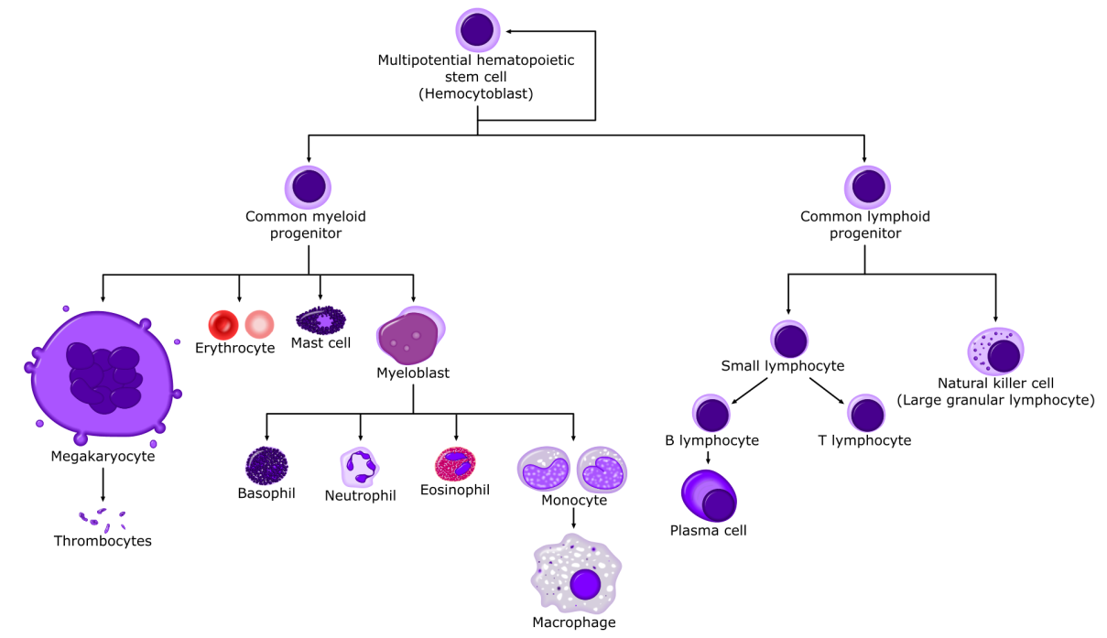

Slide 16
The pluripotential cells are few in number but are capable of completely replacing the bone marrow when injected into a host whose own bone marrow has been completely destroyed. The best current source for these hematopoietic stem cells is umbilical cord blood.

Slide 17
RBCs Erythrocyte
    Most abundant cell in the blood (4 million – 6 million per microliter of blood)
    Formed in the bone marrow
    Mature forms do NOT have a nucleus , mitochondria and ribosomes
    Shaped as biconcave disc (why?)
    6-8 micrometers in diameter
***Life span of about 120 days
RBCs are narrow & flexible for excellent fluidity especially within the small capillaries
    Hemoglobin (iron protein)is found in the RBC , Hb carries oxygen from the lungs to the rest of the body and carbon dioxide binds to the RBC and is taken to the lungs to be exhaled.

Slide 18
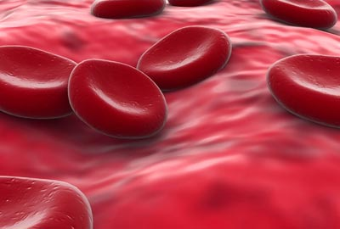
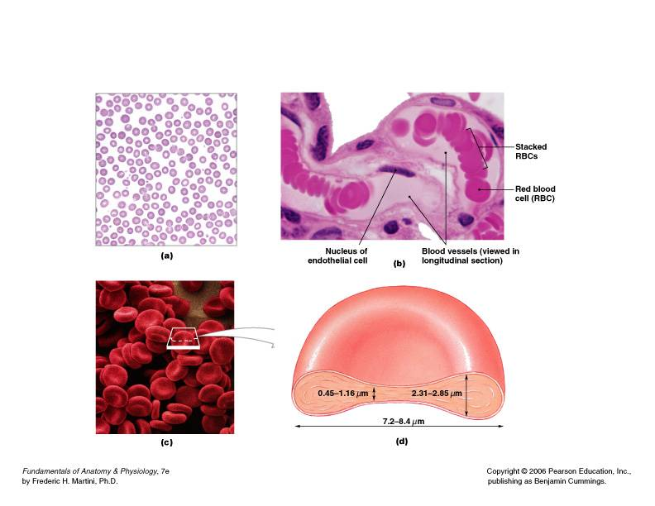

Slide 19
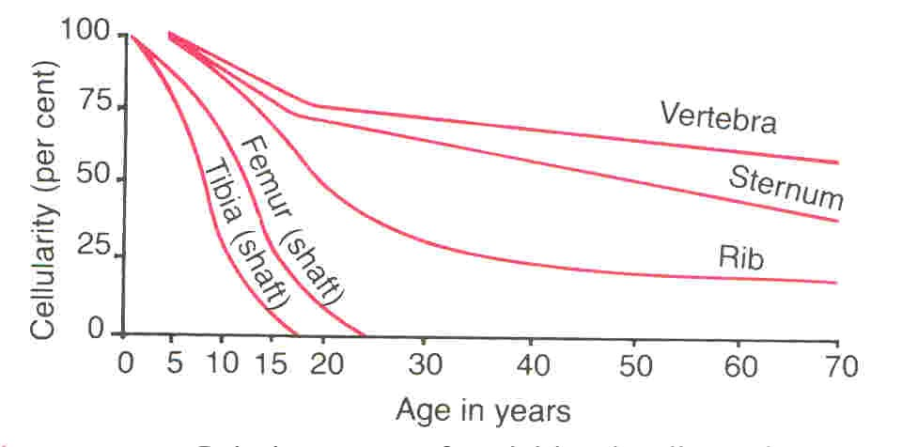
Production of RBC
Early few weeks of embryo nucleated RBCs are formed in yolk sac.
Middle trimester mainly in liver & spleen & lymph nodes.
Last months RBCs are formed in bone marrow of all bones
Bone marrow of flat bone continue to produce RBC into adult life
Shaft of long bone stop to produce RBC at puberty while epiphysis continued

Slide 20
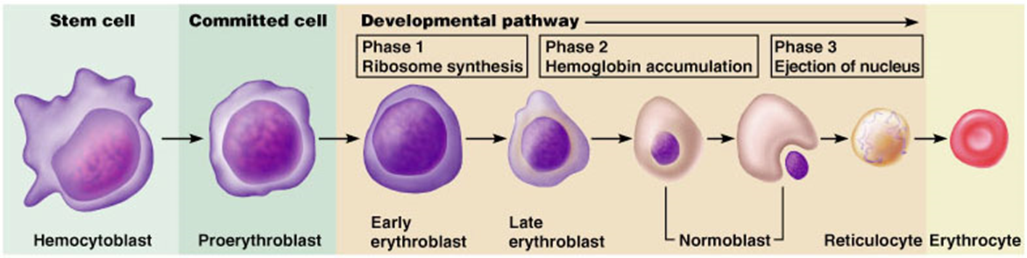
Hematopoiesis and Erythropoiesis: hematopoiesis (hemopoiesis) - the maturation, development and formation of blood cells
A- red bone marrow (myeloid tissue) - location of hematopoiesis; mainly in axial skeleton and heads of femur & humerus
B-hemocytoblast (stem cell) - the mitotic precursor to blood cells before differentiation
Erythropoiesis - the maturation, development, and formation of Red Blood Cells
hemocytoblast ->proerythroblast ->early (basophilic) erythroblast ->late (polychromatophilic) erythroblast ->(hemoglobin) normoblast -> (nucleus ejected when enough hemoglobin)reticulocyte -> (retaining some endoplasmic reticulum)

Slide 21
ERYTHROCYTE life span:
hemocytoblast -> reticulocyte 3-5 DAYS
reticulocyte -> ERYTHROCYTE 2 DAYS (in blood)
ERYTHROCYTE lifespan 100-120 Days
(primarily destroyed by macrophages in the spleen)
Regulation of Erythropoiesis
1- Erythropoiesis is stimulated by erythropoietin hormone produced by the kidney in response to hypoxia (low oxygen in the blood)
Hypoxia caused by:
. Less RBCs from bleeding
. Less RBCs from excess RBC destruction
. Low oxygen levels (high altitude, illness)
. Increased oxygen demand (exercise)

Slide 22
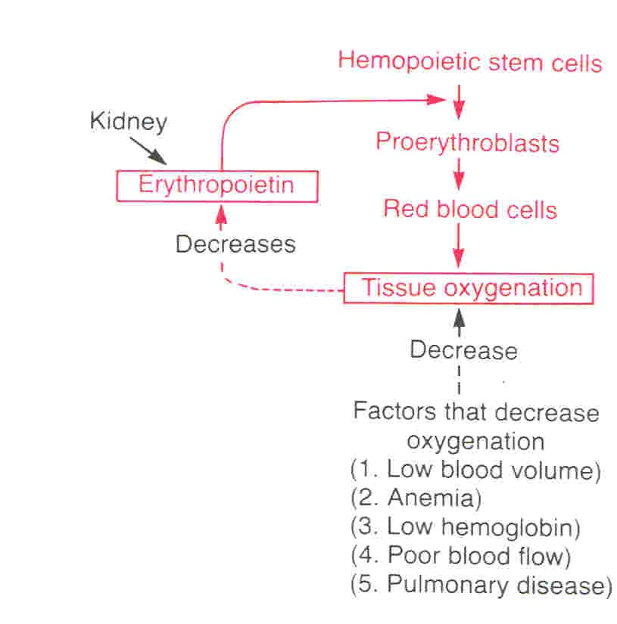
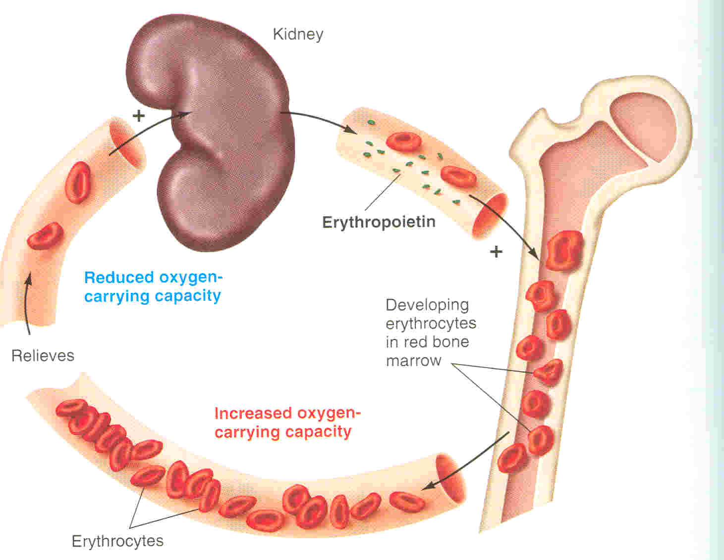

Slide 23
. Erythropoietin
Is Glycoprotein 90% from renal cortex 10% liver
Stimulate the growth of early stem cells
Does not affect maturation process
Can be measured in plasma & urine
High levels of erythropoietin
      anemia
      -High altitude Polycythemia
      Heart failure
      Lungs disease
B- Iron - essential for hemoglobin to carry oxygen
1- 65% of Fe in body is in hemoglobin
2-liver and spleen store most excess Fe bound to ferritin and hemosiderin
. 3-Fe in blood bound to transferrin
4-daily Fe loss: 0.9 mg men/l.7 mg women
C – Vitamins as B-complex - Vit B12 and Folic Acid essential for DNA synthesis in early mitotic divisions leading to erythrocytes

Slide 24

THANK YOU

