Slide 1
Surgical incisions
prof.
Dr. Alaa jamel
CABS FACS. MRCSI MBCHB
2020-2021

Slide 2
General principles
To select appropriate incision should be :-
1- near by the suspected target ( i.e grid iron in appendecectomy )
2-extensiblty for exposure so in explorative laparotomy do midline incision
3-rapidity such as top emergency or critical cases
4- less complication , (hernia , infection
-Security avoid injury to vessels or nerve or 5- avoid important structure (nerve,
6- cosmetic →skin creases

Slide 4
Abdominal incisions
I -Vertical
1- Medline incision
Through linea alba
, Advantages : avascular field , opened readily & closed easily
Enlarged quickly , dose not damage muscles Usually used in explorative laparotomy
Disadvantage :- high post op hernia specially in lower abdomen
2-paramedian Incision
Through rectus sheath 2.5 cm from midline
can extended to thorax ( thoracoabdominal incision ) & to flank

Slide 5
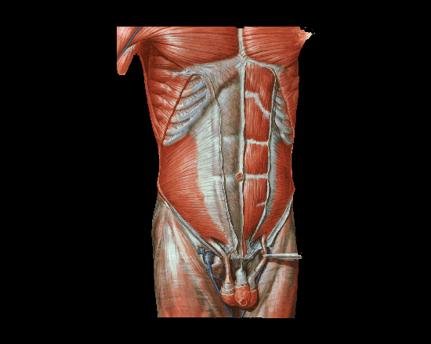

Slide 6
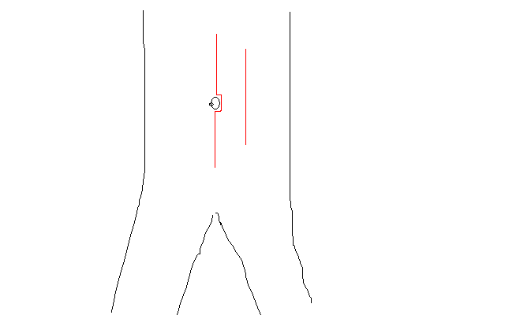

Slide 7
II - transverse incision
1-Upper abdomen used in children , cholicystectomy , or any upper abdominal pathology
2-Supraumbelical & infraublical :- used in paraumblical hernia , first incision of laparoscopy
3- Pfannenstiel ´s incision :- in gynecological & pelvis operation s
4- Lance :- is more or less transvers or oblique , its cosmotic incision for appendicectomy

Slide 9
III- oblique incisions
1-Kocher(sub costal) at Rt for gallbladder & liver operation
While Lt for spleen op
2-Grid iron is incision which cruses on line between umbilical & sup. Iliac spine at Mc Berny point lat. to rectus sheath on ext. & int. & transv . abdominal muscles usually splitting of muscle , used in apendecectomy , its good incision less post op hernia
3- Retherford Morriss is extended grid iron up or down with muscle cutting , used in complicated apendecectomy
4- Lumber Moressian sub costal at lumber area used in renal & uretric surgery
5-Inguainal incision used for inguinal hernia

Slide 10
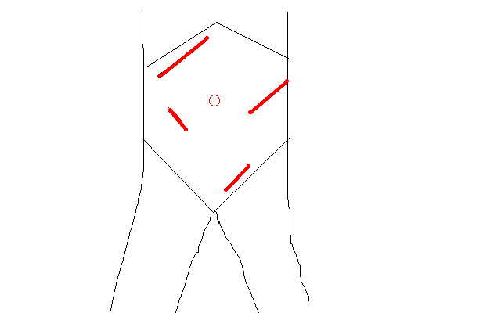

Slide 11
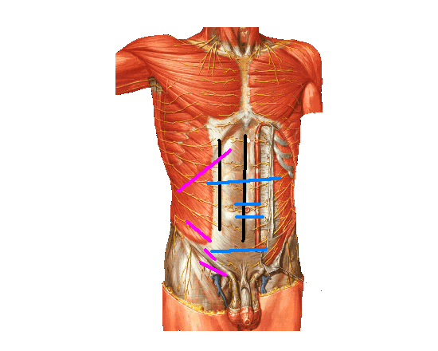

Slide 12
Thoracic incisions
1-Thoracostomy(chest tube )
In pnemothorax at 5nd ICS ant. axillary line
2-Mediastenial vertical incision used for cardiac op
3-Intercostals at 5th ICS & 8th ICS
4-Thoracoabdominal extended to Rt or Lt paramedian used for oesophagial op

Slide 13
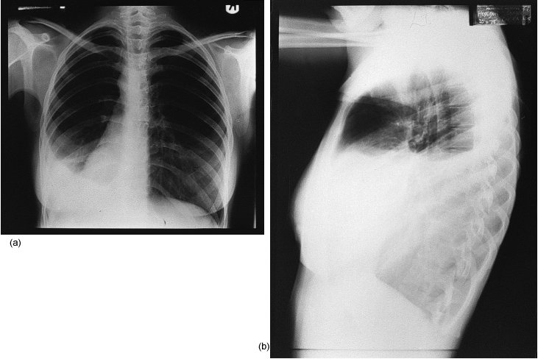

Slide 14
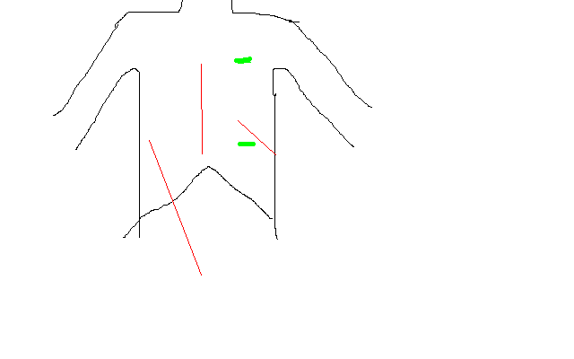

Slide 15
Breast incisions
1- Circumareolar incision : - around areola , used in lumpectomy , gynecomastia
2- Mastectomy incisions :- there is many types of incisions (Steward for simple Mastectomy , Orr , Grey for radical (Halisid ) op …. )

Slide 16
Neck & face incisions
1-Coller incision transverse incision at lower neck 2.5 cm above suprastrnal notch for thyroid & parathyroid surgery
2- Neck dissection for radical neck LN dissections
Mac Fee incision (2 horizontal incisions 1st from mastoid to hyoid , 2nd above clavicle 2cm
3-Periauricular for parotidectomy
Other face incisions should be with skin creases for good cosmotics

Slide 17
Complications of incisional wound
Early
1-Wound infection & seroma
→ open stitch and evacuation of pus or serous fluid , daily dressing
2-skin allergy from plaster, dressing or content of wound discharge
3- stitch abscess ( Rx :- removal of infected stitch)
4-Wound dehiscence
→ if partial can use plastering and delay removal of stitches
→ if major should reoperation and close it again with use tension suture
5-non or bad healing due to bad technique (over lap , everted , enverted ) or poor immunity(DM ,uremic …) or early removal

Slide 18
Late :- 1-Incisional Hernia 2-Hypertrophic scar or kiloid 3- Chronic Pain ( specially if nerve entrapment 4-Hyper- or hypopegmentation

Slide 19
This complication due to :-
--Pt causes ( poor immunity , post op. cough ,near by source of infection like colostomy --Surgeon causes ( use inappropriate stitches , poor handling …) --Nurses causes ( poor and inappropriate dressing --Operation causes ( poor sterilization )

Slide 20
keloid

Slide 21
Suture materials
Classification according to :-
Absorbtion :-
1- Absorbable like plain or chromic catgut
2-delay Absorbable ( PDS , vicryl ,
3- Non absorbable ( silk , nylon ,metalic clips)
Biological or synthetic
--Biological like
. cutgut from sheep intestine
. silk from silkwarm larva, cotton
--Synthetic vicryl , nylon , PDS , metalic clip
Monofelement or polyfelement (braided or twisted ) Monofelement like nylon , catgut , metalic clip polyfelement ( braided or twisted like silk ,vicryl

Slide 22
Suture Packaging

Slide 23
Methods of anastomosis
End to end
End to side
Side to side
Removal of suture
Early as possible , depend on
Site :- face &neck 3-5 days , while in abdomen 7-8d , In joint more

Slide 24
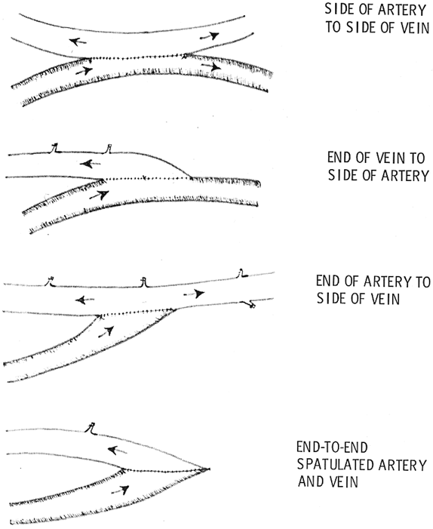

Slide 25
Facter influence healing
A) general :- Ca , DM , Malnutrition , jaundice , septecaemia . steroid , Vit. C deficiency , uremia
B) local :- poor blood supply (tension , atherosclerosis , ).infection , poor
alignment, foreign body , local X ray

Slide 26
surgical drain
A surgical drain is a tube used to remove
pus, blood or other fluids from a wound.
Indications:
1. To help eliminate dead space
2. To evacuate existing accumulation of fluid or gas, To remove pus, blood,serous exudates, chyle or bile , urine ….
3. To prevent the potential accumulation of fluid or gas
4. To form a controlled fistula e.g. after common bile duct exploration

Slide 27
Classification:
• either Open or Closed Systems:
- Open
- Closed
• according mechanisim of action
- Active. or Passive
-one way or two ways
-internal or external drain

Slide 28
open drain ( wick in abscesse , currigate , pinross ) need regular changes packs until become less wetting to be removed
closed drain (the drain connect to closed bag for drainage , removed after become very little amount or cease function ),
e.g simple tube drain( for post operative ) , foleys catheter ( for urine ) , T tube ( for bile ), NG tube ( for stomach decompression )

Slide 29
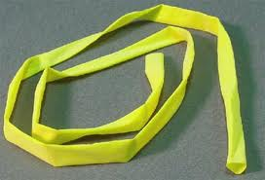
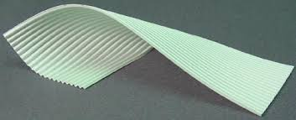
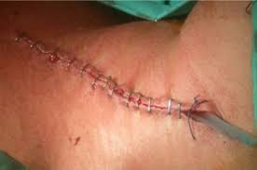
curregate
pinrose

Slide 30
Mechanism of action
-- Passive drain
Most of drains depend on gravity siphon phenomenon ,
-- some use valve for one way direction as in chest tube use underwater seal because plural cavity pressure less than atmospherec pressure ,
--Active drain
some operation use redivac drain (continuous –ve pressure

Slide 31
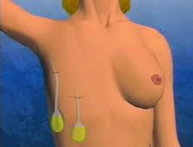
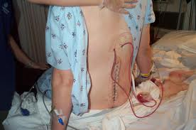
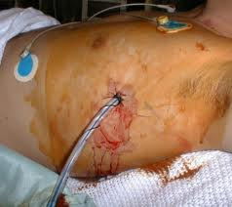
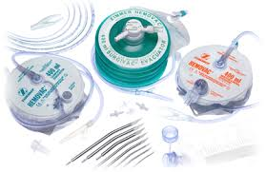
Simple drain
Radivac drain

Slide 32
Complications and Failure of Drains
1-Infection due to
• Ascending bacterial invasion
• Foreign body reaction
• Poor postoperative management
2-Discomfort / Pain
• Thoracic Tubes – diameter too large
• Stiff tubing
3- Inefficient Drainage
• Exiting in non-dependent locale (passive drains)
• Kinked tube
• Obstructed
• Poor drain selection – diameter too small to remove viscous fluid
4-Incision dehiscence / hernia Poor placement
5- Premature Removal →Accumulation of fluid

Slide 33
•
Removal of drain
• Generally, drains should be removed once the drainage has stopped or becomes less than 25 ml/day.

Slide 34
Nasogastric Tubes
Naso-gastric tube; pases through the nostrils (sometimes through oral cavity!) to the stomach, to the doudenum
Indications:
-- Aspiration: to provide samples of gastric contents for lab analysis;
--to keep stomach free of gastric contents and air; during & post operation
--Feeding
-- Lavage: in cases of poisoning or overdose
- Medication
-- Contrast study introduced into tube for Upper GIT

Slide 35
Complications of NG tube
• Epistaxis
• Erosions in the nasal cavity, and nasopharynx
• More dangerous complications include:
-Esophageal penetration.
-Aspiration.

Slide 36
Foley Urethral Catheterization
Folye’s is classified according to:
-The number of lumens:
1 way for aspiration and drain.
2 way one for the balloon inflation and the other for drain or aspiration.
3 way one for irrigation (infusion),one for the balloon inflation, and the third for drain

Slide 37
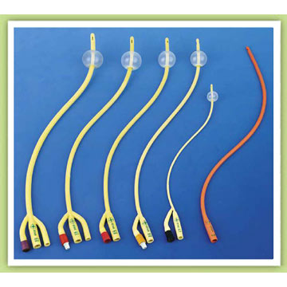

Slide 38
Indications
Diagnostic
To collect uncontaminated urine specimen
Study anatomy of the urinary tract (cystography )
Urine output monitoring
Therapeutic
Acute urinary retention
Chronic obstruction causing hydronephrosis
Intermittent bladder decompression for neurogenic bladder
Chronically bed-ridden patients for hygiene

Slide 39
Contraindications
-Urethral injury
-Trauma patients with blood at meatus or
Complications:
Inability to locate the urethra.
Vaginal catheterization.
Urethral stricture.
UTI
Inability to deflate

Slide 40
Thank you

