Slide 1
Dermatophyte Infection
(Dermatophytoses)
By
Dr.Alaa Al-sahlany
Jan 11, 2021

Slide 2
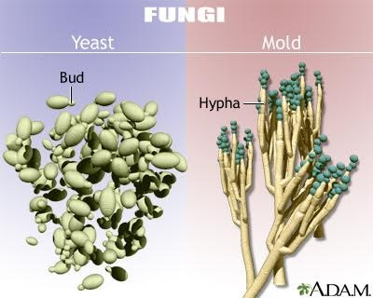

Slide 3
Introduction
Dermatophytoses are fungal infections caused by three genera of fungi that have the ability to invade and multiply within keratinized tissue (hair, skin and nails):include
(1) Trichophyton
(2) Epidermophyton
(3) Microsporum

Slide 4
Epidemiology
Trichophyton rubrum is the most common dermatophyte worldwide
Occur most frequently in postpubertal hosts except tinea capitis which occurs mainly in prepubertal children
Men tend to more frequently have tinea cruris and tinea pedis than women

Slide 5
Pathogenesis

Slide 6
First step
Clinical features | Mode of transmission | Type
Non-inflammatory to mild inflammation, chronic | Human to human | Anthropophilic i.e. T. rubrum
Moderate inflammation | Soil to human or soil to animal | Geophilic i.e. M. gypseum
Severe inflammation, acute | Animal to human | Zoophilic i.e. M. canis, T.verrucosum

Slide 7
Second step
Host factors | Dermatophyte factors
Protease inhibitor: limit the extent of invasion by inhibiting keratinase | Keratinase : break down keratin and help the fungi invade skin
Sebum has an inhibitory effect on dermatophyte | Mannans in cell wall: has immuno-suppressive effect and inhibit the epidermal proliferation that prevent sloughing off of fungi
Diseases that affect barrier function i.e. icthyosis , Hailey-Hailey disease and Darier disease predispose the skin to infection

Slide 8
Third step
Once dermatophytes have invaded the skin with help of dermatophyte factors mentioned in the box, three factors limit the infection to stratum corneum:
(1)Preference of dermatophyte for Cooler temperature at skin surface,(2) serum factors such as ferritin and β-globulin that inhibit dermatophyte growth and(3) immune system

Slide 9
Causative pathogen | Type of dermatophyte infection
Any dermatophyte but T.rubrum is the most common | Tinea corporis, tinea pedis, tinea cruris, tinea manuum, tinea faciei and tinea unguium
T.Tonsurans is the most common in nUSA T.Verrucosum is the most comon in Iraq | Tinea capitis

Slide 10
Tinea corporis
Infection of the skin of the trunk and extremities, excluding the hair, nails, palms, soles and groin
Any dermatophyte can cause it BUT T. rubrum is the most common pathogen
Infection spreads centrifugally from the point of skin invasion, with central clearing of the fungus , typically resulting in annular lesions

Slide 12
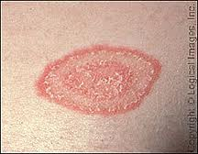
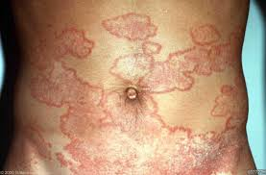

Slide 13
Variants:
Tinea incognito: tinea lesion modified by topical steroids, may lack a raised scaly border.
Majocchi’s granuloma: is characterized by follicular papulopustules or nodules, commonly seen in women who have tinea pedis or onychomycosis and shave their legs. Topical steroids and immunosuppression are predisposing factors.

Slide 14
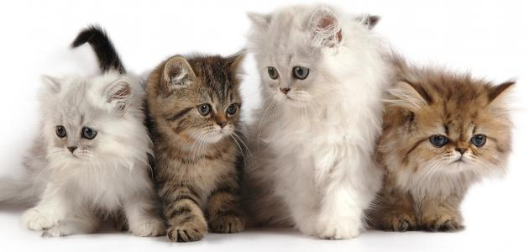

Slide 15
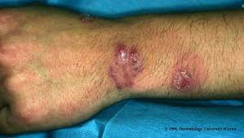

Slide 16
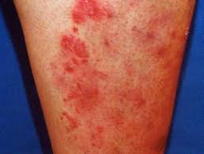

Slide 17
Tinea cruris(Jock itch)
Infection of the inguinal region
This disease is more often seen in men than in women, since the scrotum provides a warm and moist environment that encourages fungal growth
The inflicted are more likely to have tinea pedis and onychomycosis as a source of dermatophytes

Slide 19
Other predisposing factors include obesity and hyperhidrosis
Presented as a sharply demarcated with a raised, erythematous, scaly advancing border that may contain pustules or vesicles and a central clearance
The scrotum itself is generally spared, unlike candidiasis of groin

Slide 20
Tinea manuum
Infection of the palm and interdigital spaces
It is different from that of back of hands due to lack of sebaceous glands on the palms

Slide 21
Usually non-inflammatory and often unilateral there is diffuse hyperkeratosis of the palms and digits with accentuation of scales on creases that fails to respond to emollients
An important clinical clue is tinea unguium
Is often present in patients with tinea pedis (two feet and one hand syndrome)

Slide 23
Tinea pedis(Athlete’s foot)
Infection of the soles and interdigital web spaces of the feet
More common in adults
Lack of sebaceous glands and moist environment
due to occlusive shoes are predisposing factors

Slide 24
Tinea pedis is uncommon in populations that do not wear shoes although the barefoot people can acquire the fungus in public facilities i.e. gym
The feet are the most common location for dermatophyte infections

Slide 25
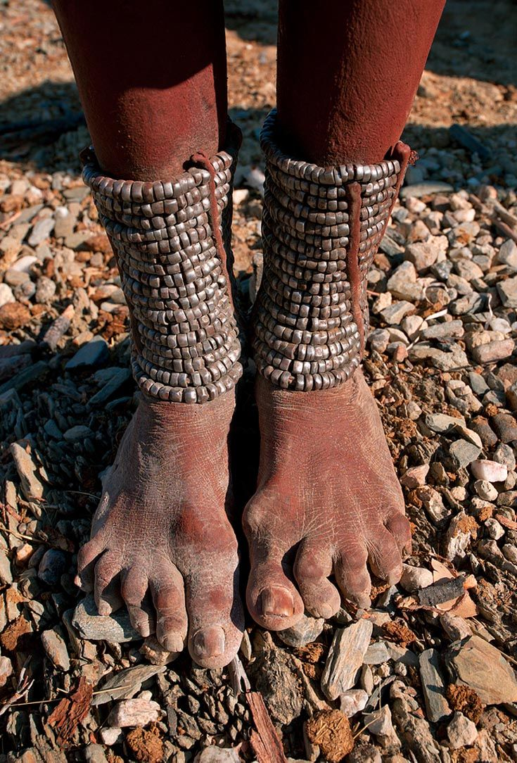
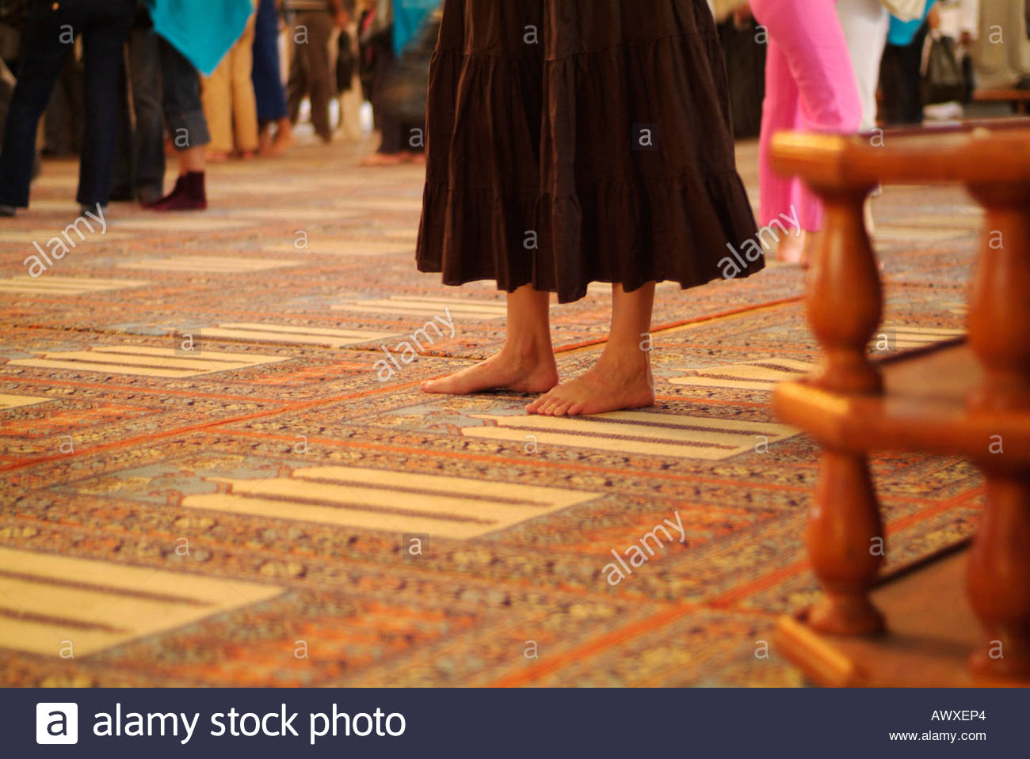

Slide 26
Types:
(1)Moccasin: diffuse hyperkeratosis, scaling and erythema
(2)Interdigital :Most common type; erythema, maceration, fissures and ,ulceration between toes
(3)Inflammatory : we see vesicles and bulla

Slide 27
Moccasin

Slide 31
Tinea barbae
Involves the bearded areas of the face and neck in men
Two types:
(1) The deep type: develops slowly and produces nodules and kerion-­like swellings: acquired from animal, caused by T. mentagrophytes var. mentagrophytes and T. verrucosum.

Slide 33
(2)Superficial type: less inflammatory, characterized by pustular folliculitis , caused by T. rubrum. Aquired from contaminated razors in barber- shops. Now less common owing to use of disposable instruments and disinfectant
In both types: the hairs are either easily plucked or lost.

Slide 34
Tinea faciei
Infection of face
The same as tinea corporis
Typical annular rings are usually lacking and the lesions are exquisitely photosensitive. Therefore, misdiagnosed

Slide 36
Tinea capitis
A common dermatophyte infection of the scalp in children, whereas adult infection occurs infrequently
T. tonsurans is currently the most common cause of tinea capitis in the US while T.verrucosum in Iraq
The “carrier state” of tinea capitis is contagious through contaminated brush, hat, towel and barber tools

Slide 37
Types of dermatophytes that invade hair:
(1)Endothrix: exist inside the hair shaft, caused by Trichophyton, non- fluorescent. Exception is T. schoenleinii (fluorescent)
(2)Ectothrix: exist outside the hair shaft, caused by Microsporum(fluorescent) or Trichophyton (non-fluorescent)

Slide 38
Clinical types:
Non-inflammatory:
Gray patch:M. auduinii, present as a dry scaly patch of alopecia
Black dots:T. tonsurans, caused by hair breakage near the surface

Slide 39
Inflammatory:
Kerion: M.canis, present as a boggy, purulent plaques with abscess formation and associated alopecia, patient may become systemically ill with extensive lymphadenopathy
Favus: T. schoenleinii, the most severe type of dermatophyte hair infection, present as a concave, sulfur-yellow crusts composed of hyphae and skin debris pierced by hairs (“scutula”)

Slide 45
Tinea unguium (onychomycosis)
Infection of the nail unit
Three types : based upon the point of fungal entry into the nail unit
Distal/lateral subungual: with invasion via the hyponychium (most common)
Superficial white: with direct penetration into the dorsal surface of the nail plate

Slide 46
Proximal subungual: with invasion under the proximal nail fold ( seen frequently in immunocompromised hosts).
Multiple nails on one or both hands or feet are usually affected
Affects men more often than women?

Slide 47
Frequently associated with chronic tinea pedis
Caused by T. rubrum, T. mentagrophytes and E. floccosum
Toenail infections are considerably more common than fingernail?

Slide 48
Clinical features:
Hyperkeratosis of nail bed
Thickenening and yellowish discoloration of nail plate
Onychlysis (seperation of nail plate from nail bed)
Nail dystrophy when the entire nail plate and bed are involved

Slide 51
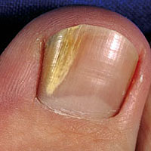
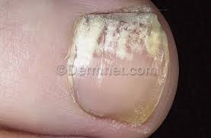

Slide 52
Diagnosis
Clinical examination(most important)
KOH examination of skin scraping(by blade), nail clipping (by nail clipper) or hair plucking(by tweezer)
Wood’s lamp(ultraviolet light of 365 nm wavelength): Infected hairs show bright green or yellow- green fluorescence

Slide 53
Culture:2-4 weeks
Biopsy: we see hyphae in stratum corneum

Slide 54
Treatment
Topical antifungals e.g. ketoconazole, clotrimazole are the first line treatment
Systemic antifungal: indications
(1) Type:
(A)tinea manuum, (B)tinea pedis, (C)tinea capitis, (D)tinea unguium
(2)When extensive area is involved

Slide 55
Antifungals
Comment | Spectrum of action | Antifungal agent
In general, the longest course of treatment is for tinea unguium followed by tinea capitis followed by other types of dermatophytosis Griseofulvin is the first choice for treatment of tinea capitis (4-12 weeks course) Imidazoles and allylamines are the first choice for treatment of tinea unguium Griseofulvin is not used for tinea unguium because it require a long course (6 months to one year) | Dermatophytes, Candida and Pityrosporum | Imidazoles e.g. ketoconazole, itraconazole, fluconazole, clotrimazole:
 | Dermatophytes | Allylamines e.g. terbinafin
 | Candida only | Polyenes e.g. amphotericin B and nystatin
 | Dermatophytes only | Griseofulvin

Slide 58
Dermatophytid(id reaction)
Associated with inflammatory tinea capitis and acute tinea pedis
Represent a systemic reaction to fungal antigens
Diagnosis requires:(1) finding of fungus at site remote from the lesions of the dermatophytid, (2)the absence of fungus in the id lesion, and(3) involution of the lesion as the fungal infection is treated

Slide 59
Definitions
Gyrate:revolves or spin around a fixed point or axis
Polycyclic:having two or more rings fused together
Serpiginious: having a wave border (snake-like)
Circinate:circular or round
Annular: ring-like

