Slide 1
Lecture-1 clinical immunology
The immune system

Slide 2
Immunity can be defined as protection from infection, whether it be due to bacteria, viruses, fungi or multicellular parasites. Like other organs involved in human physiology, the immune system is composed of cells& molecules organized into specialized tissues.

Slide 3
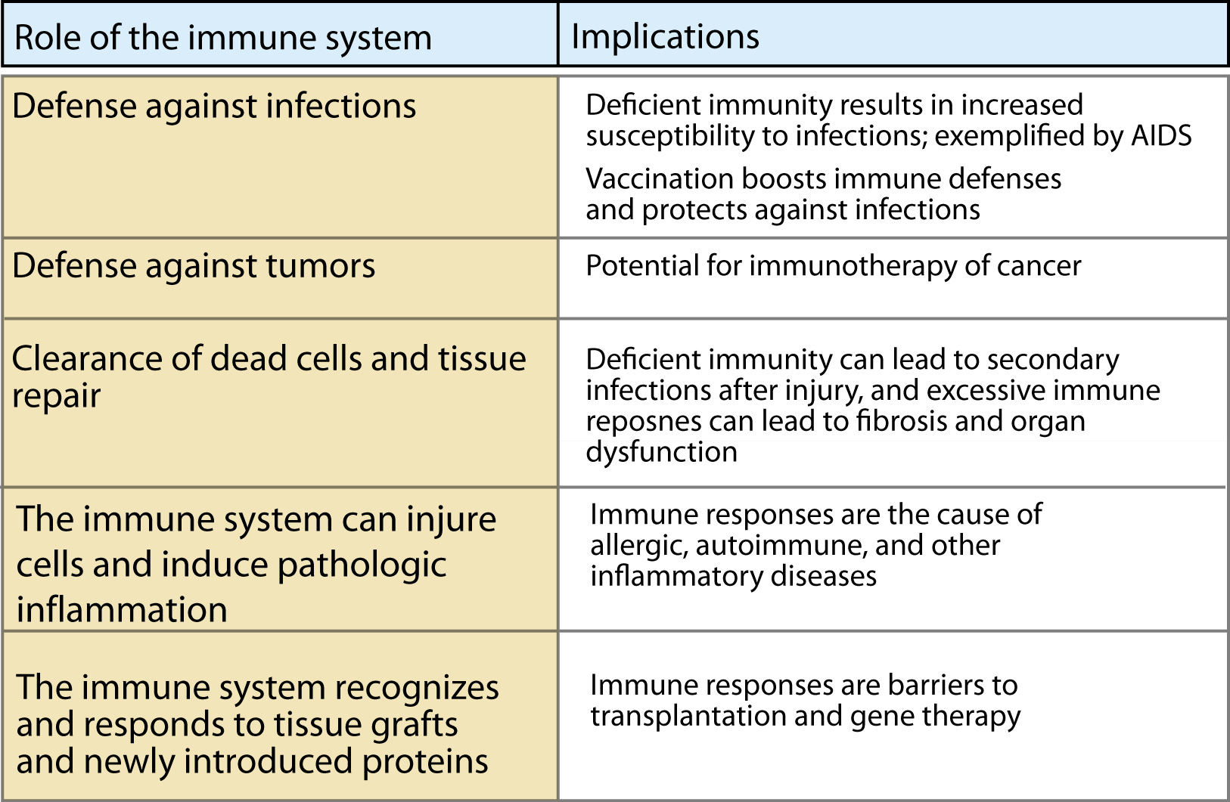
The functional importance of the immune system

Slide 4
How does the immune system respond to different infections?
Different types of microbes are eliminated by different effector mechanisms, which are designed to best combat each type of microbe
Antigens are useful models for studying immune responses to microbes

Slide 5
PRINCIPAL FUNCTION OF THE IMMUNE SYSTEM
To protect humans from pathogenic microorganisms
Pathogenic microorganisms (Pathogens)
Microorganisms capable of causing infection and/or disease
Infection
Ability of pathogen to enter host, multiply and stimulate an immune response
Disease
Clinical manifestations associated with infection

Slide 6
DEFENSE MECHANISMS OF THE HUMAN HOST
Innate Mechanisms (Innate immunity)
First line of defense
Non-specific
Adaptive Mechanisms (Adaptive immunity)
Second line of defense
Highly specific with memory
Cooperation between mechanisms

Slide 7
ORIGIN OF CELLS OF THE IMMUNE SYSTEM
Derived from common progenitor cell in bone marrow
Pluripotent hematopoietic stem cell
Progenitor Stem Cells
Erythroid lineage
Erythrocytes and Megakaryocytes
Myeloid lineage
Monocyte/macrophage, dendritic cells, PMN’s, mast cells
Lymphoid lineage
Small and large lymphocytes

Slide 8
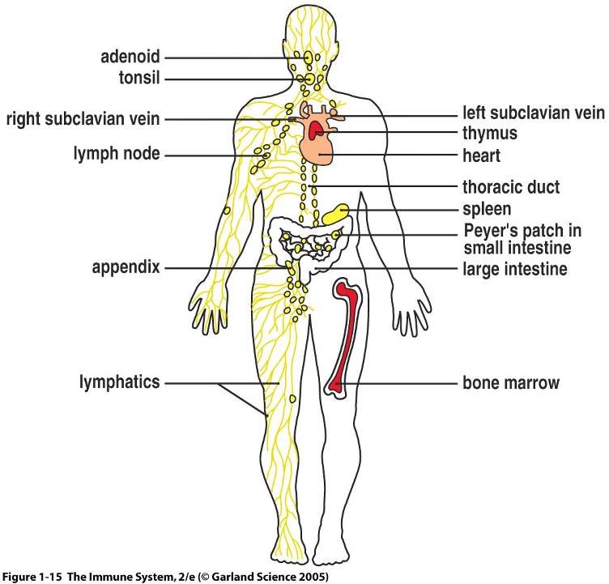

Slide 9
The primary lymphoid organs are where the cells originate & develop into immature forms. Cells& molecules of the immune system circulate in the blood, but immune responses do not take place there.

Slide 10
Rather, an immune response is initiated at the site of infection(typically the mucosa or skin) & then propagated & refined in the secondary lymphoid organs(eg. Lymph nodes).

Slide 11
After resolution of the infection, immunological memory specific for the pathogen resides in cells(lymphocytes) in the spleen& lymph nodes as well as being widely secreted in a molecular forms(antibodies)

Slide 12
The immune system is a network of cells, tissues, & organs that work together to defend the body against attacks by "foreign" invaders& destroy them. These are primarily microbes_ tiny organisms such as bacteria, parasites, & fungi .

Slide 13
Viruses also can cause infections ,but they are too primitive to be classified as living organisms. Animals of backbones called vertebrates have such advanced protective system & human immune system is the most complex among other jawed vertebrates. The human body provides an ideal environment for many microbes.

Slide 14
It is the immune system job to keep them out, or failing that, to seek out & destroy them. It is amazingly complex. It is our free of charge body guard.
Although there are millions of potentially harmful pathogens, no pathogen can invade or attack all organisms(humans & non humans) because a pathogen's ability to cause harm requires a susceptible victim, & not all organisms are susceptible to same pathogens .

Slide 15
for instance, the virus that cause AIDS in humans does not infect animals such as dogs. Similarly, humans are not susceptible to the viruses that cause mouse pox. Surprisingly, immune system has evolved to recognize self from non self tissues, thereby it can protect the host from pathogens and limits damage to self tissue.

Slide 16
Dysfunctions of immune system leads to a variety of diseases that may involve every part of the body.
Over activity of various components of immune system leads to development of allergic &autoimmune disease.
leukemia &lymphomas are the results of malignant transformation in the cells of the immune system.

Slide 17
Two kinds of immunity:
All animals posses a primitive system of defense against the pathogens to which they are susceptible. This defense is called the Innate, or natural immunity & includes two parts, one part, called humoral innate immunity, involves a variety of substances found in the humors, or body fluids.

Slide 18
These substances interfere with the growth of pathogens or clump them together so that they can be eliminated from the body.
The other part , called cellular innate immunity, is carried out by cells called phagocytes that ingest & degrade, or "eat" pathogens& by so-called natural killer cells that destroy certain cancerous cells.

Slide 19
Innate immunity is non specific---that is , it is not directed against specific invaders but against any pathogens that enter the body.
Only vertebrates have an additional & more sophisticated system of defense mechanisms, called adaptive immunity ,that can recognize &destroy specific substances. The defensive reaction of the adaptive immune system is called the immune response.

Slide 20
Any substance capable of generating such a response is called an antigen, or immunogen.
Antigens are not the foreign microorganisms & tissues themselves; they are substances---such as toxins or enzymes---in the microorganisms or tissues that the immune system considers foreign. Immune responses are normally directed against antigen that provoked them & are said to be antigen- specific.

Slide 21
. Specificity is one of the two properties that distinguish adaptive immunity from innate immunity . The other is called immunologic memory. Immunologic memory is the ability of the adaptive immune system to mount a stronger & more effective immune response against an antigen after it is first encounter with that antigen, leaving the organism better able to resist it in the future.

Slide 22
Adaptive immunity works with innate immunity to provide vertebrate with a heightened resistance to microorganisms, parasites, & other intruders that could harm them. However, adaptive immunity is also responsible for allergic reactions & for the rejection of transplanted tissue, which it may mistake for a harmful foreign invader.

Slide 23
Innate immune system provides immediate protection against invading pathogens.
Adaptive(acquired)immune system takes more time to develop but confers long lasting protection.

Slide 24
The innate immune system =====================
Nonspecific response against infections, it usually takes minutes or hours & includes
1.anatomical barriers-the skin.
2.phagocytic cells such as neutrophils ,Monocytes & macrophages .
3.cytokines

Slide 25
4.complements pathway& acute phase proteins
5.mast cells& basophils- protect against allergic diseases
6.natural killer cells, granular lymphocytes-play a major rule against tumors &virally infected cells.
Phagocytes=eating cells that kill m.o. they include
a -neutrophils; PMN leucocytes that are derived from BM& have short half life of 6 hours

Slide 26
b-monocytes &macrophages = monocytes are precursors of tissue macrophages. they are produced in BM& have 5% of WBC. Example of tissue macrophages include kup''ffer cells of liver, alveolar macrophage in lungs, mesangial cells in kidneys, &microglial cells in brain.
Unlike neutrophils ,macrophages do not die after killing of pathogens.

Slide 27
Cytokines-
are small soluble proteins that act as chemical messengers.
More than 100 cytokines are described and act as immune modifiers. EX. interferon-alpha-have antiviral activity.

Slide 28
. Other cytokines include interferon-gamma, tumor necrosis factor, interleukin 1,2,4,6&12.
Complement components ->20 proteins are described that promote inflammation & eliminate invading pathogens.

Slide 29
There are 3 mechanisms for activation of complement cascade=
1.classical pathway(antibody-antigen immune complex).
2.alternative pathway(microbial surface).
3.lectin pathway(mannose binding pathway). These pathways activate C3& cause direct cell lyses.

Slide 31
This type of immunity is characterized by an antigen-specific response to a foreign antigen or pathogen & generally takes several days or longer to materialize.
A key feature of immunity is memory for the antigen such that subsequent exposure leads to more rapid & often a more vigorous response.

Slide 32
The dual limbs of the adaptive immune system consist of cellular & humeral immunity.
The principal effectors of cellular immunity is the thymus-derived ( T) lymphocyte,& of humoral immunity is the bone marrow-derived or bursa-equivalent (B ) lymphocyte. Both B & T lymphocytes are derived from common stem cell.

Slide 33
Regulator cells of the immune system are large granular lymphocytes (monocytes-macrophages, & dendritic/ langerhans cells).
Bone marrow is the major site of maturation of B cells, monocytes-macrophages,& granulocytes & contains pluripotent stem cells which, under the influence of various colony stimulating factors, are capable of giving rise to all hematopoietic cell types.

Slide 34
T cell precursors also arise from hematopoietic stem cells but leave the yolk sac, fetal liver, or bone marrow while they are immature and home to the thymus for completion of maturation.
Mature lymphocytes, lymphocytes, monocytes, & dendritic/ langerhans cells enter the circulation & home to peripheral lymphoid organs(lymph nodes& spleen) &the gut associated lymphoid tissues (tonsils, payer's patches & appendix ) as well as the skin & mucous membranes & await activation by foreign antigen.

Slide 35
T lymphocytes differ from other immune effectors cell types in that the pool of effectors T cells is established in the thymus early in the life & is maintained throughout life by antigen-driven expansion of virgin peripheral T cells into ''memory'' T cells that reside primarily in peripheral lymphoid organs.

Slide 36
Mature T lymphocytes constitute 70 to 80 percent of normal peripheral blood lymphocytes (only 2 percent of the total body lymphocytes are contained in peripheral blood), 90 percent of thoracic duct lymphocytes & 30-40 percent of lymph node cells&30 percent of spleen lymphoid cells.

Slide 37
Cellular immunity is mediated by T-lymphocytes, which synthesize & release cytokines. These interact closely with each other& with components of the innate immune system to maximize the effectiveness of the immune response.

Slide 38
Lymphoid organs=
a. primary lymphoid organs.
1-Bone marrow 2-thymus
b. Secondary lymphoid organs
1. spleen
2. lymph nodes
3. mucosa –associated lymphoid tissues

Slide 39
HUMORAL IMMUNITY-
B-lymphocytes
These cells arise from hemopoietic bone marrow stem cells, & there major function is to produce an antibody.

Slide 40
Immunoglobulins
When a previously unstimulated B- lymphocytes are activated by an antigen, the first antibody to be produced is IgM, which appears in the serum after 5-10 days. Depending on additional stimuli provided by T- lymphocytes, other antibody classes like IgG, IgA& IgE are produced 3-7 days later.

Slide 41
cellular immunity
T-lymphocytes mediate cellular immunity & are particularly important for defense against viruses, fungi& intracellular bacteria.

