Slide 1
Lecture-2 clinical immunology immune deficiency

Slide 2
Mechanisms of Immunodeficiency
Loss or reduction of:
Cell type
Cell numbers
Cell function

Slide 3
Loss of Cell Function
Receptors
Cell signaling
Cytokine production
Ig production
Co stimulation impairment
Intracellular killing
Extravasation impairment

Slide 4
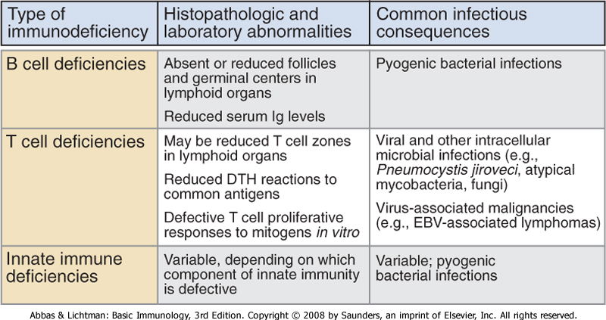
Features of immunodeficiency diseases

Slide 5
Primary or congenital immunodeficiencies
  Present at birth
  Result from genetic abnormalities in one or more components of the immune system
Secondary or acquired immunodeficiencies
  Later in life
  Much more common than primary immunodeficiency
  Result from infections, malnutrition, or treatments that cause loss or inadequate function of various components of the immune system
  Most common is acquired immunodeficiency syndrome, or AIDS

Slide 6
Primary Immunodeficiency
Myeloid lineage
  Congenital agranulocytosis
  Leukocyte-adhesion deficiency
Lymphoid lineage
  Severe combined immunodeficiency (SCID)
  B cells
    Agammaglobulinemia
    Hypogammaglobulinemia
    Specific Ig Deficiencies
  T cells
    DiGeorge Syndrome
    Wiskott Aldrich Syndrome

Slide 7
Myeloid lineage disorders – phagocytic cell defects
1/ Quantitative – decreased numbers of granulocytes –neutrophil elastase mutation
Congenital chronic agranulocytosis
Cyclic agranulocytosis (neutropenia)

Slide 8
2/ Qualitative – phagocytes functional disorders, various enzyme deficits, inability of phagocytes to degrade the ingested material
Chronic Granulomatous Disease (CGD)
Approximately in 60% X-linked
Enzymatic inability to generate toxic oxygen metabolites (H2O2) during oxygen consumption) - result of defect in neutrophilic cytochrome b (part of complex containing NADPH oxidase)
Inability to kill bacteria such as Staph. aureus, Pseud.aeruginosa that produce catalase
Clinical features: granulomas of skin, organs
Treatment: long-term antibiotic administration

Slide 9
Another example of primary phagocyte def. are disorders of phagocyte migration because of failure to express adhesion molecules results in the inability of phagocytes to exit(go out) of blood stream. They cause recurrent bacterial infections &sites of infection lack pus or neutrophils infiltration.

Slide 10
Peripheral blood neutrophil count may be very high during acute infection because of the failure of mobilized neutrophils to exit blood vessels.
.

Slide 11
Defects in cytokine &cytokine receptors also result in failure of intracellular killing& such patients are susceptible to mycobacterial infection

Slide 12
Defects of common &classical pathway result in the susceptibility to infection by encapsulated bacteria like Neisseria

Slide 13
Mannose-binding lectin pathway def. is common& occur in 5% of general population &associated with infection in only individuals who are immune compromised..

Slide 14
Genetic def. Of C1,C2&C4 classical pathway result in autoimmune disease of sever type like SLE.
Def. Of regulatory protein C1 inhibitor cause angioedema.

Slide 15
SEVERE COMBINED IMMUNODEFICENCY
In about 50% of SCID patients the immunodeficiency is x-linked whereas in the other half the deficiency is autosomal.
They are both characterized by an absence of T cell and B cell immunity and absence (or very low numbers) of circulating T and B lymphocytes.
Patients with SCID are susceptible to a variety of bacterial, viral, mycotic and protozoan infections.

Slide 16
Diagnosis
Is based on enumeration of T and B cells and immunoglobulin measurement.
Severe combined immunodeficiency can be treated with bone marrow transplant &recently with gene therapy.

Slide 17
B cell disorders
Selective IgA deficiency
Disorder of B cell function
Recurrent mild/moderate infections (respiratory, GIT, urinary tract) or asymptomatic
Risk of reaction to live attenuated vaccines or generation of anti-IgA antibodies after a blood transfusion

Slide 18
Selective IgG subclasses or specific IgG deficiency
B cell function disorder
Onset of symptoms in childhood, mostly respiratory tract infections caused by encapsulated bacteria (H.influenzae, Pneumococci)
Transient hypogammaglobulinemia of infancy

Slide 19
Common Variable Immunodeficiency (CVID)
There are defect in T cell signaling to B cells
Acquired agammaglobulinemia in the 2nd or 3rd decade of life
May follow viral infection
Pyogenic infection
80% of patients have B cells that are not functioning
B cells are not defective. They fail to receive signaling from T lymphocytes
Unknown

Slide 20
X-linked agammaglobulinaemia
In X-LA early maturation of B cells fails
Affect males
Few or no B cells in blood
Very small lymph nodes and tonsils
No Ig
Small amount of Ig G in early age
Recurrent pyogenic infection

Slide 21
With an exception of selective IgA def., immunization is generally not effective because of the defect in IgG antibody production.
As with all primary immune deficiencies, live vaccines should be avoided.

Slide 22
T-cell disorders
DiGeorge syndrome
Disorder of prethymocytes maturation due to absence of thymus (disorder of development of 3rd and 4th branchial pouch)
Congenital heart diseases
The onset of symptoms after the birth – hypocalcemic spasms and manifestations of cong.heart disease
Immunodeficiency could be only mild, the numbers of T lymphocytes later usually become normal
Treatment symptomatic

Slide 23
Wiskott-Aldrich syndrome:
Associated with normal T cell numbers with reduced functions, which get progressively worse.
IgM concentrations are reduced but IgG levels are normal
Both IgA and IgE levels are elevated.
Boys with this syndrome develop severe eczema.
They respond poorly to polysaccharide antigens and are prone to pyogenic infection.

Slide 24
Patients with suspected T-cell immune deficiencies should receive anti-Pneumocystis and antifungal prophylaxis, and require aggressive management of specific infection. Thymic transplantation may be used for treatment of DiGeorge syndrome.

Slide 25
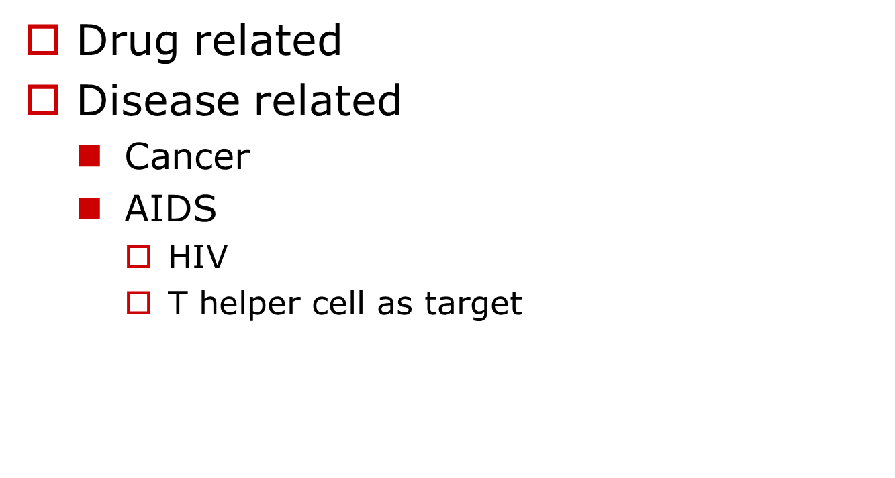
Secondary Immunodeficiency

Slide 26
Causes of secondary immune deficiency
1-physiological immune deficiency.
Ageing pregnancy prematurity
2-infection
HIV measles TB
3-Iatrogenic
Immunosuppressive therapy , antineoplastic agents , corticosteroids , stem cell transplantation& radiation therapy

Slide 27
4-malignancy
B-cell malignancies including leukemia, lymphoma & multiple myeloma, solid tumors & thymoma
5-Biochemical and nutritional disorders
Malnutrition, renal insufficiency/dialysis ,DM, specific mineral deficiencies, eg. iron , zinc.
6- other conditions
Burns, asplenia / hyposplenism .

Slide 28
Warning signs of immune deficiency
1-8 respiratory tract infections/year in a child, or more than 4 respiratory tract infections/year in an adult
2->1 infection requiring hospital admission or IV antibiotics
3-infections with unusual organisms.

Slide 29
4- infections at unusual sites
5-chronic infection unresponsive to usual treatment.
6-early end organ damage(eg. Bronchiectasis).
7-family history of immune deficiency.

