Slide 1
بسم الله الرحمن الرحيم
28/2/2021

Slide 2
IN THE NAME OF GOD THE MOST MERCIFULL

Slide 3
Objectives
  To know the following..DPL
  Epidemiology
  Etiology
  Pathogenesis
  Clinical presentation
  Diagnosis
  Treatment
  Complication and prognosis

Slide 4
Interstitial and infiltrative pulmonary diseases
I-Diffuse parenchymal lung disease

Slide 5
Interstitial and infiltrative pulmonary diseases
I-Diffuse parenchymal lung disease
II-Lung diseases due to systemic inflammatory disease.
III-Pulmonary eosinophilia and vasculitides
IV-Lung diseases due to irradiation and drugs

Slide 6
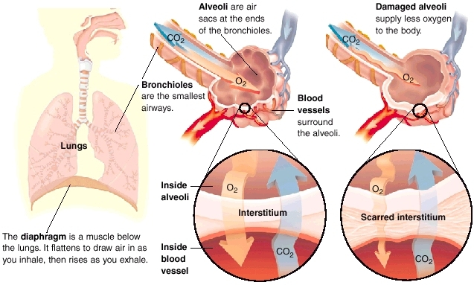
Effect of Damaged Interstitium

Slide 7
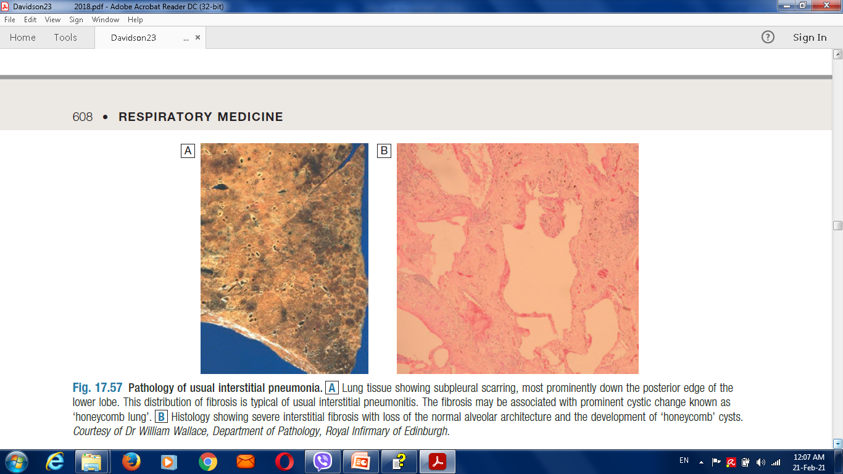
Pathology of usual interstitial pneumonia

Slide 8
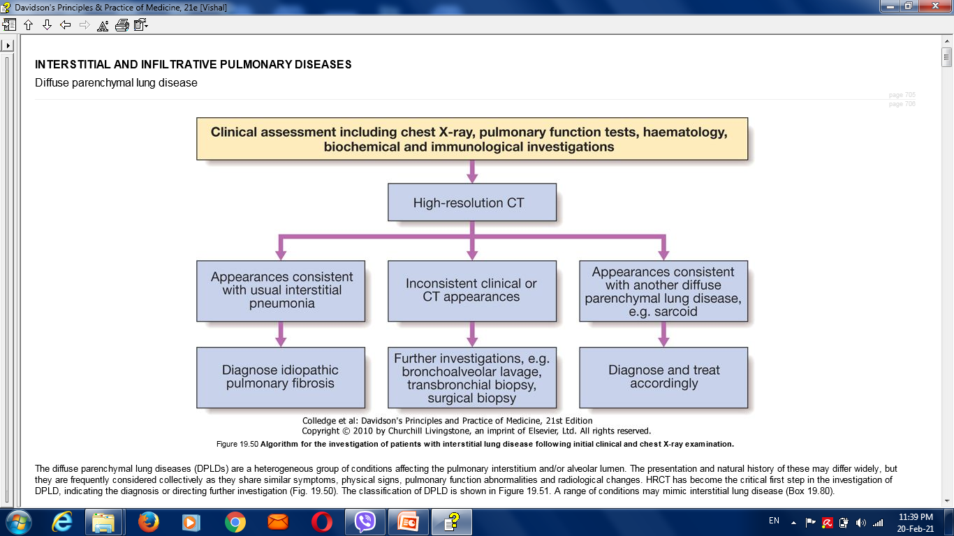

Slide 9
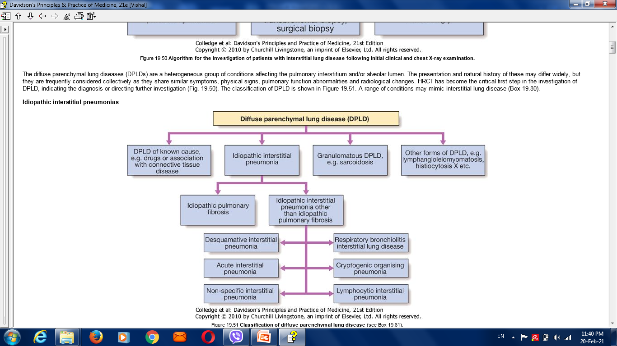

Slide 10
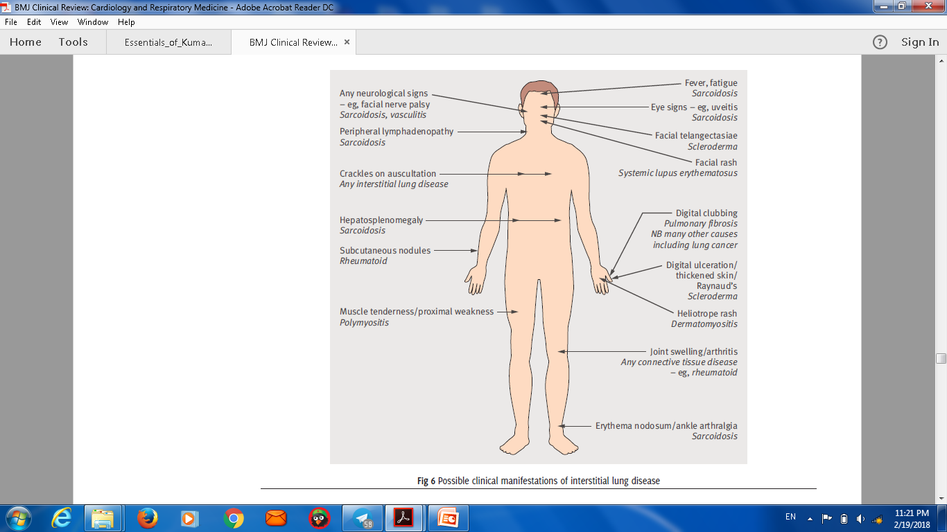
Possible clinical manifestations of interstitial lung disease

Slide 11
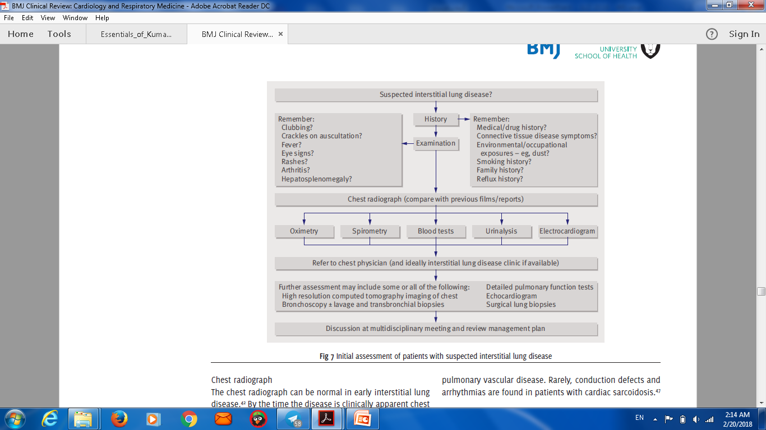
Approach in ILD

Slide 12
Differential diagnosis of DPLD
1-Infection :
viral pneumonia.
pneumocystis jirovecii
mycoplasma pneumoniae.
tuberculosis
2. Malignancy :
Leukaemia and lymphoma.
Lymphangitic carcinomatosis.
Multiple metastases.
Bronchoalveolar carcinoma.
3. Pulmonary oedema.
4. Aspiration pneumonitis.

Slide 13
Idiopathic pulmonary fibrosis
Progressive fibrosing interstitial pneumonia in the adults of unknown aetiology with histological & radiological pattern of usual interstitial pneumonia.
DDx:
Lung fibrosis secondary to drugs
Occupational exposure
Connective tissue diseases.

Slide 14
Clinical presentation:
Uncommon before the age of 50 years.
Progressive insidious breathlessness with dry cough.
Bilateral fine basal end-inspiratory crackles & digital clubbing.
Patients can develop exacerbations during the chronic course of the disease with severe SOB, reduced gas transfer & new ground-glass changes or consolidations on
chest CT.

Slide 15
Investigations:
A/ CXR: bilateral lower lobe and subpleural reticular shadowing but can be normal in early or limited disease.
B/ High-Resolution CT of the chest (HRCT):

Slide 17
C/ Pulmonary function test: restrictive defect with reduced lung volumes and gas transfer.
D/ABG :Hypoxemia & hypocapnia initially presents with exercise but later on at rest as the disease progressed.
E/ Bronchoscopy & lung biopsy: only indicated in uncertain cases that cannot be diagnosed based on other tests.
F/ Immunology: antinuclear antibody (ANA) or anti-cyclic citrullinated peptide 2 (anti-CCP2) may be mildly positive.

Slide 18
Management:

Slide 19
Managment of IPF
Disease-modifying therapy:
2-Oral N‑acetylcysteine
3- Proton Pump inhibitors.
Treatment of gastro-oesophageal reflex (relieving cough).
4. Stop smoking.
5. Annual pneumococcal vaccines.
6. Pulmonary rehabilitation program & domiciliary O2 therapy in severe cases.
7. Lung transplantation (in severe cases).
In acute exacerbations, the treatment mainly supportive (antibiotics, glucocorticoids, immunosuppression & respiratory support).

Slide 20
Prognosis
Prognosis is poor with 3-years survival is the expected outcome. However, cases with minimal disease can live longer.
Progression of the disease results in central cyanosis with pulmonary hypertension & right side heart failure.
Predictors of poor prognosis ???

Slide 21
Sarcoidosis
Sarcoidosis is a multisystem granulomatous disorder of unknown
aetiology that is characterised by the presence of non-caseating
granulomas.
More common in northern Europe.

Slide 22
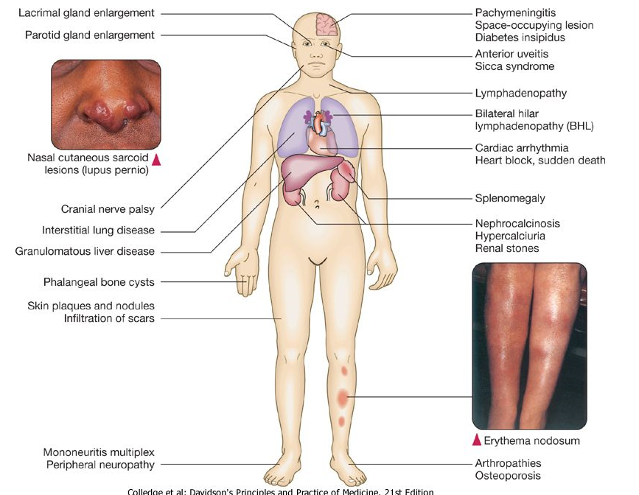

Slide 23
Clinical features:
• Asymptomatic:
• Respiratory and constitutional symptoms
• Erythema nodosum and arthralgia
• Ocular symptoms
• Skin sarcoid (including lupus pernio)
• Superficial lymphadenopathy
• Other , e.g. hypercalcaemia, diabetes insipidus, cranial nerve palsies, cardiac arrhythmias, nephrocalcinosis

Slide 24
Löfgren’s syndrome

Slide 25
Investigations:
Blood tests: lymphopenia,
mild impairment of LFT,
hypercalcaemia,
Hypercalciuria.
2. CXR: bilateral hilar lymphadenopathy, pulmonary infiltrates & fibrosis.
3. Bronchoscopy:

Slide 26
Management:
Most patients recover spontaneously.
Treatment includes NSAIDs,
steroids
immunosuppressive therapy in advanced cases.

Slide 27
Pulmonary eosinophilia and vasculitides

Slide 28
Pulmonary eosinophilia and vasculitides
Pulmonary eosinophilia refers to the association of radiographic (usually pneumonic) abnormalities and peripheral blood eosinophilia.
Acute eosinophilic pneumonia
Chronic eosinophilic pneumonia
Tropical pulmonary eosinophilia
Granulomatosis with polyangiitis
Goodpasture’s syndrome

Slide 29
Pulmonary eosinophilia and vasculitides
Pulmonary eosinophilia
Extrinsic (cause known)
Helminthes: e.g. Ascaris, ...
Drugs: nitrofurantoin,etc.
Fungi: e.g. Aspergillus fumigatus.
Intrinsic (cause unknown)
Cryptogenic eosinophilic pneumonia
Churg-Strauss syndrome .
etc.

Slide 30
Lung diseases due to irradiation and drugs

Slide 31
Lung diseases due to drugs
Non-eosinophilic alveolitis
Pleural effusion
Asthma
• Pharmacological mechanisms (β-blockers, cholinergic agonists, aspirin and NSAIDs)
• Idiosyncratic reactions (tamoxifen, dipyridamole)
Non-cardiogenic pulmonary oedema (ARDS)

Slide 32
Association of pulmonary haemorrhage and glomerulonephritis
IgG antibodies bind to the glomerular or alveolar basement membranes.
Goodpasture's syndrome.
Wegener's granulomatosis
Rare vasculitic and granulomatous condition .
Respiratory symptoms include cough, haemoptysis and chest pain.

Slide 33
Diseases due to radiotherapy
Acute radiation pneumonitis is typically seen within 6-12 weeks and presents with cough and dyspnoea.
Chronic interstitial fibrosis may present several months later with symptoms of exertional dyspnoea and cough.

Slide 34
Interstitial lung disease in old age
Idiopathic pulmonary fibrosis:.
Chronic aspiration pneumonitis:
Asbestosis: symptoms appear in old age.
Drug-induced interstitial lung disease:

Slide 35
Lung diseases due to systemic inflammatory disease

Slide 36
Lung diseases due to systemic inflammatory disease
1- Respiratory involvement in connective tissue disorders.
2-Acute respiratory distress syndrom .

Slide 37
Respiratory involvement in connective tissue disorders
Pulmonary complications of connective tissue disease are common, affecting the
airways,
the alveoli,
the pulmonary vasculature.
the diaphragm
chest wall muscles,
the chest wall itself.

Slide 38
pulmonary disease may precede the appearance of the connective tissue disorder

Slide 39
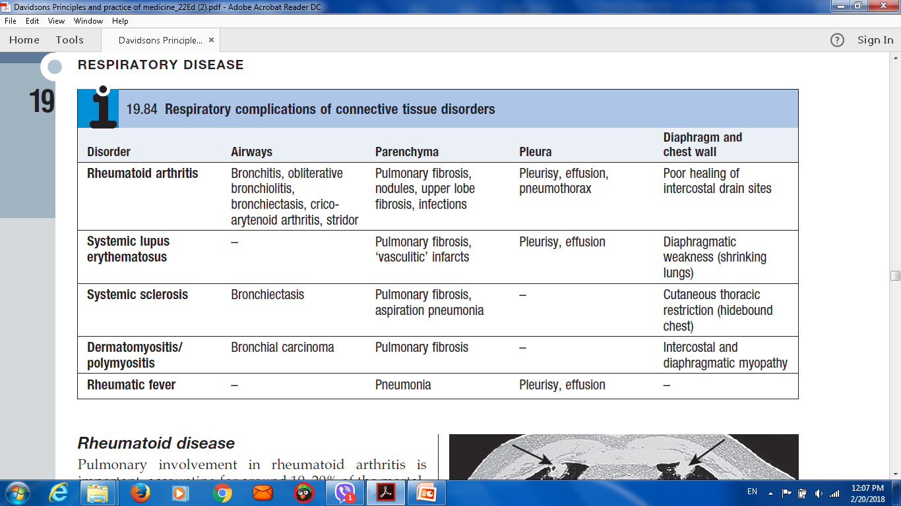
Respiratory complications of connective tissue disorders

Slide 40
Rheumatoid arthritis
Bronchitis, obliterative bronchiolitis, bronchiectasis, crico-arytenoid arthritis, stridor
Pulmonary fibrosis, nodules, upper lobe fibrosis, infections
Pleurisy, effusion, pneumothorax
Poor healing of intercostal drain sites

Slide 41
Systemic lupus erythematosus
-
Pulmonary fibrosis, 'vasculitic' infarcts
Pleurisy, effusion
Diaphragmatic weakness (shrinking lungs)

Slide 42
Rheumatic fever
Pneumonia
Pleurisy, effusion

Slide 43
Rare interstitial lung diseases
Idiopathic pulmonary haemosiderosis
Alveolar proteinosis
Langerhans cell histiocytosis (histiocytosis X)
Neurofibromatosis
Alveolar microlithiasis
Lymphangioleiomyomatosis

Slide 44

Question
Thank u

