Slide 1
CSF CIRCULATION

Slide 2
Cerebrospinal Fluid
A clear, colorless fluid that surrounds and permeates the CNS. Offers support, protection and nourishment.
Functions:
– Protection of cranial contents
– Modulates pressure changes (same specific
gravity as brain)
– Serves as a chemical buffer to maintain constant
ionic environment
– Serves as a transport medium for nutrients and
metabolites, endocrine substances and even
neurotransmitters

Slide 3
Location of CSF
• Two lateral ventricles
• Third ventricle
• Fourth ventricle
• Spinal cord central
canal
• Subarachnoid space
• Continuous with
extracellular fluid of
brain parenchyma

Slide 4
Properties
•
•
•
•
Volume
: approximately 150 mL
Rate of formation: approximately 0.3 mL/min
Specific gravity : 1.005
Reaction
: Alkaline
In adults, the total excreted CSF is about 400 – 500 ml so it is replaced every 3-4 hours

Slide 5
Composition
Cerebrospinal Fluid
Water - 99.13%
Solids - 0.87%
Organic substances
Inorganic substances
1.Proteins
2.Amino acids
3.Sugar
1.Sodium
2.Calcium
3.Potassium
4.Magnesium
5.Chlorides
6.Phosphate
7.Bicarbonates
8.Sulfates
4.Cholesterol
5.Urea
6.Uric acid
7.Creatinine
8.Lactic acid
Lymphocytes in CSF : 6/ cu mm

Slide 6
Formation of CSF
• Choroid plexuses of lateral, third and fourth
ventricles
Ependymal lining of ventricular system
Blood vessels: Smaller quantities formed from fluid leaking into perivascular spaces surrounding cerebral vessels
+
Cells are believed to actively secrete Na into the ventricular system in exchange for K. Sodium ions electrically attract Cl and osmotically draw water from the blood vascular system to constitute the CSF.
-

Slide 7
The Choroid Plexus
• The choroid plexus also helps to cleanse the
CSF by removing waste products and other
unnecessary solutes
• Once produced CSF moves freely through the
ventricles

Slide 8
Choroid Plexus
• Choroid plexus
hang from the
roof of each
ventricle
• These plexuses
form CSF
• The plexuses are
clusters of thin
walled capillaries
enclosed by a
layer of
ependymal cells

Slide 10
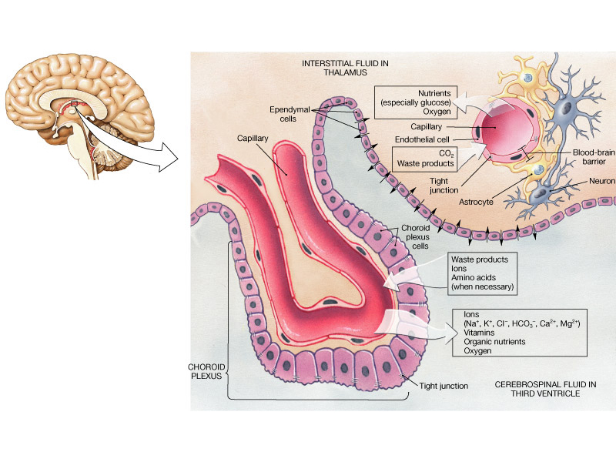

Slide 12
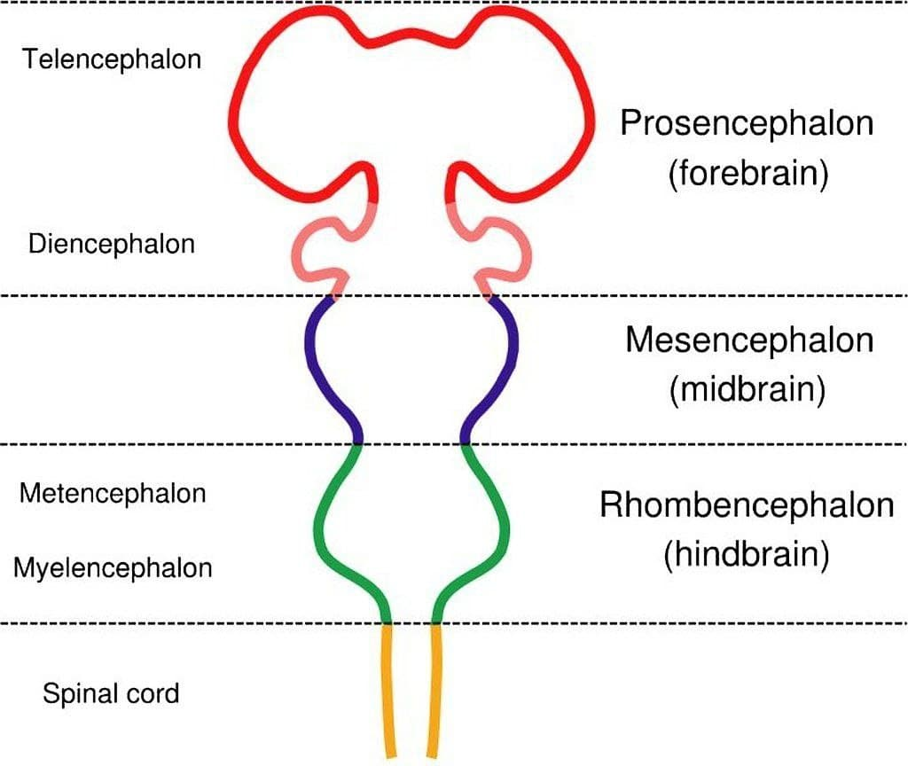

Slide 13
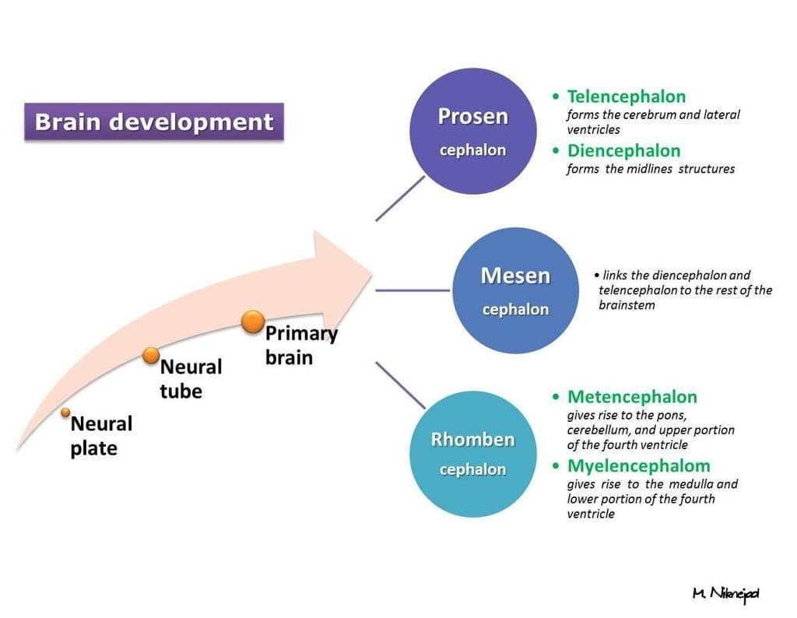

Slide 14
The lateral ventricles
• Situated in the cerebral hemispheres, it has a
body, an anterior horn in the frontal pole, posterior
horn in the occipital pole & inferior horn in the
temporal pole.
• The two lateral ventricles are interconnected by
interventricular foramen and it also communicates
with the 3rd ventricle.
• All ventricles are lined by ependyma.

Slide 15
3rd Ventricle
• It lies below the lateral ventricles.
• It is a cavity of the diencephalon. In the roof there is
choroid plexus, that produce CSF.
• Superiorly it communicates with the two lateral
ventricles through the interventricular foramen.
• Inferiorly it communicates with the 4th ventricle
through the cerebral aqueduct.
• The lateral wall is formed by thalamus and
hypothalamus.

Slide 16
4th Ventricle
It is a cavity of the rhombencephalon
It has a roof and floor.
The floor is formed by two parts, medullary & pontine part.
The roof formed by cerebellum
It has 3 foramina, one is median (foramen of Magendie) located posteriorly and two are lateral (foramina of Lushka)

Slide 17
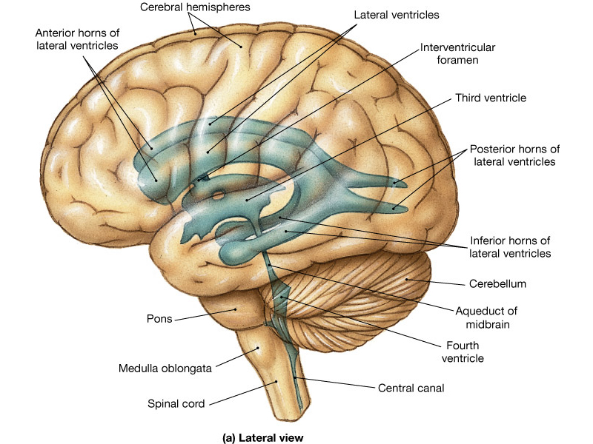

Slide 18
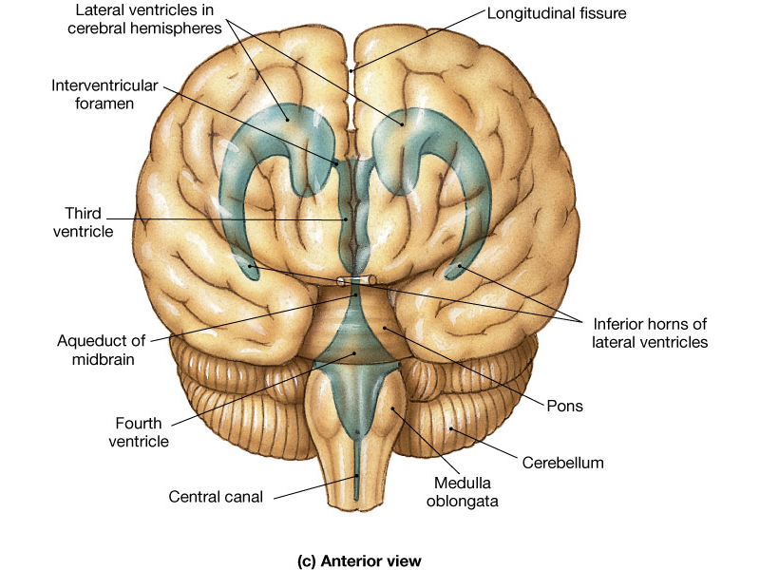

Slide 19
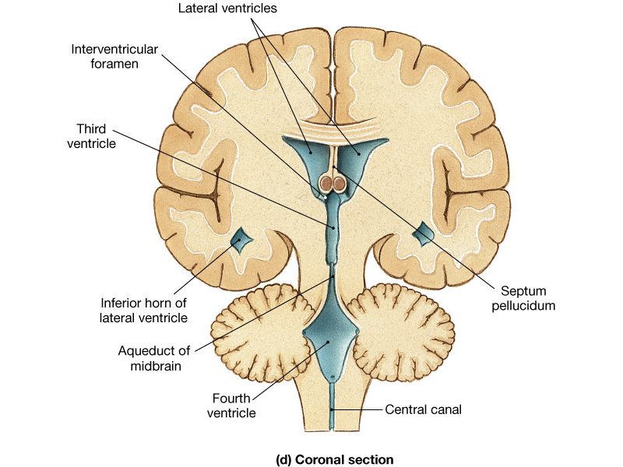

Slide 20
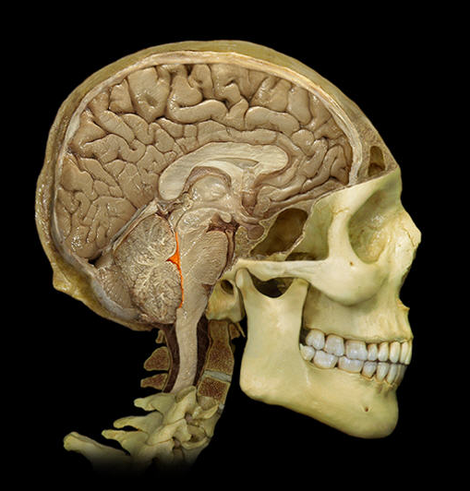
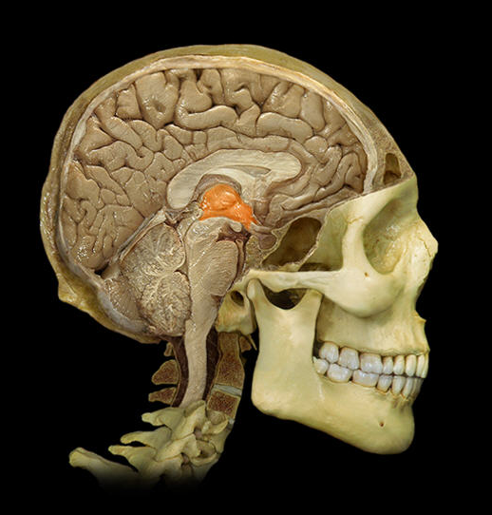
Ventricles
Lateral
Third
Fourth

Slide 21
Flow of CSF:
The CSF passes from the lateral ventricles (I and II) through the foramen of Monro into the third ventricle (III) then through the aqueduct of Sylvius into the fourth ventricle (IV) and out into the subarachnoid space through the foramina Lushka & Magendie .

Slide 22
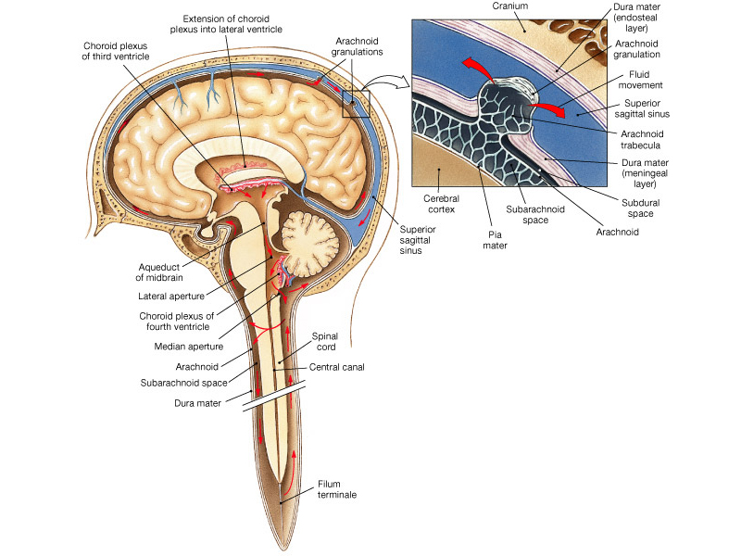

Slide 23
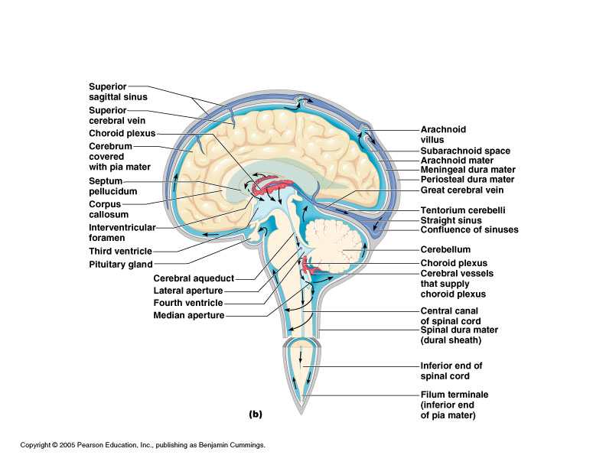

Slide 24
Absorption of CSF
Through the arachnoid villi, a protrusion of arachnoid membrane into the central venous sinus and other sinuses
A valve opens when CSF pressure exceeds venous pressure
Absorption by veins and capillaries of CNS

Slide 25
arachnoid granulation

Slide 26
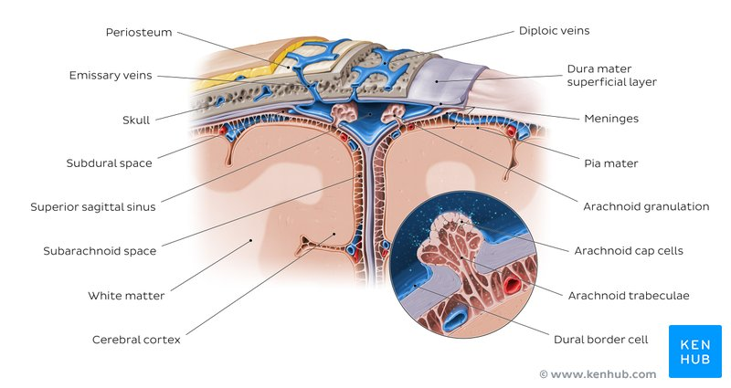

Slide 27
Summary

Slide 29
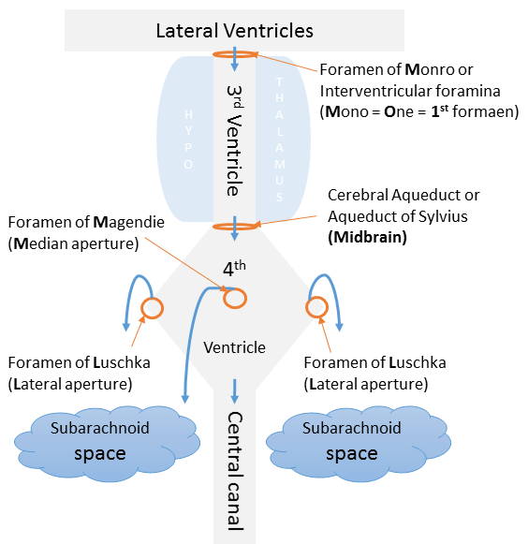

Slide 30
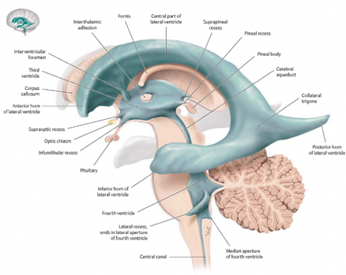

Slide 31
Radiological anatomy

Slide 32
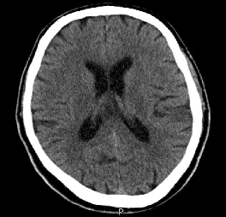
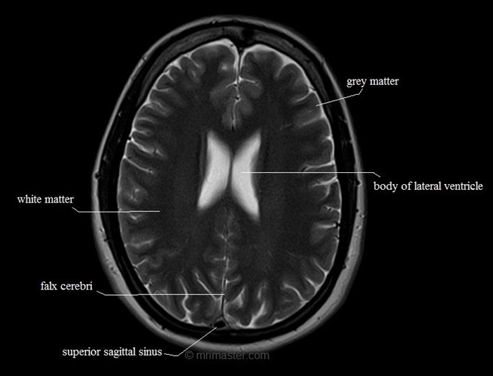

Slide 33
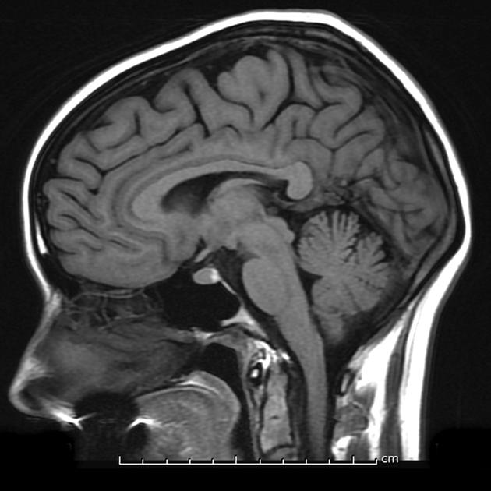

Slide 34
Clinical application

Slide 35
Hydrocephalus
• An abnormal increase in the volume of
CSF
• Symptoms: sleep changes, spastic
paresis, papilledema, bulging of skull in
young, seizures, cranial nerve deficits,
depression.

Slide 36
Hydrocephalus

Slide 38
Lumbar puncture
LP:
is a diagnostic procedure that is performed in order to collect a sample of cerebrospinal fluid (CSF) for biochemical, microbiological, and cytological analysis

Slide 40
lumbar puncture

Slide 41
Spinal cord terminates at L1; needle entry
must occur distal to this location

Slide 42
Proper angle of entry through the L3-L4
interspace

