Slide 1
Complements
Nov/ 22/ 2021
Dr. Minen Al-Kafajy

Slide 2
Complement
was discovered by Jules Bordet as a heat-labile component of normal plasma that causes the opsonisation and killing of bacteria. The complement system refers to a series of >30 proteins, circulating in the blood and tissue fluids. Most of the proteins are normally inactive, but in response to the recognition of molecular components of microorganisms they become sequentially activated in an enzyme cascade – the activation of one protein enzymatically cleaves and activates the next protein in the cascade.

Slide 3
Complement can be activated via three different pathways (Figure 1), which can each cause the activation of C3, cleaving it into a large fragment, C3b, that acts as an opsonin, and a small fragment C3a (anaphylatoxin) that promotes inflammation. Activated C3 can trigger the lytic pathway, which can damage the plasma membranes of cells and some bacteria. C5a, produced by this process, attracts macrophages and neutrophils and also activates mast cells.

Slide 4
Overview of Complement
Classical Pathway
Lectin Pathway
Alternative Pathway
Antibody binds to specific
antigen on pathogen surface
Mannose-binding protein
binds pathogen surface
Pathogen surface creates
environment conducive to
complement activation
Clearance of
Apoptotic Cells
Complement Activation
Formation of C3 and C5 convertases
Membrane Attack Pathway
Cytolysis of some pathogens
Inflammatory response
Opsonization & phagocytosis
of some pathogens
Clearance of
Immune complexes

Slide 5
Classical Pathway
This pathway involves complement components C1, C2 and C4. The pathway is triggered by antibody-antigen complexes binding to C1, which itself has three subcomponents C1q, C1r and C1s. The pathway forms a C3 convertase, C4b2a, which splits C3 into two fragments; the large fragment, C3b, can covalently attach to the surface of microbial pathogens and opsonise them; the small fragment, C3a, activates mast cells, causing the release of vasoactive mediators such as histamine.

Slide 6
The Classical Pathway
Activation of C1:
C1 consists of C1q , C1r, and C1s
Subunits are held together by Calcium ions
C1q is a polymer of 6 identical units
C1q activation requires binding to a c1q- specific receptor on the FC region of at least 2 adjacent molecules of IgG or a single molecule of IgM, a reaction that requires Calcium ions

Slide 7
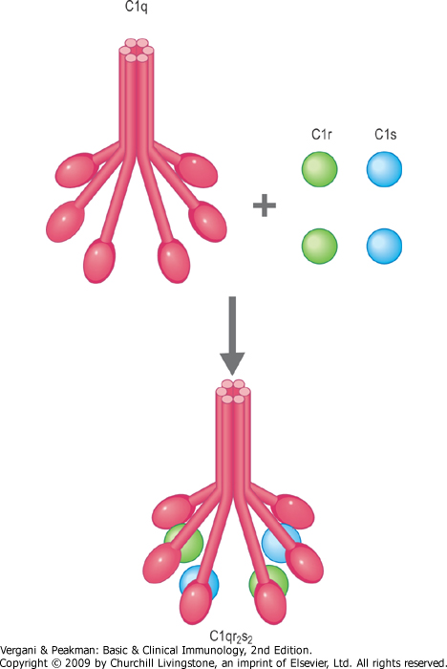

Slide 8
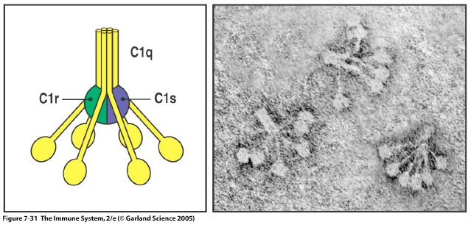
Molecular structure of C1

Slide 10
IgA and IgE cannot activate complement

Slide 11
The Classical Pathway
IgG4, IgA, and IgE do not have complement receptors
Activated C1q activates C1r which in turn activates C1s
Activated C1s has esterolytic and proteolytic properties which acts on C4 splitting it into two fragments; C4a and C4b
C4b complexes with C1s forming an active component that acts on C2 splitting it into C2a and C2b
C2a binds to C4b creating a very active complex called the C3 convertase, where a single molecule can activate hundreds of C3 molecules

Slide 12
The Classical Pathway
C3 is split by C4b2a into C3a and C3b
C3b binds to cells and to C4b2a to generate C5 convertase which splits C5 into C5a and C5b
C5b binds to cells and activates C6 and C7
The complex C5b67 activates C8 and C9 forming a giant molecule with a molecular weight of 10⁶ Daltons called the membrane attack complex (MAC)

Slide 13
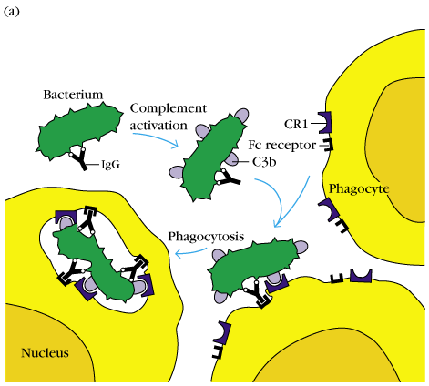
C3b can bind to bacteria and enhance phagocytosis.

Slide 14
The Classical Pathway
C5b6789 bound to cells insert themselves into the cell membrane and produce transmembrane channels allowing ions to pass through
The osmotic equilibrium of the cell is disturbed with rapid influx of water into the cell which swells and lyses

Slide 15
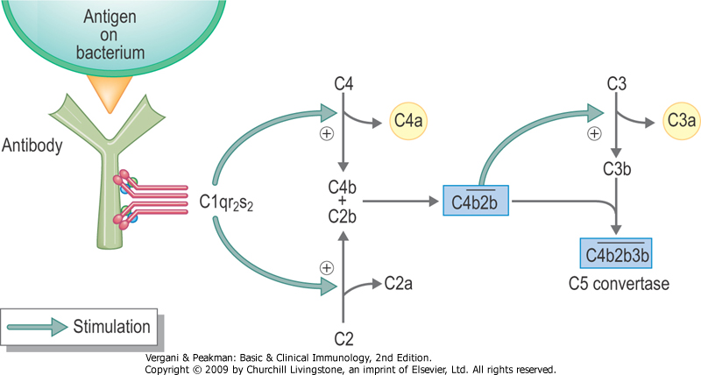

Slide 16
Complement functions related to immune defense
Lysis of cells: This is the original function identified and causes hypotonic cell death by making holes. It is not effective against organisms with rigid cell walls such as fungi

Slide 17
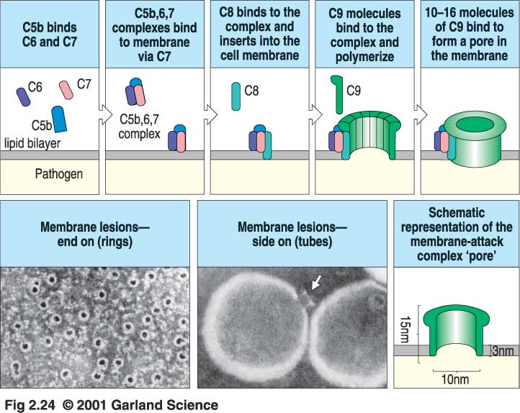
Terminal complement components and the formation of the membrane attack complex

Slide 18
The Alternative (properdin) Pathway
Activators: Bacterial LPS, cell wall of some bacteria, some yeast cells, aggregated IgA, and a factor
Components: C3 – C9, factor B, factor D, and Properdin
C3b present in trace amounts in serum combines with factor B forming C3bB

Slide 19
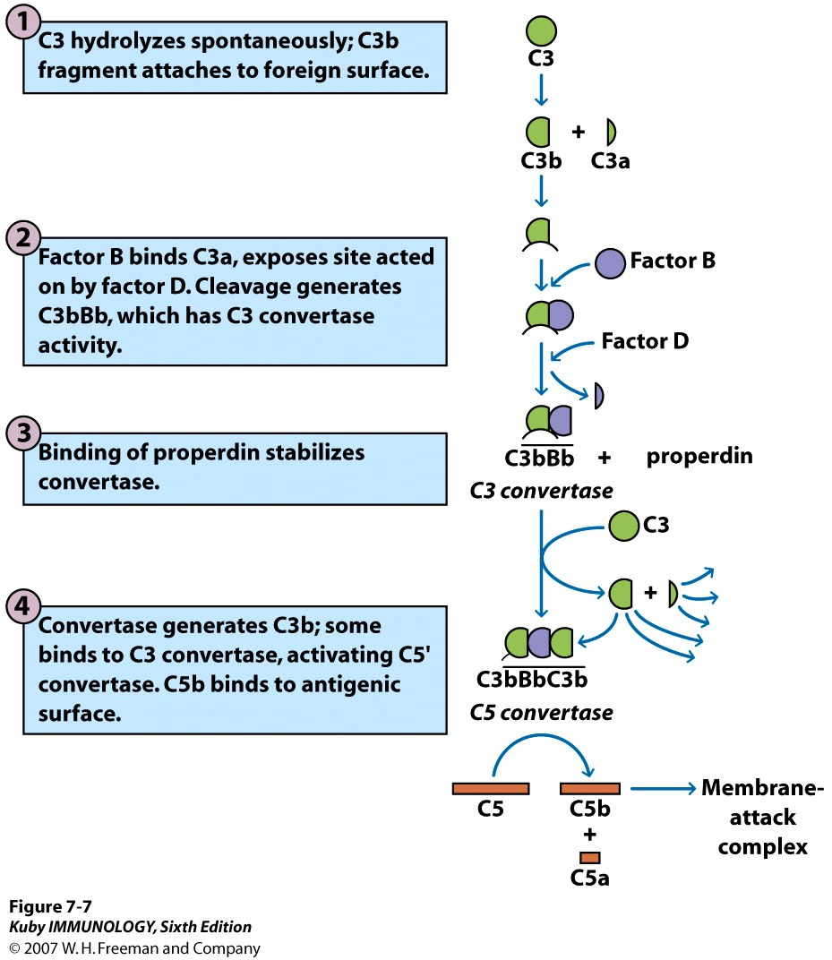

Slide 20
The alternative system
C3 is the principal protein of concern.
Exists in high concentrations
Contains an unstable internal thiolester with slow “spontaneous” (or serum protease mediated) cleavage.
By convention, the smaller product is designated “a” and the larger “b” (though there is one exception.)
C3b can bind to bacteria and enhance phagocytosis.

Slide 21
Mannose-binding Lectin Pathway
This pathway is activated by the binding of mannose-binding lectin (MBL) to mannose residues on the pathogen surface. This in turn activates the MBL-associated serine proteases, MASP-1 and MASP-2, which activate C4 and C2, to form the C3 convertase, C4b2a.

Slide 22
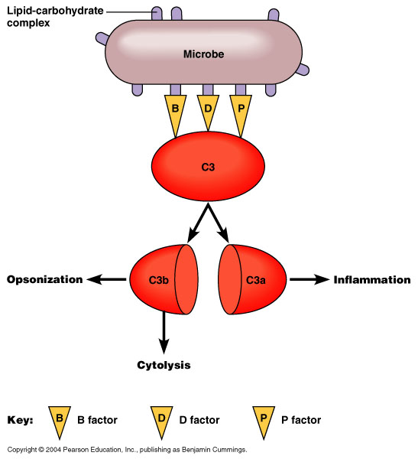
Alternative Pathway
Figure 16.14

Slide 23
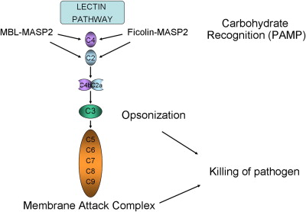
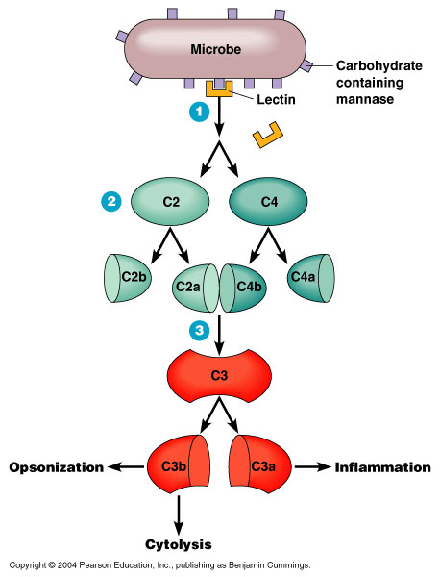
Lectin Pathway
Figure 16.15

Slide 24
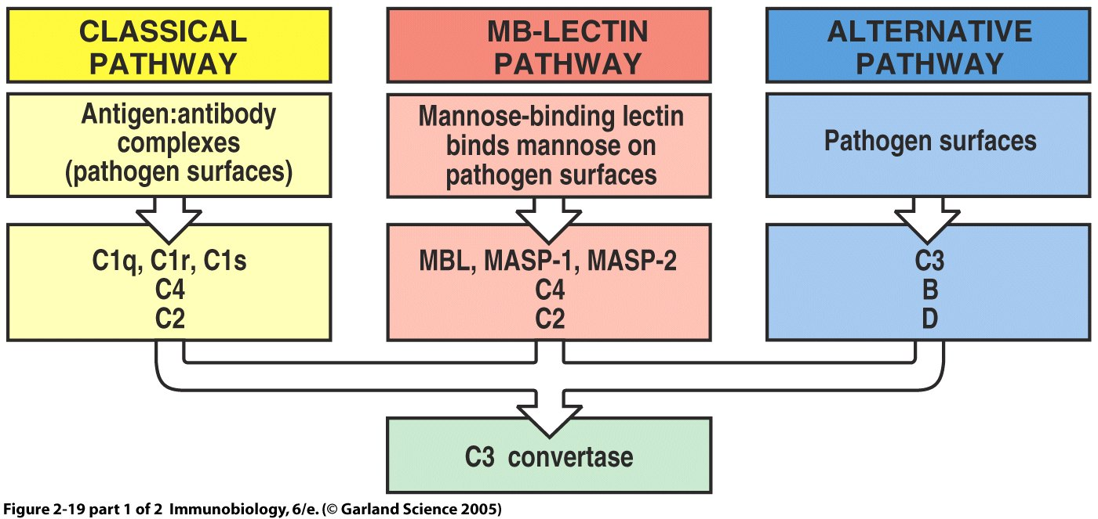

Slide 25
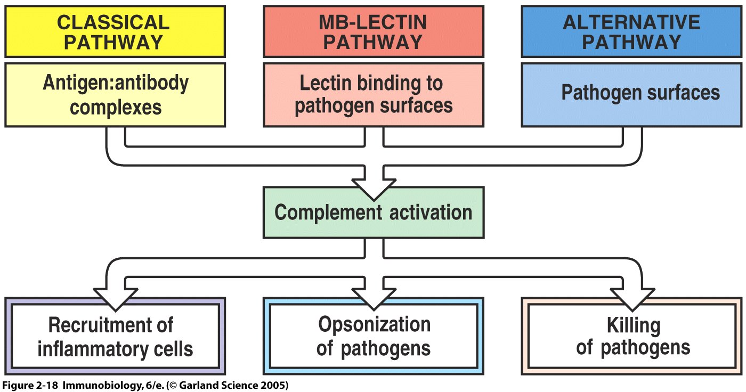
General Functions of Complement

Slide 26
Role of Complement in Disease
The complement system plays a critical role in inflammation and defence against some bacterial infections. Complement may also be activated during reactions against incompatible blood transfusions, and during the damaging immune responses that accompany autoimmune disease. Deficiencies of individual complement components or inhibitors of the system can lead to a variety of diseases (Table 1), which gives some indication of their role in protection against disease

Slide 27
Table 1. Diseases associated with complement deficiencies
Complement Deficiency | Disease
C3 and Factor B | Severe bacterial infections
C3b-INA, C6 and C8 | Severe Neisseria infections
Deficiencies of early C components C1, C4, C2. | Systemic lupus erythematosus (SLE), glomerulonephritis and polymyositis
C1-inhibitor | Hereditary angioedema

